Slide 1
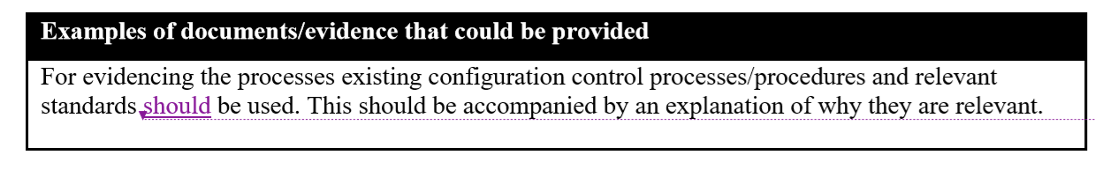
Comments on the Interpretation Document for SU
“Recommendation Document” which is already outdated is still referred in some parts of the interpretation document. List of examples of risks, threats and mitigations were already moved to the regulation for CS. Documents to be referred in the interpretation document with regard to CS issue should be converged to the CS regulation.
Examples of documents/evidence
Documents appeared in this section are examples. Each document is used to evidence each individual case and not generalized. Therefore these documents should be used as examples.
Interpretation for 7.1.1.2
Proposal:
For evidencing the processes existing configuration control processes/procedures should be used and relevant standards may be referred. This should be accompanied by an explanation of why they are relevant.

Slide 2
Comments on the Interpretation Document for SU
Interpretation for 7.2.2.5
Explanation of the requirement
Proposal:
The manufacturer should define preconditions to be met if software updates can be performed safely, and confirm it whenever the software update starts.
Examples of documents/evidence that could be provided
Proposal:
The following may be used to provide assurance that this requirement is met:
demonstration of requirements via documentation/presentation and/or physical test.

