Slide 1
IWG Measurement Uncertainties
6th session
6/7 October 2020

Slide 2
Justification of the main impact quantities.
Justification by different approaches:
by measurement (or simulation) results from specific experiments, e.g. investigations on power train noise at indoor test bench
by classic statistical methods e.g. parameter studies and correlation analysis (ACEA Tyre study)
by theoretical derivations based on physical relations e.g. distance law (deviation from centered driving)

Slide 3

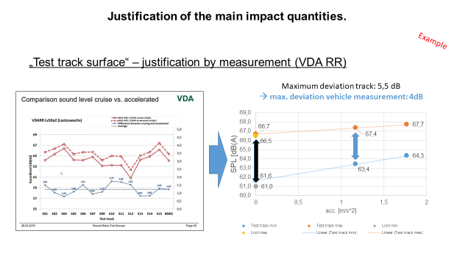
Justification of the main impact quantities.
Situation | Input Quantity | estimated deviations of the meas. result (peak-peak) |  | Impact on Lurb | Status | Justification by
 |  |  |  |  |  | measurement | statistical methods | theoretical derivations
 |  | Lwot | Lcrs
Run to Run | Micro climate wind effect | 0,40 | 0,77 | 0,53 | done | X
 | DRIVER #1: Deviation from centered driving | 0,50 | 0,50 | 0,50 | done |  |  | X
 | DRIVER #2: Start of acceleration | 0,50 | 0,00 | 0,33 | done | X
 | DRIVER #3: Speed variations of +/- 1km/h | 0,30 | 0,30 | 0,30 | done |  | X
 | DRIVER #4: Load variations during cruising | 0,00 | 0,50 | 0,17 | done |  | X
 | Varying background noise | 0,10 | 0,10 | 0,10 | done | X
 | Variation on operating temperature of engine (WOT) and tyres (WOT&CRS) ==> See ISO 362-1 NOTE | 1,20 | 0,50 | 0,96 | done | X
Day to Day | Barometric pressure (Weather +/- 30 hPa) | 0,60 | 0,00 | 0,40 | done |  |  | X
 | Air temperature effect on tyre noise (5-10°C) | 1,00 | 2,00 | 1,34 | done | X
 | Air temperature effect on tyre noise (10-40°C) | 1,00 | 2,00 | 1,34 | done | X
 | Varying background noise during measurement | 0,60 | 1,00 | 0,74 | done | X
 | Air intake temperature variation | 1,50 | 0,00 | 0,99 | done | X
 | Residual humidity on test track surface | 0,70 | 1,00 | 0,80 | done | X
Site to Site | Altitude (Location of Test Track) -100 hPa/1000m (from 1015 to 915 hPa) | 1,00 | 0,00 | 0,66 | done |  |  | X
 | Test Track Surface | 3,50 | 5,00 | 4,01 | done | X
 | Microphone Class 1 IEC 61672 | 1,00 | 1,00 | 1,00 | done | X
 | Sound calibrator IEC 60942 | 0,80 | 0,80 | 0,80 | done | X
 | Speed measuring equipment continuous at PP | 0,07 | 0,13 | 0,09 | done |  | X
 | Acceleration calculation from vehicle speed measurement | 0,50 | 0,00 | 0,33 | done |  |  | X
Vehicle to Vehicle | Production Variation on Tyres; Aging of Tyres until delivery to customer (1dB after one year) | 0,75 | 1,50 | 1,00 | done | X
 | Variation on Tyre Size and Brand (non-OEM) | 0,00 | 0,00 | 0,00
 | Production Variation in Power | 0,40 | 0,00 | 0,26 | done |  |  | X
 | Battery state of charge for HEVs (3 dB(A)) | 0,00 | 0,00 | 0,00
 | Production Variability of Sound Reduction Components | 1,00 | 0,50 | 0,83 | done | X
 | Impact of variation of vehicle mass | 1,40 | 0,60 | 1,13 | done | X
Status of completeness: 100%

Slide 4
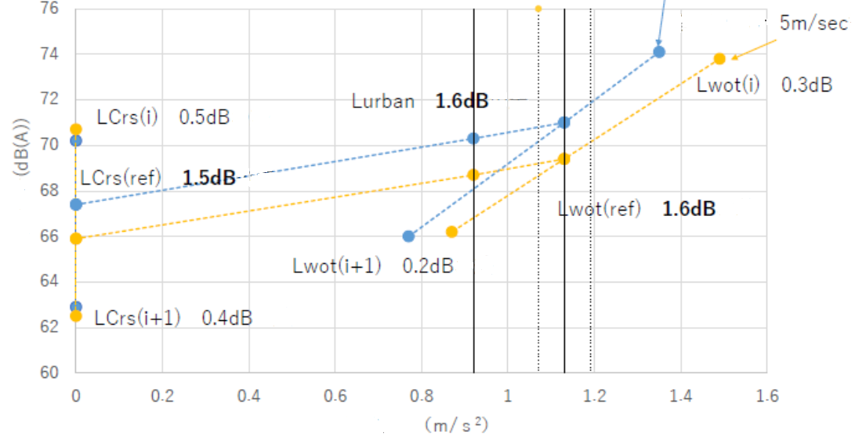
Justification of the main impact quantities.
„wind effect“ – justification by measurement
Wind speed within 5m/sec tolerance may affect acceleration performance.
Normally its influence is not so significant, but we should know some vehicles have large impact.
The example shows 1.6 dB(A) difference for L_{urban} in the conditions of following and against wind.
Against wind 5m/s
Following wind 5m/s
2nd gear
Influence of k- factor
Sound Pressure level [dB(A)]
ΔSPL_{urban}:
1,6 dB
3rd gear
Acceleration [m/s²]
A car with low PMR and large frontal projected area such as tall body shape is affected in acceleration during pass-by noise test by wind speed but sound pressure levels in cruise and acceleration are less changed by wind speed.
The impact for the final result of L_{urban} is 1.6dB.

Slide 5
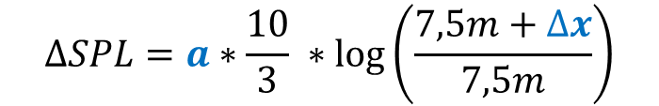
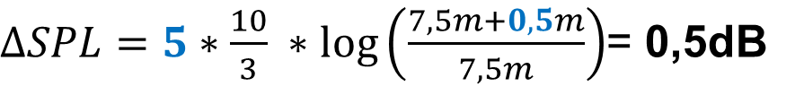
Justification of the main impact quantities.
„ DRIVER#1: deviation from centered driving“ – justification by theoretical derivation
Invers square law:
center
$$∆SPL=a∗\frac{10}{3} ∗log\left(\frac{7,5m+∆x}{7,5m}\right)$$
with:
ɑ coefficient for dB/distance doubling
Δx deviation from center
deviation from center Δx
$∆SPL=5∗\frac{10}{3} ∗log\left(\frac{7,5m+0,5m}{7,5m}\right)$= 0,5dB
ΔSPL_{urban}:
0,5 dB
Assumption for the calculation: 5dB/distance doubling (monopole source under semi-free field conditions) and 0,5m for the deviation from center.

Slide 6
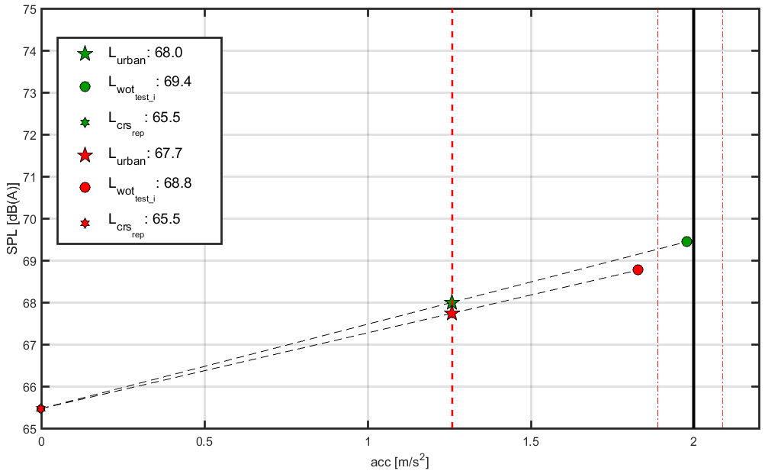
Justification of the main impact quantities.
„ DRIVER#2: start of acceleration“ – justification by measurement
ΔSPL_{wot}
=0,6 dB
ΔSPL_{urban}:
0,3 dB
preacceleration [meter bevor line AA]: -5m/-3m
The variation of the point of push down gas pedal causes different accelerations and a different sound emission in the wot measurement.

Slide 7
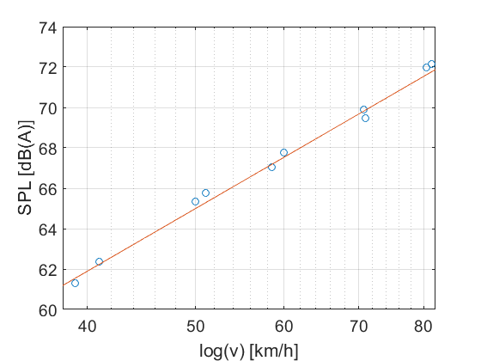
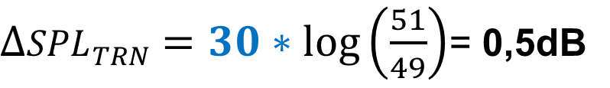
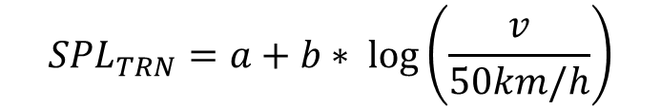

Justification of the main impact quantities.
„DRIVER#3: speed variations of +/- 1km/h“ – justification by theoretical derivation
SPL_{tyre road noise} vs. vehicle speed (derived from R117)
$${SPL}_{TRN}=a+b∗ log\left(\frac{v}{50km/h}\right)$$
$${SPL}_{TRN} \sim log\left(v\right)$$
with:
ɑ SPL_{TRN}@50km/h
b coefficient for speed dependency
$∆{SPL}_{TRN}=30∗log\left(\frac{51}{49}\right)$= 0,5dB
ΔSPL_{urban}:
0,5 dB
Assumption for calculation: mean coefficient of the speed dependency is 30 (usually varies between 27 -33 for C1 tyres). Depending on the source distribution this effect influences the test result of crs and wot measurement.

Slide 8
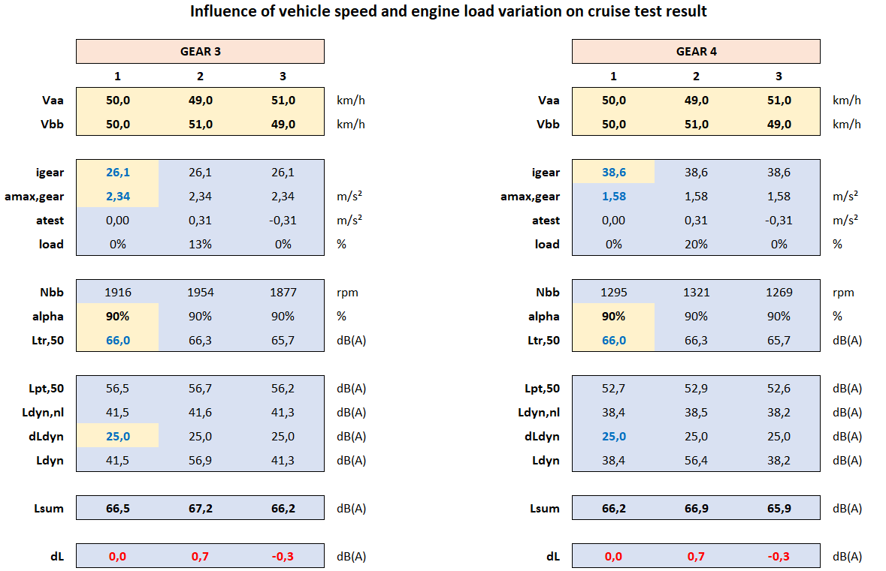
Justification of the main impact quantities.
„ DRIVER#4: Load variations during cruising“ – justification by statistical methods
ΔSPL_{urban}: 0,3dB
(ΔSPL_{crs}:1.0dB)
A constant speed test is considered valid, if the vehicle speed does not change by more than 1 km/h around the vehicle target speed of 50 km/h. The tables above provide a calculation scheme for the 3rd (left table) and the 4th gear (right table). Per gear three columns are shown. Column 1 is a run, with 50 km/h throughout the test area. Column 2 is an acceleration from the lower border vehicle speed to the upper border vehicle speed. Column 3 is almost a free rolling from the upper border speed to the lower border speed. The calculations of the sound source tyre/rolling sound (Ltr,50) and the mechanics/dynamic sources (Ldyn) are done according to the RD-ASEP model with a split of 90% tyre rolling sound and 10% for the remaining sources. The impact on Lurban is estimated by a 1/3rd share of the cruise test to the overall result.

Slide 9
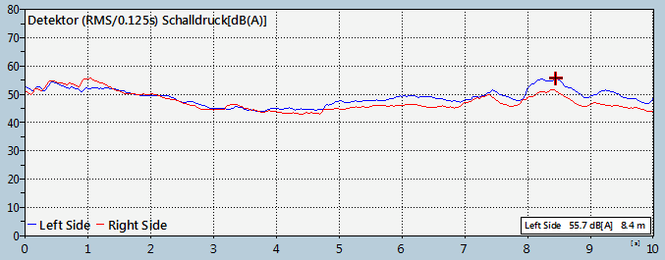
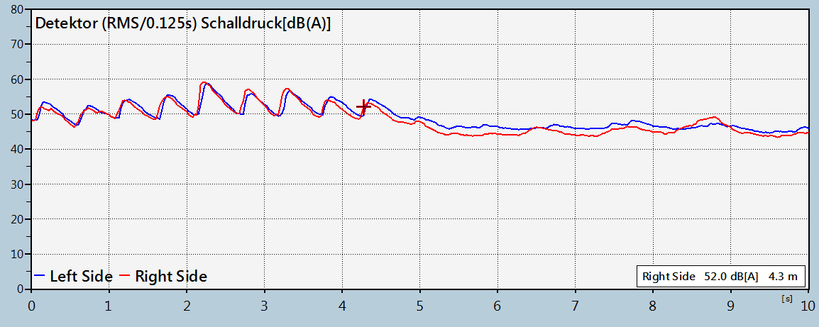
Justification of the main impact quantities.
„Varying background noise“ – justification by measurement
14 dB(A)
16 dB(A)
ΔSPL_{urban}:
0.0 – 0.4 dB
Background shall be measured before and after a serious of measurements. During a measurement it is not possible to determine the background noise.
While the background noise might be low during its measurement, transient broadband events with up to 60 dB(A) may occur.
Such events are typical for test centers with multiple tracks and events, but hardly noticeable during pass-by measurements.
These transient noises will be counted as vehicle signal and can especially affect cruise measurement up to 1.0 dB to 1.2 dB higher values. In a 1/3rd share of the cruise test to Lurban, the impact on Lurban is estimated up to 0.4 dB.

Slide 10
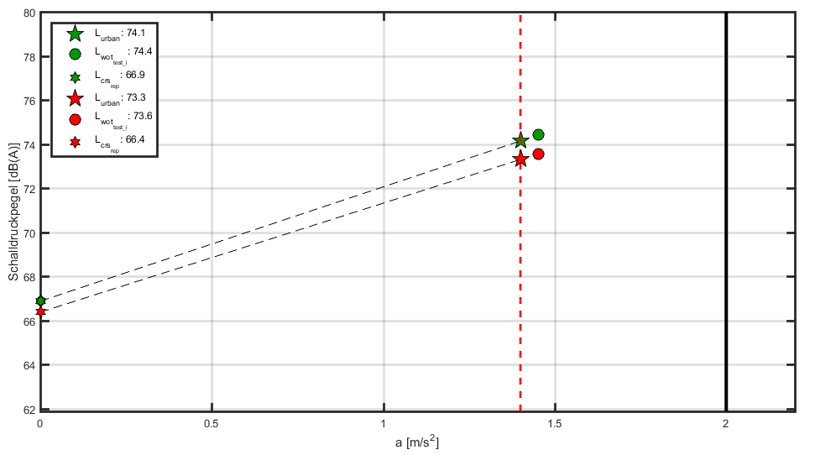
Justification of the main impact quantities.
„variation on operating temperature of engine and tyres “ – justification by measurement
Variation of approx. 100 °C on exhaust system (KAT Temp.)
+
Variation of 10°C test track temp (derived from R117)
ΔSPL_{urban}:
0,8 dB
High-performance vehicles in particular can have a large dependency on component temperatures of the power train. Here, too, the source distribution decides how large the influence on the end result is.

Slide 11
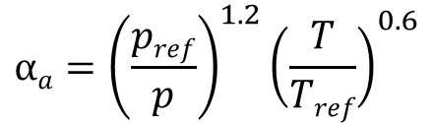

Justification of the main impact quantities.
„barometric pressure“ – justification by theoretical derivation
 | Barometric Pressure |  | Power variation | Acceleration variation | Lurban [dB(A)]
Day to day | Weather +/- 30 hPa | 60hPa | 7.7% | 7.7% | 0.4dB
Site to site | Altitude -1000m Location of Test Track | 100hPa | 13.5% | 13.5% | 0.7dB
ISO1585 paragraph 6.3.1
Correction of engine power;
P$=αap$
ΔSPL_{urban}:
up to 0,7 dB
Correction factor for spark-ignition engines;
$${αa=\left(\frac{pref}{p}\right)}^{1.2}{\left(\frac{T}{Tref}\right)}^{0.6}$$
a_urban
a_wot
The influence of barometric pressure can be calculated by using ISO 1585 “Engine test code – Net Power”(or R85)

Slide 12
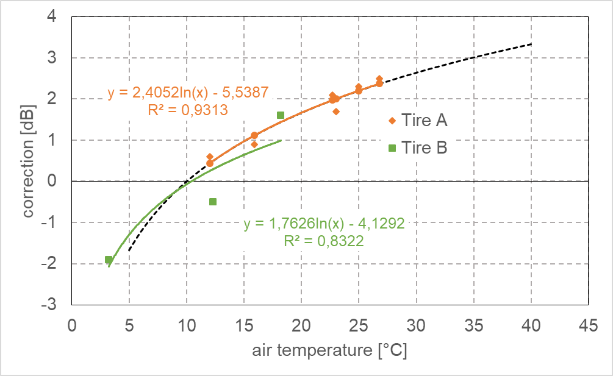
Justification of the main impact quantities.
„Air temperature effect on tyre noise (5-10°C)“ – justification by measurement
„Air temperature effect on tyre noise (10-40°C)“ – justification by measurement/ calculation
Extrapolation (upper temp. range) of the measured SPL
by a logarithmical fitting function (derived from temperature
correction of the R117 for C1 tires) with using the air
temperature.
extrapolation
3,3dB
ΔSPL_{CRS}: 5 dB ΔSPL_{WOT}: 3.2 dB
-1,7dB
ΔSPL_{urban}:
3.8 dB
The influence of the air temperature on the tire/ road noise can be up to 5dB within the total temperature range from 5 up to 40°C. For Lcrs 100% contribution of tire noise is considered and for LWOT 50% contribution of tire noise is considered.

Slide 13
Justification of the main impact quantities.
„ Varying background noise during measurement“ – justification by …
redundant– see slide „ Varying background noise“ (no. 5)
…

Slide 14
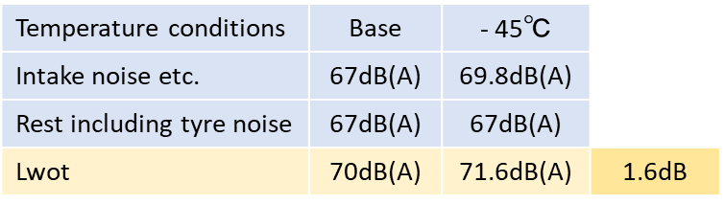
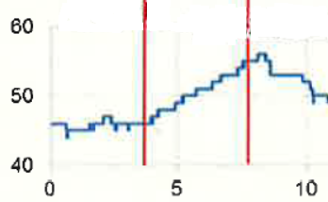
Justification of the main impact quantities.
„Intake temperature“ – justification by measurement
Air temperature range
(The regulation allow tem-perature condition at 5 to 40℃.)
35℃
1 ~ 1.5dB /20℃
Estimation of the impact on Lwot
Impact of Intake noise against intake temperature
(Decreasing by 20℃ provides increasing of intake noise by 1 to 1.5dB based on measured data.)
+2.8dB
Relation between air- and intake temperature (at least increasing by 10℃ at higher temp.))
10℃
2.25~3.38dB
Total range of intake temperature (5 to 50 ℃)
45℃
Ave. 2.8dB
1.6dB
[℃]
Impact to intake noise
Impact to Lwot
E.g. Staying idle for 5 minutes provides intake temperature increases by 10℃.
ΔSPL_{urban}:
1 dB
Intake temp.
time [min.]
Temperature effect for Lcrs and Lwot for tyre noise are covered in “Air temperature effect on tyre noise“. Therefore temperature effect for Lwot for power train noise is considered here.
The temperature effect for intake noise is used measured data. Same impact of air (gas) flow excitation to exhaust etc. are considered.
The contribution of sound level provided by such excitation is assumed by 50% for calculation of Lwot.

Slide 15
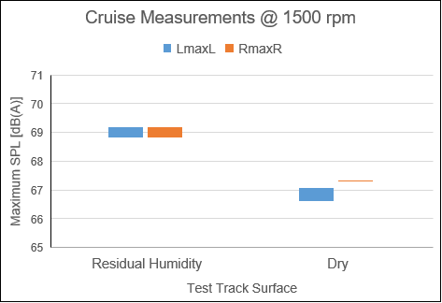
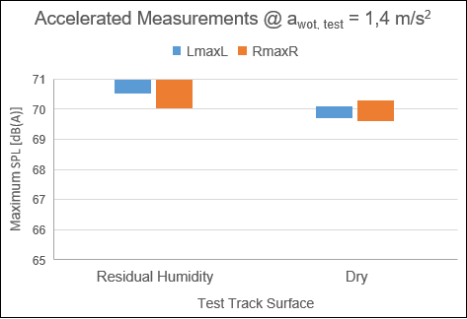
Justification of the main impact quantities.
„Residual humidity on test track surface“ – justification by measurement
0,9
0,7
2,1
1,7
ΔSPL_{urban}:
1 – 1,3 dB
3 Measurements in each operating condition, Runs with residual humidity: test track surface between AA‘ and BB‘ almost 100% dry
All measurements performed on the same day according to R51.03, Annex 3 (Tyre dimensions: 285/40 ZR21; 315/35 ZR21)
Residual humidity on one side of the line CC‘ only can lead to Run-to-Run deviations

Slide 16
Justification of the main impact quantities.
„Altitude (Location of Test Track) -100 hPa/1000m (from 1015 to 915 hPa) “ – justification by …
redundant– see slide „Barometric pressure“ (no. 7)
…

Slide 17
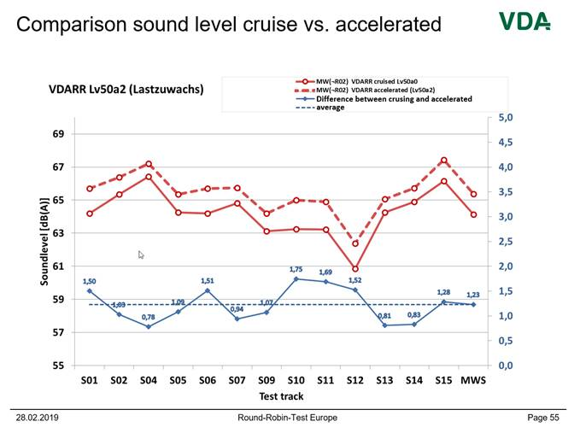
Justification of the main impact quantities.
„Test track surface“ – justification by measurement (VDA RR)
Maximum deviation track: 5,5 dB
→ max. deviation vehicle measurement: 4dB
ΔSPL_{urban}:
4 dB
Different test tracks surfaces lead to different tyre road noises. Depending on the source distribution these differents influence the test result of crs and wot measurement.

Slide 18
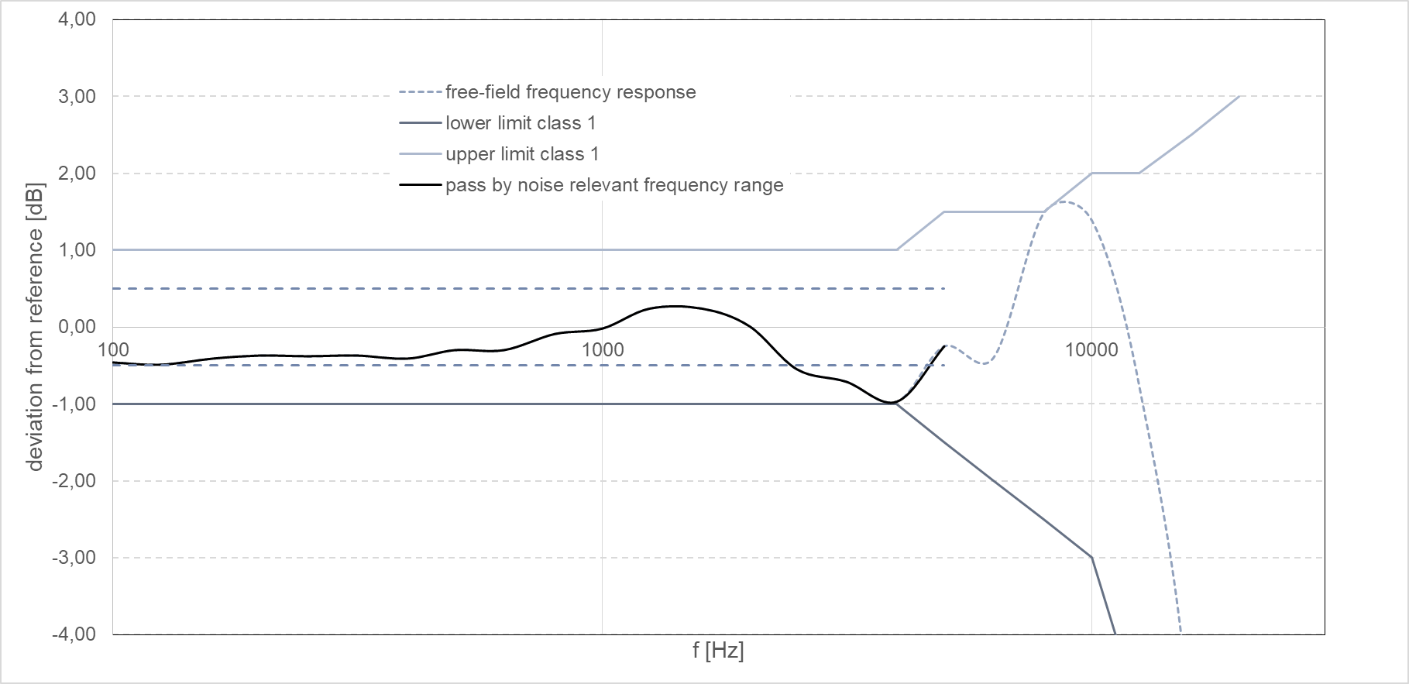
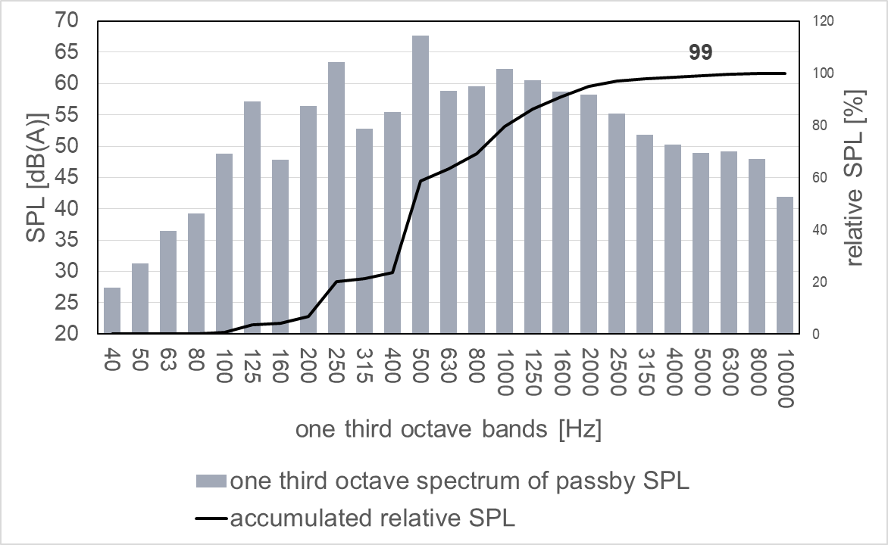
Justification of the main impact quantities.
„Microphone Class 1 IEC 61672“ – justification by measurement (calibration)
ΔSPL_{urban}:
1 dB
5000 Hz
The deviation from reference of today used microphones is normally in a range of +/- 0.5 dB. The maximum error during measurement by using two different sound level meters can be up to 1 dB. The frequency range of interest of pass by test is up to 5000 Hz (example in the left diagram, 99% of the OAL @5000Hz)

Slide 19
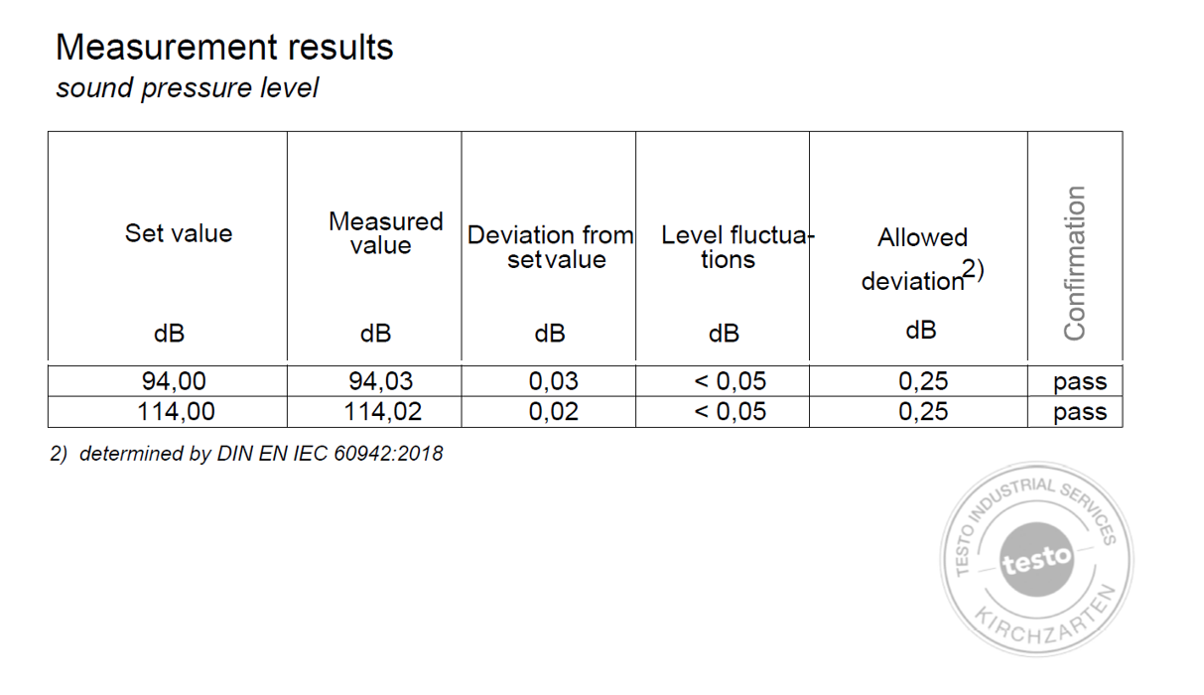
Justification of the main impact quantities.
„Sound calibrator IEC 60942“ – justification by measurement (calibration)
Excerpt from a calibration report
ΔSPL_{urban}:
0,5 dB
The maximum allowed deviation determined by DIN EN 60942:2018 “Electroacoustics. Sound calibrators“ is +/- 0.25 dB. The maximum error during measurement by using two different sound calibrators can be up to 0.5 dB.

Slide 20
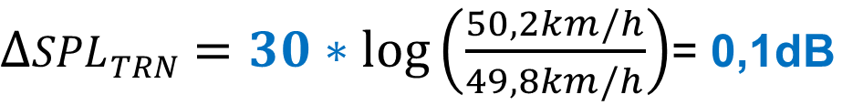
Justification of the main impact quantities.
„speed measuring equipment at PP“ – justification by theoretical derivation
Same approach as „DRIVER#3: speed variations of +/- 1km/h“
Precision of todays speed measuring systems: approx.:
+/-0,2 km/h
$∆{SPL}_{TRN}=30∗log\left(\frac{50,2km/h}{49,8km/h}\right)$= 0,1dB
ΔSPL_{urban}:
0,1 dB
See „DRIVER#3: speed variations of +/- 1km/h“

Slide 21
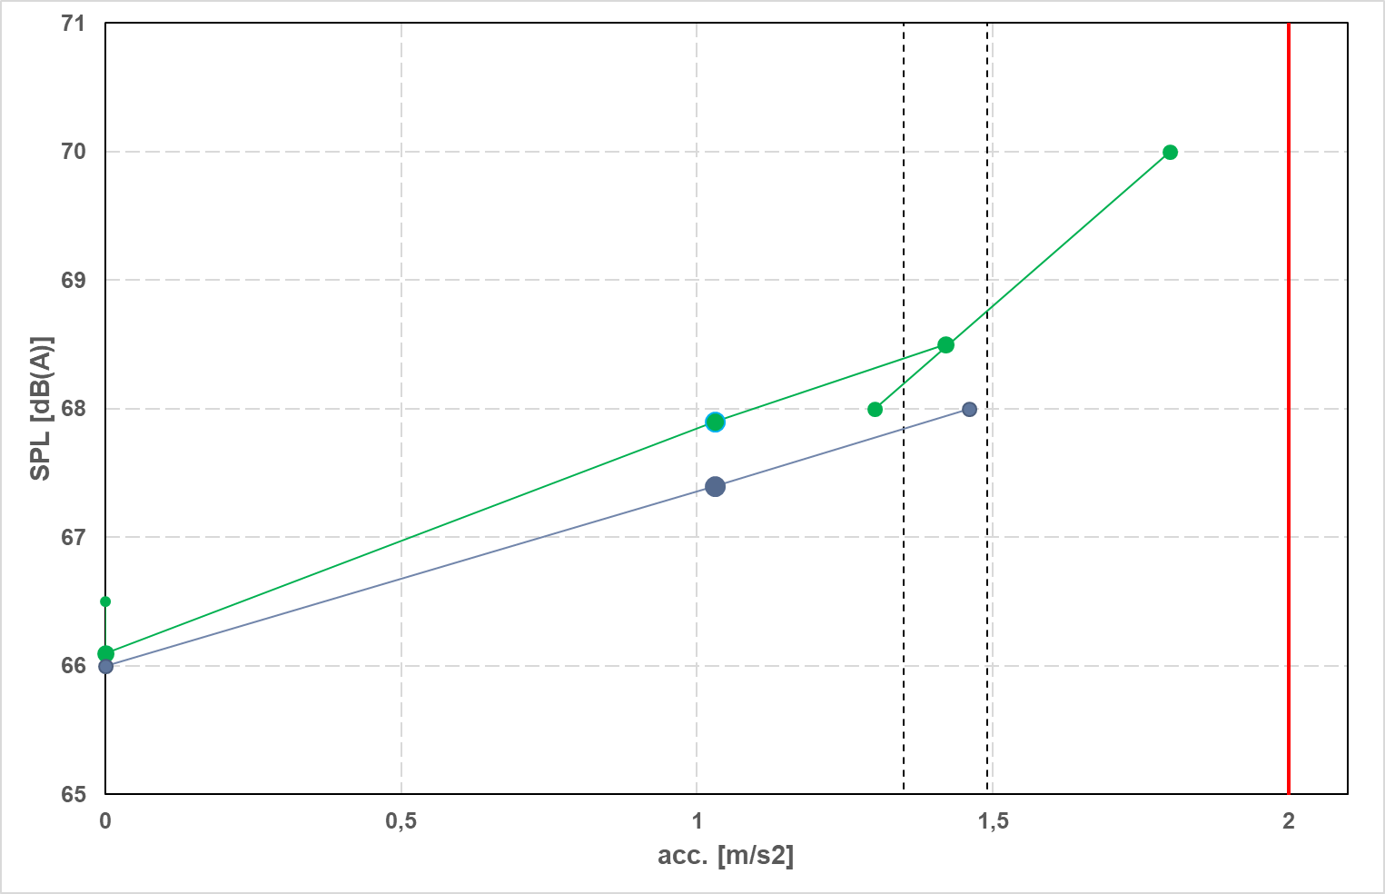
Justification of the main impact quantities.
„Acceleration calculation from vehicle speed measurement“ – justification by theoretical derivation
0,5 dB
ΔSPL_{urban}:
0,5 dB
The acceleration is derived by calculation from the speed measurement. The speed measurement shall be determined with devices according to is subject to uncertainty and given by the regulation according to paragraph 1.4 of Annex 3 of UN R51.03. The tables and the figure show the impact of the allowed speed uncertainty on the final test result.

Slide 22
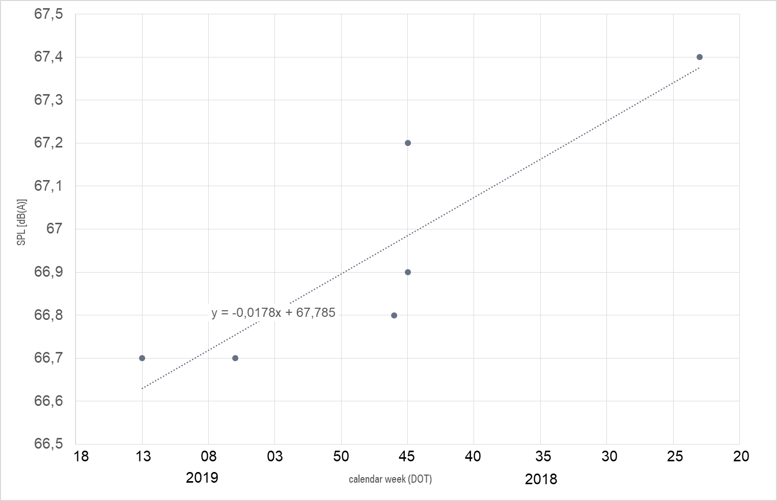
Justification of the main impact quantities.
„Production variation on tyres; Aging of tyres until delivery to customer“ – justification by measurement
aging: ≈ 1 dB/ year
+
prod. variation: ≈ 0,5 dB
= 1,5 dB (CRS)
production variation
ΔSPL_{urban}:
up to 1dB
aging
The variation of 0,75 dB in WOT measurement assumes a source distribution of 50% between tyre road and power train noise.

Slide 23
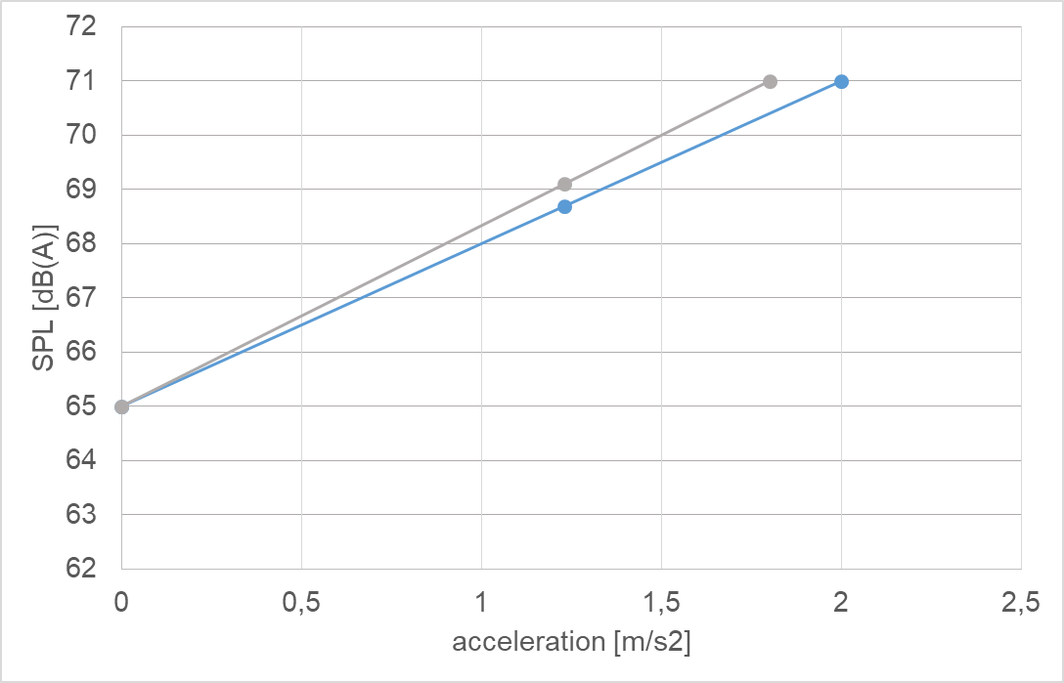
Justification of the main impact quantities.
„Production variation in power“ – justification by theoretical derivation
Power variation | Power variation absolut | Acceleration variation | Lurban [dB(A)]
+/- 5% | 10% | 10% | 0.4dB
approach similar to
„barometric pressure“
0,2 m/s2
0,4 dB
ΔSPL_{urban}:
up to 0,4 dB
Based on a allowed production variation in power of +/- 5% and a total variation in acceleration of 10% the impact on Lurban is up to 0,4 dB.

Slide 24
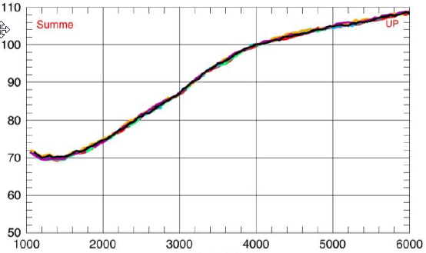
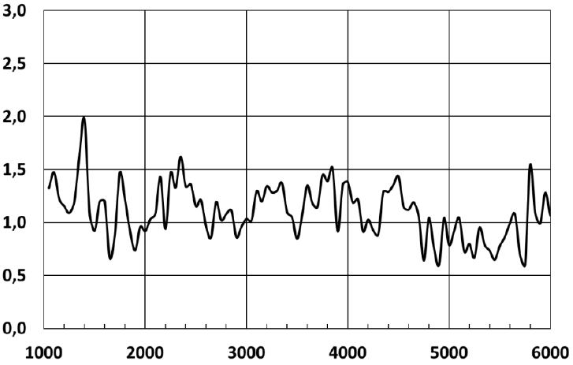
Justification of the main impact quantities.
„Production Variability of Sound Reduction Components“ – justification by measurement
tailpipe noise
Variation up to 2dB
SPL [dB(A)]
deviation [dB]
Measurement of 7 exhaust
systems from the same type
ΔSPL_{urban}:
up to 0,7 dB
rpm [1/min]
rpm [1/min]
The impact on Lurban of 0.7 dB assumes a contribution of the effect of 50% on Lwot (1.1dB). The effect in the Lcrs is neglectible.

Slide 25
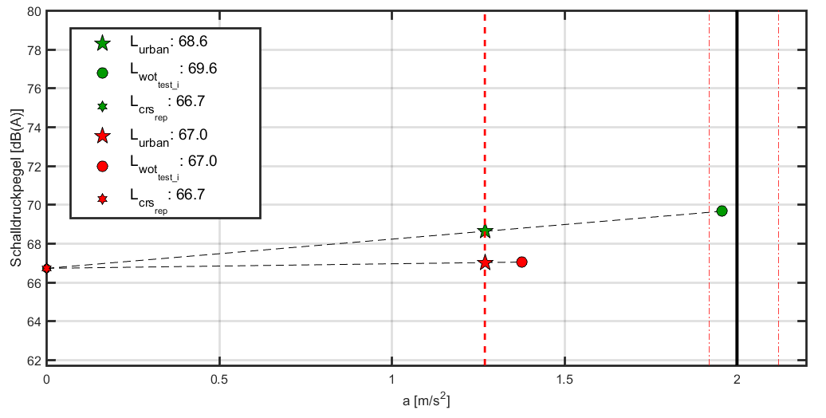
Justification of the main impact quantities.
„variation vehicle mass “ – justification by measurement (simulation)
argumentation chain:
„test gear change“
Δm_{FZG}
Δa
Δtest gear
Δengine speed
ΔSPL
ΔSPL
_{=1,6dB}
vehicle mass + 200kg (appr. + 11%)
gear i becomes valid
gear i+1
normal vehicle mass
The main impact of the variation of the vehicle mass is on acceleration behavior and can causes a test gear change. The test gear change leads to an other test engine speeds and an other sound emission.

