Slide 1
Measurement uncertainties
STATUS REPORT ON WORKS IN PROGRESS
- Uncertainty induced by measurement system
- Measuring run to run deviation
IWG-MU October 06-07, 2020

Slide 2
01
Uncertainty induced by measurement system

Slide 3
Uncertainty induced by measurement system accuracy
Scope: define the influence of the measurement system accuracy on Lurban
  As speed measurement is used to calculate acceleration
  And SPL level is used on L_{woti} and L_{wot i+1}
SPL and Speed accuracy can be considered
  In run to run uncertainty
  In Site to site.

Slide 4
Uncertainty induced by measurement system accuracy
Impact of SPL and Speed measurement accuracy – Single gear case
SPL (dBA).
Lwot i
L_{urban}
Lcrs
Accel.
0
A _{urban}
A _{wot i}

Slide 5
Uncertainty induced by measurement system accuracy
Impact of SPL and Speed measurement accuracy – two gears case
    Obviously, the combined influence of SPL and Speed measurement uncertainties cannot be easily calculated
Lwot i
SPL (dBA).
Lwot_rep
L_{urban}
Lcrs i
Lcrs_rep
Lwot i+1
Lcrs i+1
Accel.
0
A _{urban}
A _{wot_ref}

Slide 6

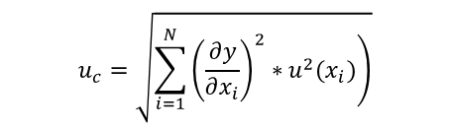
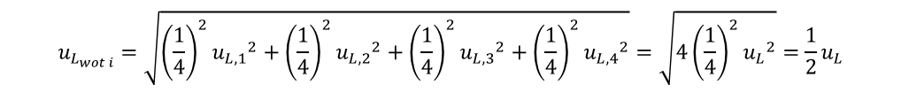
Uncertainty induced by measurement system accuracy
Proposed approach: uncertainties propagation law
  For a given influencing parameter, the uncertainty (k=1) is given by:
$$u_{c}=\sqrt{\sum_{i=1}^{N}{\left.{\left(\frac{∂y}{∂x_{i}}\right)}^{2}∗u^{2}(x_{i})\right)}}$$
Application to uncertainty on L_{wot i}, L_{wot i+1}, L_{crs i}, _{Lcrs i+1}
  These quantities are the average of 4 runs:
  The uncertainty on L_{wot i} is given by:
$$L_{wot i}=\frac{1}{4}\left(L_{wot i,1}+L_{wot i,2}+L_{wot i,3}+L_{wot i,4}\right)$$
$$u_{L_{wot i}}=\sqrt{{\left(\frac{1}{4}\right)}^{2}{u_{L,1}}^{2}+{\left(\frac{1}{4}\right)}^{2}{u_{L,2}}^{2}+{\left(\frac{1}{4}\right)}^{2}{u_{L,3}}^{2}+{\left(\frac{1}{4}\right)}^{2}{u_{L,4}}^{2}}=\sqrt{{4\left(\frac{1}{4}\right)}^{2}{u_{L}}^{2}}=\frac{1}{2}u_{L}$$

Slide 7
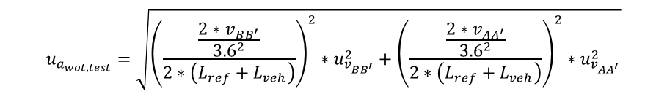
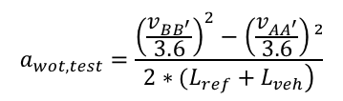
Uncertainty induced by measurement system accuracy
Application to uncertainty on acceleration
  In the general case:
  Considering v_{AA’} and v_{BB’} as uncertain:
$$a_{wot,test}=\frac{{\left(\frac{v_{BB^{′}}}{3.6}\right)}^{2}−\left(\frac{v_{AA^{′}}}{3.6}\right)²}{\left.2∗(L_{ref}+L_{veh}\right)}$$
$$u_{a_{wot,test}}=\sqrt{{\left(\frac{\frac{2∗v_{BB^{′}}}{{3.6}^{2}}}{2∗\left(L_{ref}+L_{veh}\right)}\right)}^{2}∗u_{v_{BB^{′}}}^{2}+{\left(\frac{\frac{2∗v_{AA^{′}}}{{3.6}^{2}}}{2∗\left(L_{ref}+L_{veh}\right)}\right)}^{2}∗u_{v_{{AA}^{′}}}^{2}}$$

Slide 8
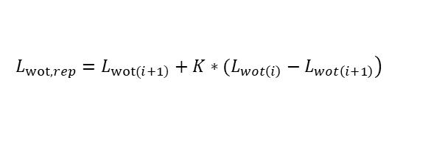
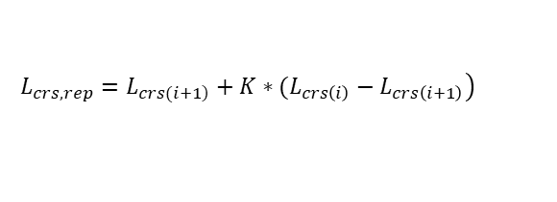
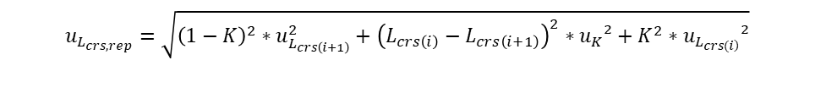
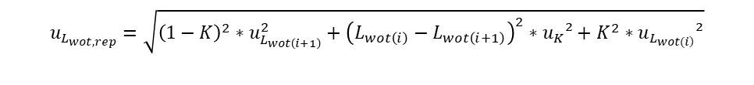
Uncertainty induced by measurement system accuracy
Cascading to reported values Lwot_rep and Lcrs_rep
  Given the equation for Lwot_rep and Lcrs_rep:
  The uncertainties on reported values are:
$$\left.L_{wot,rep}=L_{\left.wot(i+1\right)}+K∗(L_{wot\left(i\right)}−L_{wot\left(i+1\right)}\right)$$
$$\left.L_{crs,rep}=L_{\left.crs(i+1\right)}+K∗(L_{crs\left(i\right)}−L_{crs\left(i+1\right)}\right)$$
$$u_{L_{wot,rep}}=\sqrt{{{\left(1−K\right)}^{2}∗u}_{L_{wot\left(i+1\right)}}^{2}+{\left(L_{wot\left(i\right)}−L_{wot\left(i+1\right)}\right)}^{2}∗u_{K}²+K^{2}∗u_{L_{\left.wot(i\right)}}²}$$
$$u_{L_{crs,rep}}=\sqrt{{{\left(1−K\right)}^{2}∗u}_{L_{crs\left(i+1\right)}}^{2}+{\left(L_{crs\left(i\right)}−L_{crs\left(i+1\right)}\right)}^{2}∗u_{K}²+K^{2}∗u_{L_{\left.crs(i\right)}}²}$$
In COP (and MS) this term may be null, as K and Kp may/shall be taken from homologation test (Annex 6, 2.1 and Annex 7, 1.) ➔ u_{K}=0

Slide 9
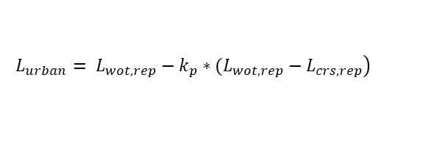
Uncertainty induced by measurement system accuracy
… and final calculation on Lurban uncertainty
  Given the equation for Lurban:
  The final uncertainty is:
$$\left.L_{urban}= L_{wot,rep}−k_{p}∗(L_{wot,rep}−L_{crs,rep}\right)$$
$$u_{L_{urban}}=\sqrt{{{\left(1−k_{p}\right)}^{2}∗u}_{L_{wot,rep}}^{2}+{\left(−L_{wot,rep\left(i\right)}+L_{crs,rep}\right)}^{2}∗u_{k_{p}}²+{k_{p}}^{2}∗u_{L_{crs,rep}}²}$$
Again, in COP (and MS) this term may/shall be null, as K and Kp may/shall be taken from homologation test (Annex 6, 2.1 and Annex 7, 1.) ➔ u_{Kp}=0

Slide 10

Uncertainty induced by measurement system accuracy
Input data
  SPL measuring equipment
  Speed measuring equipment
 | U (k=2) | Std. deviation (normal) | Std. deviation (uniform) | Run to Run | Day to Day | Site to site
Ind. Measurement system (Siemens, M-BBM, B&K…) – Microphones & acq. system | 0.3 dB | 0.07 dB | 0.09 dB
Standard Class 1 Mic. IEC 61672 Sound calibrator IEC 60942 | 1.0 dB | 0.25 dB | -
Regulation R51-03 (An. 3, 1.2) | 0.5 dB | 0.13 dB | 0.14 dB
 | U (k=2) | Std. deviation (normal) | Std. deviation (uniform) | Run to Run | Day to Day | Site to site
GPS : +/- 0.1 km/h | 0.2 km/h | 0.05 km/h | 0.06 km/h
Regulation R51-03 (An. 3, 1.4 “continuous measurement devices”) - +/- 0.5 km/h | 1 km/h | 0.25 km/h | -
Regulation R51-03 (An. 3, 1.4 “independent measurements of speed”) - +/- 0.2 km/h | 0.4 km/h | 0.1 km/h | 0.12 km/h

Slide 11
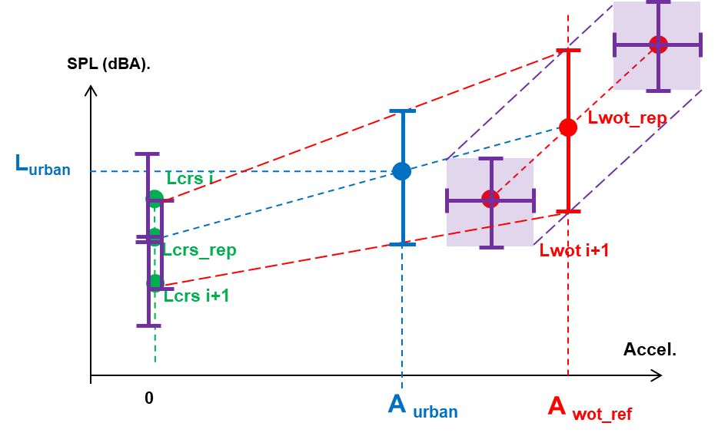
Uncertainty induced by measurement system accuracy
Results in the case of 2 gear ratios
  Summary
  Detailed input and results – combined propagation of SPL and Speed uncertainties
 | U(k=2) | U_Lwot_rep (dB) | U_Lcrs_rep (dB) | U_Lurban (dB)
SPL | 0.5dB | 0.18 to 0.20 | 0.18 to 0.20 | 0.13 to 0.16
Speed | 1km/h | 0.07 to 0.42 | 0.01 to 0.22 | 0.08 to 0.30
SPL and speed | 0.5dB & 1km/h | 0.21 to 0.46 | 0.18 to 0.30 | 0.18 to 0.33

Slide 12
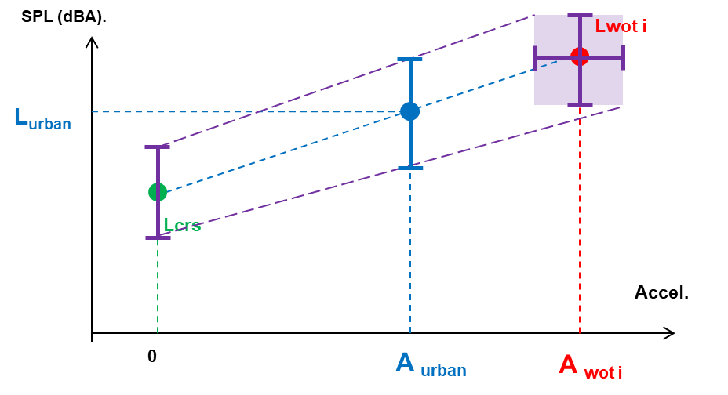
Uncertainty induced by measurement system accuracy
Results in the case of 1 gear ratio
  Summary
  Detailed input and results – combined propagation of SPL and Speed uncertainties
 | U(k=2) | U_Lwot_rep (dB) | U_Lcrs_rep (dB) | U_Lurban (dB)
SPL | 0.5dB | 0.25 | 0.25 | 0.19 to 0.24
Speed | 1km/h | 0 | 0 | 0.08 to 0.21
SPL and speed | 0.5dB & 1km/h | 0.25 | 0.25 | 0.20 to 0.30

Slide 13
02
Measuring run to run uncertainty
From a restrained dataset

Slide 14
Measuring run to run uncertainty
Lurban measurement repeatability roadblocks
  Repeating Lurban measurements to get statistically relevant data is long
  Weather conditions may not be constant
  The driver may not behave as for the first runs… or can get tired.
How to get more information from a few Lurban measurements ?

Slide 15
Measuring run to run deviation from a restrained dataset
Principle: use data combination
  Repeating 2 or 3 Lurban measurements only
  Consider all possible combinations by picking 4 runs among each pass-by condition and compute a new Lurban value

Slide 16

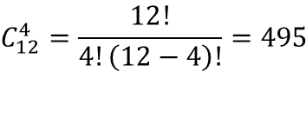

Measuring run to run deviation from a restrained dataset
How many possible combinations with 3 Lurban measurement sets ?
  For each pass by condition, the possible combinations of 4 runs within 3x4 runs is
  In the case of 2 gears ratio (WOTi, WOTi+1, CRSi, CRSi+1 = 4 pass-by conditions) the total possible different calculations of Lurban are :
  In the case of 1 gear ratio: (WOTi, CRSi = 2 pass-by conditions):
$$C_{12}^{4}=\frac{12!}{4!\left(12−4\right)!}=495$$
$$n={\left(C_{12}^{4}\right)}^{4}={6.10}^{10}$$
$$n={\left(C_{12}^{4}\right)}^{2}=245 025$$

Slide 17
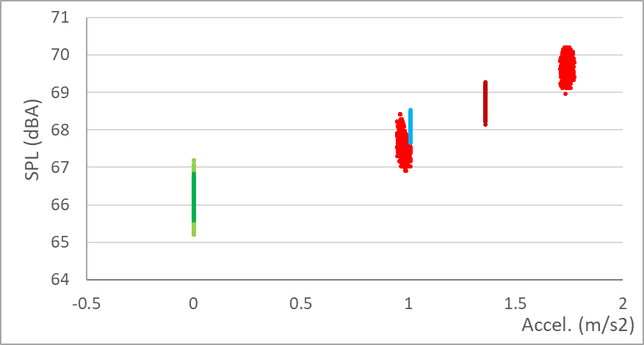
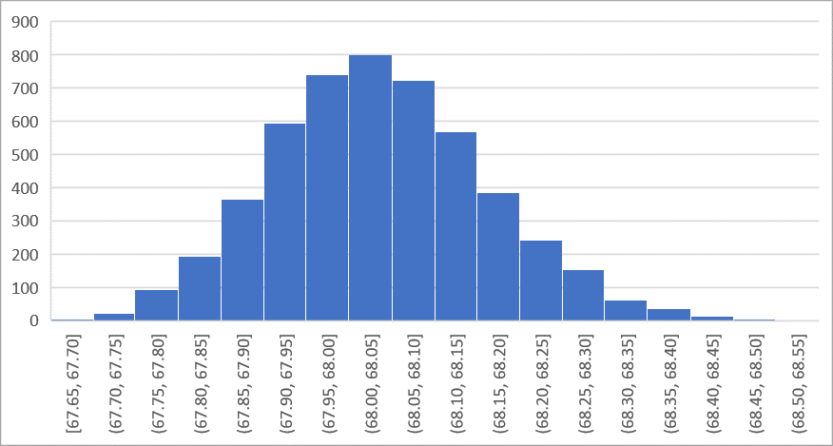
Application and Results
Application
  B class diesel vehicle
  3 Lurban measurements in a row (3°C temperature variation), on gears 3 and 4
  60 billion possible unique values of Lurban
  Here: 5000 calculations of Lurban
Lurban
WOT 3
CRS 3
Lwot rep
Lcrs_rep
WOT 4
CRS 4
Results
0.05 dB
Lurban values
(5000 calculations)

Slide 18
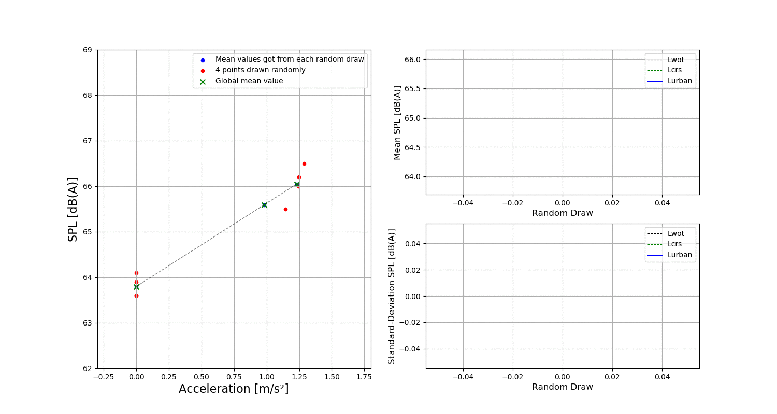
Feedback on PSA case one single gear : 4 points drawn randomly for Lcrs and Lwot ; 50 draws
Calculations done by Lionel Oddo, UTAC for PSA
  What is new ?
    Random selection of 4 runs in wot, 4 runs in csr, among 60 runs
    Averaging to Lwoti, Lcrsi
    Final interpolation to Lurban.
  Results :
    Lurban St. dev. = 0.125dB
    U (k=2) = 0.5dB

Slide 19
Wrap-up
Measures of Run-to-run uncertainty
 | U (k=2) | Std. dev.
L_{urban} – 2 gears | 0.51 dB | 0.127 dB
L_{urban} – 1 gear (PSA study) | 0.50 dB | 0.125 dB
Analytical | 1.12 dB | 0.281 dB
Effects of uncertainty of measurement devices
 | U (k=2) | Std. dev (dB)
SPL & Speed | 0.5 dB 1 km/h | 0.13 dB 0.25 km/h
L_{urban} – 2 gears | 0.18 dB to 0.33 dB | 0.044 to 0.082
L_{urban} – 1 gear | 0.20 dB to 0.30 dB | 0.051 to 0.076

