Slide 1
Measuring Tire-pavement Noise at the Source: Precision and Bias Statement
Donavan and Lodico
Summary of Document
Doug Moore

Slide 2
Summary
Evaluation of measurement uncertainty for tire/road noise
Inclusion of Tire/Road temperature correction
Crosswind limits
Tire aging limits
Air Temperature Limits
Statistical analysis for Precision and Bias of Measurements

Slide 3
Definitions
Precision
  Repeatability: Single operator testing same pavement under same environmental conditions within a single test session -> +/- 0.2 dB with a limit of 0.6 dB
  Reproducibility: Multiple test teams measuring under the same environmental conditions or a single test team measuring over multiple days -> +/- 0.4 dB with a limit of 1.1 dB
Bias: Uncertainty from longer periods of time between tests or from multiple test sites -> +/- 0.5 dB with a limit of 1.4 dB

Slide 4
Findings
Tire/pavement noise decreases with increasing temperature and this relationship depends on both the tire and the pavement.
  0.039 dB/deg F established as general correction factor
Test tire differences are a source of variability. However, no correlation could be established based on hardness, tread depth, or tire age, within the limits tested.
  Hardness:62-66
  Tread : 1200 miles
  Age: 2.5 years

Slide 5
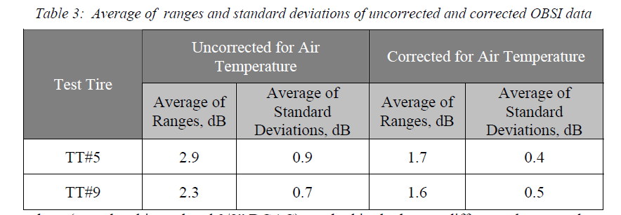
Tire/Road Air Temperature correction performance

Slide 6
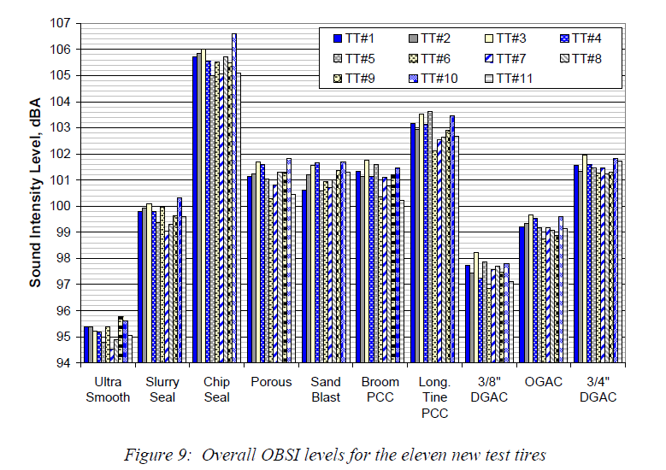
Effect of tire to tire variation: 0.7 to 1.6 dB across pavement types (Tires all new SRTT)
Std Dev = 0.43

Slide 7
Limits on tires used
Max hardness limit of 68
Minimum tread depth of 7.2mm (SRTT)
Age limit of four years
Mileage over 7000 miles

