Slide 1
influence of temperature and atmospheric pressure on sound pressure level
Shervin solhkonan

Slide 2
Sound pressure from a monopole
Sound pressure p_{m} from a monopole sound source can be described by
[1]
where is the density of the surrounding fluid, r is the distance to the source and f is the frequency. Q₀ is the volumeflow of the source and is described by
[2]
where v is the velocity of the occilations of the source

Slide 3
Ideal gas law
The Ideal gas law is descirbed as
[3]
where P is the atmospheric pressure, R is the gas constant with value 257,058 and T is the temperature in Kelvin

Slide 4
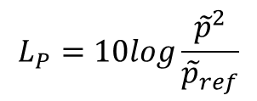
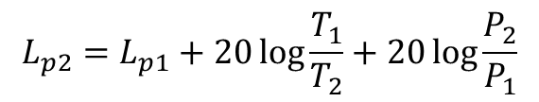
Since the sound pressure is proportional to the density of the surrounding fluid, the relation between two arbitrary densities corresponds to the relation between the sound pressures.
[4]
By inserting the ideal gas law [4] in the above equation we get
[5]
Inserted in the definition of sound pressure level the expression becomes
[6]
[7]
$$L_{P}=10log\frac{{\tilde{p}}^{2}}{{\tilde{p}}_{ref}}$$
$$L_{p2}=L_{p1}+20\log{\frac{T_{1}}{T_{2}}+20\log{\frac{P_{2}}{P_{1}}}}$$

Slide 5
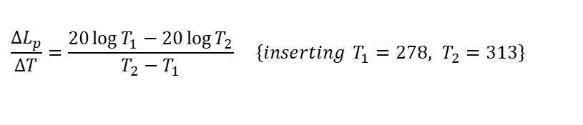

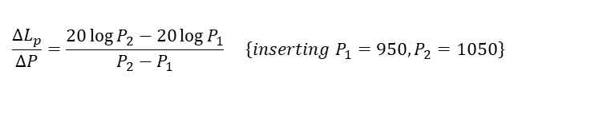
It would be convenient to find the linearized change rate (slope) of the sound pressure difference, ΔL_{p} / ΔT and ΔL_{p} / ΔP
A relevant approach would be to find the slope between the highest and lowest allowed temperature during a pass-by noise test, and between the highest and lowest atmosperic pressure that can practically occure. Hence, we set T₁ = 5 °C and T₂ = 40 °C (278 och 313 K) and P₁=950Pa och P₂=1050 Pa.
[8]
[9]
$$\frac{ΔL_{p}}{ΔT}=\frac{20\log{T_{1}}−20\log{T_{2}}}{T_{2}−T_{1}} \left\{inserting T_{1}=278, T_{2}=31\left.3\right\}\right.$$
$$\frac{ΔL_{p}}{ΔP}=\frac{20\log{P_{2}}−20\log{P_{1}}}{P_{2}−P_{1}} \left\{{inserting P}_{1}=950,P_{2}=\left.1050\right\}\right.$$
Finally, the linearized expression becomes
$$ΔL_{P}=−0,03ΔT+0,009ΔP$$

Slide 6
 | Temperature dB/10ºC | Atmospheric pressure dB/10 hPa
Sound pressure difference dB | -0,3 | 0,09
 | Temperature P-P (5-40ºC) | Atmospheric pressure P-P (950-1050 hPa)
Sound pressure difference dB | 1,05 | 0,9
Sound pressure level difference normalized to 15°C
Sound pressure level difference normalized to 1013 hPa.

