Slide 1


AEBS-12 – Industry Input

Slide 2
Car to Bicycle – Why Car2Bicycle AEBS is such a challenge

Slide 3
AEB IWG 12 – Industry Input
Robustness of Car2Bicycle AEBS
Why Car2Bicycle AEBS is a much greater challenge than Car2Car or Car2Pedestrian?
At the lower speed limit: Stable detection of a bicycle is far more difficult than that of a pedestrian.
  The limiting factor of performance is the field of view of the sensing system.
  Due to the speed relation, decisions often need to be made while the bicycle is at the edge of the detection area.
  In order to make a robust decision for intervention, the objects need to be detected and classified consistently over a period of time.
At the upper speed limit: The PONR calculation used in system design is more complex than the basic assumptions used to calculate the maximum speed reduction.
  Car2Pedestrian = intervention starts, when the pedestrian is only 30cm away from the path of the vehicle.
  Car2Bicycle = intervention starts, when the bicycle is several meters away.
  Therefor the risk of false activations is increased.
Car2Bicycle AEB is not yet as mature and well established as vehicle or pedestrian detection (see next slide)
  EURO NCAP implemented Car2Pedestrian in 2016
  EURO NCAP implemented Car2Bicycle in 2018

Slide 4
AEB IWG 12 – Industry Input
Robustness of Car2Bicycle AEB
Examples: Selected ADAS features – Market Entry vs. 1st Euro NCAP requirements vs. Minimal Legal Regulations
2005 2010 2015 2020 2025
> 10 years
8 years
Today
AEB-Car-to-Car Rear-End
AEB Car-to-Pedestrian Crossing
5 years
8 years
<1 year
6 years
AEB Car-to-Bicyclist Crossing
Market Entry (in premium segment)
1st Euro NCAP requirements introduced
Type Approval Regulation

Slide 5
Car to Bicycle – Speed of the bicycle

Slide 6
AEB IWG 12 – Industry Input
Justification for increasing the lower bicycle velocity
5.2.3.4. a) with unobstructed crossing bicycles with a lateral speed component of not more than 15 km/h;
Problem:
Different bicycle velocities will lead to different avoidance speeds. If we include a table in the regulation it will only apply to one specific bicycle velocity. If a speed range for the bicycle is defined, we either need to include various tables or we need to agree to use the values of the lowest achievable speed reduction for all bicycle speeds.
However, it might not be necessary to define a bicycle speed range since we are bound by this sentence: “It is recognised that the performances required in this table may not be fully achieved in other conditions than those listed above. However the system shall not deactivate or unreasonably switch the control strategy in these other conditions. This shall be demonstrated in accordance with Annex 3 of this Regulation.”
Proposal:
Change the sentence to
(a) With unobstructed perpendicularly (90°+/-3°) crossing bicycles with a speed of 15 +0/-2 km/h;

Slide 7
Car to Bicycle – Justification for a two step approach or generally increased lower avoidance speed

Slide 8
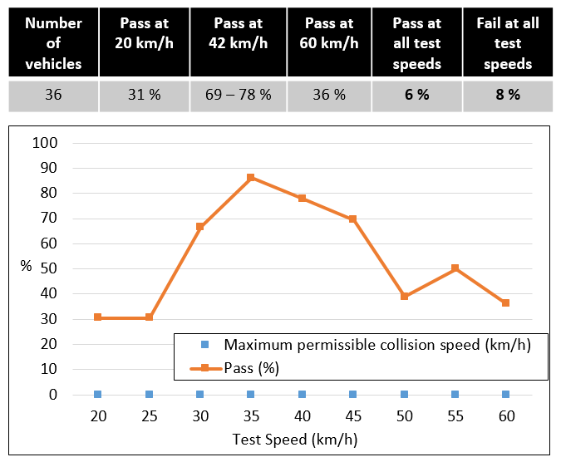
AEB IWG 12 – Industry Input
Two step approach
Collision avoidance in the speed range of 20-60km/h does not reflect the performance of today’s AEB systems.
EURO NCAP Test results (according to AEBS-10-04))
Impact speed acc. to Industry proposal
Maximum Impact Speed (km/h) for M₁* (Step 1)
Subject vehicle speed (km/h) | Maximum mass | Mass in running order
35 | 0 | 0
40 | 10 | 10
45 | 25 | 25
50 | 30 | 30
55 | 35 | 35
60 | 40 | 40
Maximum Impact Speed (km/h) for M₁* (Step 2)
Subject vehicle speed (km/h) | Maximum mass | Mass in running order
25 | 0 | 0
30 | 0 | 0
35 | 0 | 0
38 | 0 | 0
40 | 10 | 10
45 | 25 | 25
50 | 30 | 30
55 | 35 | 35
60 | 40 | 40

Slide 9

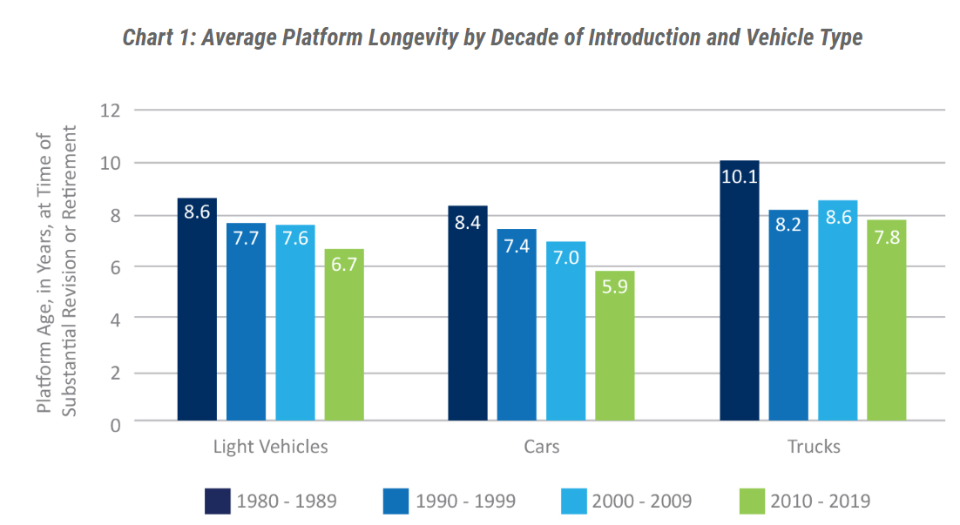
AEB IWG 12 – Industry Input
Justification for increasing the lower avoidance velocity
Automotive Product Development Cycles.
If the average platform longevity is assumed to be 6.7 years, additionally a development time of 3-5 years has to be taken into account. Especially for small-scale series the platform longevity can be significantly longer.
Even assuming average development and production periods the AT date for C2B in 07/2026 will affect vehicles whose development started around 2015.
Vehicle model | Production Period
RR Ghost | 2010-20??
RR Phantom VII | 2003-2017
Bentley Mulsanne | 2009-2020
VW T5/6 | 2003-20??
Renault Twingo 1 | 1993-2006
Fiat Panda 1 | 1980-2003
Fiat Cinquecento (500) | 2007-2020
Source: https://www.cargroup.org/automotive-product-development-cycles-and-the-need-for-balance-with-the-regulatory-environment/

Slide 10
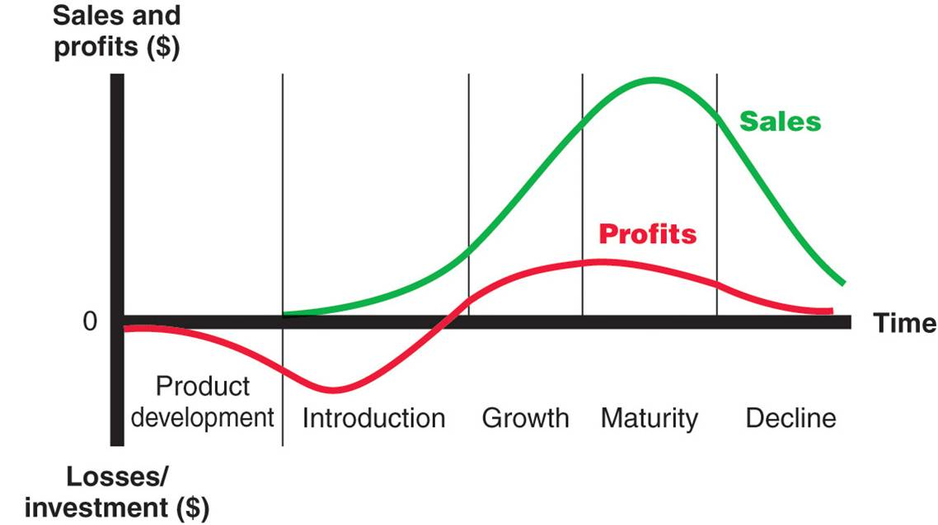
AEB IWG 12 – Industry Input
Justification for increasing the lower avoidance velocity
Automotive Product Life Cycle.
Regulation changes in late stages of the product life cycle will necessitate unplanned investments and affect the profitability of the vehicle model.
This can force an early end of production.
Source: https://marketing-insider.eu/marketing-explained/part-iii-designing-a-customer-driven-marketing-strategy-and-mix/product-life-cycle-strategies/

Slide 11
AEB IWG 12 – Industry Input
Justification for increasing the lower avoidance velocity
Why is it not possible to rework an entire AEB function within the lifecycle of a vehicle?
AEB Gen1 *new*
Typical of one system generation:
Sensors
Pricinple Logic/Software of the function
Architecture/platform characteristics of the vehicle
AEB Gen1
AEB Gen2
AEB Gen1 development/rollout phase
AEB Gen2 development/rollout phase
Vehicle line A
Vehicle line A (new model)
Vehicle
Platform 1
Vehicle line B
Vehicle line B (new model)
Vehicle line C
Vehicle line C (new model)
Vehicle line D
Vehicle line E
Vehicle line F
Vehicle
Platform 2
Vehicle line G
Vehicle line H
time

