Slide 1
Requirement of N1 in C2C and C2P
Fundamental parameters for requirements
Items | C2C | C2P as 00 series | C2P as 01 series
Maximum Deceleration | 9 m/s² in N1 (9 m/s² in M1) | 9 m/s² | 9 m/s²
TTC | 0.9 s LPS (Last Point of Steer) | 0.72 s Based on vehicle width | 0.9 s Based on vehicle width + 0.3 m*
Time to 1G | Maximum Mass 0.73 s in N1 (0.66 s in M1) | Maximum Mass 0.73 s | Maximum Mass 0.73 s
Dummy
Vehicle Path
Vehicle
Additional Critical Area
*: Vehicle width + Additional critical area (0.3 m)

Slide 2
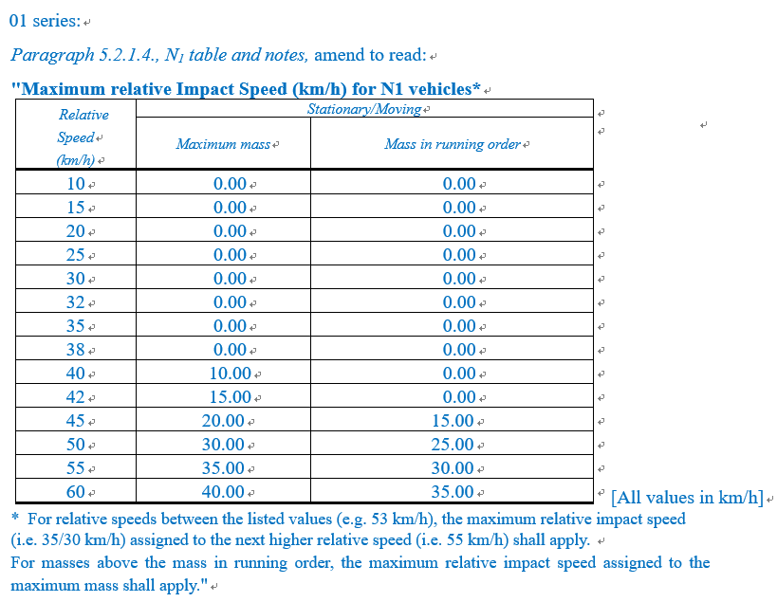
Requirement of N1 in C2C 01 series
Collision avoidance is until 38 km/h in the maximum mass condition.

Slide 3
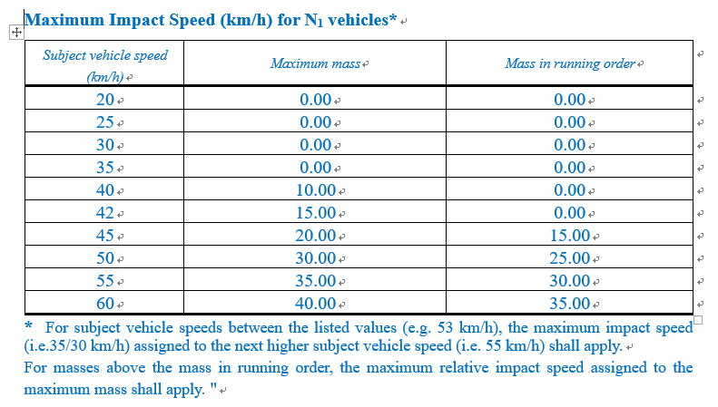
Requirement of N1 in C2P 01 series
Collision avoidance is until 35 km/h in the maximum mass condition.

Slide 4
Requirement of N1 in C2P 01 series
Fundamental parameters for requirements
Subject vehicle speed | Maximum mass | Mass in running order
20 | 0.00 | 0.00
25 | 0.00 | 0.00
30 | 0.00 | 0.00
35 | 0.00 | 0.00
38 | 0.00 | 0.00
40 | 10.00 | 0.00
42 | 15.00 | 0.00
45 | 20.00 | 15.00
50 | 30.00 | 25.00
55 | 35.00 | 30.00
60 | 40.00 | 35.00
Items | C2C | C2P as 01 series
Maximum Deceleration | 9 m/s² | 9 m/s²
TTC | 0.9 s | 0.9 s
Time to 1G | 0.73 s | 0.73 s
Fundamental parameters is same in C2C and C2P
Should we need to add a requirement of 38 km/h in C2P?

