Slide 1
Child cyclist requirement
Proposal:
No requirement now. We propose to include, when dummy charasteristics will be known by all counterparties, child cyclist requirements
VRU-Proxi-14-04

Slide 2
Problem on child cyclist dummy
No experience in industry to test with child cyclist dummy
No guarantee fulfilment of the specification of ISO by current available child dummy because of absence of “Workshop”
2/5

Slide 3
What is workshop?
Purpose: To ensure dummy (target and platform) specification and real vehicle sensing characters defined by EURO NCAP and ISO
Many stakeholders (mainly: technical service, dummy suppliers and sensor suppliers) contribute to finetuning the dummy specification to reflect real vehicle or VRU
3/5

Slide 4
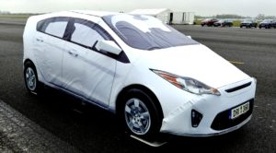
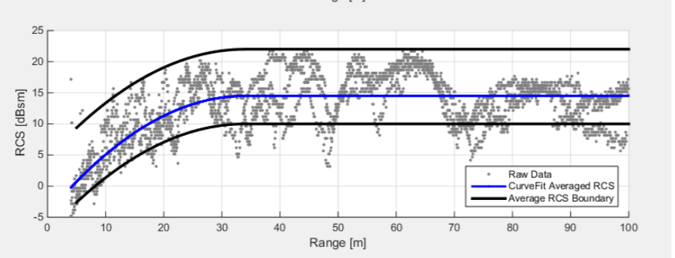
Experience on GVT
Global Vehicle Target (GVT) is representing a vehicle for automotive sensing technologies to be detected from any angle (3D vehicle dummy)
Required more than 10 workshops (more than 1 yr) to reach technically valid target designs for various sensor technologies
All angle
All Sensing characters (e.g. radar RCS)
4/5

Slide 5
Minimum forward separation plane distance
Proposal: 2.29. "Minimum forward separation plane" means the plane perpendicular to the longitudinal plane of the vehicle representing the shortest forward separation distance that the MOIS is required to detect the presence of a VRU. The distance of this plane from the vehicle front shall be 0.35m 0.8m.
Justifications:
To harmonize the values between vehicle categories, we may propose only one value
  Minimum requirement for all MOIS vehicle categories
  Compromise value that will give more flexibility on the sensor height installation according to the vehicle body

Slide 6
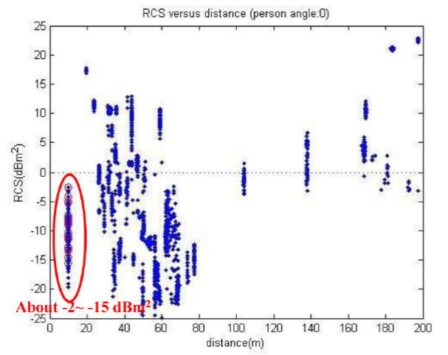
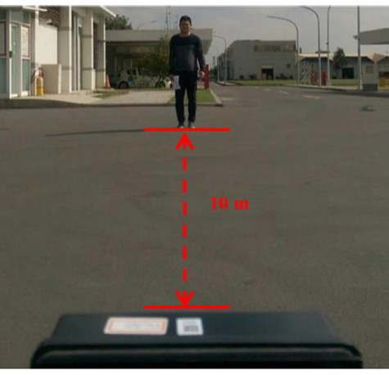
Radar - introduction
RCS: Radar cross section

Slide 7
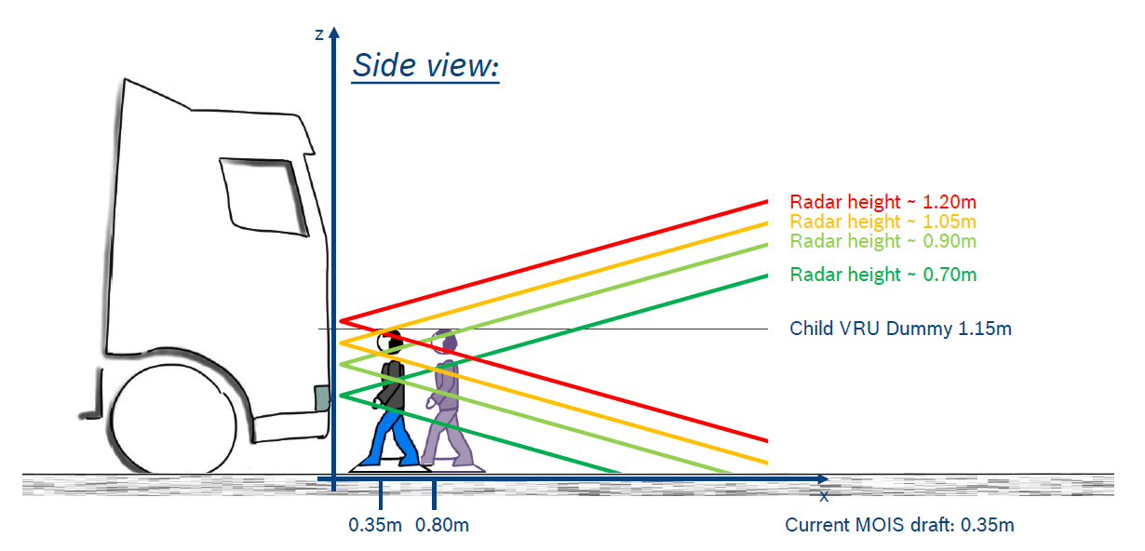
BACKGROUND
To support the MOIS discussion on the mounting issue as described in the image below, this presentation lays out:
1) The required vertical opening angle of the radar
2) The degree to which the child dummy in the opening radar cone to obtain robust detections and classifications
Objective: To devise a value laying out at which
height the sensor has to be mounted given the
limitations, as the currently used opening angles
(+/-10° elevation) do not allow such detection at
short distances, especially at high installation
positions.
2/5

Slide 8
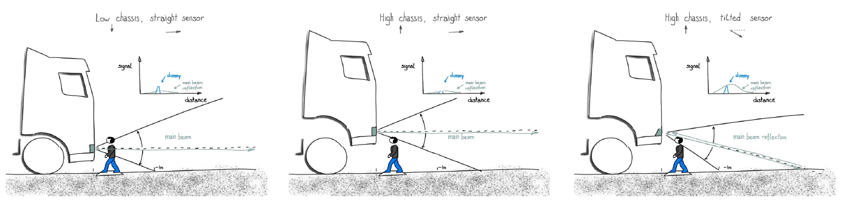
CONSTRAINTS 1
Based on theoretical assumptions there are negative implications (reflections, implausible signals,…) with tilted mounting
2. No knowledge on detection performance with tilted mounting under real life conditions (series / series development)
3/5

Slide 9
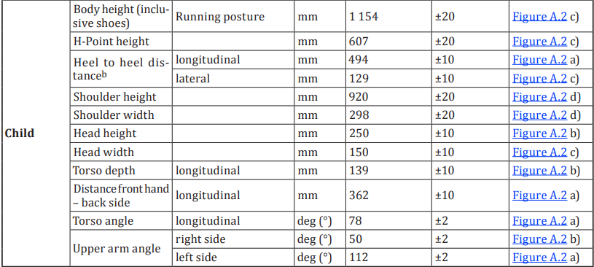
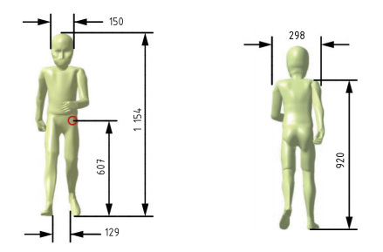
CONSTRAINTS 2
Vertical opening angle α ≈ ±10° Elevation
Distance to dummy l = 0.35m
Dummy height h = 1.154m
Body of dummy to cover whole FoV (Elevation)
RCS value mostly generated by chest of dummy
Legs of dummy helpful for doppler effect
ISO 19206-2:
Replacement diagram:
α
x
y
h
h/2
l
4/5

Slide 10
CONCLUSIONS
Proposed mounting position y for a 0.35 m min forward distance:
0.5-0.75m above ground
5/5

Slide 11
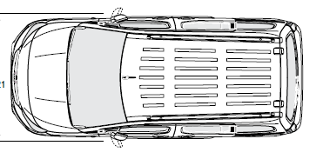
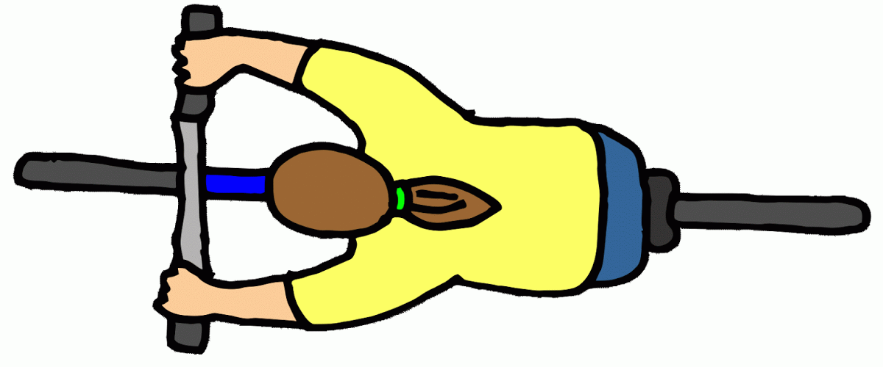
Proposal for Longitudinal Test
Information Signal
6.6. Longitudinal Stopping for Moving Off Cyclist Tests
6.6.1. The cyclist test target (T) shall be located within the test area marked out as shown in Figure 2 in Appendix 1. The cyclist test target shall be positioned at the relevant test target starting point (p_{cyc}) in Table 2 of Appendix 1 and face in the direction of travel and parallel to the longitudinal median plane of the subject vehicle. The cyclist test target reference point shall be at the most rearward point on the centreline of the bicycle.
0.5m
0.6m
0.35m
3.7m
0-10km/h
0-10km/h
0.5m
Proposal:
This cyclist is fully visible to the driver (what is the height of a child cyclist target? – supposed >90cm), so that it would be justifiable to set the reference point at where the highest point of the target is (this is presumably somewhere at the CoG of the cyclist) – otherwise we would also contradict to the Blind-Spot principle, in that we are warning/ informing about an object that is visible to the driver.
We have to keep in mind that the purpose of the regulation is to enable detection and recognition, not to automatically prevent a collision.

Slide 12
Driver eyes
Direct vision
  DVS eyes for N3 vehicles (and big N2?)
  New (to be consolidated): for M2, small N2, alternative compliance with UN-R125 (125 eyes’ points)
MOIS
  Proposal: definition of the blind zone area based on
    DVS driver eyes or
    UN-R125 driver eyes
The driver eyes shall be harmonized between direct vision and MOIS for each catgory of vehicles.
  It should not be possible to approve the direct vision of a vehicle with DVS driver eyes and the MOIS with UN-R125 driver eyes

