Slide 1

Direct Vision
Division N3 Vehicles – Follow up
VRU-Proxi 14th Session Follow-up
WebEx meeting
June 24, 2020
Acea working group truck safety
Erik Dahlberg, Director Technical Affairs, Scania
VRU-Proxi-14-16

Slide 2
Direct Vision – N3 Differentiation
At the 14th VRU-Proxi on May 24 2020, OICA presented a proposal on a division of the direct vision requirement between Urban vehicles that are more likely to run in cities and Rural that very seldomly or never enter a city
Different thresholds should apply for the different vehicle groups
The proposal is based on a few basic vehicle characteristics and leverage on a similar division done in the EU CO2 Regulations

Slide 3
Direct Vision – Differentiation Table
The following N3 vehicles are proposed in the Rural Direct Vision level
  Tractors >16 t, and
  Rigids >16 t, when
    4x2 >265 kW and sleeper cab
    6x2 and sleeper cab
    6x4, 8x2, 8x4 >370 kW and sleeper cab, and
  All wheel drive vehicles, and
  N3G
All other N3 vehicles are proposed in the Urban Direct Vision level

Slide 4
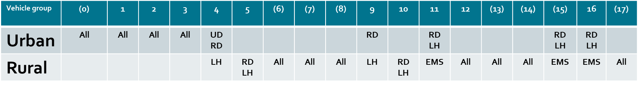
Direct Vision – Differentiation Table
Using the CO2 Regulation taxonomy:
and N3G: Rural

Slide 5
Direct Vision – N3 Differentiation
The VRU-Proxi meeting endorsed the proposal
Stakeholders asked for extra clarification on three parts of the proposal
  Is a division needed for tractors, between Urban and Rural groups (5-RD/LH,
  10-RD/LH and 12-RD/LH) or can all tractors belong to Rural as proposed?
  Is a power threshold at 265 kW for 6x2 rigids (9-LH) in Rural group needed, to sort the low-power vehicles to the Urban group instead of the Rural as proposed?
  Is the EMS power threshold at 370 kW needed to sort heavier rigids (11-EMS, 15-EMS,
  16-EMS) to the Rural group?
OICA has investigated those three areas further, using data from connected vehicles in an extended number of countries and concluded that the proposal is a good representation of reality and can be kept as proposed
  We welcome any other evidence if doubts still exist after this presentation

Slide 6
Direct Vision Differentiation
Real Driving Data

Slide 7
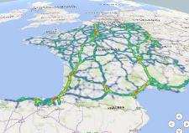
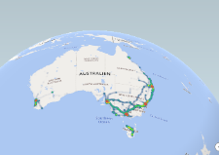
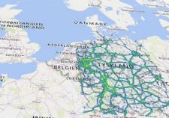
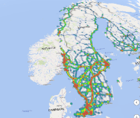
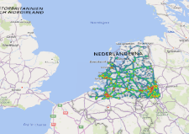
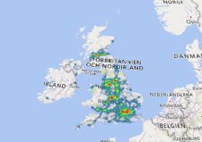
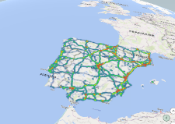
Direct Vision – Real Driving Data
Data from connected Scania vehicles manufactured in 2017 and later
Positions from 2019, full year
Connected vehicles that has produced frequent data
(i.e. not all vehicles)
UK, Germany, Netherlands, France, Sweden/Finland, Spain/Portugal, Australia
Total time spent per position
Filter possibility according to proposal on Urban and Rural

Slide 8
Direct Vision – Real Driving Data
N.B. Narrowly defined vehicle groups with relatively small sales volumes cannot always be analysed or presented in heat maps due to privacy and competition regulations
This set limitations on the analysis and presentation of the three further investigated areas

Slide 9
Clarification 1. Tractors RD/LH
Question 1: Is a division needed for tractors, between Urban and Rural groups (5-RD/LH, 10-RD/LH and 12-RD/LH) or can all tractors belong to Rural as proposed?
Sales volumes according to ACEA report on CO2 baseline estimations for Q3 and Q4 2019, indicate production:
  4x2 tractor: 5-LH to 5-RD = 79 to 1
  6x2 tractor: 10-LH to 10-RD = 97 to 1
Due to small relative sales volumes of RD tractors, comparison possibilities in heat maps are limited due to privacy and competition
The following heat maps from Spain/Portugal and from Australia are however acceptable and they show that the proposed division with is usable and do not introduce any risk volumes of vehicles

Slide 10
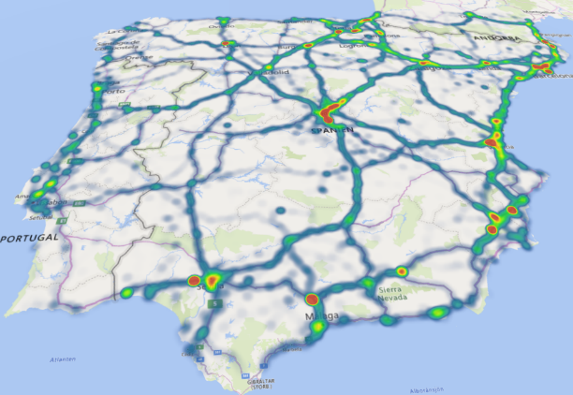
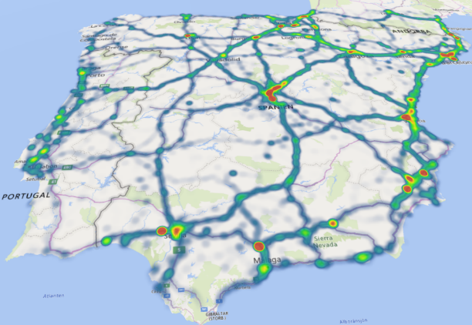
Clarification 1. Tractors RD/LH
Heat maps almost identical →RD contribution negligible
All 4x2 and 6x2 Tractors, sleeper cab
>265 kW, i.e. 5-LH and 10-LH
All 4x2 and 6x2 Tractors , i.e. 5-LH, 5-RD,
10-LH and 10-RD

Slide 11
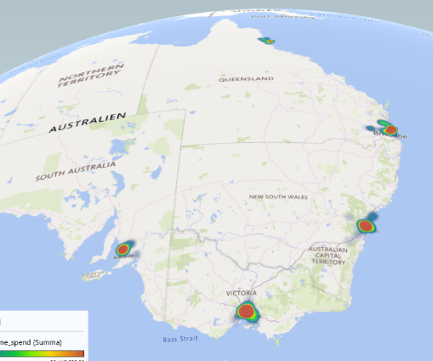
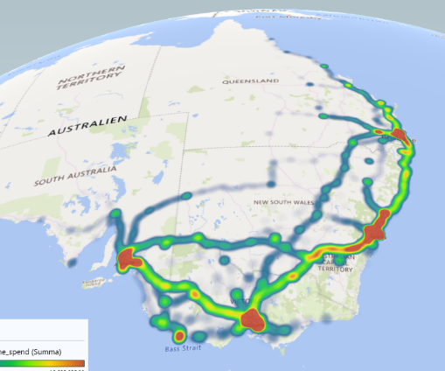
Clarification 1. Tractors RD/LH
Local traffic: RD
Highway traffic: LH
All 6x4 Tractors day cab, i.e. 12-RD
All 6x4 Tractors sleeper cab, i.e. 12-LH

Slide 12
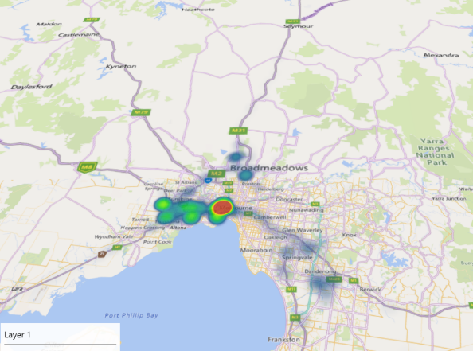
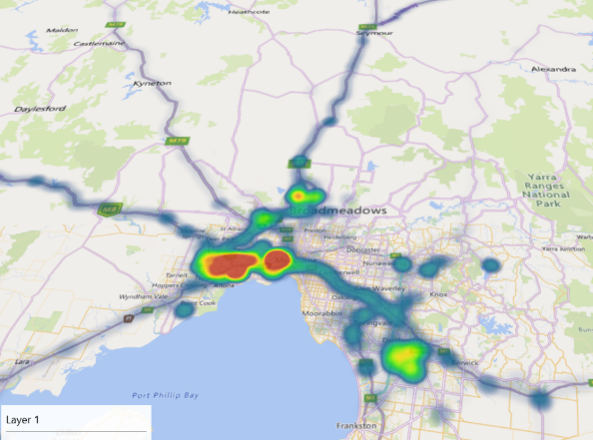
Clarification 1. Tractors RD/LH
Zoom in Melbourne
Similar driving pattern
→ no RD/LH difference
Harbour
All 6x4 Tractors day cab, i.e. 12-RD
All 6x4 Tractors sleeper cab, i.e. 12-LH

Slide 13
Clarification 2. 6x2 Rigid 265 kW
Question 2: Is a power threshold at 265 kW for 6x2 rigids (9-LH) in Rural group needed, to sort the low-power vehicles to the Urban group instead of the Rural as proposed?
In the CO2 regulations, there is no power threshold for 6x2 rigids (9-LH), since sales volumes are very small
Due to these small relative volumes, privacy and competition regulations limits our analysis possibilities
Following heat maps from UK are however acceptable and indicate that the proposed definitions are usable and do not introduce any risk volumes of vehicles

Slide 14
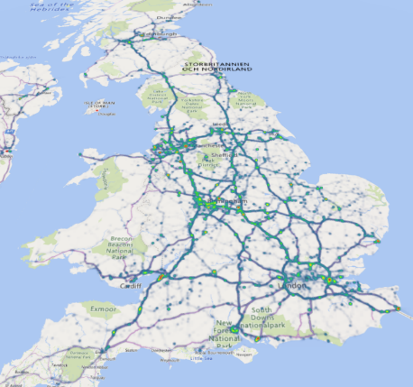
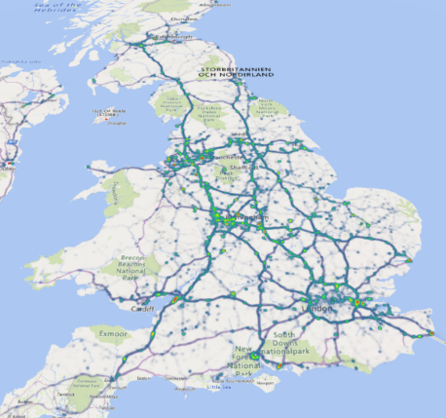
Clarification 2. 6x2 Rigid 265 kW
Heat maps almost identical
All 6x2 Rigid sleeper cab except <265 kW
All 6x2 Rigid sleeper cab, i.e. proposed group Rural (including <265 kW)

Slide 15
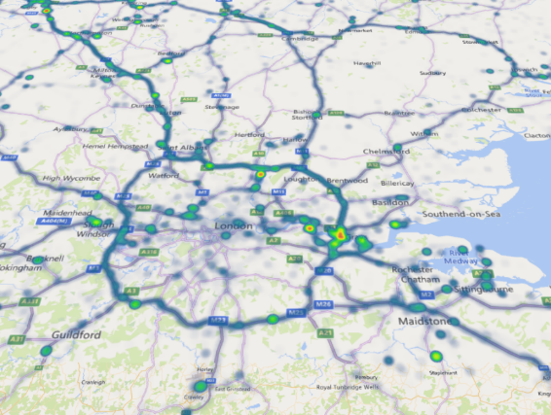
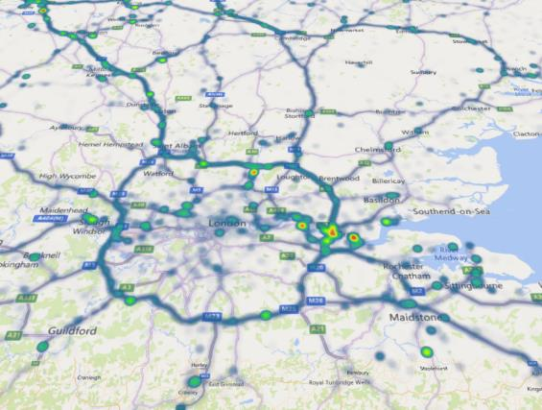
Clarification 2. 6x2 Rigid 265 kW
Zoom in London
Heat maps almost identical → <265 kW contribution negligible
All 6x2 Rigid sleeper cab except <265 kW
All 6x2 Rigid sleeper cab, i.e. proposed group Rural (including <265 kW)

Slide 16
Clarification 3. EMS 370 kW
Question 3: Is the EMS power threshold at 370 kW needed to sort heavier rigids (11-EMS, 15-EMS, 16-EMS) to the Rural group?
Not all groups and countries have been possible to compare in heat maps due to privacy and competition reasons
Following heat maps from Sweden/Finland are however acceptable and they make it evident that the proposed division is needed and do not introduce any risk volumes of vehicles

Slide 17
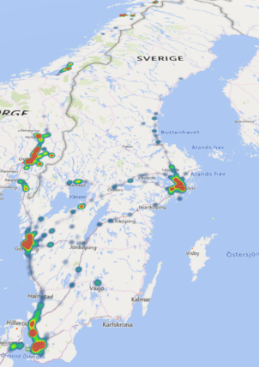
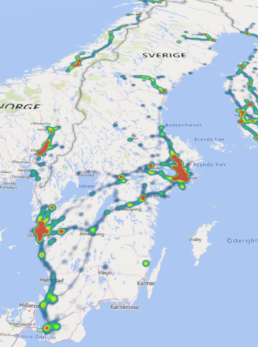
Clarification 3. EMS 370 kW
Local traffic: non-EMS
Highway or Forest: EMS
All 8x4 Rigids <370 kW or day cab,
i.e. 16-non EMS
All 8x4 Rigids >370 kW sleeper cab,
i.e. 16-EMS

Slide 18
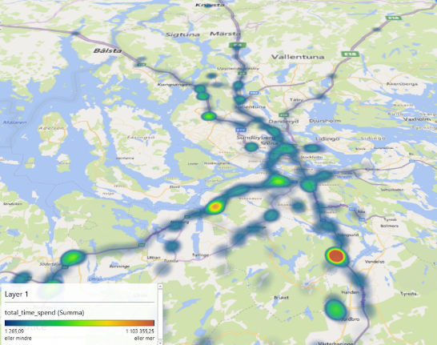
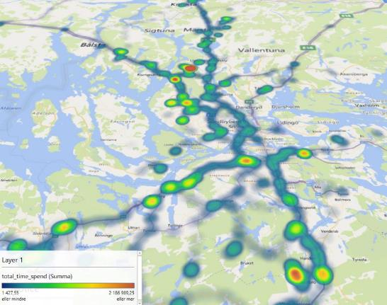
Clarification 3. EMS 370 kW
Zoom in Stockholm
EMS-vehicles on highways and ring roads → EMS valid
All 8x4 Rigids <370 kW or day cab,
i.e. 16-non EMS
All 8x4 Rigids >370 kW sleeper cab,
i.e. 16-EMS

Slide 19
Direct Vision Differentiation
Conclusions on Follow-up

Slide 20
Direct Vision Division – Conclusions
Further analysis of the direct vision division of N3 vehicles has shown that the ACEA/OICA proposal from last VRU-Proxi meeting is valid
  No division needed for tractors (5-RD/LH, 10-RD/LH and 12-RD/LH)
  No 265 kW threshold needed for 6x2 rigids (9-LH)
  The EMS 370 kW power threshold for heavier rigids (11-, 15-, 16-EMS/non-EMS)
  is evident , therefore needed
N.B. Other categories of vehicles than N3 should be considered separately

