Slide 1

Ministry for Sustainable Development and Tourism
Montenegro
The basic principle of the Spatial Plan of Montenegro
is sustainable development which implies the consideration of
environmental protection, economic development and social needs

Slide 2
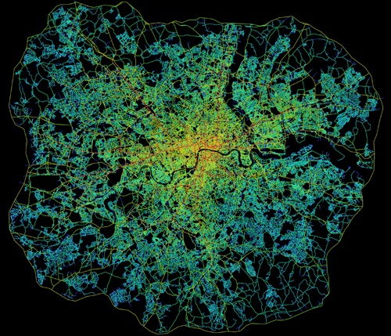
LEGISLATION and ACTION PLAN
ON REGULARIZATION OF UNAUTHORISED BUILDINGS

Slide 3
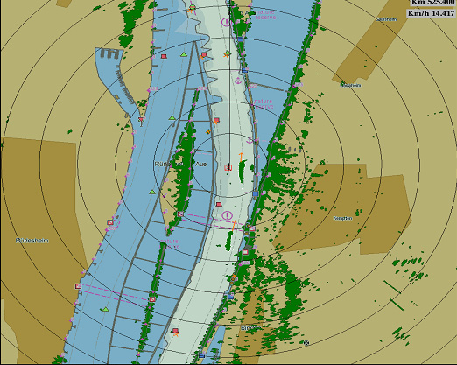
CAUSES OF INFORMAL CONSTRUCTION
The emergence of informal building phenomenon is, by all social classes, commonly associated with the (lack of) work and (in) sufficient activity of building inspections and usually inspections are primary declared responsible for this state which is actually caused by many reasons.
We can indentify following causes of illegal construction:
  social
  commercial
  professional
  administrative and legal
The problem of informal construction have rarely been considered outside of the spatial planning and construction legal framework, and such long term limited approach resulted in reducing the value of space, negative attitude of builders to legal instruments, social life between regulated urban and unregulated suburban areas, and the reduced value of commercial and infrastructure investment.

Slide 4

Problems
SEISMIC RISK
PLANNING-URBAN DISORGANIZATION OF SPACE
INSUFFICIENT INFRASTRUCTURAL EQUIPPING OF SPACE
LOWER QUALITY OF LIFE
INEXISTENCE OF ADEQUATE SOCIAL OR PUBLIC INSTITUTIONS
VIOLATION OF ECOLOGICAL STANDARDS and RISK TO HUMAN HEALTH
COLLECTION OF COMMUNAL and TAX OBLIGATIONS

Slide 5
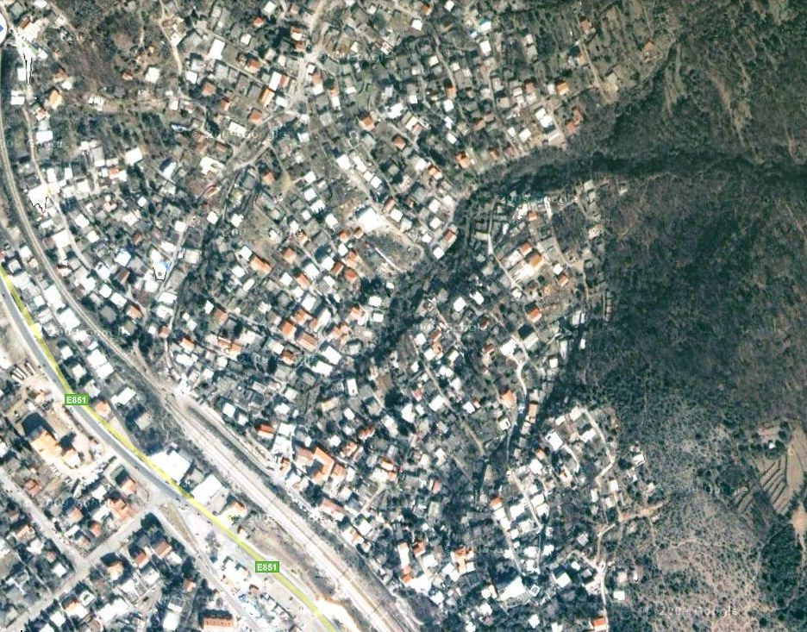

Slide 6
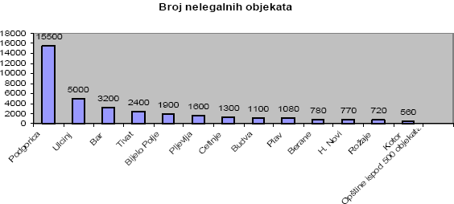
PHYSICAL INDICATORS
According to data of Real Estate Administration, on the territory of Montenegro there is around 40.000 illegal objects, and most of them are in Podgorica - 16.430 .
However, the number of informal structures is significantly higher compared to the data given by the Real Estate Administration, especially if one takes into account the fact that a significant number of informal structures is not registered.
Local governments haven’t conducted the inventory of informal objects even if they were obligated by previous legal decisions.

Slide 7
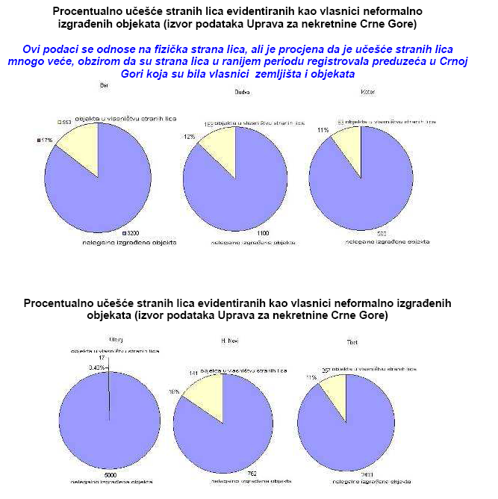
Percentage of foreigners that are owners of unauthorized objects
It has been estimated that the number of objects is much higher than it is recorded in the REA

Slide 8
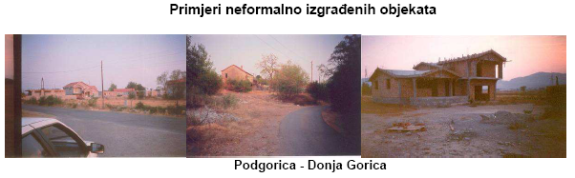
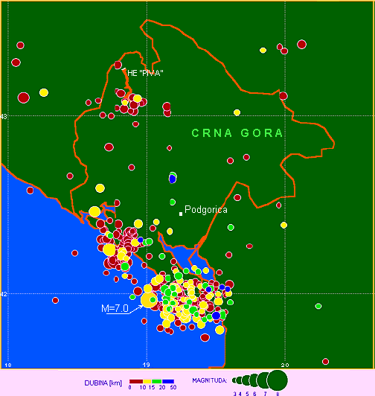
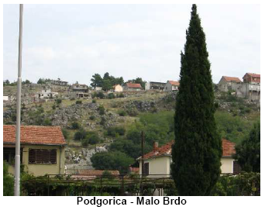
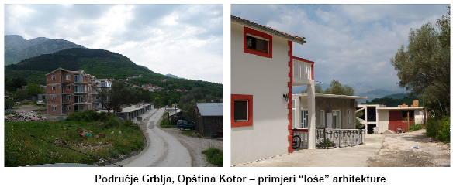
Examples of illegal settlements

Slide 9
Chronology of events and project status – Jun 2012
Pilot Project (Bar) - In order to implement the conclusions of First Government Session, pilot project was initiated (Municipality of Bar), and it considers drafting the Plan for illegal settlement "Pobrdje-Rutke" in accordance with the principles and documentation prepared
Akcion Plan for transformation of informal settlements into formal and regularization of illegal objects was adopted by the Government of Montenegro on 30 June 2011
Legislative solution - On March 15, 2012 the Government of Montenegro has approved the Draft Law on Legalization of informal settlements with Proposal for public hearings, which was submitted by the Ministry of Sustainable Development and Tourism. Law proposal was confirmed on July 19 at the Government Session, after which it was submitted to the Parliament for adoption.
Bylaws are in preparation and will be adopted in accordance with the terms stipulated by Draft Law.
Media campaign is being prepared and it will follow the implementation of the Project for legalization

Slide 10
INSTITUTIONAL COOPERATION
Government of Montenegro
Ministry of Finance
Ministry of Sustainable Development and Tourism
Local
Self-Governments
Real Estate Administration
Local Communal Service Companies
Regional offices of the Real Estate Administration
Implementation Unit

Slide 11
ACTION PLAN

Slide 12
THE PREPARATORY PHASE
The preparatory phase including the design of database
Development and adoption of the Draft Law on Legalization of objects
Communication with local governments and competent authorities on the implementation of Law and establishment of implementation units in municipalities
Determining the real situation on data in municipalities by ortho-photo overlay
Creating a database of informal objects
Communication of the Ministry of Finance and MSDT with financial institutions to provide funds for the project implementation
Promoting the goals of law
The implementation of the communication strategy

Slide 13
THE IMPLEMENTATION PHASE
Defining the process of regularization procedures and communication with
the public
Enabling the process of submitting the application for regularization (9 months)
Creating 3D views of objects with overdue in dimensions and number of floors
Creating a database of objects that exceed the dimensions and number of floors
Implementation of pilot projects (Bar, Zabljak and Bijelo Polje)
Implementation of tax policy measures

Slide 14
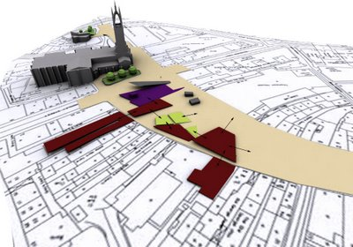
PILOT PROJECT
’’ Informal settlements improvement Pobrđe – Rutke’’
One of the grounds for the adoption of the Plan was the Pilot Project, from July 2011, by renowned author IIBW (Canada) and Housing Ltd (Austria). This study is a result of author’s understanding of the informal settlements development models in Montenegro, as well as pragmatic approaches to the design of their economic, social and spatial integration.
The study will be used by the author the planning document, which was chosen by the local government for the development of DUP "Bjelila-Rutke-Gorelac". Over 5,000 facilities will be treated as a part of the plan in locations that are conditioned by geographical and social boundaries.
Current Project status:
  Preliminary draft of DUP "Bjelila-Rutke-Gorelac ‘ has passed a public hearing, which was organized by the Municipality of Bar although it was not legally obliged
  Adoption of the draft by the competent Ministry is expected after the public hearings (it is estimated that 1/3 of illegal buildings are owned by foreigners)

Slide 15
LEGISLATION

Slide 16
  Definition of unauthorized object – residential building and business premises i.e. parts of the already existing object where construction work has been carried out on at least one floor without a building permit or in contravention of the building permit
  The buildings of primary residence - Unauthorized buildings of primary residence are a residential buildings where the gross construction area is not more than 250 m2 and the owner of the illegal object have a residence and lives with the members of his household, if the owner and members of his household do not own a second home in Montenegro, i.e. housing unit on the territory of Montenegro
  This law is not applicable to objects:
    In the coastal zone;
    In the area of ​​national park
    In the road protection zone
    In the railway protection zone and aero port zone
    In the zone of protection of cultural resources;
    In the zone of protection of natural resources
    In the zone of protection of electro energy facilities
    on soil water and protection zones of water source

Slide 17
    In the forest park areas, protected forests, green areas
    On the landslide and exploitation area
    At the distance less than 400 m from the military objects that are intended for explosives and ammunition disposal
    At the site designated by a planning document for the infrastructure constructions and other facilities of public i.e. general interest
  Property rights - Legalization of informal building that was built on privately owned land or property rights are utilized by the state or local governments, can be performed after the resolution of property rights with the owner or with the party who is exercising property rights over land
  The responsible authority is obliged to carry out an overlapping of orthophoto images of the territory of Montenegro with the existing digital layers and planning documents, and to make data available for local governments and the Ministry within eight days from the date of entry into force of this Act
  Records – Informal objects are identified according to orto photo image made from September 21, 2010 to April 21, 2011
  Technical documentation- Owners of the objects in size of 500 m2 and more are obliged to submit to the local government technical documentation required by law, which is defined differently depending on the square meters of an object

Slide 18
  Compensation for municipal equipping of the construction land with informal structures will be charged and paid in accordance with local government regulations that determines conditions, method, deadlines and procedure payment for utility furnishing in 240 or 120 monthly installments
  The compensation amount for the informal structures (except for residential buildings, primary objects) is 5% of the determined amount paid for utility equipment
  Examination of static and seismic stability of unauthorized buildings may perform a company, legal person or entrepreneur who meets the requirements for the preparation of technical documentation i.e. for construction determined by building regulations
  Local Government or Ministry without delay submit the final conclusion upon rejection of the legalization application to the Inspection for Environmental Protection, which is responsible for the removal of the informal structure or its part.
  Alternative accomodation – in accordance with the obligations deriving from the Vienna Declaration, in the case of object demolition that has been used as a primary residence, local government is obliged to provide the owner with alternative accommodation appropriate to the number of members of the household

Slide 19
Public informing
  Via website of the Ministry of Sustainable Development and Tourism and e-government portal;
  By publishing of the public hearing programme in three daily newspapers;
  By organization of 13 public hearings in Ulcinj (30 participants), Bar (27), Kotor for municipality of Kotor and Herceg Novi (45), Budva for municipality of Budva and Tivat (50), Cetinje (20), Niksic for municipality of Niksic and Pluzine (10), Zabljak for municipality of Zabljak and Savnik (30), Kolasin for municipality of Kolasin and Mojkovac (20), Berane for municipality of Berane and Rozaje (35), Plav for municipality of Plav and Andrijevica (20), Bijelo Polje (40), Pljevlja (35) and Podgorica (50).
  By organizing a roundtable with experts in Podgorica
All discussions attended over 400 participants, and 25 opinions, comments and suggestions were submitted to the ministry

Slide 20
FINANCIAL SUPPORT TO REGULARIZATION OF INFORMAL STRUCTURES
Following the development of planning documents and implementation of adequate political mechanisms, the main goal is to create an efficient system that would stimulate the property owners to join the regularization and make all required payments
Conveniente for citizents and in the same time
Efficient enough for local government

Slide 21
Possibilities and opportunities for new employments
Legal decisions will directly affect all illegal builders and indirectly will make influence on local governments and the state who will be responsible for implementation of the procedures of legalization. The positive effect will be budgets income of local governments and the state, and the launching of new economic activity in the construction sector, which will be reflected in the overall economy of Montenegro
Positive consequences of adopting regulations fully justify the related costs because it will create a financial structure which provides that citizens who had not paid the legal obligations when building their informal structures do so, and thus invest in better equipment of communal space, raise the value of their buildings and also contribute to the strengthening of local government budgets

Slide 22
FINANCIAL PARAMETERS AND REVENUE TO BE REALIZED
It is estimated that the local governments revenue from the collection of utility fees will be several houndred milion of euros.
In addition, once legalized these facilities will be in the system and thus required to a payment of taxes on real estate which will further contribute to maximizing annual income.

Slide 23
Necessary preconditions
Qualitative analysis of the situation
Applicable legislation
Providing favorable funding to support the process of legalization
Political support at the highest level
Synergy among state institutions involved in the implementation
Media campaign that will introduce illegal builders with the process of legalization, as well as the rights and obligations
Raising awareness on compliance with legal provisions and respect for the environment
The legalization of informal structures is highly interactive process, where almost all bearers the Montenegrin development will participate, from the state and local self-governance to the banking and construction sector. In same time it will create exceptional opportunities for business development and employment.

Slide 24
Problems / risks
lack of staff and resources for quality process of legalization
indifference of unauthorised builders to enter into the process
it is evident that the difficult economic situation may affect the payment of the duties prescribed by law
there is a risk of state institutions inefficiency during the project realization
lack of credit lines to support the process of legalization
Holders of activities
Local government institutions
Real Estate Administration
Ministry of Sustainable Development and Tourism
Ministry of Finance
Ministry of Economy

Slide 25
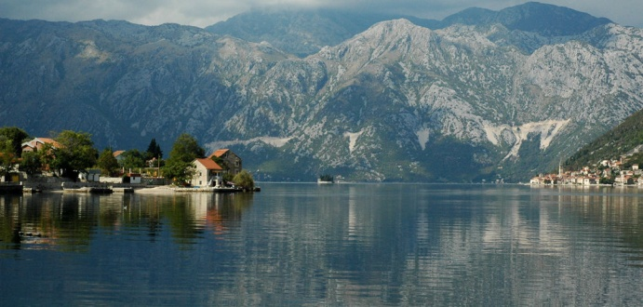
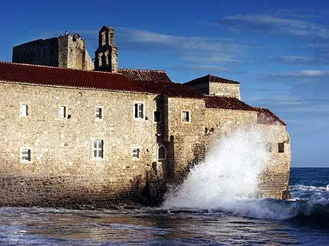
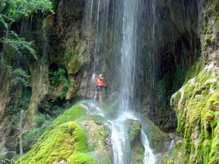
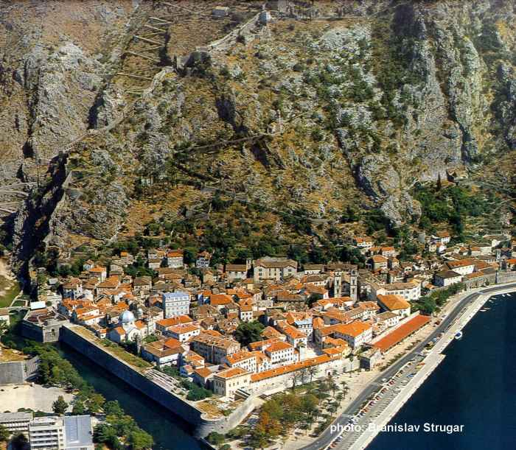
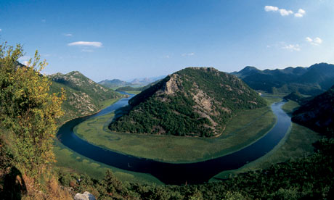
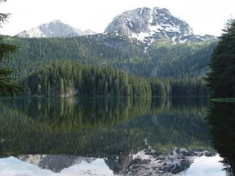
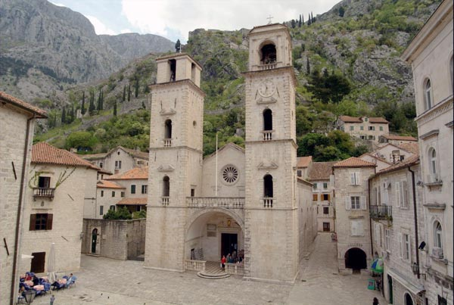
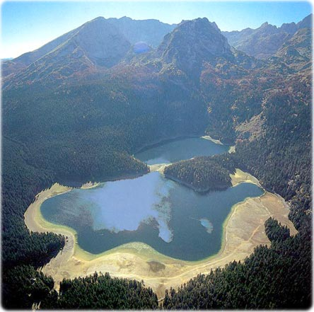
Montenegro

