Slide 1



GSR TPMS Testing
13-20 July 2020
19 August 2020

Slide 2
Open questions for defining the test procedure
Can several large tyres be deflated in a reasonable time period ?
What is a reasonable time period ?
How long does it take to stabilise at Pwarm ?
What is the effect of loading ?
Can the proposed test procedures be carried out repeatably, reliably, practically ?
Any other lessons ?

Slide 3
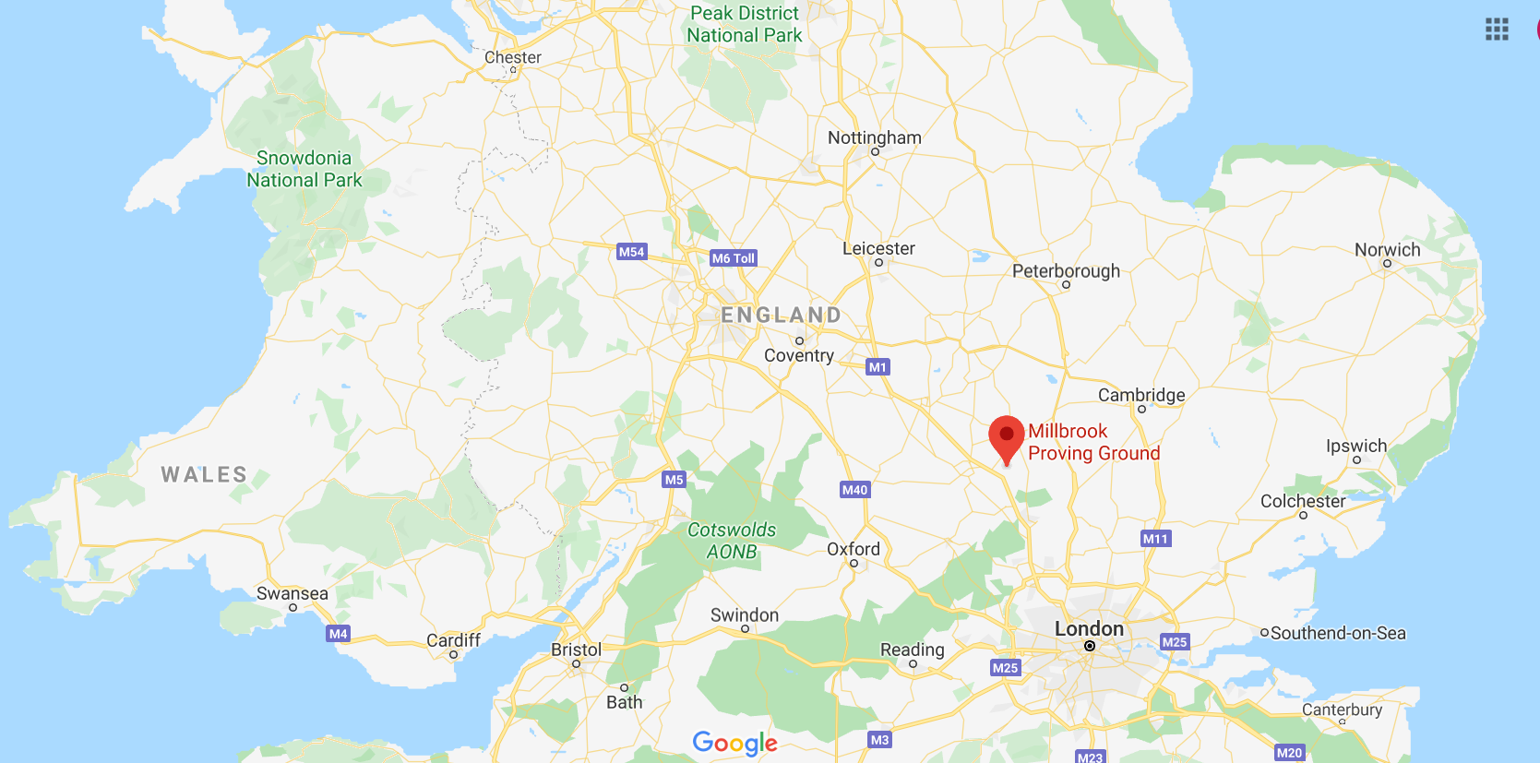
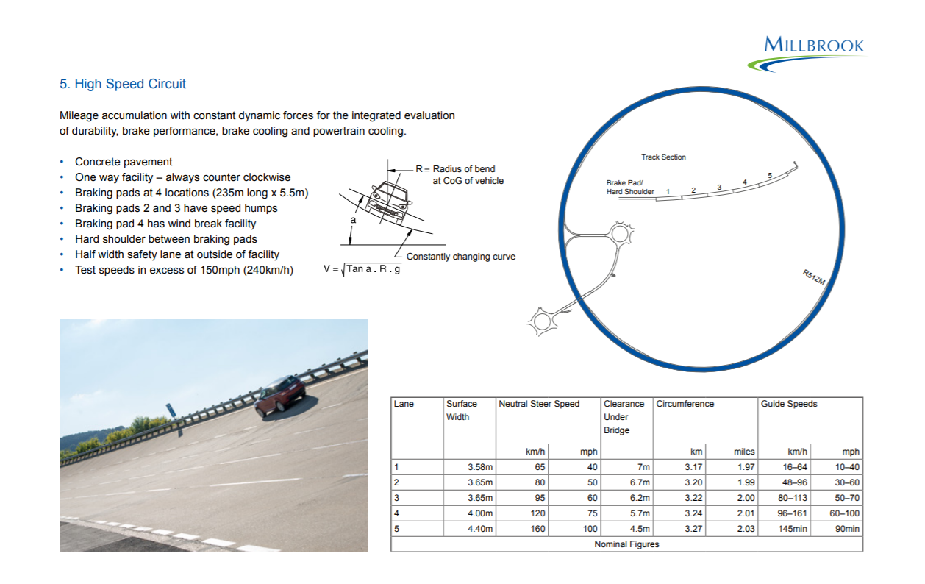
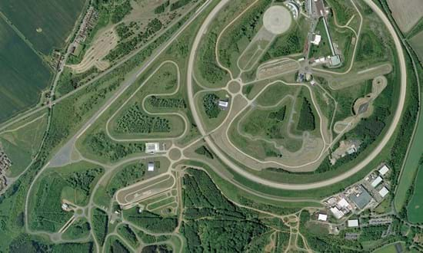
Test location and vehicles
Leading independent test facility in UK - Millbrook
Used by major vehicle manufacturers
Track used – 3.2 km circumference banked track
Lane 2 – neutral steer speed 80 kph

Slide 4
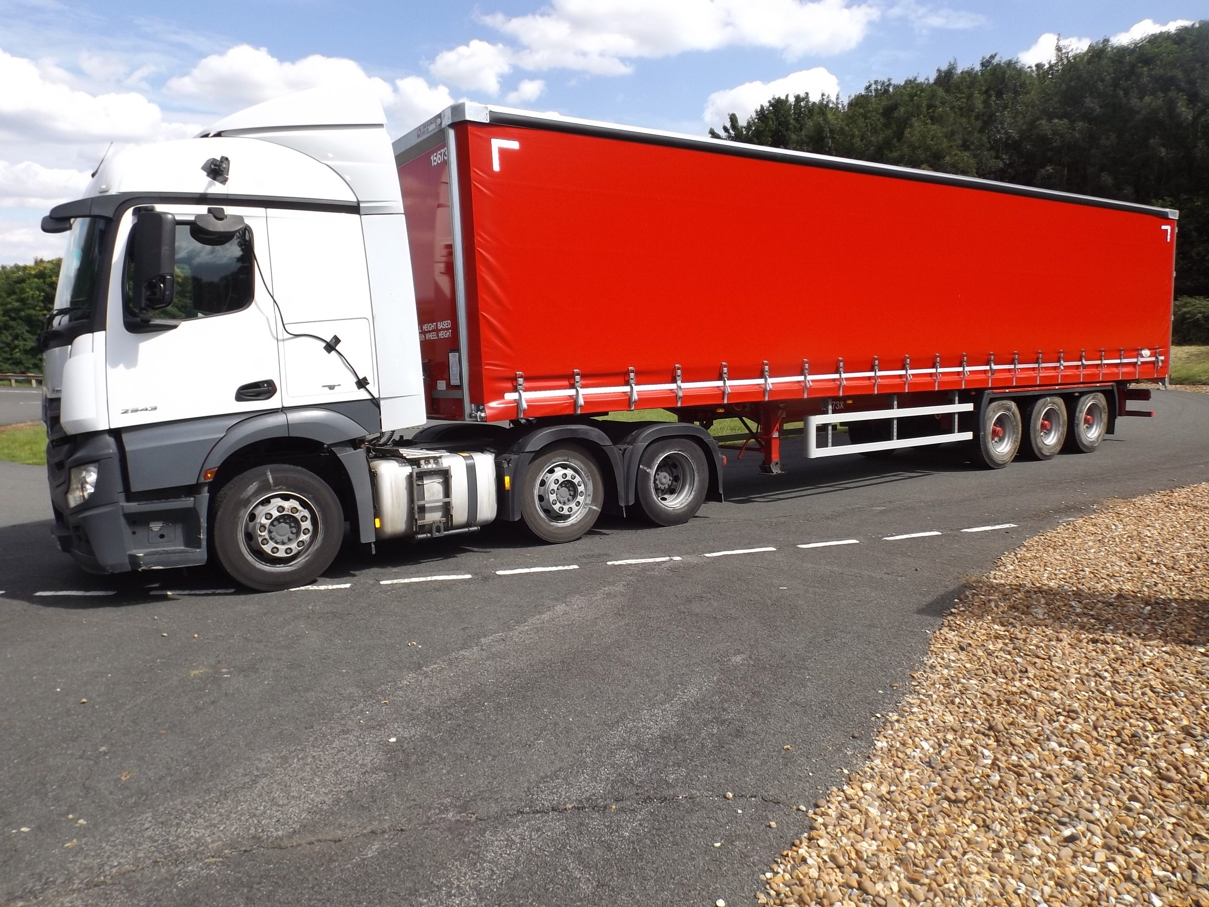
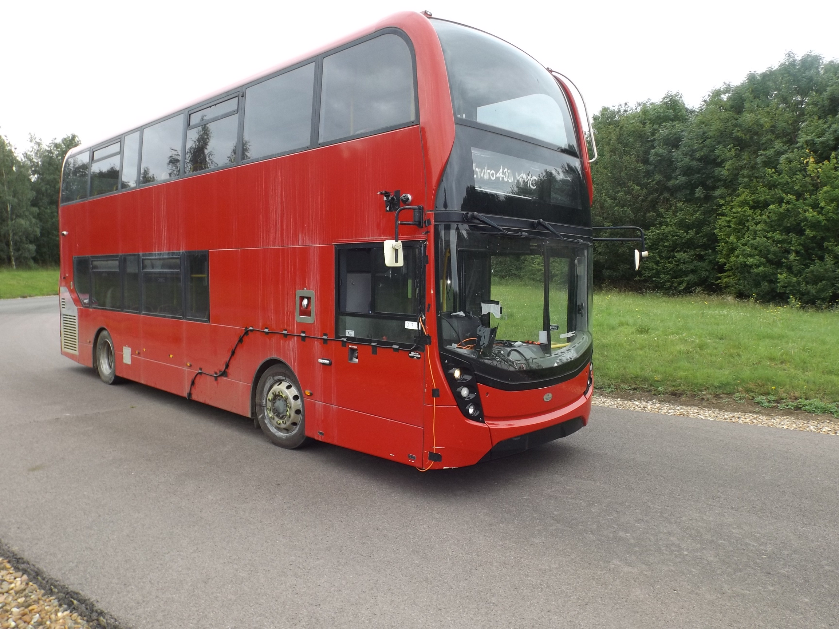
Test location and vehicles
Mercedes Actros tractor unit
3 axle – steer + drive twin + lift
315/70 R22.5 tyres – 5 brands
Lawrence David trailer
3 axle
Bridgestone 385/65 R22.5 tyres
ADL E400 bus
4x2 axle configuration
Michelin 275/70 R22.5 tyres

Slide 5
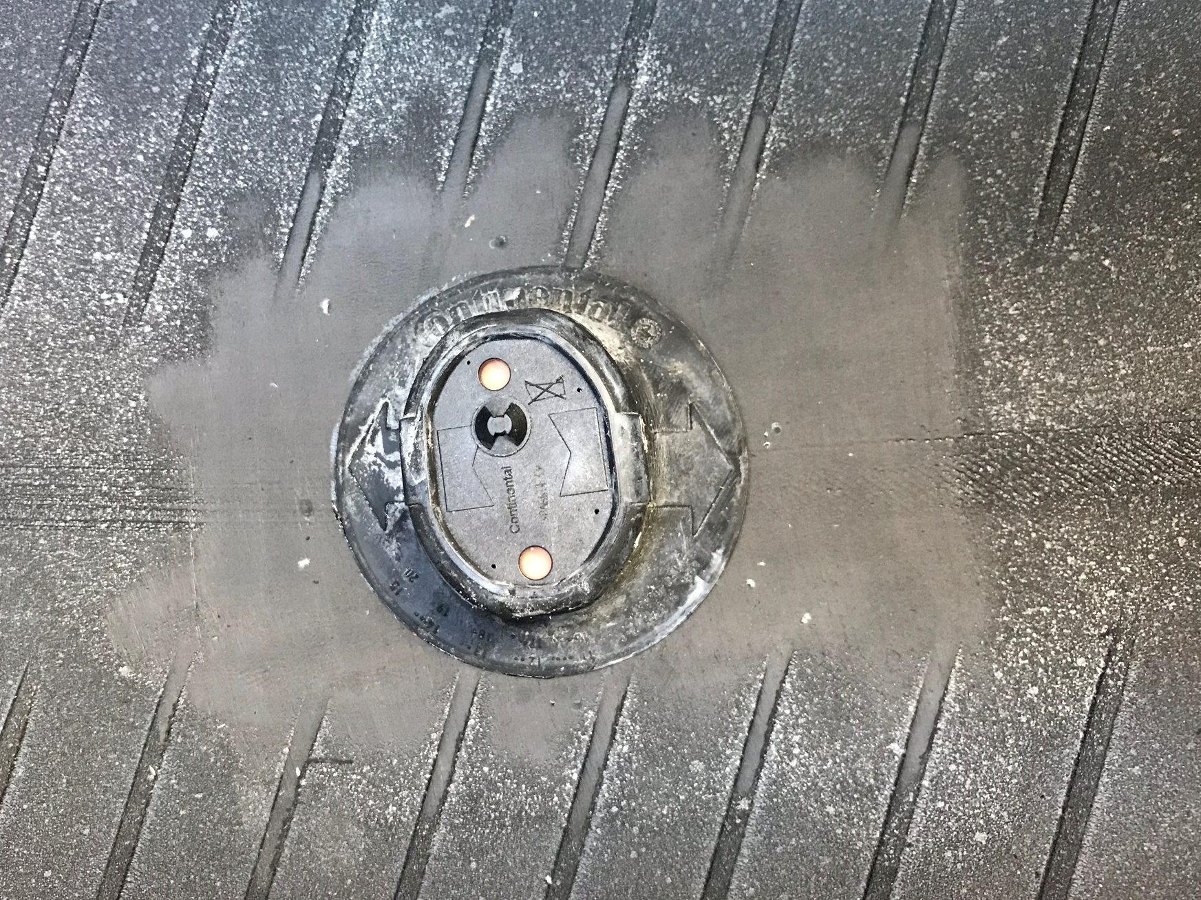
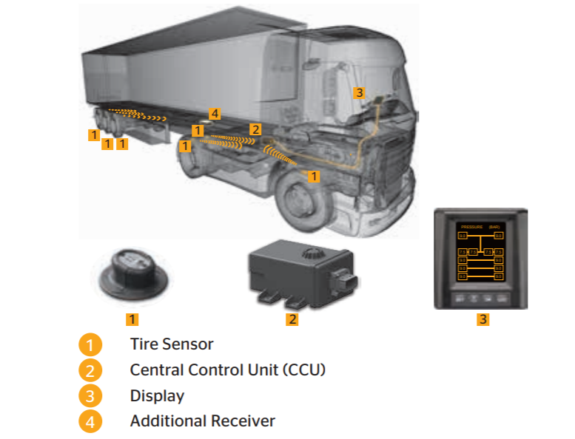
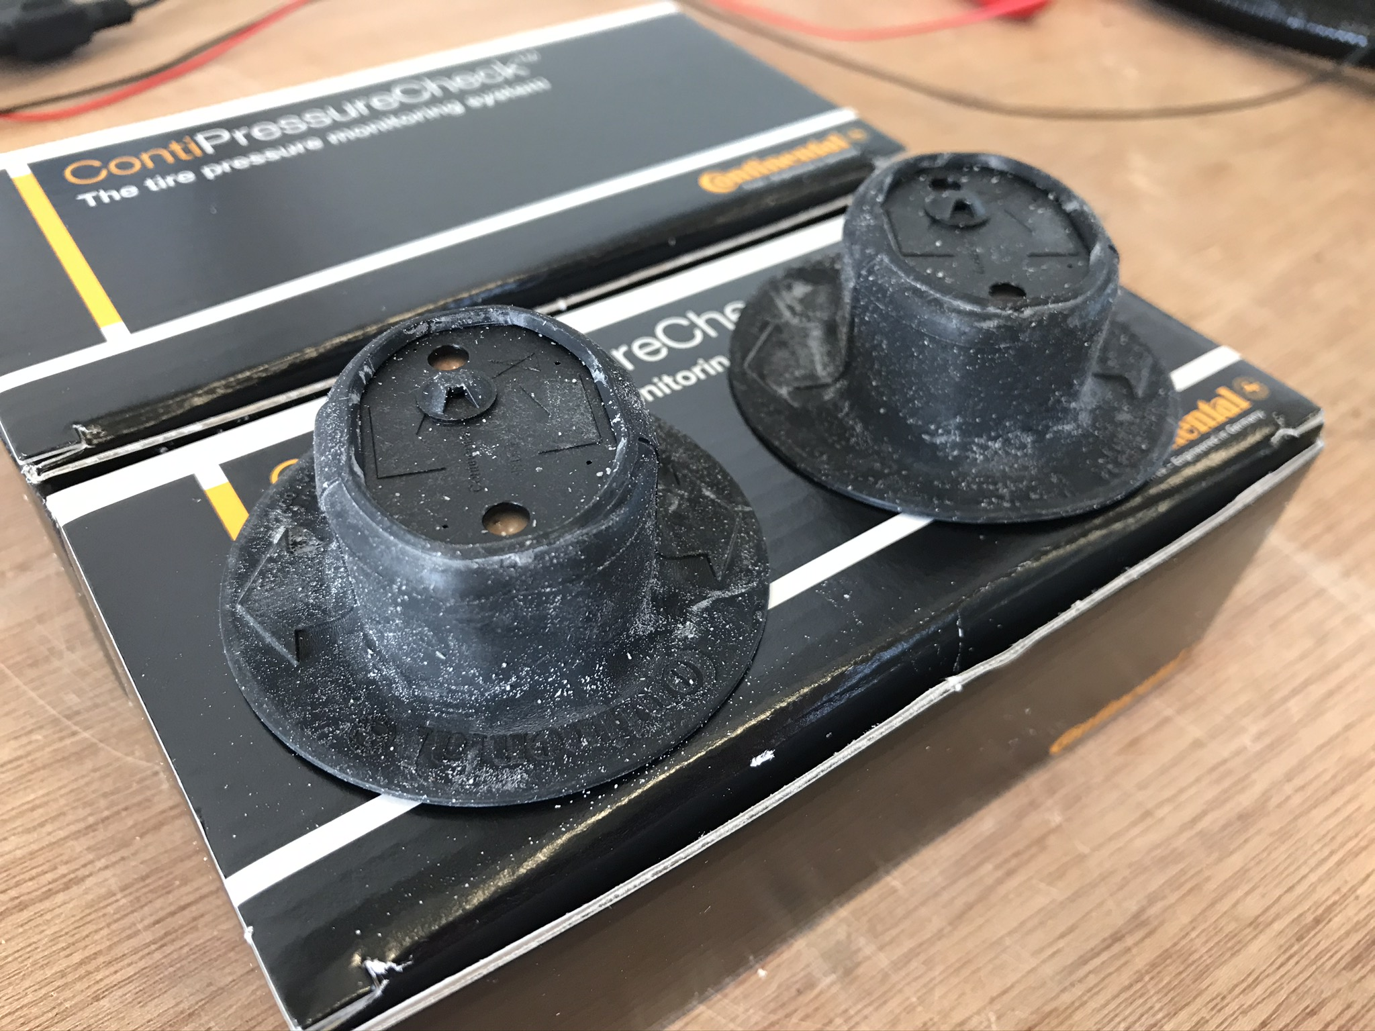
TPMS used – Conti Pressure Check
Includes temperature measurement

Slide 6
Test programme

Slide 7
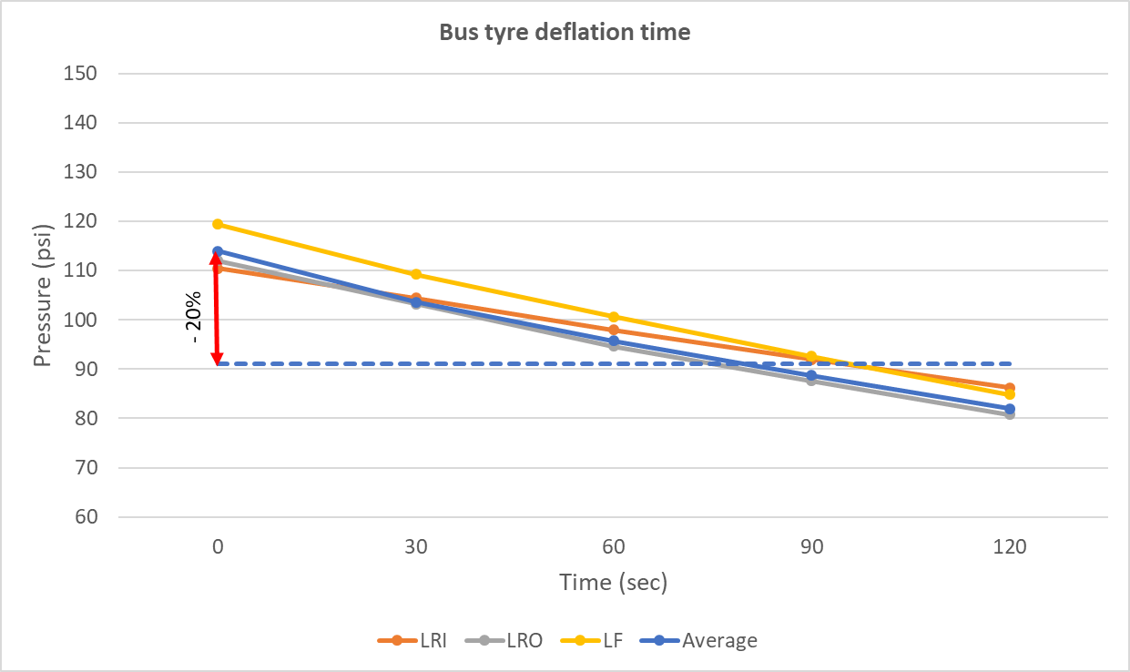
Tyre deflation – how long does it take ?
Initial test with bus:
To reduce by 20% ≈ 80 seconds
Deflation times for -20% were measured in the diffusion tests:
Bus:
6 tyres / 2 people = 10:53 mins
Truck:
8 tyres / 2 people = 13:48 mins
3.5 mins / tyre / person
Additional people were needed for timing and recording
(For reference: 1 psi = 69 mBar)

Slide 8
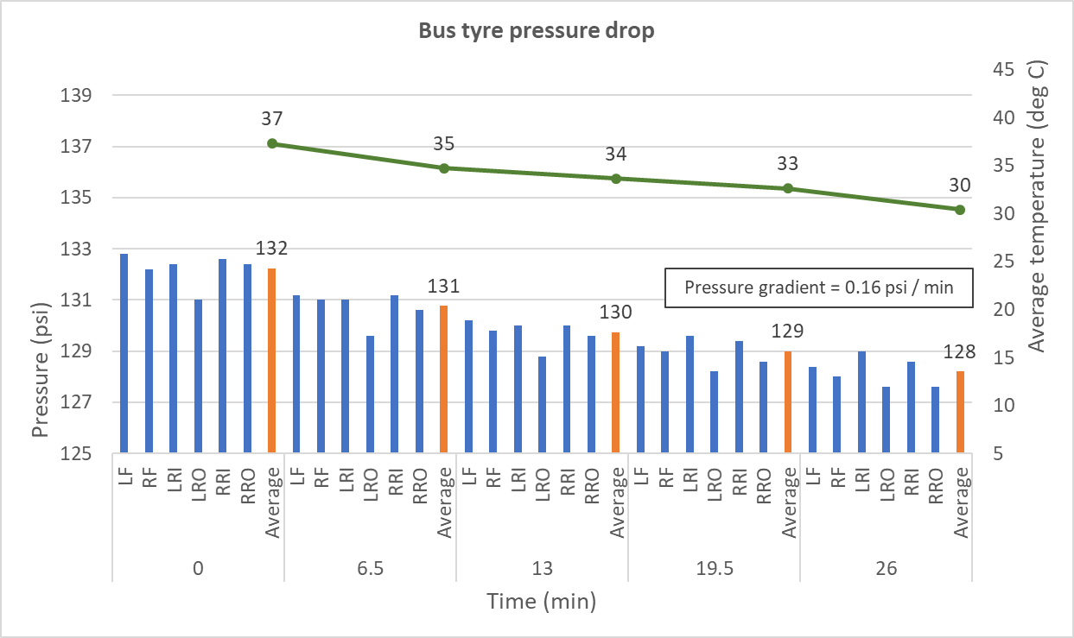
Tyre deflation – temperature / pressure effects with time
Bus cooling test
Reduction of 4 psi (0.28 Bar)
average in 26 mins
0.16 psi (11 mBar) / min

Slide 9
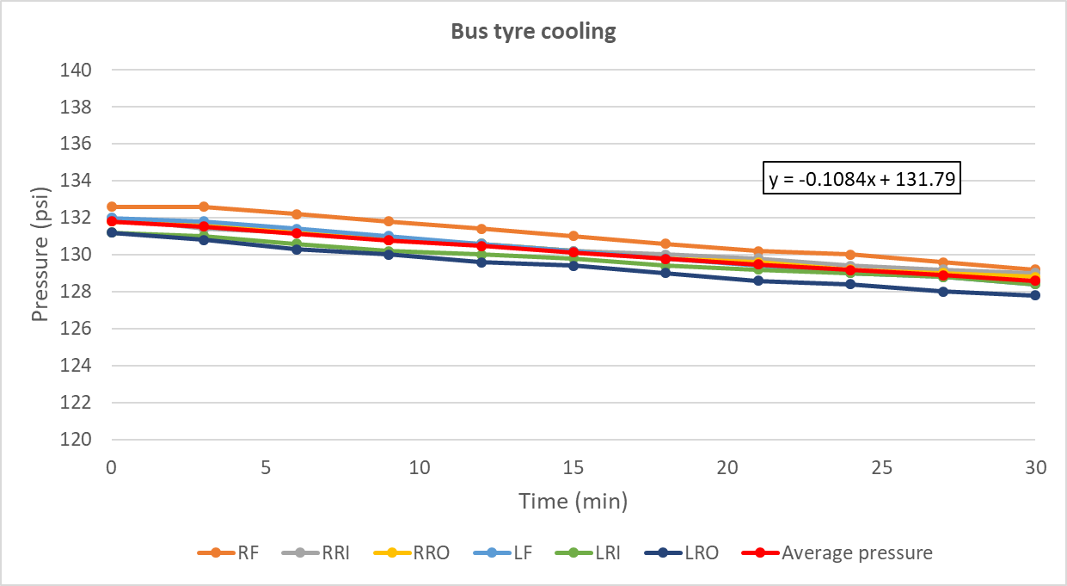
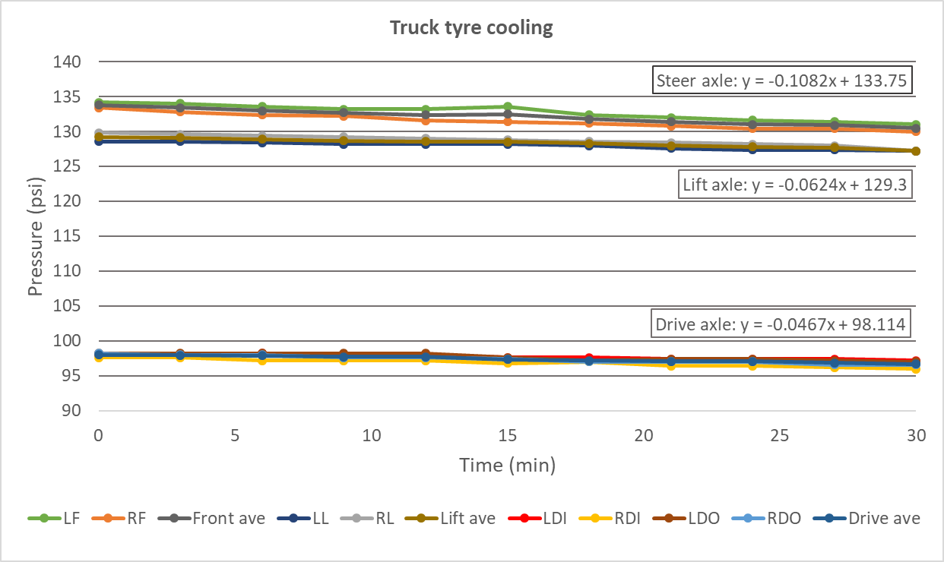
Tyre deflation – temperature / pressure effects with time
Bus:
Reduction of 3 psi
average in 30 mins
= 0.11 psi / min
Bus and truck cooling
Truck:
Reductions of 1.1 – 2.9 psi
= 0.05 – 0.11 psi / min
= 0.6 – 1.1 % in 15 min

Slide 10
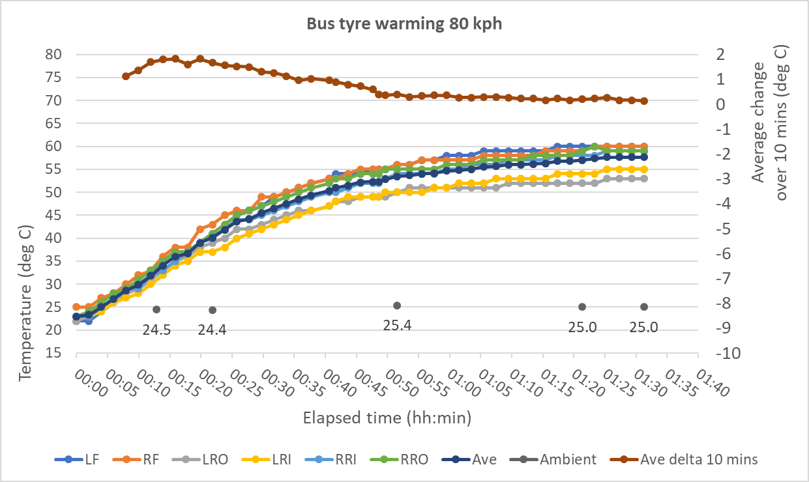
Tyre warming
Bus puncture test
Temperatures stabilise after
∼ 1.25 hour

Slide 11
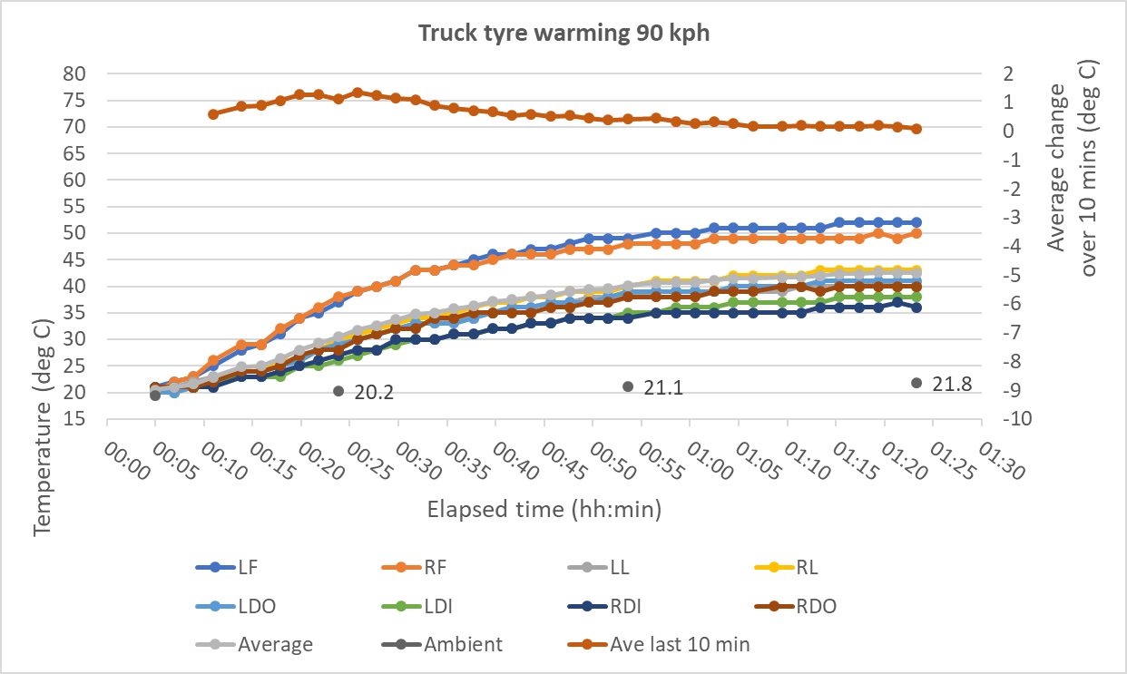
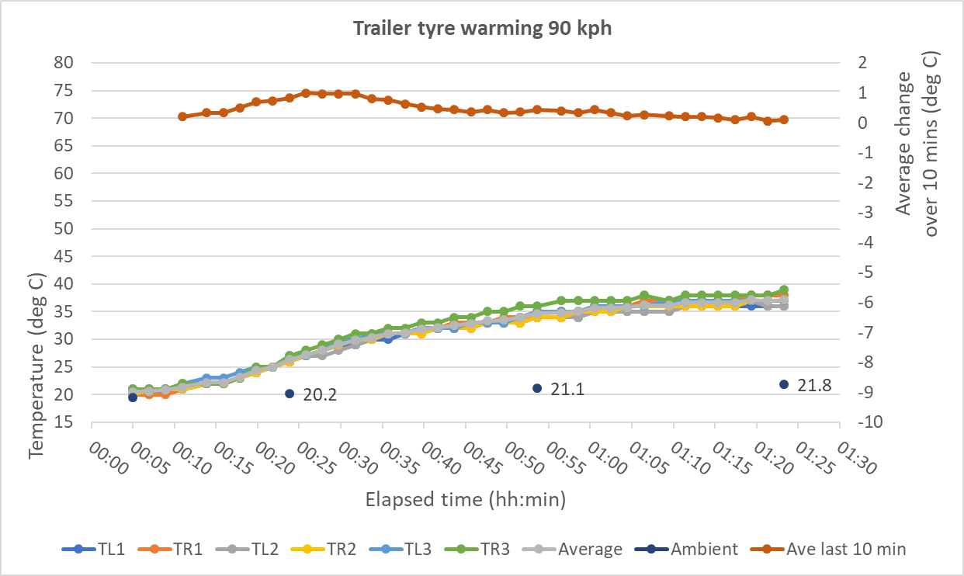
Tyre warming
Truck and trailer diffusion test
Temperatures stabilise after ∼ 1 hour

Slide 12
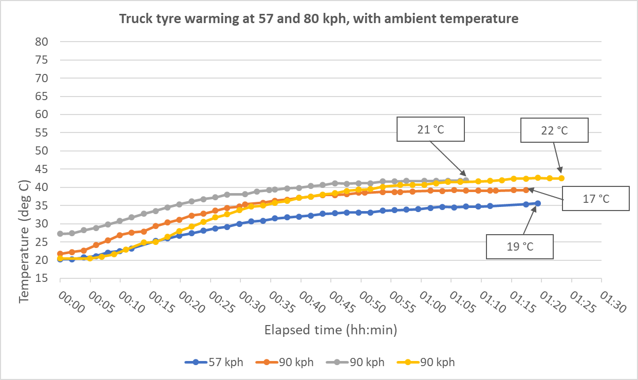
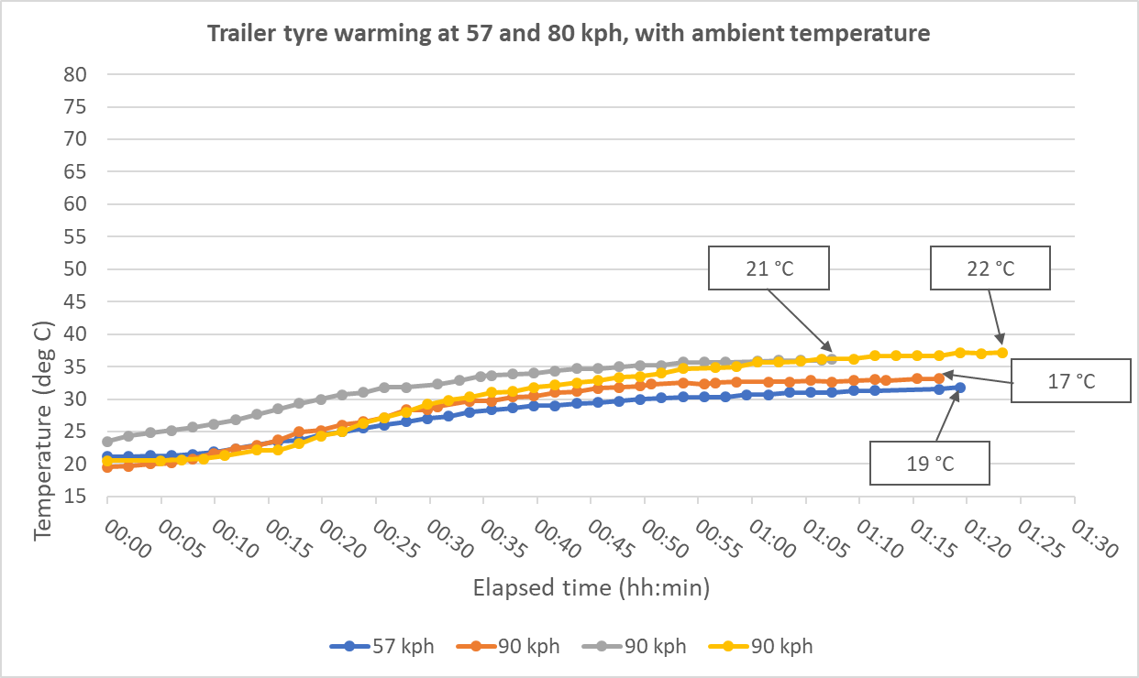
Tyre warming
Truck tests compared:
Temperatures stabilise after ∼ 1 hour
at higher speed

Slide 13
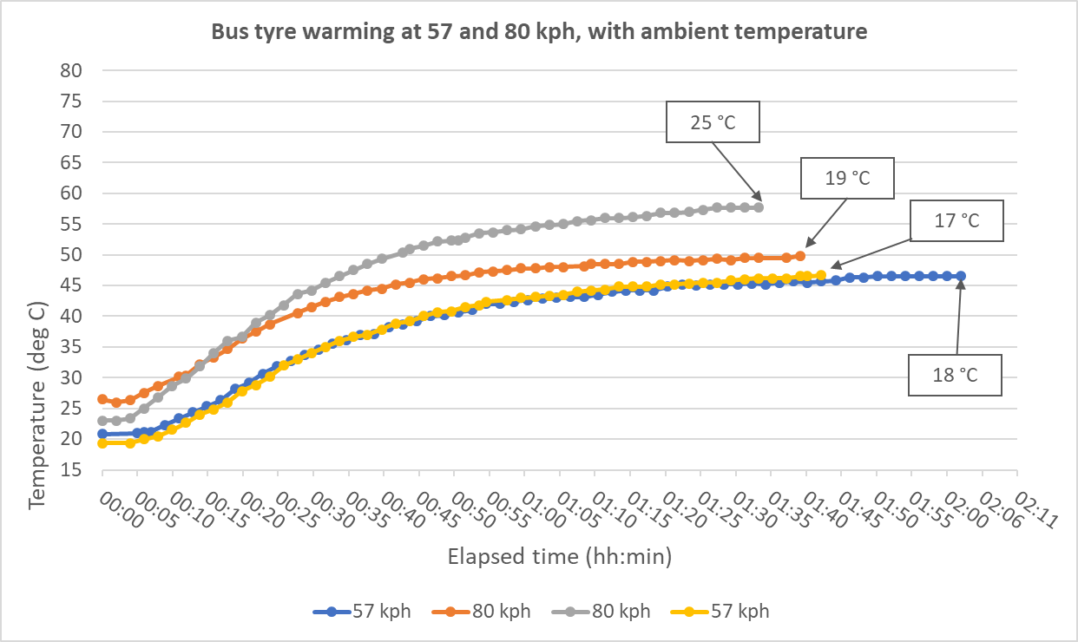
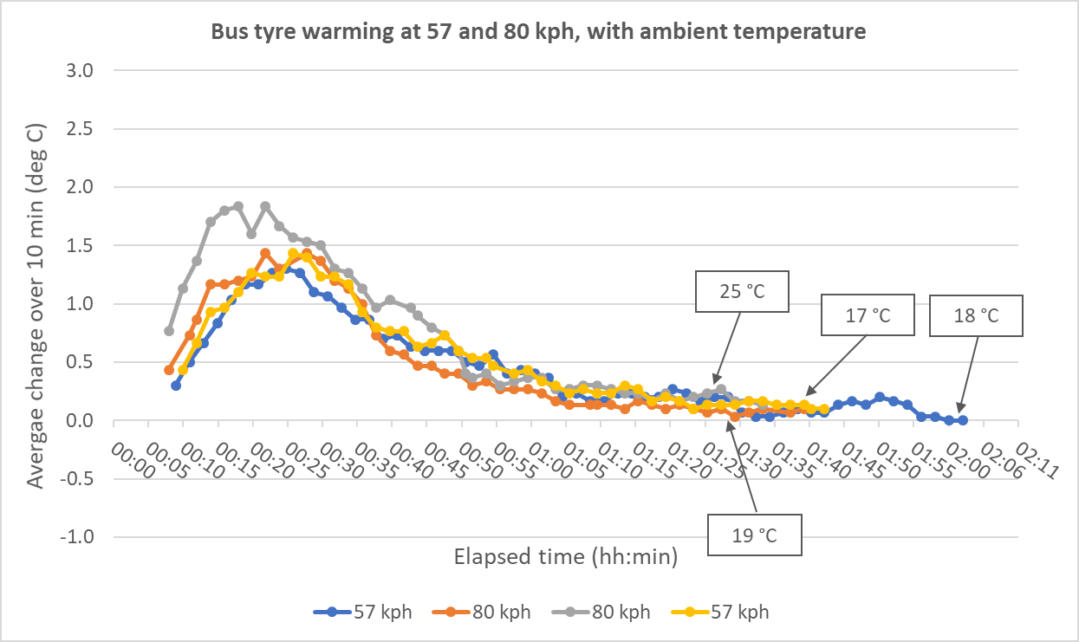
Tyre warming
Bus tests compared:
Temperatures stabilise after
∼ 1.25 – 1.5 hour
Speed effect is insignificant

Slide 14
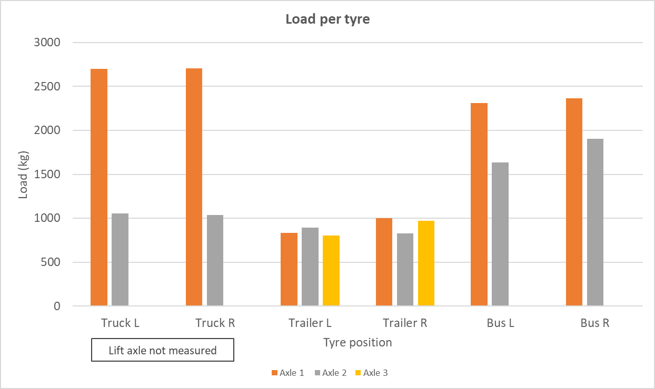
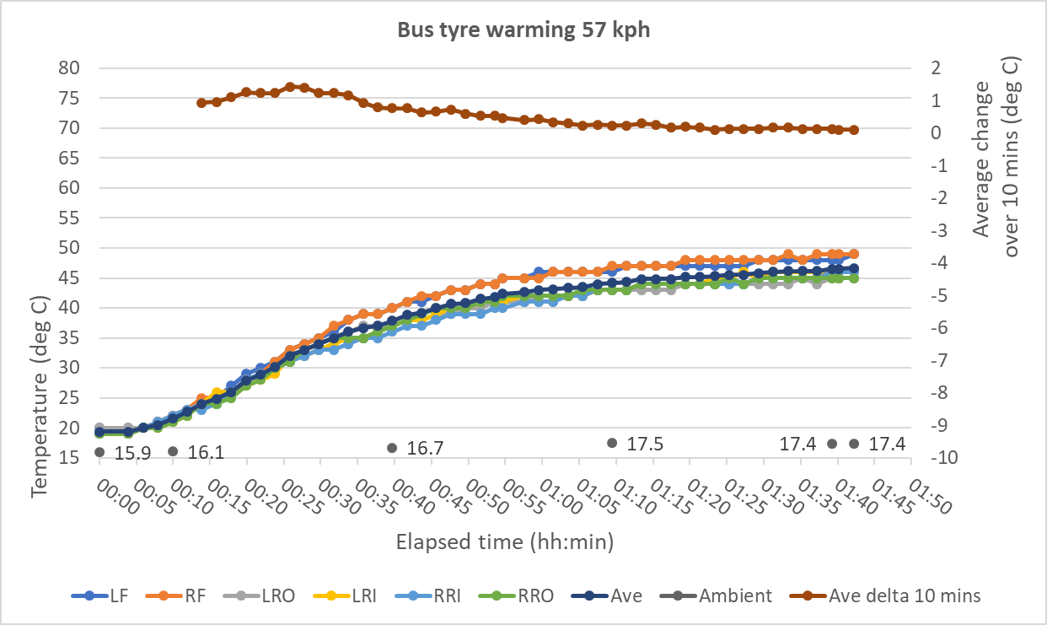
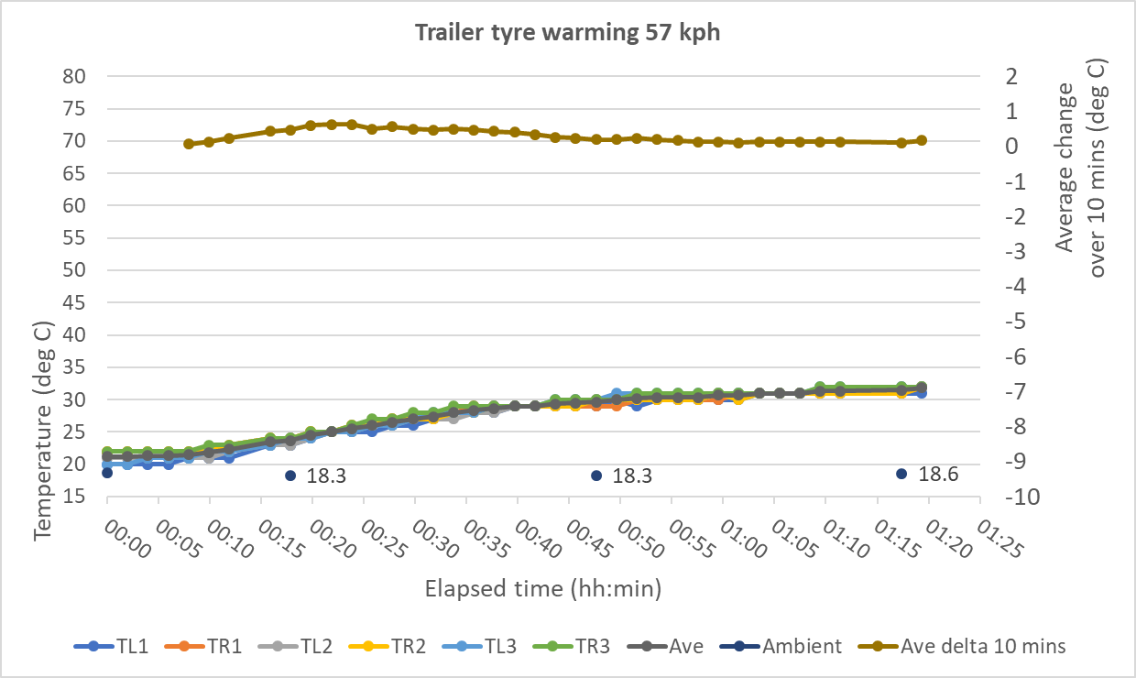
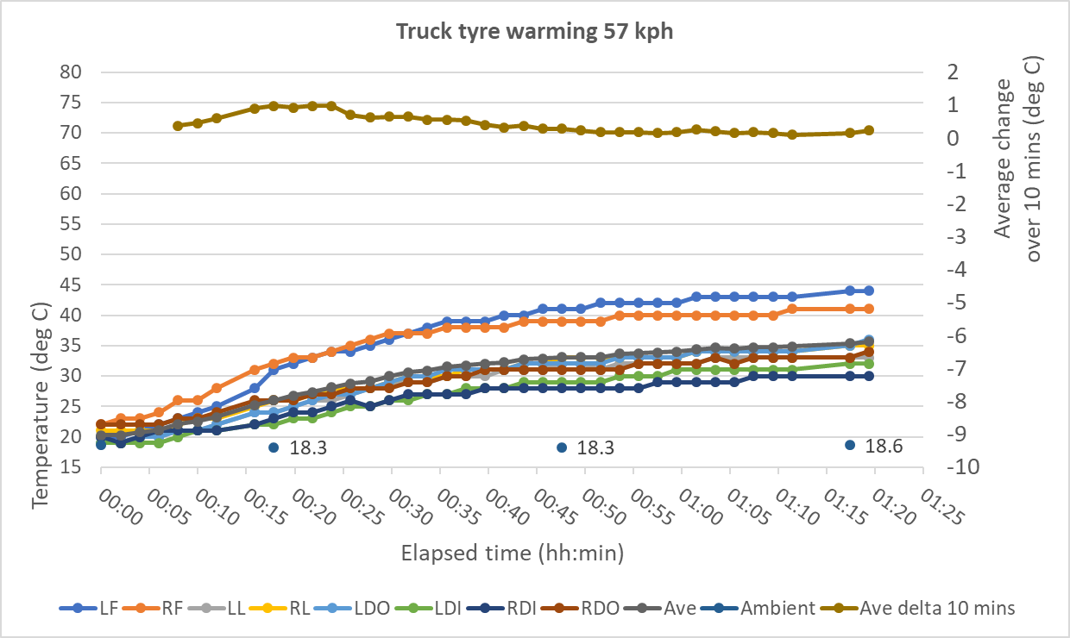
Tyre load
Little effect on warmup time
Temperature reached is higher

Slide 15
Other learning
Pressure gauges should be used with a high deflation flow rate, or with an additional system for releasing pressure (e.g. an additional valve)
Soak time should be increased – 1 hour is not enough.

Slide 16
Conclusions
Can several large tyres be deflated in a reasonable time period ? Yes
What is a reasonable time period ? 15 minutes
How long does it take to stabilise at Pwarm ? Two hours will be needed, higher speed makes little difference
What is the effect of loading ? Increased temperature, same warming time
Can the proposed test procedures be carried out repeatably, reliably, practically ? Yes
Any other lessons ? Better gauges, soak time > 4 hours

