Slide 1
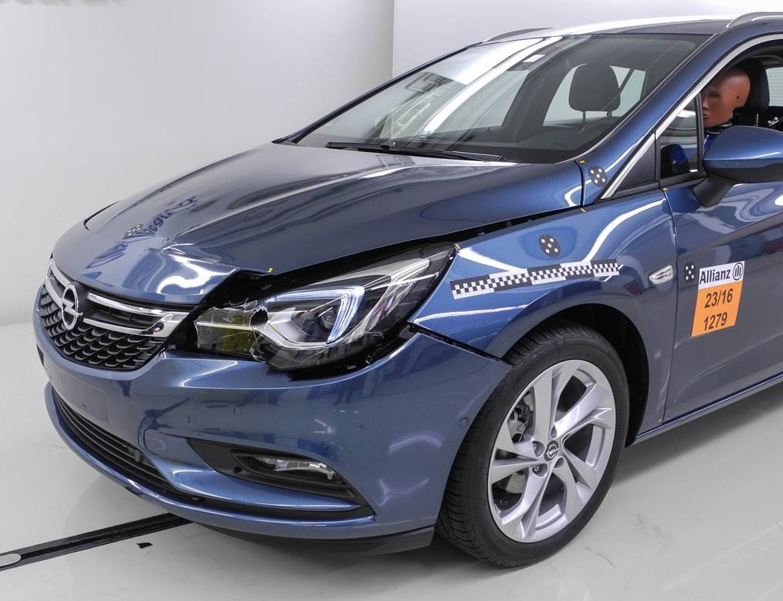


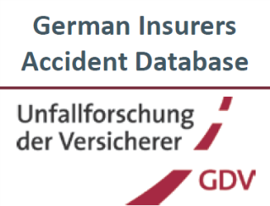



EDR/DSSAD IWG Chairs Approach to Facilitate Completion of EDR Step 1
Assessment of the Ability of Airbag-Deployment as Trigger
IWG members/authors: Johann Gwehenberger
Oliver Braxmeier
Michael Weyde
Sarah Kinzler
Dietmar Bönninger
Data/Expertise Support: Isabella Ostermaier
Bettina Zahnd Henrik Liers
Matthias Kühn

Slide 2
Airbag Deployment in Accidents Involving Injury
Data Source | Data Set and Representativeness | Sample Size | Percentage of Airbag Deployment
 | • Database mainly contains accidents with serious consequences for the persons involved in the accident (accidents in which rescue helicopters were used) • Accidents involving at least one vehicle of category M1 • Year of manufacture of the vehicle 2008 and later • Period of accidents: 2008 – 2018 | 2,044 accidents | 79.6%
 |  | 2,405 M1 vehicles | 77.3%
 | • Claims of Allianz in Germany Database Third Party Liability with injuries (random samples) • Accidents involving at least one vehicle of category M1 (Policyholder) • No limitation of vehicle age • Period of accidents: 2011, 2013, 2014 and 2018 • Distinction between accidents and M1 vehicles | 1,585 accidents | 15.1 %
 |  | 2,703 M1 vehicles | 10.0 %
 | • Accident Database UDB: representative for all Third Party Liability claims of the German Insurers • Only Third Party Liability claims involving personal injury and at least 15,000 € total claim value • Analyses of vehicle related, infrastructural and behavioral topics • M1 vehicle from the year of first registration 2005 and later | 3,255 accidents | 22.1% (Driver-Airbag)
 | • Reconstructed accidents with personal damage from the accident years 2007 – 2019 • Generally, all types of road users and accident constellations are covered • The in-depth investigation is done within two defined investigation areas in Germany (in/around Dresden and Hannover) • No limitation of vehicle age • Only vehicles with at least one collision (exclusion of non-collided accident causers / other vehicles) | 23,008 accidents | 20.5%
 |  | 23,839 M1 vehicles | 22.4% (Irreversible Systems)

Slide 3
Airbag Deployment in Accidents Involving VRUs*
Data Source | Data Set and Representativeness | Sample Size | Percentage of Airbag Deployment
 | • Database mainly contains accidents with serious consequences for the persons involved in the accident (accidents in which rescue helicopters were used) • Accidents involving at least one VRU • Year of manufacture of the vehicle 1997 and later • Period of accidents: 2005 – 2018 | 921 accidents with VRU and motorcycles | 36.6 %
 |  | 944 M1 vs. VRU / motorcycles collisions | 35.7%
 |  | 253 accidents with VRU | 13.0 %
 | • Claims of Allianz in Germany Database Third Party Liability with injuries (random samples) • Accidents involving at least one vehicle of category M1 (Policyholder) • No limitation of vehicle age • Period of accidents: 2011, 2013, 2014 and 2018 • Accidents involving VRU | 274 accidents with VRU | < 0.1 % (n = 1)
 | • Accident Database UDB: representative for all Third Party Liability claims of the German Insurers • Only Third Party Liability claims involving personal injury and at least 15,000 € total claim value • Analyses of vehicle related, infrastructural and behavioral topics • M1 vehicle from the year of first registration 2005 and later | 303 accidents with VRU | 0.7 % (Driver-Airbag)
 | • Reconstructed accidents with personal damage from the accident years 2007 – 2019 • Generally, all types of road users and accident constellations are covered • The in-depth investigation is done within two defined investigation areas in Germany (in/around Dresden and Hannover) • No limitation of vehicle age • Only vehicles with at least one collision (exclusion of non-collided accident causers / other vehicles) | 23,008 accidents | 0.3 %
*VRU = Bicycle, pedestrian (without motorcycles)

Slide 4
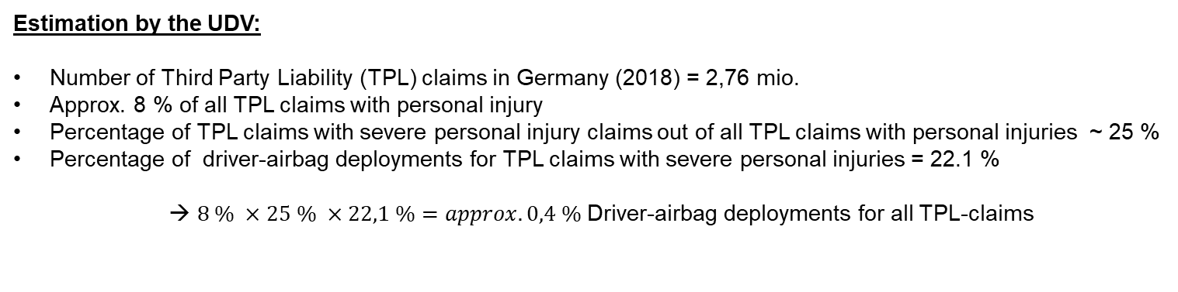
Airbag Deployment in Accidents Involving Material Damage
Data Source | Data Set and Representativeness | Sample Size | Percentage of Airbag Deployment
 | • Claims of Allianz in Germany Database Third Party Liability with material damage (random samples) • Accidents involving at least one vehicle of category M1 • No limitation of vehicle age • Period of accidents: 2011, 2013, 2014 and 2018 • Distinction between accidents and M1 vehicles | 3,088 accidents | 1.1 %
 |  | 5,876 M1 vehicle | 0.6 %
 | • Claims of Allianz in Germany Database Motor-own-Damage (random samples) • Database mainly contains accidents without personal injuries • Accidents involving at least one vehicle of category M1 • No limitation of vehicle age • Period of accidents: 2011, 2013, 2014 and 2018 • Distinction between accidents and M1 vehicles | 4,164 accidents | 3.8 %
 |  | 5,811 M1 vehicle | 2.7 %
Estimation by the UDV:
Number of Third Party Liability (TPL) claims in Germany (2018) = 2,76 mio.
Approx. 8 % of all TPL claims with personal injury
Percentage of TPL claims with severe personal injury claims out of all TPL claims with personal injuries ~ 25 %
Percentage of driver-airbag deployments for TPL claims with severe personal injuries = 22.1 %
→ $8 \% ×25 \% ×22,1 \%=approx. 0,4 \%$Driver-airbag deployments for all TPL-claims

Slide 5
Distribution of Delta-V in Accidents
*Cars with a frontal collision with a pedestrian or bicyclist (Delta V < 8 kph) n = 2,973 (11.4 %)
AXA-claims with installed Event-Data-Recorder in Switzerland (Year: 2008 – May 2020)
It should be noted that the percentage must be regarded as a minimum. Accidents have been reported in the low speed range, but no crash recorder data acquisition took place.

Slide 6
EDR/DSSAD IWG Chairs Approach to Facilitate Completion of EDR Step 1 Assessment of the Ability of an Airbag-Deployment as Trigger
Authors/IWG members: Johann Gwehenberger
Oliver Braxmeier
Michael Weyde
Sarah Kinzler
Dietmar Bönninger
Data/Expertise Support: Isabella Ostermaier
Bettina Zahnd Henrik Liers
Matthias Kühn

