Slide 1


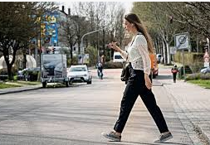
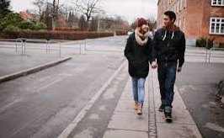
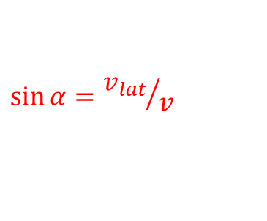
AEB IWG 13 – Industry Input
Why use “perpendicular” also for the pedestrian scenario?
5.2.2.4. (a) With unobstructed perpendicularly crossing pedestrians with a lateral speed component of not more than 5 km/h;
_{v_ped_lat <=} _{5 km/h}
Goal: Create an unambiguous regulation -> use same wording as for Car2Bicycle.
Problem: Because the crossing angle is currently undefined, the performance requirement applies to completely different scenarios
$$\sin{α}={v_{lat}}/v$$
v_lat
v_lat (<=5 km/h) | v | α
5 km/h | 5 km/h | 90°
5 km/h | 5,5 km/h | 65,4°
5 km/h | 7 km/h | 45,6°
2 km/h | 5 km/h | 23,5 °
2 km/h | 7 km/h | 16,6°
„perpendicular“
v
α
„much more likely that the pedestrian will not enter the road“

Slide 2
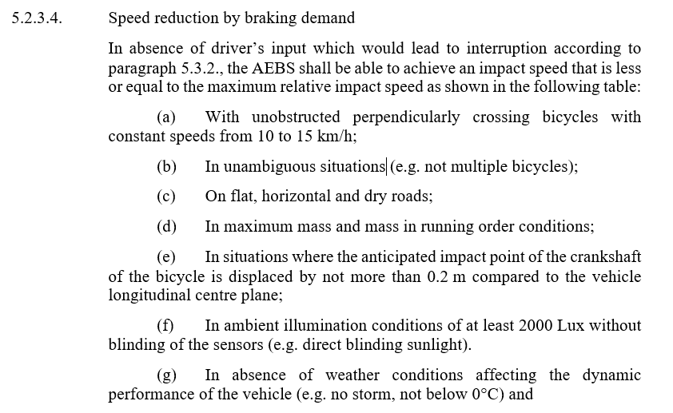
AEB IWG 13 – Industry Input
Why highly dynamic driving and turning events should be excluded from the maximum performance requirements?
Proposal: Modify item (h) and add new item (i)
(h) In absence of extreme highly dynamic driving conditions (e.g. harsh cornering).
(i) In absence of turning events (e.g. at an intersection) affecting the system performance
What creates these challenges?
Influences of dynamic vehicle behaviour on the accuracy of detection
Objects can be outside of the field of view while the vehicle is turning
See illustration of these effects on the following slides

Slide 3
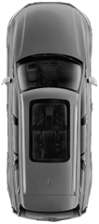
AEB IWG 13 – Industry Input
(a) Influences of dynamic vehicle behaviour on the accuracy of detection
1) Driving straight ahead
Sensor 1
absolute velocity
velocity
Sensor 1
2) Turning
lat. velocity
„Virtual“ object velocity related to sensor coordinates due to rotary movement of Sensor 1
Sensor 1
centre of rotation
absolute velocity
long. velocity
v = d* yaw rate
d
velocity
Sensor 1
yaw rate
Sensor 1
yaw rate
yaw rate
When the vehicle is rotating objects will get a „virtual“ velocity. This effect cannot be fully compensated because the yaw sensors of the vehicle have accuracy limits.
Therefor while the vehicle is cornering or turning, a stationary object at the side of the road can appear to be moving, posing a risk for false activations.
In order to avoid false activations under these circumstances, systems adapt their intervention strategies in these scenarios.

Slide 4
AEB IWG 13 – Industry Input
(b) Objects can be outside of the field of view while the vehicle is turning
The field of view of the sensors is primarily directed to the front of the vehicle in order to detect critical situations coming up ahead.
When the vehicle is turning, the critical situations develops to the side of the vehicle and therefor outside of the AEB‘s detection area, which prevents the AEB from initiating an emergency braking.

