Slide 1

IWG-DPPS
Dynamic & Static test result
7th IWG-DPPS Meeting
Webmeeting, 2020.09.15~17
Kore Automobile Testing & Research Institute, Korea Transportation Safety Authority

Slide 2
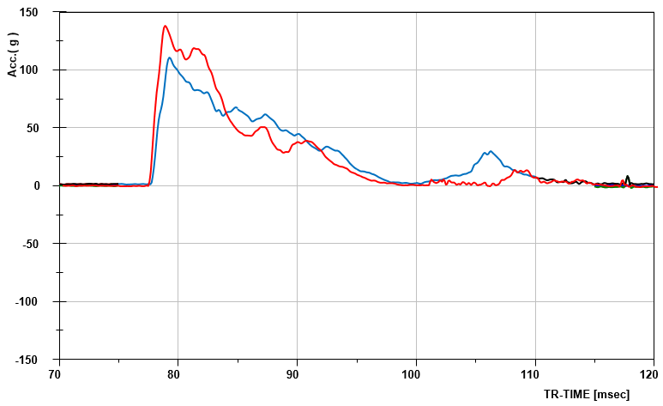
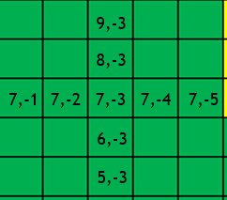
Result difference between Dynamic and Static head test
Background : Physical test request regarding simulation study of Japan in “IWG-DPPS meeting minutes”
Test | Static | Dynamic | Remark
Condition | V = 40.25km/h Impact point : C7,-3 | V = 39.56km/h Impact point : C7,-3 | The impact points(C7,-3) of dynamic and static test were about 3mm apart. (Note, all close to 7-3 of KNCAP result are green scores)
Result | HIC15 : 464.46 | HIC15 : 733.18
Related picture
HIC from dynamic headform test is 58% higher than HIC from static headform test

