Slide 1

IWG-DPPS
Determination of Headtest Area
7th IWG-DPPS Meeting
Webmeeting, 2020.09.15~17
Kore Automobile Testing & Research Institute, Korea Transportation Safety Authority

Slide 2
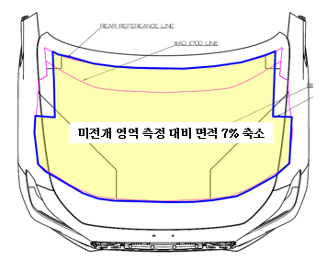
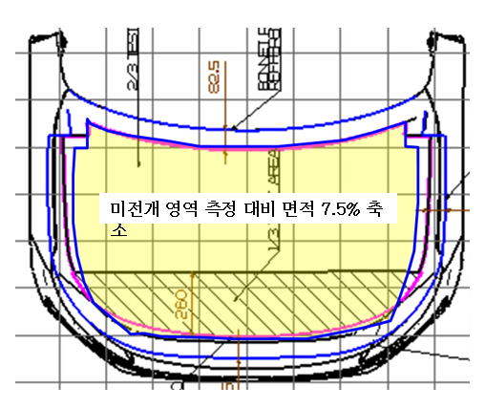
Head test area difference between in Deployed and Un-deployed
If head test area is defined in a deployed position only for static test with deployed position,
# Sedan
Marked in un-deployed
Marked in deployed
Conditions |  | testable
“Test vehicle” with out DPPS |  | O
“Test vehicle” with DPPS | Static Test | X
 | Dynamic Test | O
 | Static + Dynamic Test | O
 | Static Test (Un-deployed position at LT) | O
Test point
Test area reduction (7%)
(compared to “un-deployed”)
# SUV
2 Head Test Areas is existing, depending on DPPS fitment of the same car model
2 Head Test Areas is existing, depending on the test method in the same car
Determination of Head Test Area reference lines may not be unclear (refer to IWG-DPPS-05-03)
Headform test in undeployed position at 0.9 x LT speed is necessary for DPPS
Marked in un-deployed
Test point
Test area reduction (7.5%)
(compared to “un-deployed”)
Marked in deployed

