Slide 1
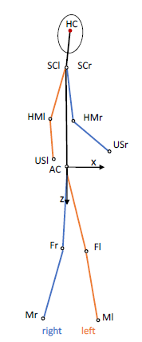
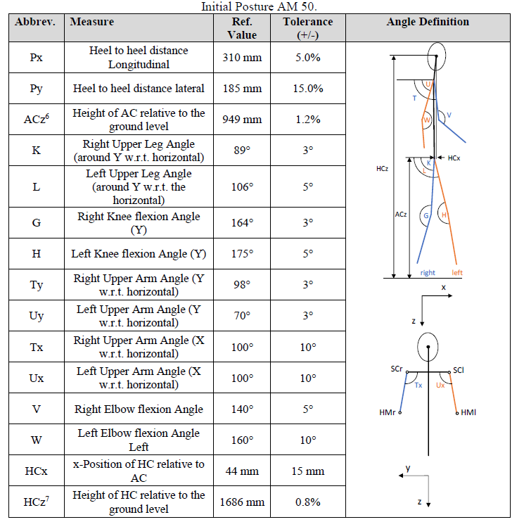
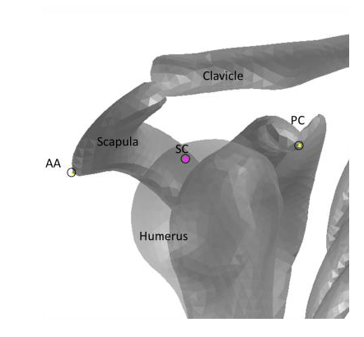
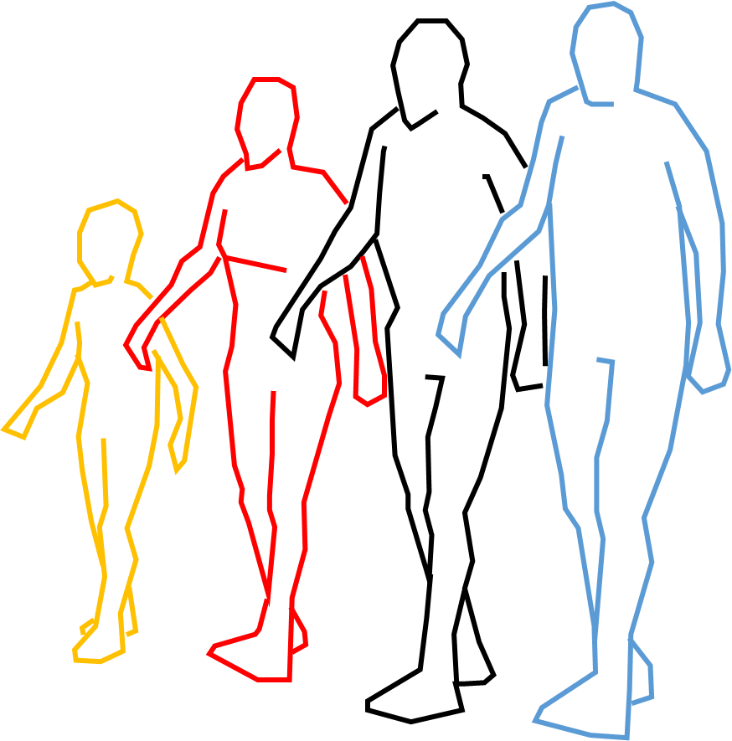
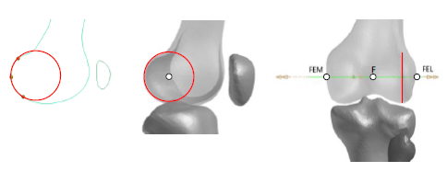
HBM positioning
in Euro NCAP Tech.Bulletin 024
1. Anatomic landmarks used to define measure points on the skeleton:
2. For each HBM:
Definition of reference values for all measure points (under use of tolerances).
“based on the recommendations of the international society of biomechanics (ISB)“
[TB024, p33]
“The joint angles of the legs are based on SAE J2782 and the arm posture is based on a natural posture.” [TB024, p7]
OICA confirms using the TB 024 HBM positioning and proposes to introduce it in amended GTR9/UN R127.

