Slide 1
R150 RRD Retro-reflective Devices
SLR-41-14
(Rev. of SLR-39-01/Rev.2)
Simplification stage 2

Slide 2
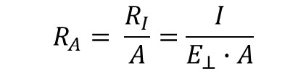

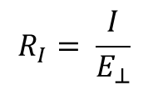
Update of definitions
Correction of the Photometric Definitions
Referenced Document:
CIE Publication 54.2:2001;CIE 54:2001
Retroreflection - Definition and measurement
In the current version Reg 150 (former Reg 3) – no definition of the CIL value
NEW
"Coefficient of luminous intensity R_{I}" means the quotient of the luminous intensity I reflected by the retro-reflective device in the direction considered, divided by the normal illumination $E_{⊥}$ of the retro-reflecting device for given angles of illumination, divergence and rotation.
$$R_{I}= \frac{I}{E_{⊥}}$$
NOTE 1 R_{I} is often referred to as CIL. The unit is cd/lx.
Old definition of R´
R´ → R_{A}
"Coefficient of retro-reflection (symbol R')" means the quotient of the coefficient of luminous intensity R of a plane retro-reflecting surface and its area A
"Specific coefficient of retro-reflection (symbol R_{A})" means the quotient of the coefficient of luminous intensity R of a plane retro-reflecting surface and its area A
$$R_{A}= \frac{R_{I}}{A}=\frac{I}{E_{⊥}∙A}$$
The coefficient of retro-reflection R_{A} is expressed in candelas per m² per lx (cd∙m⁻²∙lx⁻¹)

Slide 3
Update of definitions
Correction of the Photometric Definitions
Referenced Document:
CIE Publication 54.2:2001;CIE 54:2001
Retroreflection - Definition and measurement
Luminance factor
(symbol ß) - means the ratio of the luminance of the body to the luminance of a perfect diffuser under identical conditions of illumination and observation;
(symbol ß) → (symbol R_{F})
"Luminance factor (symbol R_{F})" means the ratio of the luminance of the body to the luminance of a perfect diffuser under identical conditions of illumination and observation;
All definitions for angles are Greek symbols (α, β, …) – to prevent mix-ups.
Definition of the angles for the measuring geometry setup
In Reg. 150 there is a mix of the definitions for the observation angles.
E.g. β_{V} , β_{H} or V , H or β₁ , β₂
Depended from the Reg 3 or 70, 104, …
Consistantly using ß₁ and ß₂
"Entrance angle (symbol β)" means the angle from the illumination axis to the reference axis. The entrance angle is usually not larger than 90° but, for completeness, its full range is defined as 0° < β < 180°. In order to specify the orientation in full, this angle is characterised by two components, β₁ and β₂;
"Observation angle (symbol α)" means the angle between the illumination axis and the observation axis. The observation angle is always positive and, in the case of retro-reflection, is restricted to small angles;

Slide 4
Resistance to weathering
Annex 13 and 22
Annex X (new)
Weathering with xenon-arc weathering device
Evaluation by reference materials blue wool – grey scale
State of the art test, defined parameter in refrenced ISO 4892-2
Weathering with xenon-arc weathering device
Defined time of 500 h
Evaluation by set up minimum level for specific coefficient of retroreflection at 80% of required values
Evaluation of colour as defined in R48
Justification

Slide 5
Resistance to weathering
Methode applicable for retroreflective sheeting material used for
  retroreflective markings of
  Classes C, D, E, F
  Classes 1, 2, 3, 4, 5
  and SMV Class 1 and 2
Not applicable for retroreflectors of
  Classes IA, IB, IIIA, IIIB and IVA
  Advance Warning Triangle of Type 1 and 2

Slide 6
Annex 24
Arrangement of approval markings
Adjustment of the sizes of the approval marks
  In Table 1, to reduce the number of minimum sizes of “a”,
  the value “4 mm” should become “5 mm” and
  the value “12 mm” should become “8 mm”.
Changes in the examples of the approval marks
  Space removed for class IIIA
  Sice alligned
  „104R“ removed
  „27R“ replaced by WT

Slide 7
Table 1
List of retro-reflective devices and their symbols
Retro-reflective devices | Symbol | Minimum “a” for examples of figures in Annex 24 (values in mm) | Paragraph
Retro-reflector for motor vehicles (independent) | IA | 5 | 5.1.
Retro-reflector for motor vehicles (combined with other signal lamps which are not watertight) | IB | 5 | 5.1.
Retro-reflector for trailers (independent) | IIIA | 5 | 5.1.
Retro-reflector for trailers (combined with other signal lamps which are not watertight) | IIIB | 5 | 5.1.
Wide-angle retro reflector | IVA | 5 | 5.1.
Conspicuity marking (material for contour/strip marking) | C | 8 | 5.2.
Conspicuity marking (material for distinctive markings/graphics intended for a limited area) | D | 8 | 5.2.
Conspicuity marking (material for distinctive markings/graphics intended for an extended area) | E | 8 | 5.2.
Conspicuity marking (materials for distinctive markings or graphics as base or background in printing process for fully coloured logos and markings of class "E" in use which fulfil the requirements of class "D" materials) | D/E | 8 | 5.2.
Retro-reflective materials for extremities marking of class F | F | 8 | 5.2.
Retro-reflective marking for long or heavy vehicles (retro-reflective and fluorescent materials) Marking plate of class 1 or class 2 | RF | 5 | 5.2.
Retro-reflective marking for long or heavy vehicles (retro-reflective only materials) - Marking plate of class 3, class 4 or class 5 | RR | 5 | 5.2.
Marking for slow moving vehicles (retro-reflective and fluorescent materials) - Marking plate of class 1 | RF | 5 | 5.2.
Marking for slow moving vehicles (retro-reflective only materials) - Marking plate of class 2 | RR | 5 | 5.2.
Advance Warning Triangle (Type 1) | T1 | 8 | 5.3
Advance Warning Triangle (Type 2) | T2 | 8 | 5.3

Slide 8
IIIA
a/3
E4
a/2
a/3
a
150R01 216
a/3
Space removed
C
WT
E1
E3
1148
150R01
150R01
4216
104R replaced by 150R
27R replaced by WT

Slide 9
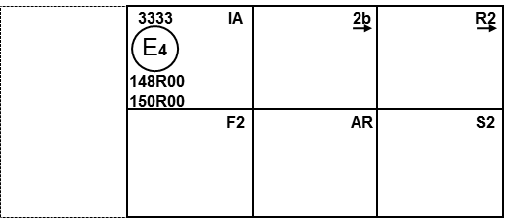
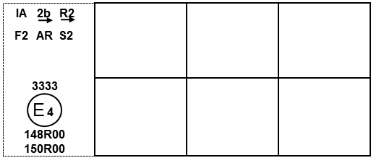
Existing examples in R148 Annex 7 and R150 (real size of the marking)
Figure YYY - Marking example ZZ
3333
IA 2b R2
E4
148R00
150R00
F2 AR S2
IA 2b R2
F2 AR S2
3333
IA
2b
R2
3333
E
4
148R00
150R01
E4
F2
AR
S2
148R00
Size aligned
150R00

