Slide 1
Session 6
Status Review and Session Orientation
Document FRAV-06-03
6th FRAV session, 29 October 2020
Web Conference
29 October 2020

Slide 2
Today’s Agenda
Adoption of the Agenda
Adoption of the report of the last session
FRAV status and session orientation
Document 5 update (Request for comments)
Elaboration of ADS safety requirements (Discussion)
Approaches to setting performance limits (Discussion)
Next steps and deliverables

Slide 3
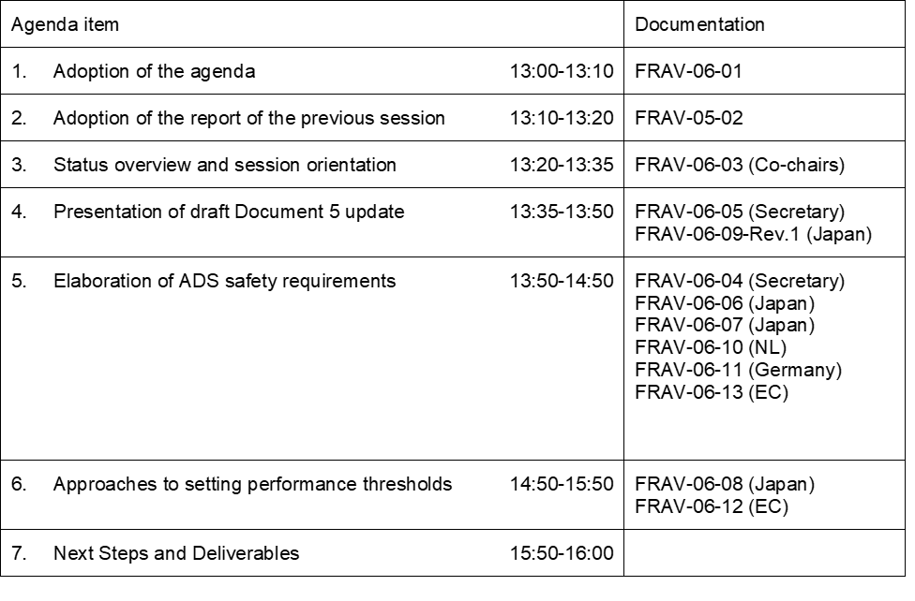
Agenda Item 1
Adoption of the Agenda

Slide 4
Today’s Agenda
Adoption of the Agenda
Adoption of the report of the last session
FRAV status and session orientation
Document 5 update (Request for comments)
Elaboration of ADS safety requirements (Discussion)
Discussion of approaches to setting performance limits (Discussion)
Next steps and deliverables
Given the short period between 5th and 6th sessions, we will re-confirm approval of the report at the next session.

Slide 5
Agenda Item 3
Review of FRAV Points of Consensus (cont.)
“Automated Driving System” (ADS) means the hardware and software that are collectively capable of operating a vehicle on a sustained basis.
FRAV requirements specifically regard the ADS and its performance in the operation of a vehicle.
Operational Design Domain (ODD) refers to the operating conditions under which an ADS is designed to function.
ADS may be designed to function under more than one discrete set of operating conditions (i.e., more than one ODD).
“(ADS) feature” means an application of ADS hardware and software designed specifically for use within an ODD.
An ADS may have one or more features as defined by their unique ODD.
“Operational Design Domain” means the operating conditions under which an ADS feature is specifically designed to function.
In operation, the ADS continuously controls the vehicle motion, monitors the vehicle environment, interacts with other road users, and determines responses to road and traffic conditions (collectively known as the Dynamic Driving Task (DDT)).
The ADS has functions that collectively perform the entire DDT while the ADS is in use.
The ADS monitors the functions and safely manages failure modes when detected.
The ADS functions enable the features to operate the vehicle within the ODD of the feature.
An ADS feature may use all or some of the functions of the ADS.
ADS features may share ADS functions.
An ADS should be assessed based on its intended use(s) and limitations on the use of its features.
ADS requirements should be technology-neutral and performance-based.

Slide 6
Agenda Item 3
Review of FRAV Points of Consensus (cont.)
ADS requirements should be applicable across the anticipated diversity of configurations (i.e., features and functions).
ADS assessments require information specific to the configuration of the ADS (i.e., features, functions, ODD, other usage specifications).
Manufacturers provide the information specific to the ADS design and intended uses.
FRAV will define mandatory requirements for ADS descriptions (i.e., ODD elements, other usage specifications).
The manufacturer description of the ADS provides a means to determine the application of the ADS performance requirements.
The NATM process should begin with a review of the ADS description to verify fulfillment of the mandatory description requirements and to determine the application of the performance requirements.
The ADS requirements should be derived from the following safety perspectives:
  The ADS should drive safely.
  The ADS should interact safely with the user.
  The ADS should manage safety-critical situations.
  The ADS should safely manage failure modes.
  The ADS should maintain a safe operational state.
No comments received since the last session.
If there are reservations, concerns, or questions regarding these points, please convey them to the FRAV secretary. FRAV will address the issues at a future session.

Slide 7
Today’s Agenda
Adoption of the Agenda
Adoption of the report of the last session
FRAV status and session orientation
Document 5 update
  Request for comments for discussion at 7th (17 November) session
  Japan input regarding ODD (document FRAV-06-09)
Elaboration of ADS safety requirements
Discussion of approaches to setting performance limits
Next steps and deliverables

Slide 8
Agenda Item 4
Document 5 Update
Please review document FRAV-06-05 before the next session.
  Preferable to have comments in advance (i.e., by Thursday, 12 November)
Principal changes
  Updated background to summarize discussions to date
  Proposes revised “Purpose of the document” (Clarify understanding of purpose)
  Proposes “Dynamic Driving Task” and “ADS function” (working) definitions
    Proposes update to “ADS” definition accordingly
  Proposes “ADS Safety Requirements” introductory chapter
    Description of “system safety”, FRAV strategy, etc.
  Proposes “ADS Performance Requirements” chapter
    D5 structure: “ADS Safety Requirements”, “ODD”, “ADS Performance Requirements”
    Group ADS performance requirements in subsections

Slide 9
Today’s Agenda
Adoption of the Agenda
Adoption of the report of the last session
FRAV status and session orientation
Document 5 update
  Request for comments for discussion at 7th (17 November) session
  Japan input regarding ODD (document FRAV-06-09)
Elaboration of ADS safety requirements
Discussion of approaches to setting performance limits
Next steps and deliverables

Slide 10
Today’s Agenda
Adoption of the Agenda
Adoption of the report of the last session
FRAV status and session orientation
Document 5 update
Elaboration of ADS safety requirements
  Circulated FRAV-06-04 as basis for development
  Input from Japan (FRAV-06-06/07), Netherlands (FRAV-06-10), Germany (FRAV-06-11), EC/JRC (FRAV-06-13)
Discussion of approaches to setting performance limits
Next steps and deliverables

Slide 11
Agenda Item 5
Performance Requirement Starting Points
ADS should drive safely. (Ensure safe behavior of the ADS as “the driver”)
ADS should interact safely with the user. (Ensure safe use of ADS and safe interactions with the user such as transfers of control, user override, etc.)
ADS should manage safety-critical situations. (Differentiate between normal driving and emergency situations to ensure safe responses to the latter)
ADS should safely manage failure modes. (Ensure safe responses to system malfunction, physical damage, etc.)
ADS should maintain a safe operational state. (Ensure safety throughout the useful life of the ADS, such as safety critical updates, response to obsolescence)
Item 2: Driver/User/Operator Question
Which term does FRAV prefer to refer the human interacting with the ADS?

Slide 12
Driver/User/Operator?
Driver
  Under some interpretations, ADS can be the driver
  This interpretations means an ADS vehicle has two possible drivers: the ADS or the human with access to vehicle motion control.
    Vehicle with driver controls → occupant of the driver’s seat
    Vehicle operated remotely → human operator in control center
    Hybrid system? → human in vehicle and/or remote operator if needed
User
  Term does not necessarily imply control over ADS beyond activate/deactivate
Operator
  Term implies human responsibility at some level for correct use
  Some driver’s licenses use the term “operator”

Slide 13
Today’s Agenda
Adoption of the Agenda
Adoption of the report of the last session
FRAV status and session orientation
Document 5 update
Elaboration of ADS safety requirements
  Circulated FRAV-06-04 as basis for development
  Input from Japan (FRAV-06-06/07), Netherlands (FRAV-06-10), Germany (FRAV-06-11), EC/JRC (FRAV-06-13)
Discussion of approaches to setting performance limits
Next steps and deliverables

Slide 14
Today’s Agenda
Adoption of the Agenda
Adoption of the report of the last session
FRAV status and session orientation
Document 5 update
Elaboration of ADS safety requirements
Discussion of approaches to setting performance limits
  Document from Japan (FRAV-06-08) and EC/JRC (FRAV-06-12)
Next steps and deliverables

Slide 15
Agenda Item 7
Next session
Next session 17 November
  Initial performance goal list
    How to proceed to reach agreement on the initial list during Session 7?
    Primary goal: Common understanding of each starting point and the items to be covered
    Clear understanding of safety aspect provides basis for discussion on work plan
  Provide input by 12 November to facilitate 7th session preparations
Request further views on methods for establishing performance criteria/limits
  Last session in 2020 on 8 December
  Aim to understand options to support work on defining limits for performance goals in 2021

