Slide 1
R150 RRD Retro-reflective Devices
Simplification stage 2
Questions on Luminance factor and Marking of Advance Warning Triangle
SLR-42-09
(Rev. of SLR-39-01/Rev.2)

Slide 2
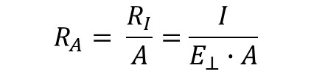
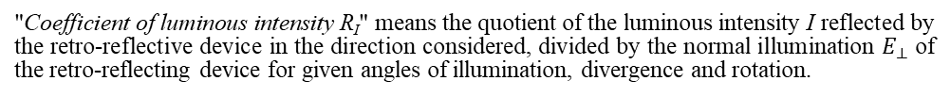
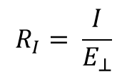
Update of definitions
Correction of the Photometric Definitions
Referenced Document:
CIE Publication 54.2:2001;CIE 54:2001
Retroreflection - Definition and measurement
In the current version Reg 150 (former Reg 3) – no definition of the CIL value
NEW
"Coefficient of luminous intensity R_{I}" means the quotient of the luminous intensity I reflected by the retro-reflective device in the direction considered, divided by the normal illumination $E_{⊥}$ of the retro-reflecting device for given angles of illumination, divergence and rotation.
$$R_{I}= \frac{I}{E_{⊥}}$$
NOTE 1 R_{I} is often referred to as CIL. The unit is cd/lx.
Old definition of R´
R´ → R_{A}
“Specific coefficient of retro-reflection (symbol R')" means the quotient of the coefficient of luminous intensity R of a plane retro-reflecting surface and its area A
"Specific coefficient of retro-reflection (symbol R_{A})" means the quotient of the coefficient of luminous intensity R of a plane retro-reflecting surface and its area A
$$R_{A}= \frac{R_{I}}{A}=\frac{I}{E_{⊥}∙A}$$
The coefficient of retro-reflection R_{A} is expressed in candelas per m² per lx (cd∙m⁻²∙lx⁻¹)
Draft of ISO-Standard:
Photometry of Lighting and Light Signalling Devices for road vehicles
From CIE TC 2-19 and IEC at ISO (CIE FDIS 017_E_2019)

Slide 3
Update of definitions
Correction of the Photometric Definitions
Referenced Document:
CIE Publication 54.2:2001;CIE 54:2001
Retroreflection - Definition and measurement
Luminance factor
(symbol ß) - means the ratio of the luminance of the body to the luminance of a perfect diffuser under identical conditions of illumination and observation;
(symbol ß) → (symbol R_{F})
"Luminance factor (symbol R_{F})" means the ratio of the luminance of the body to the luminance of a perfect diffuser under identical conditions of illumination and observation;
All definitions for angles are Greek symbols (α, β, …) – to prevent mix-ups.
Definition of the angles for the measuring geometry setup
In Reg. 150 there is a mix of the definitions for the observation angles.
E.g. β_{V} , β_{H} or V , H or β₁ , β₂
Depended from the Reg 3 or 70, 104, …
Consistently using ß₁ and ß₂
"Entrance angle (symbol β)" means the angle from the illumination axis to the reference axis. The entrance angle is usually not larger than 90° but, for completeness, its full range is defined as 0° < β < 180°. In order to specify the orientation in full, this angle is characterised by two components, β₁ and β₂;
"Observation angle (symbol α)" means the angle between the illumination axis and the observation axis. The observation angle is always positive and, in the case of retro-reflection, is restricted to small angles;

Slide 4
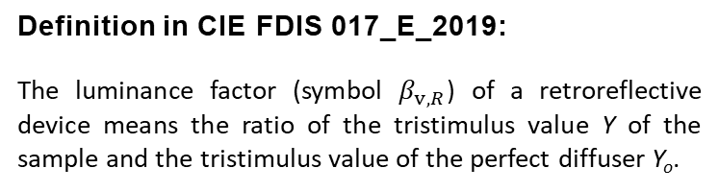

Definition of the Luminance Factor
Draft of ISO-Standard:
Photometry of Lighting and Light Signalling
Devices for road vehicles
From CIE TC 2-19 and IEC at ISO (CIE FDIS 017_E_2019)
Current: β
Proposal in GRE 83-26e: R_{F}
luminance factor (at a surface of a non-self-radiating medium in a given direction, under specified conditions of illumination) [β_{v}]
NOTE For photoluminescent media, the luminance factor consists of 2 components:
the reflected luminance factor, β_{v,R}, and the luminescent luminance factor, β_{v,L}.
The sum of the reflected and luminescent luminance factors is the total luminance factor, β_{v,T}: β_{v,T} = β_{v,R} + β_{v,L}.
The subscript R is used here for the reflected luminance factor because it is more intuitive than the traditional S and avoids confusion with the use of S to denote a state of polarization.
Definition in CIE FDIS 017_E_2019:
The luminance factor (symbol $β_{v,R}$) of a retroreflective device means the ratio of the tristimulus value Y of the sample and the tristimulus value of the perfect diffuser Y_{o}.
 | $$β_{v,R}= \frac{Y}{Y_{0}}$$
New proposal: β_{v,R}

Slide 5
Table 1
List of retro-reflective devices and their symbols
Retro-reflective devices | Symbol | Minimum “a” for examples of figures in Annex 24 (values in mm) | Paragraph
Retro-reflector for motor vehicles (independent) | IA | 5 | 5.1.
Retro-reflector for motor vehicles (combined with other signal lamps which are not watertight) | IB | 5 | 5.1.
Retro-reflector for trailers (independent) | IIIA | 5 | 5.1.
Retro-reflector for trailers (combined with other signal lamps which are not watertight) | IIIB | 5 | 5.1.
Wide-angle retro reflector | IVA | 5 | 5.1.
Conspicuity marking (material for contour/strip marking) | C | 8 | 5.2.
Conspicuity marking (material for distinctive markings/graphics intended for a limited area) | D | 8 | 5.2.
Conspicuity marking (material for distinctive markings/graphics intended for an extended area) | E | 8 | 5.2.
Conspicuity marking (materials for distinctive markings or graphics as base or background in printing process for fully coloured logos and markings of class "E" in use which fulfil the requirements of class "D" materials) | D/E | 8 | 5.2.
Retro-reflective materials for extremities marking of class F | F | 8 | 5.2.
Retro-reflective marking for long or heavy vehicles (retro-reflective and fluorescent materials) Marking plate of class 1 or class 2 | RF | 5 | 5.2.
Retro-reflective marking for long or heavy vehicles (retro-reflective only materials) - Marking plate of class 3, class 4 or class 5 | RR | 5 | 5.2.
Marking for slow moving vehicles (retro-reflective and fluorescent materials) - Marking plate of class 1 | RF | 5 | 5.2.
Marking for slow moving vehicles (retro-reflective only materials) - Marking plate of class 2 | RR | 5 | 5.2.
Advance Warning Triangle (Type 1) | T1 → WT1 | 8 | 5.3.
Advance Warning Triangle (Type 2) | T2 → WT2 | 8 | 5.3.

Slide 6
Symbol for the marking of Advance Warning Triangle
Retro-reflective devices | Symbol | Minimum “a” for examples of figures in Annex 24 (values in mm) | Paragraph
Advance Warning Triangle (Type 1) | T1 → WT1 | 8 | 5.3.
Advance Warning Triangle (Type 2) | T2 → WT2 | 8 | 5.3.
Symbol
Advance Warning Triangle (Type 1)
Advance Warning Triangle (Type 2)
T1
T2
WT1
WT2
or

Slide 7
New markings
IIIA
C
WT
a/3
E1
E3
E4
1148
a/2
a/3
150R01
150R01
4216
a
150R01 216
a/3
Space removed
104R replaced by 150R
27R replaced by WT
T1
T2
WT1
WT2
E3
E3
E3
E3
OR
150R01
4216
150R01
4217
150R01
4216
150R01
4217
27R replaced by T1
27R replaced by T2
27R replaced by WT1
27R replaced by WT2

