Slide 1
Toward a Real-Time
Business Conditions Index
Alessandro Alasia
Centre for Special Business Projects (CSBP)
Presented to the UNECE and ITF virtual meeting series on Mobility Monitoring:
“Exploring new transport data sources”
January 26, 2021

Slide 2
The context
Acceleration of digital transformation brought in by COVID-19
Need to monitor business conditions real time data
Need to have greater level of geographic granularity
2

Slide 3
Desirable attributes of a Real Time Business Conditions Index
Real time: weekly data or higher frequency
Geographic granularity: measures of health and economic impact are increasingly local; hence the index needs to represent local conditions (ideally with data at the neighborhood level)
Integrated with Statistics Canada data holdings, when possible
Minimum processing time: hours between data extraction and release of index
3

Slide 4
From “what we wish” to “what we can” do: meeting the requirements
Three components:
  Where are businesses located and what is their economic size: business density component generated with Statistics Canada’s business data
  Measure of business conditions: a conglomerate of data acquired from private sector APIs that measure business closures
  A measure of “mobility” in the business district: road traffic flow in selected areas
  Examples provided in the following slides are illustrative or based on similar and published data
4

Slide 5
Business density measure with Statistics Canada’s business data holdings
Used to identify areas with high concentration of businesses and optimise the use of private sector APIs (business conditions and road traffic)
For a selected grouping of North American Industry Classification System (NAICS) codes to align this measure with data from APIs
Computed at the neighborhood level in urban areas
This component is static, it uses 2020 data but provides broad geographic coverage

Slide 6
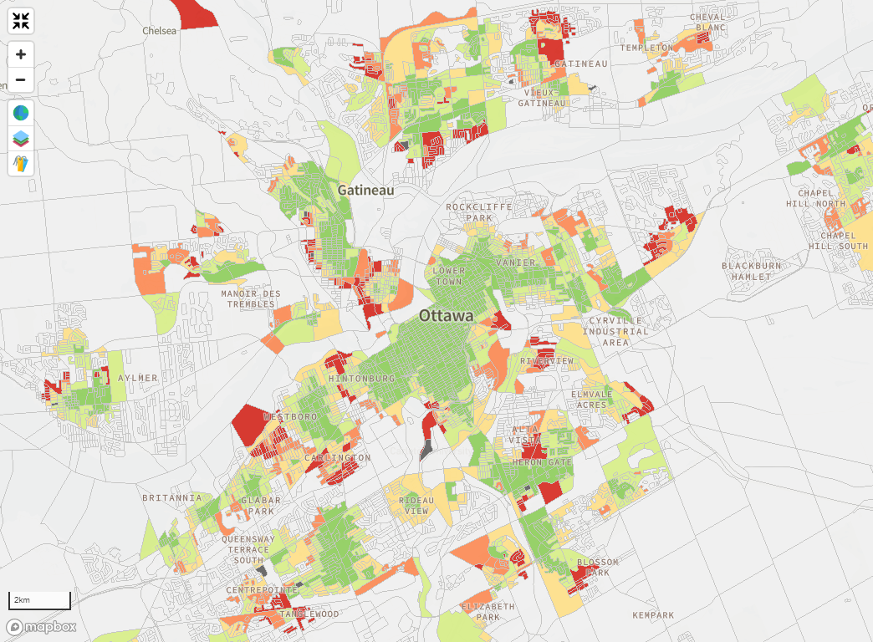
Business density measure with Statistics Canada’s business data holdings
(Example from: https://www150.statcan.gc.ca/n1/pub/71-607-x/71-607-x2020011-eng.htm

Slide 7
Business conditions as measured by operation status
This component is generated from a conglomerate of private sector APIs reporting business operation status for a selected type of businesses (mainly main street businesses)
Measure: percentage of businesses reporting closure (temporary or permanent)
The sample of businesses is drawn primarily from business dense areas

Slide 8
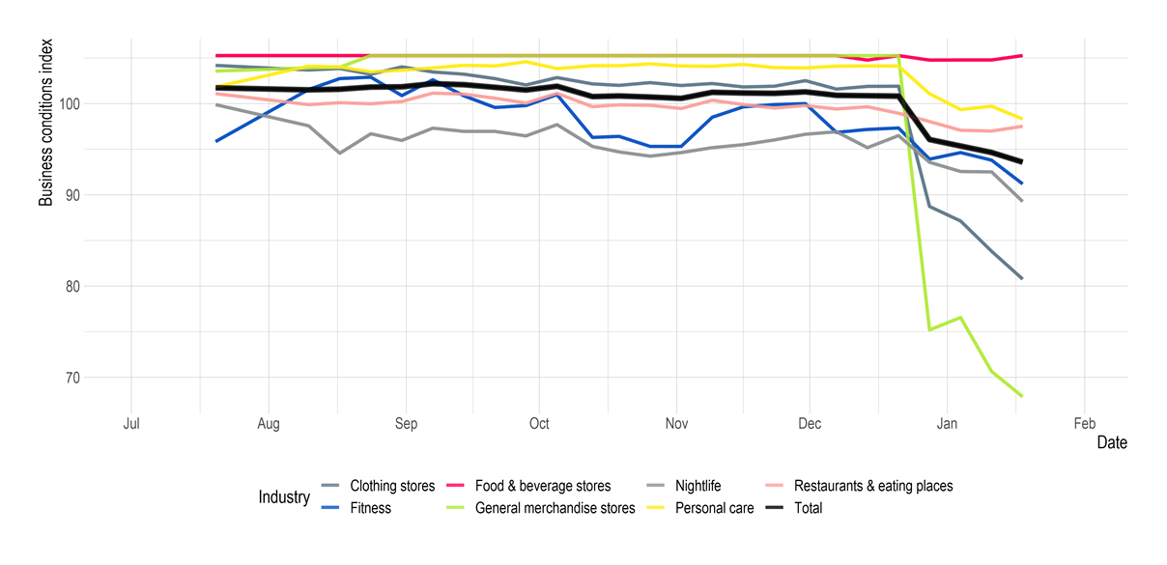
Business operation status: insights from City 1

Slide 9
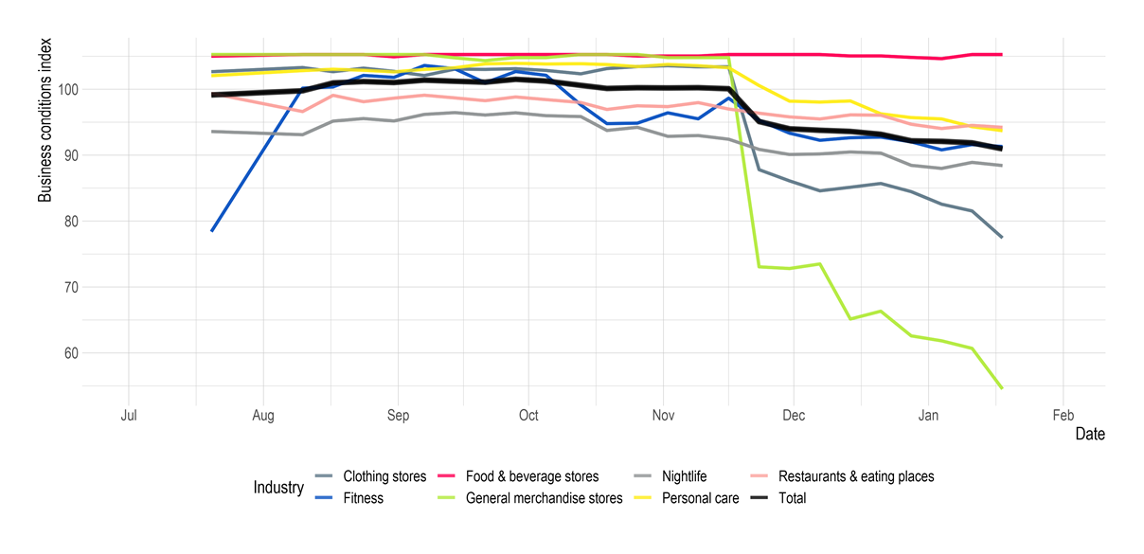
Business operation status: insights from City 2

Slide 10
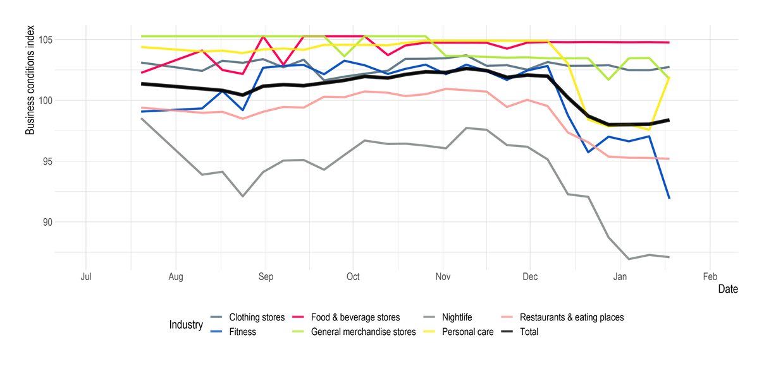
Business operation status: insights from City 3

Slide 11
Measuring road traffic in selected areas
Base on real time and historic data on road traffic volumes
Generated using road traffic APIs (current being evaluated)
Year-to-year change (for a given week) is expected to be used as input in the index

Slide 12
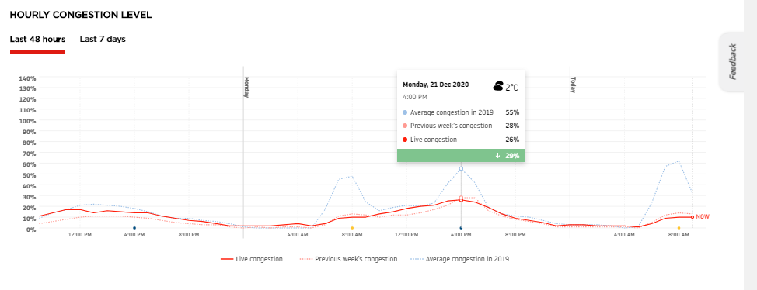
Measuring differences in road traffic intensity before and after COVID-19: an example
Source: www.tomtom.com

Slide 13
A stylized representation of a RT-BCI
For a give urban area the RT-BCI can be represented as:
RT-BCI = VRR * (1 - PBC) * (1 + DIT)
Where:
VRR = Volume of Retail Revenue for the given geographic area, estimated from Statistics Canada business data
PBC = Percentage of Business Closure estimated from a conglomerate of commercial APIs
DIT = Difference In road Traffic volume between a given week t, in 2020/21 and corresponding week in 2019, from road traffic APIs
13

Slide 14
Working towards an experimental index
Computed for major urban areas across Canada
Computed with weekly frequency
Index and dynamic visualization tool
14

Slide 15
Challenges
An experimental index comes with several challenges:
  Substantial fine-tuning and revisions are expected
  Need to avoid overinterpretation: what business conditions are we really measuring?
  Need to understand conversion of “traffic” into “business sales/revenue”
  Need to understand the shift from physical “traffic” to “virtual” traffic (online sales)
15

Slide 16
Opportunities and further developments
Experimental release of a first version of a RT-BCI can be followed by several developments
Integration with additional Statistics Canada data holdings (monthly retail, wholesale and labour surveys, etc.)
There is rapid development in private sector APIs / databases with mobility-related data at the local level:
  Foot traffic
  Road traffic
  Mobility (from-to)
16

Slide 17
Thank you
Contact: alessandro.alasia@canada.ca
17

