Slide 1
GTR9-7-13
FlexPLI Rebound Phase
7th IG GTR9-PH2 Meeting
3/July/2013
Japan Automobile Standards Internationalization Center (JASIC)

Slide 2
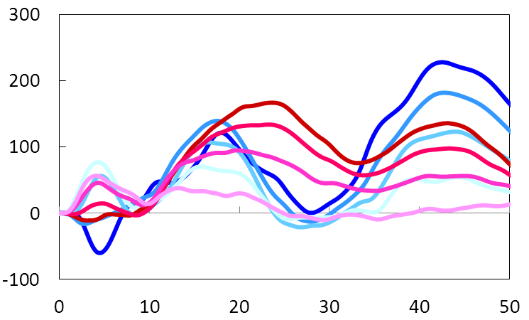
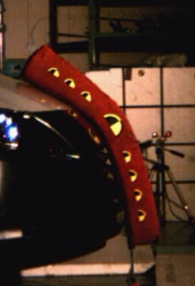
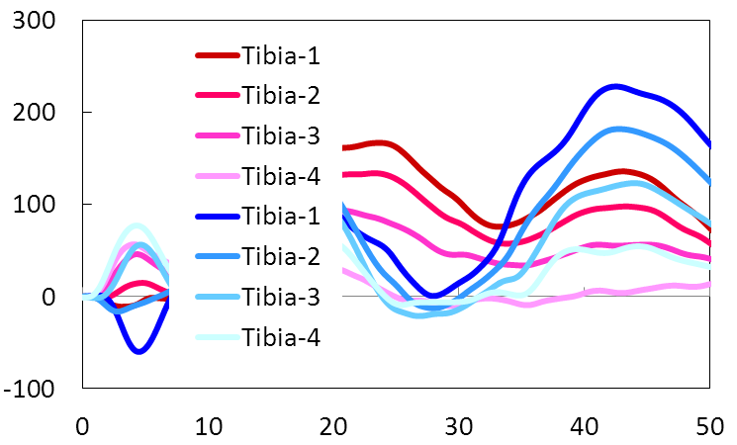
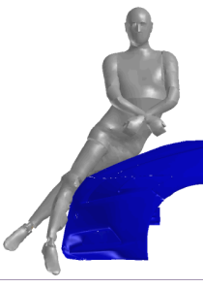
Understanding of Issue
GTR9-7-13
FlexPLI vs. Human Comparison of Tibia Bending Moment Time History
FlexPLI:
Overall peak = second peak
FlexPLI Test
Human:
Overall peak = first peak
Bending Moment (Nm)
Human Model Simulation
Time (ms)
A comparison of tibia bending moment time histories has shown that the exaggerated secondary peak of the FlexPLI model relative to the human model may affect the maximum value for some specific vehicles
The conditions under which this inconsistency takes place have been developed and validated against existing test data (example : GTR9-5-08)

Slide 3
Understanding of Issue
GTR9-7-13
Despite the technical issues identified,
  The identified inconsistency is relevant infrequently
  There are some other minor issues with regard to biofidelity inherent in a mechanical substitute of a human body
  No cases critical against the proposed injury criteria have been identified so far
  The conditions under which this inconsistency is identified has not been validated against vehicle structures completely different from the current vehicles

Slide 4
JASIC Position
GTR9-7-13
Considering these situations, the issue does not necessarily need to be further discussed and agreed for GTR9 Phase-2, prioritizing the current ToR schedule of the IWG
Provided that some issues will be resolved, the BASt proposal can be acceptable, although not fully supported due to the lack of considerations on this issue

Slide 5
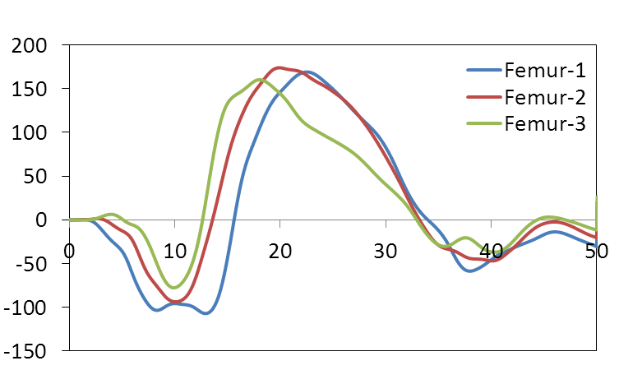
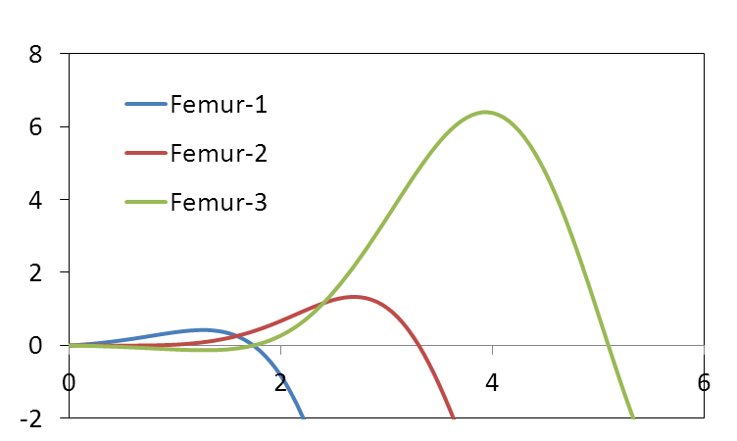
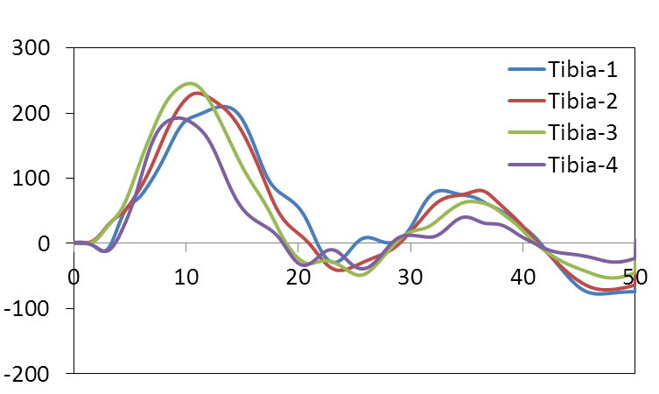
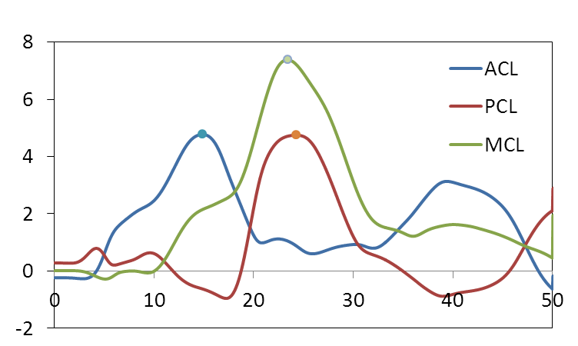
Issues with BASt Proposal
GTR9-7-13
Definition of Timing
The BASt definition may result in an unexpected definition of the effective time range
Effective time range
Femur Moment
Time History
The last zero crossing of Femur
First local maximum
Tibia Moment
Time History
Ligament Elongation
Time History
The last zero crossing of Tibia
Intended time range
The definition of the first local maximum needs to be modified

Slide 6
Issues with BASt Proposal
GTR9-7-13
Terminology – Biofidelic Assessment Interval (BAI)
  JASIC recognizes the biofidelity issue of the exaggeration of the secondary peak of the tibia bending moment
  The word ‘Biofidelic’ is recommended to be eliminated – ‘Assessment Interval’ would be supported

