Slide 1
Conclusions of the UNECE Working Party on Land Administration workshop
„Collaborating for secure ownership“
Uppsala, 29 - 31 May 2013
Gulnara Roll, Head, Housing and Land
Management Unit, UNECE

Slide 2
Who will use the workshop recommendations?
Participants of the seminar
Representatives of governmental agencies and relevant stakeholders in the UNECE region
International partner organizations – the World Bank, OECD, UN-HABITAT, others (report will be disseminated)

Slide 3
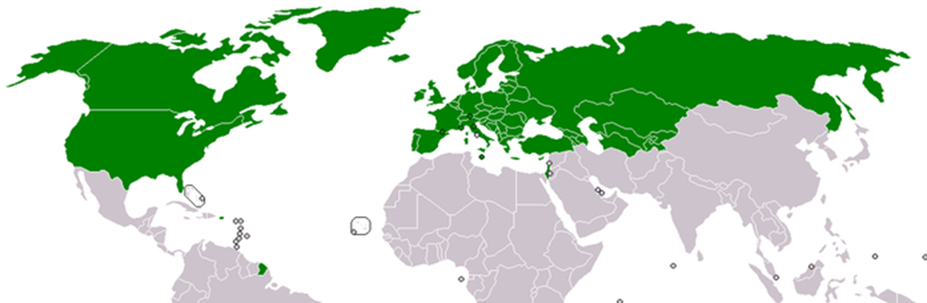
56 member States of the Committee and WPLA

Slide 4
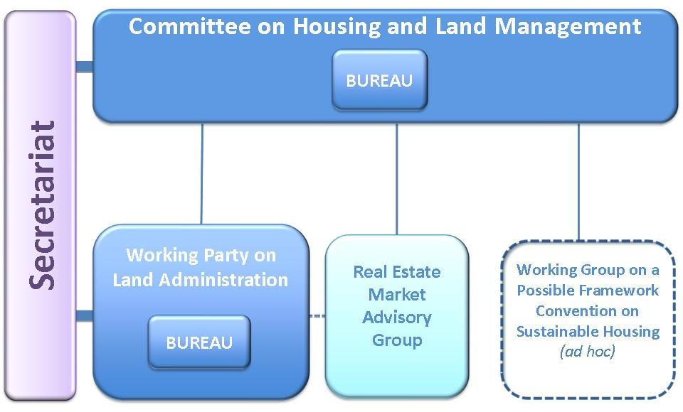
The structure of the Committee
on Housing and Land Management

Slide 5
Previous WPLA workshops
Land administration in a networked society, Amsterdam, 12 to 15 October 2011;
Supporting global economic recovery: the role of land registration authorities, London, 10 to 13 October 2012;
Spatial information, informal development, property and housing, Athens, 10 to 14 December 2012;
The challenges of land registration in Central Asia, Bishkek, 19 and 20 March 2013

Slide 6
Uppsala WPLA workshop
Took place at Norrlands nation, Uppsala
110 participants from 35 countries
Representatives of government agencies, academia, private sector, Swedish Association of Local Authorities, international organizations (UNECE, EuroGeographics, EULIS, FIG).

Slide 7
Workshop’s main question:
How can e-government be developed in a way that gives the individual land owner better service and gives the administration as a whole conditions to serve society more efficiently?

Slide 8
From land administration to land governance
Stronger communication with policy-makers, stakeholders as well as with public, higher impact on the society
Land and property register, cadaster, spatial data in general are the basis for e-governance

Slide 9
Land administration authorities as engines of the global economic recovery
Land administration is important to macroeconomy. It plays an important role in providing rules and information for the real property market.
At the same time, improvement of the data and services’ provision has a positive impact on the macroeconomic situation

Slide 10
Land administration authorities as engines of the global economic recovery
Big gains for the financial sector from making the data available online and for free. Example: Finland lost 1,5 million EUR in revenues while also gained from opening the data
Openness of the data/information to the market drives land registries work and also pays for a great deal of the business
To study and obtain the data on the financial gains from more efficient data and service provision

Slide 11
The cooperation between the different agencies and stakeholders is critically important
The cooperation brings:
Higher quality and efficiency of services
Provides more complete sets of services for certain client situations
Promotes flow of information
Increases transparency.
Importance of the cooperation with municipalities and youth..
Recommendations: Promote the cooperation using existing models (such as e-Government delegation in Sweden)

Slide 12
Example: the Swedish eGovernment operational level:
Coordination between agencies to enhance efficiency and quality;
Initiate and support strategical interagency projects;
Standartisation;
Joint guidelines.

Slide 13
Keep it simple for the user
Apply the principle „As simple as possible for as many as possible“
(the Swedish eGovernment delegation moto)
This requires
Development and implementation of business strategies to learn and accomodate customers’ needs;
Regular dialogue with stakeholders through, establishing advisory committees, workshops, testing, marketing and education;
Hiring highly qualified professionals to develop IT solutions

Slide 14
Improve efficiency and quality of operations in the administration
Organizational changes to respond to the changing economic situation
Open and flexible administration supports innovation and participation (The Swedish eGovernment delegation)

Slide 15
Move from the registration business to data provision
Data strategy
Free data – transparency agenda, a pressure to release more data for free (I,5 million EUR loss by releasing the data for free in Finland)
Data for licensing
Developing commercial products
Diversity is important.

Slide 16
Technical issues
Promote interoperability of different data registers

Slide 17
No „one size fits all“ approach in the institutional arrangements and IT systems
Organizational structures and IT systems’ solutions depend on the countries’ legal systems and traditions
Use of cultural symbols in implementation
Therefore, no „one size fits all“ approach could be used; need in meetings to exchange practices and approaches

Slide 18
Prepare users for the use of the digital content
Be proactive in promoting change of the behaviour and attitudes of the customers to promote use of the digital content through:
Education and marketing
Establishing trust and dialogue
Use tools and instruments to motivate the customers (quicker return of taxes while applying online)

Slide 19
Prepare employees to serve better the customer, especially during organizational changes
Importance of one organizational culture in agencies serving the population
When you make changes, changing the organizational culture (the soft component of the change) should be addressed with the same seriousness as the change of the organizational structure.

Slide 20
Challenges
Open data (data for free??)
Quality of data, stability of the systems
Personal data protection
Missing legal base
Simplicity versus flexibility?
To be possible discussed at next WPLA workshops:
Denmark, 2014: „How the property registries and the data they collect could be used to support public administration“ as well as
Vienna, Austria; Baku, Azerbaijan, 2015

Slide 21
Ministerial Meeting on housing and land management
Seventy-fourth session and related events
Monday, 7 October – Seventy-fourth session of the Committee
Tuesday, 8 October – Ministerial Meeting
Wednesday, 9 October – Seventy-fourth session of the Committee (continued)
When arranging the dates of your travel, please also take into account the following side events:
Monday, 7 October - Lunch seminar on the occasion of World Habitat Day 13.00, room XIX
Evening cocktail on the occasion of World Habitat Day 18.00, venue to be confirmed
Tuesday, 8 October - Special Ministerial working lunch
13.00, venue to be confirmed (reserved for Ministers only)

Slide 22
THANK YOU!
For more information,
please contact at
gulnara.roll@unece.org
http://www.unece.org/hlm/welcome.html

