Slide 1
UN-R 107
Alernative to hammer in Brazil

Slide 2

Resolution CONTRAN 445/13 (M3) defines that equivalents devices are allowed to replace safety hammer (art. 3 item IV):
CONTRAN 416/12 Annex VIII (M2)
4.1 Alternatively to the safety hammer described in item 3, another safety device of equivalent function may be used, with different characteristics, presenting format, material, dimensions and weight different to the established;

Slide 3
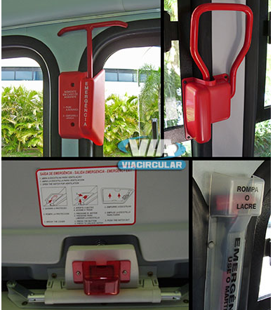
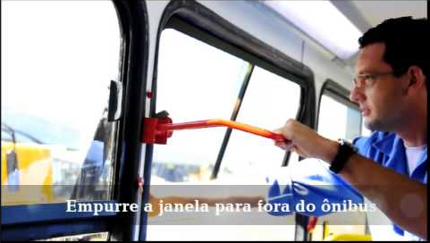
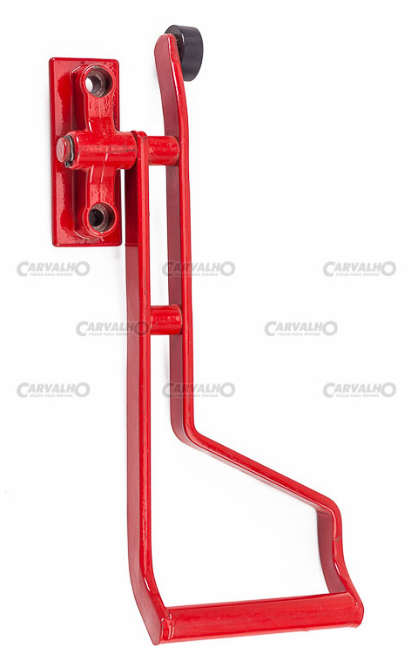
https://www.google.com/search?q=saida+de+emergencia+alavanca+BUS&rlz=1C1GCEB_enFR873FR874&source=lnms&tbm=isch&sa=X&ved=2ahUKEwjfv4ab6dvrAhVJUhoKHRZFCLEQ_AUoAXoECAsQAw&biw=1536&bih=736

Slide 4
standard NBR 15570 (Transport — Technical specification for vehicles of urban characteristics for the public transport of passengers manufacturing)
Ordinance ARTESP April/2015 - Provides for revision of the Specifications Road and Urban Vehicle Techniques for Intermunicipal Collective Transport of Passengers (specific to São Paulo state)

Slide 5
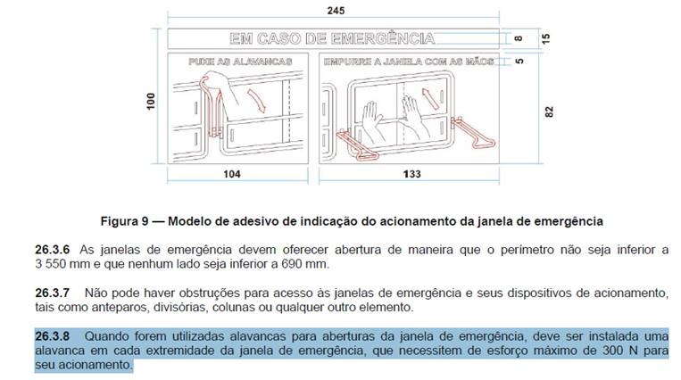
NBR 15570:

Slide 6
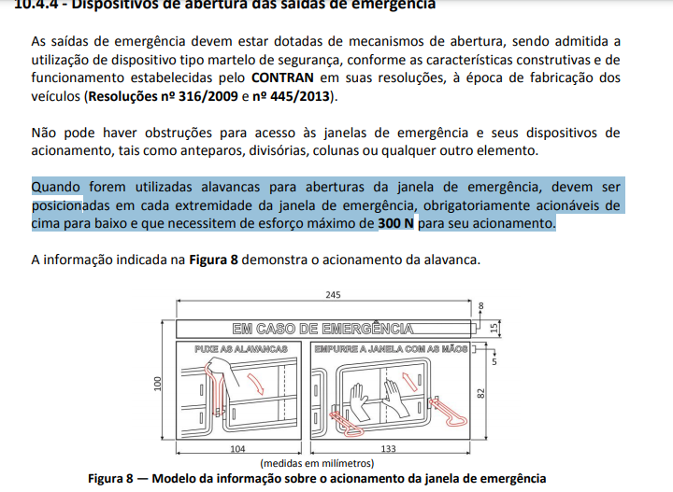
Ordinance ARTESP April/2015:

