Slide 1
Document FRAV-07-10
7th FRAV session
17 November 2020
Competent and Careful human driver performance model
Nov 17, 2020
Transmitted by experts of Japan

Slide 2
Agenda
Background
Basis for each parameter
1. Risk perceive situation
What is 0.375m?
2. Human delay
What are 0.72m and 0.75sec
3. Max Decerebration G and
What is 0.774G/0.6sec w/ AEB

Slide 3
Background

Slide 4

Accident Rate Caused by Human Factors of Driver (Highway)
97% of the accidents were related to the human factors of driver. (of which 60 % was due to delay in perception caused by caused by lack of attentiveness)
Most of the accidents can be prevented if the driver’s
level of attentiveness is high.
■Data collection criteria:
Accidents occurred on highways in Japan in which the primary responsible party was
a vehicle (automobile/motorcycle) (2017)
Accidents related to human factors: 97%
Delay in perception
Misjudgment
Delay in perception
Delay in
perception
Operation
mistake
Number of accidents
(n=8,686)
Accidents due to low level of attentiveness: 85%
Delay in perception
(inattention to the forward roadway (external))
Delay in perception (safety check insufficient)
Misjudgment (traffic environment)
Misjudgment
(inattention to the movement)
Operation mistake
Unknown
Delay in perception
(inattention to the forward roadway (internal))
Misjudgment (wrong assumption)
Special cases
Notes:
We researched how much accident reduction effect can be expected by applying attentive skilled human drivers as a boundary.
I will explain this using the highway accident data in Japan.
The data on this slide is taken from the accident research results in 2017. The number of accidents researched was 8,686 in total. Out of which, 97% were related to the human factors.
The detailed factors are shown at the bottom of this page.
From this data, we can see that most of the accidents were due to the low level of attentiveness of drivers.
(Not shown the data here, as well in the US, 94% of accidents in total is based on the human factors.)
As seen from the above, most of the highway accidents were caused by the human factors arose from insufficient attentiveness.

Slide 5
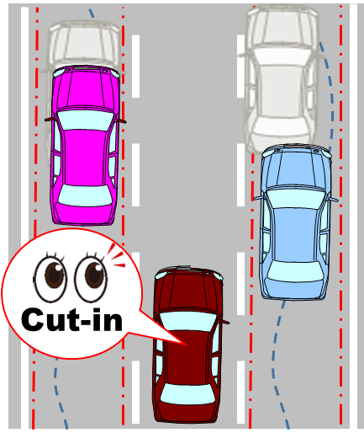
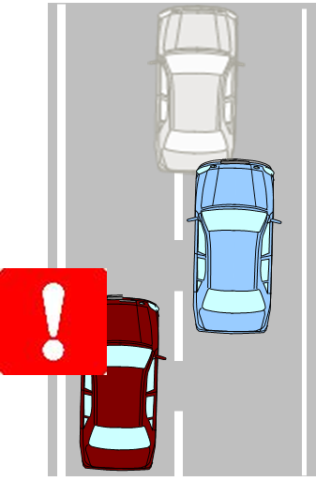

Driver Model Structure
Brake pedal
Accelerator
pedal
Brake pedal
Delay in releasing accelerator pedal
Delay in pressing brake pedal
Human reaction delay
Deceleration degree
and Max. G-force
Risk Perceive
Situation
Risk Perceived delay
Braking delay
Definition of a situation that is perceived as a risk that requires evasive action in response to the behavior of surrounding vehicles.
The time it takes to perceive the behavior of surrounding vehicles as dangerous
The time between recognizing the risk, determining avoidance action, and changing from the accelerator pedal to the brake pedal.
Definition of time and maximum G until deceleration rises to a given G
＋AEB assist
Notes:
Now, let’s move on to the driver model to be used as the reference.
Generally, when a dangerous situation occurred, driver recognizes it first. Then, makes a decision on braking maneuver, releases the accelerator pedal and moves foot to the brake pedal, and finally applies brake.
To study the driver model, we have separated this operational sequence into 3 segments. The first segment is “Risk perceive situation”, in which the risk is recognized. The second one is “Delay in time” which represents the time from the release of accelerator pedal to the application of brake pedal. And the third one is “Deceleration degree and maximum g-force” of braking maneuver.
In the following slides, I will present the further details.

Slide 6
Basis for each parameter

Slide 7
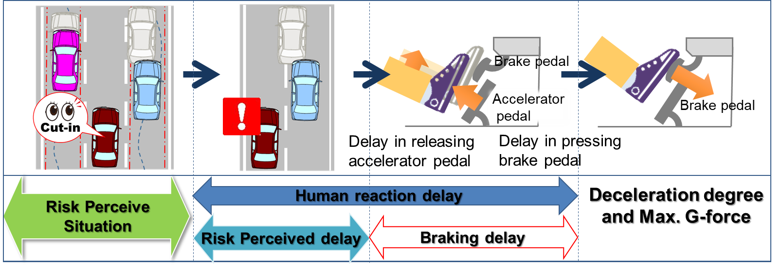
1. Risk perceive Situation
Notes:
Now, let’s move on to the Risk perceive situation part.

Slide 8

Risk Perceived Boundary by Lateral Movement
When the other vehicle is wandering within its own lane, it is unlikely that the ego-vehicle perceives the possibility of cut-in
Define the cut-in perceived boundary based on the lateral movement range of other vehicle wandering within its own lane
Risk perceived
Situation
１
ふらつきの振幅
Wandering width
Lane width =3.5m
95%tile
99%tile
One side of wandering width
0.75[m]/2=0.375[m]
50%tile
50%tile:0.75[m]
95%tile:1.59[m]
99%tile:2.02[m]
0.75
1.59
2.02
n=5244
0.375m
lateral movement
1
Wandering zone
Notes:
ここではCut-inの“Risk perceive situation”について説明する。
一般的に、人が運転する車はレーン内で左右にふらつきながら走行している。そして、Cut-inする意思があるドライバは、通常のふらつき幅を超えて移動する。
そこで、我々は一般ドライバがどの程度のふらつき幅で直進しているのかを調査した。その結果が①である。
ここで、中央値である0.75mを一般的な値とした。つまり、片側の振れ幅としては0.375mとなり、これを超えたところが、自車から見て他車がCut-inしてくると認識する瞬間の距離になる。
更に他車の横移動に対し危険と判断する時間を要する。ここでは、実測データからクリティカルな状態になり得る最大横速度を1.8m/sとし危険と判断するまでに掛かる時間を0.4secと定義した。
これらの数値から、他車がCut-inし始めて危険と判断するまでに掛かる時間を横移動量として表すと0.72mになる。それが②に当たります。
そして、①と②を足し合わせたところから緊急回避ブレーキの操作が行われる。
This slide explains the “Risk perceive situation” for the cut-in scenario.
A human-driven car usually travels within its lane with wandering movement. When the driver intends to cut-in, he/she will make a lateral movement beyond the normal wandering range.
Considering these aspects, we studied the wandering range of normal drivers when they are driving straight forward. The results are shown in ①.
Based on the results, the reference value was set to 0.75m, which is a median value of the wandering range. This means that the wandering range to the right or left from the center is 0.375m. If the other vehicle moves beyond this range, the ego-vehicle will judge that the other vehicle is trying to cut-in.
Additionally, it was necessary to consider the time to perceive the risk against the lateral movement of other vehicle.
In this case, according to the actual measurement data, the Max. lateral velocity and the time to perceive the risk were specified as 1.8m/s and 0.4 second respectively.
Using these values, the time to perceive the risk was converted into the lateral movement amount, and 0.72m was obtained as shown in ②.
The emergency braking maneuver will be initiated when the lateral movement amount exceeds the sum of ① and ②.

Slide 9
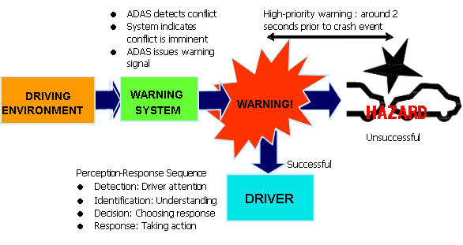
Risk Perceived Boundary by Longitudinal Distance
Based on the UNR guidelines on warning signals, define
Time To Collision (TTC) of 2.0 seconds as the boundary of emergency braking area
Emergency braking area
（TTC＜＝２sec)
Low-level: driver prepares action or decision within 10 seconds to 2 minutes;
may escalate to a higher level if not acted upon;
(b) Mid-level: requires action or decision within around 2 to 10 seconds;
may escalate to high-level warning if not acted upon;
(c) High-level: warning requires the driver to take immediate action or decision
(0 to around 2 seconds) to avoid a potential crash that could result in serious
injuries or fatalities.
Warning
2.0 seconds prior to crash event
「ECE/TRANS/WP.29/1091/Add.1
Annex III Guidelines on establishing requirements
for high-priority warning signals」
Notes:
TTC of 2.0 seconds is defined according to the UNR guidelines on warning signals.
TTC2秒については、UNR衝突警報ガイドラインを引用しました。

Slide 10
2. Human reaction Delay
Notes:
Now, let’s move on to the Risk perceive situation part.

Slide 11

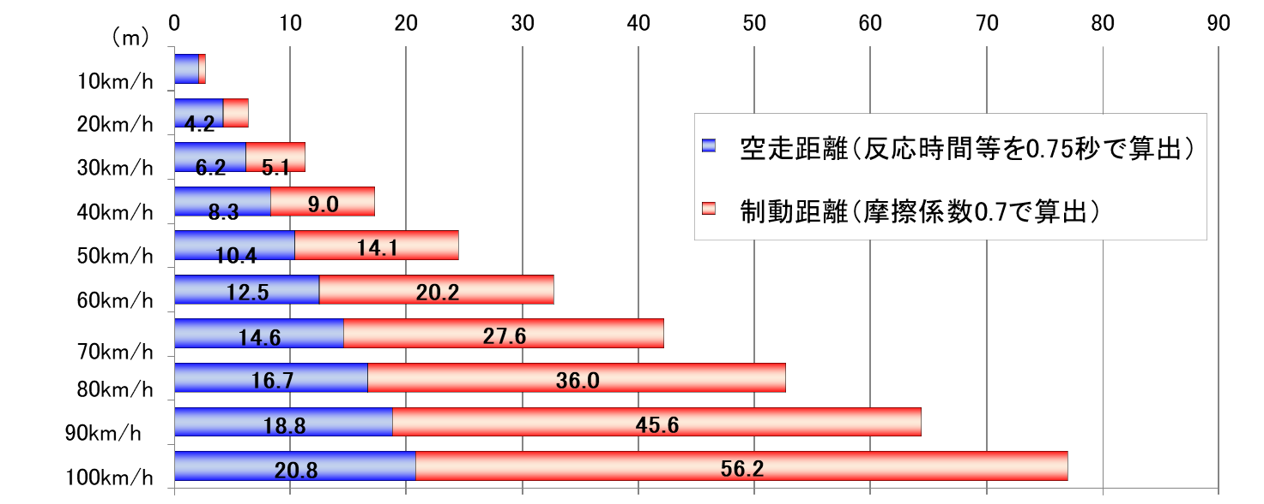
Braking Delay
Braking delay 0.75sec is the value commonly used to calculate the stopping distance among the police and the courts in Japan.
Stopping Distance against velocity
Velocity / Stopping Distance = Braking Delay ≒ 0.75
■Free running distance
distance from the point at which the driver judges that emergency braking is necessary because of the danger,
■Braking distance
Distance to stop from deceleration
Reference: https://www.pref.niigata.lg.jp/uploaded/attachment/226116.pdf
※This value has been in use since about 1967.

Slide 12
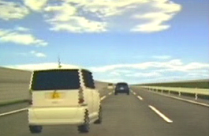
Analysis of Risk Perception Time by DS Test
Analyze DS test data of driver reaction time against cut-in by other vehicle
■ Measure risk perception time (time to react and avoid) of drivers against cut-in by other vehicle with 11 test participants
DS test summary
Parameter | Value
Lane width | 3.5 m
Ego-vehicle target velocity V_{e} | 100 km/h
Platoon velocity traveling in parallel forward V_{o} | 70 km/h
Max. lateral velocity of cut-in vehicle V_{oL} | 1.8 m/s
TTC at cut-in start | 3.0 s
Cut-in
Test group details
No. of participants | Description | Composition of participants
11 | Having 5 years or more driving experience on regular basis, drives on highway at least once a month | - 6 Males, 5 Females - Avg. age: 38.7
Notes:
ここでは、“危険と判断する時間”について説明する。
先程、危険と判断するまでに掛かる時間を0.4secと定義した。この根拠はDriving Simulatorによって被験者テストを行った結果である。
２０名の被験者のCut-inに対する反応時間と回避操作を計測した。
Cut-inの条件及び被験者の属性はこの表の通りです。
Now we will explain the “Risk perception time”.
As previously mentioned, the time to perceive the risk was specified to 0.4 second.
This value was obtained from the Driving Simulator test.
In this test, the time required to react and avoid the cut-in were measured with 20 participants.
The details of cut-in conditions and test groups are shown in the tables on the slide.

Slide 13
Risk Perception Time Against Cut-in by Other Vehicle
Average time of risk perception was 0.8 sec in the first trial, and 0.4 sec in the second and subsequent trials
Total delay of driver's reaction to cut-in by other vehicle
Cut-in start
Release accelerator pedal
Transfer foot
Brake pedal
Brake pedal
Accelerator pedal
Accelerator pedal
Risk Perceive
Situation
<1st trial>
Risk Perceived
Delay
Braking delay=0.75s
<2nd and subseq. trials>
Risk Perceived
Delay

Slide 14
Risk Perception Time Against Cut-in by Other Vehicle
Average time of risk perception was 0.8 sec in the first trial, and 0.4 sec in the second and subsequent trials
Time to perceive risk after other vehicle started to cut-in
0.87 0.47
Time[sec]
Avg.
1st 2nd and subseq.
（n=4） (n=4)
- 1st trial: Approx. 0.9 sec.
- 2nd and subseq. trials: Approx. 0.5 sec.
※The collected data are results of same TTC and brake avoidance with the same cut-in timing.
Notes:
この結果、初回と２回めでは危険と判断するまでの時間に大きな差があることが分かった。
初回の判断時間は0.8sec、２回目以降は0.4sec
この理由について考察したのが次のスライドになります
The test results indicated that there was a significant difference in risk perception time between the 1st and 2nd trial.
The 1st trial showed that risk perception requires 0.8 second but the 2nd trial only required 0.4 second.
The reason for this difference will be discussed in the next slide.

Slide 15
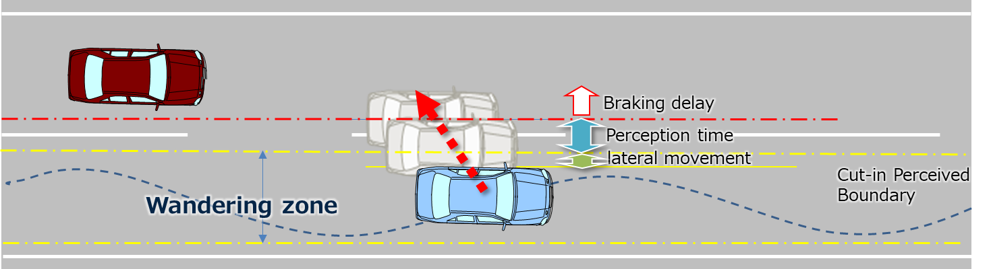
Driver Reaction Time Against Cut-in
In 2nd trial driver has learned the protocol in 1st trial and will expect the cut in just after starting the lateral movement of the vehicle in adjacent lane.
<1st trial>
0.8s
<2nd and subseq. trials>
0.4s
Notes:
初回は、被験者は何が行われるか分からない状況であり、他車がCut-inしても危険と判断するまでに多くの時間を要する。
しかし２回目以降はCut-inすなわち危険であると学習するため、他車がカットインしたら即危険と判断する。
この結果、即危険と判断しても0.4secは必要であることが得られた。
我々はスキルドドライバを提案するため、常に注意力を高めたドライバとして、反応時間は0.4secで設定した。
In the first trial, test participants did not recognize the situation immediately and thus required longer time to perceive the risk when the other vehicle started to cut-in.
However, in the second trial, participants perceived risk immediately after the cut-in, because they had learnt that cut-in could lead to danger.
According to the test results, it became clear that at least 0.4 second was required to make a decision even if attention was paid.
We adopted this 0.4 second as the reaction time because our proposal is grounded on the skilled drivers who always pay attention.

Slide 16
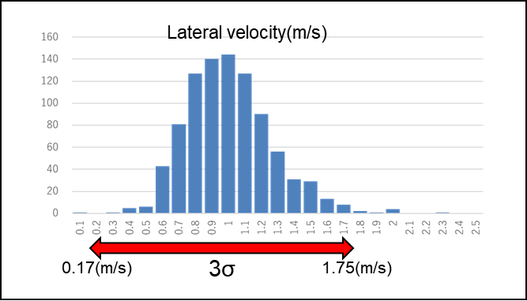
Risk Perceived Boundary
Risk perceived boundary
When the lateral velocity is slower then the risk perception time become longer.
So the quicker risk perception time, which is more demanding to AD, is adapted as assumption.
Max lateral velocity：1.8m/s
Risk perception time：0.4sec
1.8m/sec*0.4sec=0.72[m]
1.8(m/s)
n=911
Emergency braking area
（TTC＜＝２sec)
0.72m Risk Perceived Boundary
Cut-in Perceived
Boundary
Wandering zone

Slide 17
3. Deceleration degree and Max. G-force
Notes:
Now, let’s move on to Deceleration degree and Max.G-force.

Slide 18
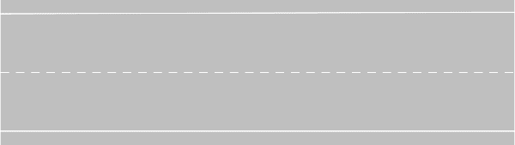
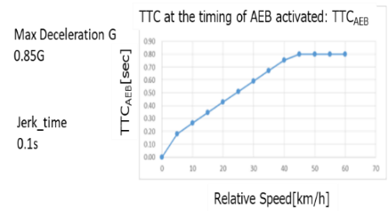
Deceleration Degree and Max. G-force
Emergency braking area
TTC：2.0sec
Entered emergency braking area
Cut-in Perceived Boundary
Center of lane
Reference Driver
AEB
C2-a
Max. Deceleration G: 0.774 G (tentative)
Ego-vehicle deceleration
Delay in time
=0.75sec
+
C2-b
Deceleration degree:
0.6 sec (tentative)
Time
Entered emergency braking area
Notes:
次に、Deceleration Degree と Max. G-forceについて説明する。
ここで定義するのは、進行方向のEmergency braking areaであるTTC、ブレーキペダルを踏む速さとしてのDeceleration Degree、そして最大減速Gである。
これらについて次スライドで説明する。
Now, we will explain the deceleration degree and the max. g-force.
In this part, the TTC which represents the emergency braking area in travelling direction, the Deceleration degree which shows the brake application force, and the Max. deceleration g-force will be defined.
The details will be provided in the next slide.

Slide 19
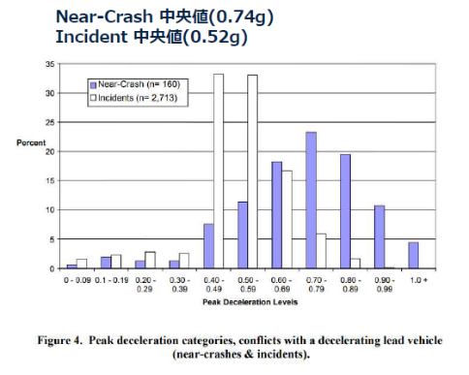
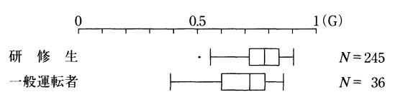
C2-a
Max. deceleration G-force
Page 14
Trained drivers’ Max. deceleration G-force: 0.774G
=> Define the driver model with skilled drivers
who have driving skills superior to regular drivers
【JP】
【US】
A study example of emergency braking characteristics of driving trainees in Japan
Near-Crash median (0.74 G)
Incident median (0.5 G)
- Regular drivers ：0.689 G
- Trained drivers* ：0.774 G
*Trained drivers: Trainees of Japan Safe Driving Center (JSDC) Central Training Academy for Safe Driving
0.774
Trained drivers
Regular drivers
(Makisita et al., 2001)
*Dry road surface
(NHTSA, 2007)
・100-car naturalistic driving study
・Age group: 18-20(15％), 21-24(20%),
25-34(17%), 35-44(18%), 45-54(18%), 55+(12%)
・ 183 Trained drivers, (JP, 21～65years old)
Notes:
Now, I will explain the maximum deceleration G-force in the emergency braking area.
The data on the left of this slide shows the study results of braking characteristics of human reported by the Japan Safe Driving Center in 2001. The graph on the right is taken from the research report of NHTSA in 2007.
The study results in Japan provide the data of regular drivers and trained drivers of the Japan Safe Driving Center, in which the difference in the maximum G-force between these drivers are shown.
From this result, it can be confirmed that the trained drivers, namely, the expert drivers, have high level of driving skills.
Based on this, we decided to use the maximum G-force (0.774G) of expert drivers as the reference value for the emergency braking area.
This value is also consistent with the median value observed in near-crash events reported by NHTSA.
まず最初に緊急制動エリアの最大Gについてです。
左の図は、2001年に自動車安全運転センター中央研修所が発表した人の緊急制動特性の調査結果です。右の図は、2007年にアメリカのNHITSAが調査した結果です。
日本の調査は一般ドライバと訓練を受けた中央研修所の所員のデータがあり、その最大Gに差があります。
訓練を受けたドライバ、つまり熟練ドライバはこの結果を見ても技量が高いことが分かります。
我々は、この熟練ドライバの最大G（0.774G）を緊急制動エリアのリファレンスとしました。この数値はNHITSAの事故を回避したドライバの中央値とほぼ一致しています。

Slide 20
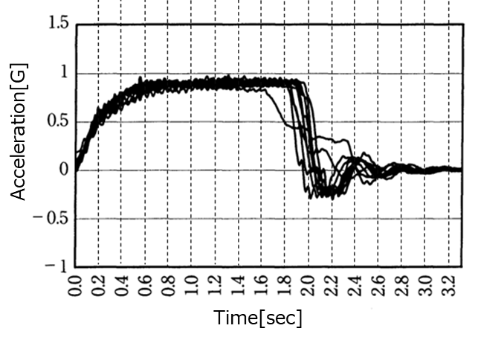
C2-b
Achieving Time to max G
Trained drivers’ time to reach Max. deceleration: 0.６second
■Acceleration waveforms of trained drivers
・ 183 Trained drivers, (JP, 21～65years old)
0.6s
Achieved steady deceleration state of 0.9 G within 0.6 second
(Based on the graph)
(Makisita et al. , 2001)
Notes:
This slide shows the Deceleration Degree in the Emergency Braking Area.
For Japan, we adopted the data of drivers who received training from the Central Training Academy of Japan Safe Driving Center.
According to this data, time to reach the maximum G-force was about 0.6 second.
Based on these results, we defined the max deceleration degree of 0.6 second for the emergency braking area.
これは、緊急制動エリアにおける減速度の傾きについてです。
日本のデータは先程の自動車安全運転センター中央研修所のトレーニングを受けたドライバのデータを引用しています。
この結果から、最大Gに至るまでの到達時間は0.6秒程度でした。
以上の結果から、我々は、緊急制動エリアにおける減速度の傾きは0.6秒と設定しました。

Slide 21
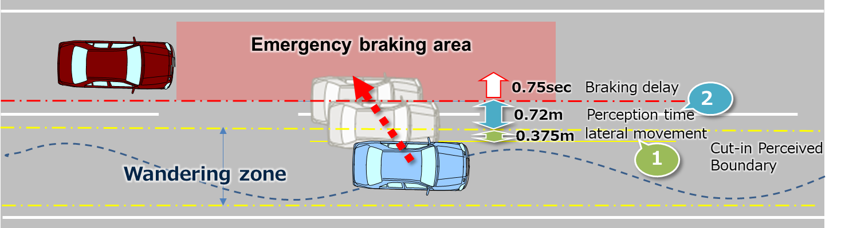
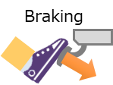



Competent and Careful human driver performance model
Risk Evaluation and Decision
Reaction
Risk evaluation
Delay in decision
Reaction delay
Next car started interrupt to me
How to avoid?
Release accelerator pedal
Transfer foot
Apply brake
or
to Brake pedal
Danger！
Brake pedal
Braking!
Accelerator pedal
Driver
Driver
Accelerator pedal
Situation
Perception
Driver
Breaking Delay=0.75sec
Time to enable braking
Risk Perceived Delay
Foot transfer
Decide emergency braking is required
Release accelerator pedal
Accelerator pedal
Brake Maneuver
AEB:0.85G
0.375m
0.72m
Driver:0.774G
Decision on braking
Time
Behavior
Start
Cut-in
Perceive
Risk
Perceived
Accelerator pedal completely released
Start
Deceleration
Max. Deceleration G: 0.774 G (tentative)
Ego-vehicle deceleration
Delay in time
=0.75sec
+
Deceleration degree:
0.6 sec (tentative)
Time
Entered emergency braking area

