Slide 1

Session 8
Status Review and Session Orientation
Document FRAV-08-03
8th FRAV session, 8 December 2020
Web Conference
8 December 2020

Slide 2
Today’s Agenda
Adoption of the agenda
Adoption of the reports of the previous sessions
FRAV status and consensus to date
ADS level of safety
Elaboration of the five starting points
Updates to Documents 4 and 5
Next steps and deliverables

Slide 3
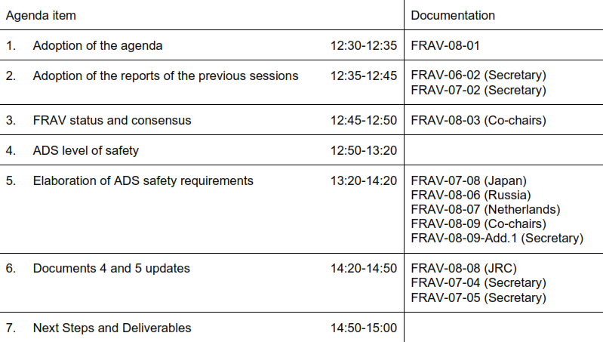
Agenda Item 1
Adoption of the Agenda

Slide 4
Agenda Item 2
Adoption of the Reports
Adoption of the agenda
Adoption of the reports of the previous sessions
  FRAV-06-02 (confirmation of adoption)
  FRAV-07-02 (request for comments, if any)
FRAV status and consensus to date
ADS level of safety
Elaboration of the five starting points
Updates to Documents 4 and 5
Next steps and deliverables

Slide 5
Agenda Item 3
Review of FRAV Points of Consensus (1/2)
“Automated Driving System” (ADS) means the hardware and software that are collectively capable of operating a vehicle on a sustained basis.
FRAV requirements specifically regard the ADS and its performance in the operation of a vehicle.
Operational Design Domain (ODD) refers to the operating conditions under which an ADS is designed to function.
ADS may be designed to function under more than one discrete set of operating conditions (i.e., more than one ODD).
“(ADS) feature” means an application of ADS hardware and software designed specifically for use within an ODD.
An ADS may have one or more features as defined by their unique ODD.
“Operational Design Domain” means the operating conditions under which an ADS feature is specifically designed to function.
In operation, the ADS continuously controls the vehicle motion, monitors the vehicle environment, interacts with other road users, and determines responses to road and traffic conditions (collectively known as the Dynamic Driving Task (DDT)).
The ADS has functions that collectively perform the entire DDT while the ADS is in use.
The ADS monitors the functions and safely manages failure modes when detected.
The ADS functions enable the features to operate the vehicle within the ODD of the feature.
An ADS feature may use all or some of the functions of the ADS.
ADS features may share ADS functions.
An ADS should be assessed based on its intended use(s) and limitations on the use of its features.
ADS requirements should be technology-neutral and performance-based.

Slide 6
Agenda Item 3
Review of FRAV Points of Consensus (2/2)
ADS requirements should be applicable across the anticipated diversity of configurations (i.e., features and functions).
ADS assessments require information specific to the configuration of the ADS (i.e., features, functions, ODD, other usage specifications).
Manufacturers provide the information specific to the ADS design and intended uses.
FRAV will define mandatory requirements for ADS descriptions (i.e., ODD elements, other usage specifications).
The manufacturer description of the ADS provides a means to determine the application of the ADS performance requirements.
The NATM process should begin with a review of the ADS description to verify fulfillment of the mandatory description requirements and to determine the application of the performance requirements.
The ADS requirements should be derived from the following safety perspectives:
  The ADS should drive safely.
  The ADS should interact safely with the user.
  The ADS should manage safety-critical situations.
  The ADS should safely manage failure modes.
  The ADS should maintain a safe operational state.
No comments received since the last session.
If there are reservations, concerns, or questions regarding these points, please convey them to the FRAV secretary. FRAV will address the issues at a future session.

Slide 7
Today’s Agenda
Adoption of the agenda
Adoption of the reports of the previous sessions
FRAV status and consensus to date
ADS level of safety
Elaboration of the five starting points
Updates to Document 5
Updates to Document 4
Next steps and deliverables

Slide 8
Agenda Item 4
Overall Level of Safety
C&C human driver (Japan)
State-of-the-Art (Germany)
Safety envelope
Statistical positive risk balance
Combining methods (JRC)
We have discussed performance levels during the past four sessions.
Improve road transport
Performance based
Technology neutral
Measurable
Social acceptance
Feasibility
FRAV-01-13 (safety elements list)
142 candidates list
WP.29-186-10 (common FPR)
FRAV-06-04 (OICA/CLEPA administrative exercise)

Slide 9

Agenda Item 4
Overall Level of Safety
Can we agree on an “overall level of safety” guiding principle?
ADS will initially be deployed in human-dominated traffic
ADS will be used by humans
Human error is the critical factor in 90%+ of crashes
ADS should not cause crashes

Slide 10
Agenda Item 4
Overall Level of Safety
ADS will initially be deployed in human-dominated traffic
  The ADS driving behavior should be consistent with norms of human driving
ADS will be used by humans
  The ADS should meet human user expectations
Human error is the critical factor in 90%+ of crashes
  ≈ 40% recognition errors (inattention)
  ≈ 33% decision errors (illegal, false assumption)
  ≈ 11% performance errors (poor control)
ADS should not cause crashes
  All of the above while avoiding introduction of new ADS-specific risks

Slide 11
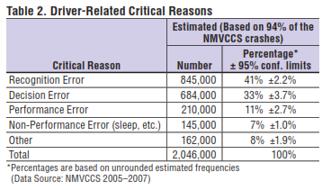
Agenda Item 4
Overall Level of Safety
ADS performance should be consistent with human driving behaviors while avoiding human recognition, decision, and performance errors and the introduction of new risks.
“Careful and competent human driver”
  Build out data on human responses to traffic situations
“State-of-the-art” based on technological feasibility
  Define technical parameters within range of optimal human behaviors
“Safety envelope”
  Mathematical formulas based on technical parameters and conditions
Statistical “positive risk balance”
  Optimal human behaviors omitting human errors

Slide 12
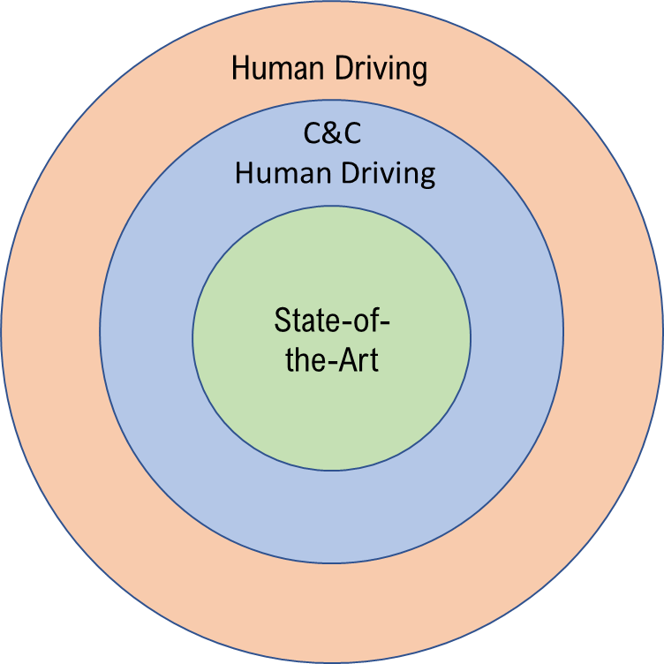
Agenda Item 4
Overall Level of Safety
ADS performance should be consistent with human driving behaviors while
avoiding human recognition, decision, and performance errors and the introduction of new risks.
Outline of Further Work
Research on human driver responses under scenarios
Typical “safe driver” responses and performance ranges
Comparison against ADS capabilities
Define minimum ADS performance

Slide 13
Today’s Agenda
Adoption of the agenda
Adoption of the reports of the previous sessions
FRAV status and consensus to date
ADS level of safety
Elaboration of the five starting points
  (Japan) FRAV-07-08: Comments on Germany’s review of FRAV-06-04 (FRAV-06-11)
  (Russia) FRAV-08-06: Comments on 142 candidates (FRAV-07-09)
  (Netherlands) FRAV-08-07: Comments on FRAV-06-04
  Co-chair proposal for structuring further work
Updates to Document 5
Updates to Document 4
Next steps and deliverables

Slide 14
Agenda Item 5
Performance Requirement Starting Points
ADS should drive safely. (Ensure safe behavior of the ADS as “the driver”)
ADS should interact safely with the user. (Ensure safe use of ADS and safe interactions with the user such as transfers of control, user override, etc.)
ADS should manage safety-critical situations. (Differentiate between normal driving and emergency situations to ensure safe responses to the latter)
ADS should safely manage failure modes. (Ensure safe responses to system malfunction, physical damage, etc.)
ADS should maintain a safe operational state. (Ensure safety throughout the useful life of the ADS, such as safety critical updates, response to obsolescence)
Response to request for stakeholder comments on
FRAV-07-09 and FRAV-06-04 insufficient to confirm consensus

Slide 15
Agenda Item 5
Co-Chairs’ Guidance Proposal
Co-chairs recognize the challenges facing stakeholders under the current circumstances
  Break down starting points into smaller topics
Guidance is based on all 142 candidates
  For transparency, a concordance between the guidance and the 142 candidates has been prepared.
Guidance proposes topics for further discussion based on all stakeholder views and input
  The guidance neither endorses nor rejects stakeholder input
  The guidance proposes discussion topics under the five starting points.
  The intent is to use these topics to stimulate more detailed and focused discussions at future FRAV sessions.

Slide 16
Agenda Item 5
ADS should drive safely
The ADS should perform the entire Dynamic Driving Task.
  The ADS should control the longitudinal and lateral motion of the vehicle.
  The ADS should recognize the ODD conditions and boundaries of the ODD of its feature(s).
  The ADS should detect, recognize, classify, and prepare to respond to objects and events in the traffic environment.
The ADS should respect traffic rules.
The ADS should interact safely with other road users.
The ADS should adapt its behavior in line with safety risks.
The ADS should adapt its behavior to the surrounding traffic conditions.
The ADS behavior should not be the critical factor in causation of a collision.

Slide 17
Agenda Item 5
ADS should interact safely with the user
Activation of an ADS feature should only be possible when the conditions of its ODD have been met.
The ADS should signal when conditions indicate a probable ODD exit.
The user should be permitted to override the ADS to assume full control over the vehicle.
The ADS should safely manage transitions of full control to the user.
  Prior to a transition of control to the user, the ADS should verify the availability of the user to assume control.
  Pursuant to a transition, the ADS should verify full control of the vehicle by the user prior to deactivation.
The ADS should tolerate user input errors.
The ADS should provide feedback to the user on its operational status.
The ADS should warn the user of failures to fulfill user roles and responsibilities.
The user should be provided with information regarding user roles and responsibilities for the safe use of the ADS.

Slide 18
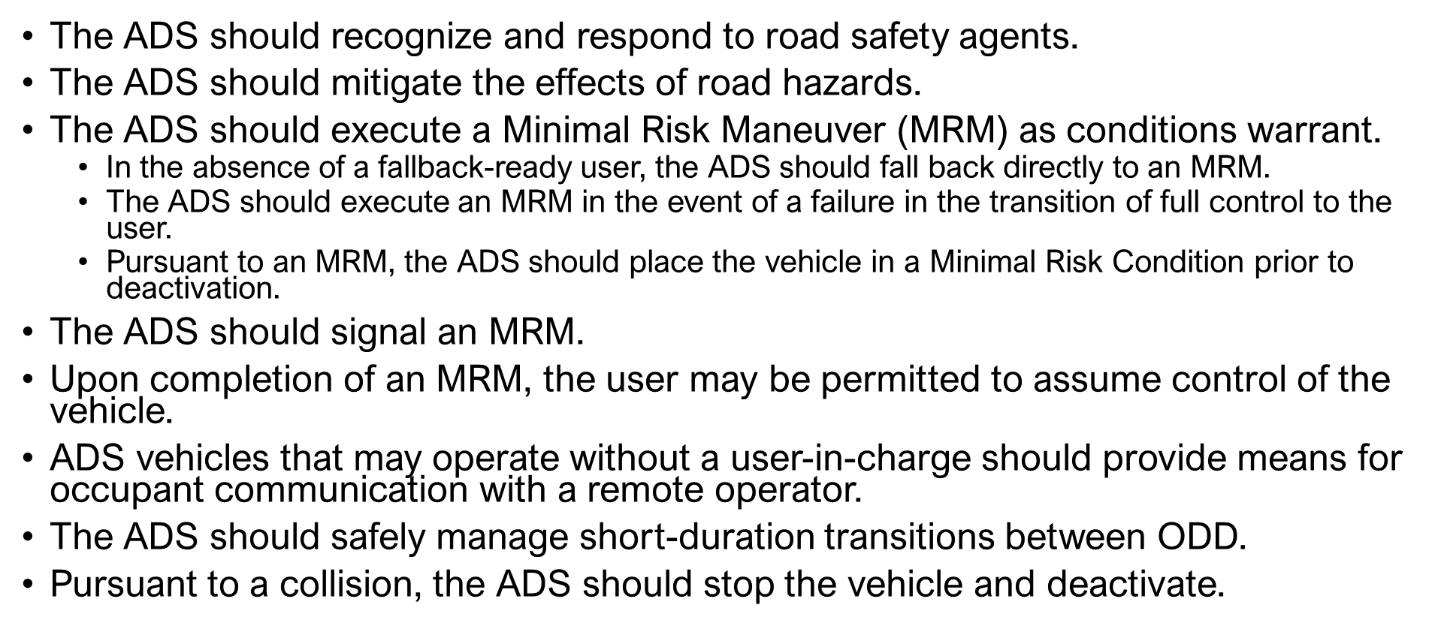
Agenda Item 5
ADS should manage safety-critical situations

Slide 19
Agenda Item 5
ADS should manage safety-critical situations
Reminder: Under this heading, SAE found a focus on emergency responses to other road user actions and sudden events clearer. Discussion of MRM here could be confusing because MRM can be associated with system failures.
Is MRM better addressed under another topic?

Slide 20
Agenda Item 5
ADS should safely manage failure modes
The ADS should detect system malfunctions and abnormalities.
The ADS should execute a safe fallback response upon detection of a failure that compromises performance of the DDT.
Provided a failure does not compromise ADS performance of the entire DDT, the ADS should respond safely to the presence of a fault in the system.
The ADS should signal faults and resulting operational status.

Slide 21
Agenda Item 5
ADS should maintain a safe operational state
The ADS should be permanently disabled in the event of obsolescence.
Pursuant to a collision and/or a failure detected in DDT-related functions, ADS activation should not be possible until the safe operational state of the ADS has been verified.
The ADS should signal required system maintenance to the user.
The ADS should be accessible for the purposes of maintenance and repair to authorized persons.

Slide 22
Today’s Agenda
Adoption of the agenda
Adoption of the reports of the previous sessions
FRAV status and consensus to date
ADS level of safety
Elaboration of the five starting points
Updates to Documents 4 and 5
  FRAV-07-04: Document 4 status
  FRAV-07-05: Document 5 status
  (JRC) FRAV-08-08: Comments on safety requirements and definitions
Next steps and deliverables

Slide 23
Agenda Item 6
FRAV-07-04 (posted 25 November based on 7th session discussions)
Separated record of discussions and related background sections of Document 5 into a separate document (i.e., Document 4)
Updated record to better reflect Japan input per the 7th session discussions.
Presently covers decisions through the 5th session pending further consensus decisions coming out of the “level of safety” and next-level “elaboration of requirements” discussions.

Slide 24
Agenda Item 6
FRAV-07-05 (posted 25 November based on 7th session discussions)
Updated definitions per the 7th session discussions
  DDT: Description of “tactical” and “operational” functions per FRAV request
  “Activation” of MRM and MRC definitions (unconsidered text now pertinent)
  User-related definitions (including “fallback-ready user”)
  “transition of control” definition
Descriptions of the five starting points
Please review and comment
FRAV-08-05 will propose text based on today’s discussion and comments received on FRAV-07-05.
  Comments welcome anytime but aim to post FRAV-08-05 by 18 December

Slide 25
Today’s Agenda
Adoption of the agenda
Adoption of the reports of the previous sessions
FRAV status and consensus to date
ADS level of safety
Elaboration of the five starting points
Updates to Documents 4 and 5
Next steps and deliverables

Slide 26
Agenda Item 7
Next session
Next session 12 January
  Reach agreement on FRAV-07-05 updates
  Review updates introduced in FRAV-08-05
  Reach agreement on overall level of safety principle
  Consider input on work plan and research/data needs
    Available research and/or research centers on human driving performance
    Available research and/or research centers on ADS driving performance
  Discussion of topics under “ADS should drive safely”
Provide submissions by 6 January to facilitate 9th session preparations
Proposal for 10th FRAV session on 2 February
  Review submission(s) to GRVA February session

Slide 27
Agenda Item 7
Next session preparation requests
Comments on FRAV-07-05, if any
Comments on the overall level of safety principle, if any
Input on “drive safely” topics with a view towards measurable/verifiable descriptions
Potential resources for data on driving norms/performance
Deadline for written submissions: 6 January

