Slide 1
JRC comments on safety requirements and definitions
Document FRAV-08-08
8th FRAV session, 8 December 2020
8th FRAV Meeting
08 December 2020
M.C. Galassi, C. Sollima, B. Ciuffo, K. Mattas

Slide 2
Safety Requirements
Valid thorughout the vehicle lifecycle/lifetime
1. ADS should drive safely: requirement on roadmanship/normal driving? Maybe performance requirements should go with behavioural evaluation too (scoring)
2. interact safely with the user AND OTHER ROAD PARTICIPANTS
5. ensure a safe operational state throughout the useful life of the vehicle: are end-of-life requirements included here (e.g. data handling, permanent deactivation…)? Requirements also needed in case of discontinued production/assistance/maintenance

Slide 3
Definitions
Foreseeable: A foreseeable event or situation is one that can be known about or guessed before it happens (Cambridge Dictionary).
Should be based on expert judgement (e.g. by heterogeneous group of experts as suggested by STPA technique for safety analysis) and
Supported by tools and methods already used in other fields (e.g. see generation of new scenarios presented in VMAD-05-04 CDV Overview.pdf by SAFE)

Slide 4
Definitions
ADS feature / function : our aim is to define Safety Objectives and Requirements, therefore we should focus on safety function (and feature, i.e., last item of the chain) definition rather than on the design approach (i.e. there might be systems/subsystems/features outside the ADS that might be called by ADS to perform safety functions relevant to ADS operation)
ODD definition: operating conditions under which an automated driving system (together with the related subsystems, components and features) is specifically designed to function

Slide 5
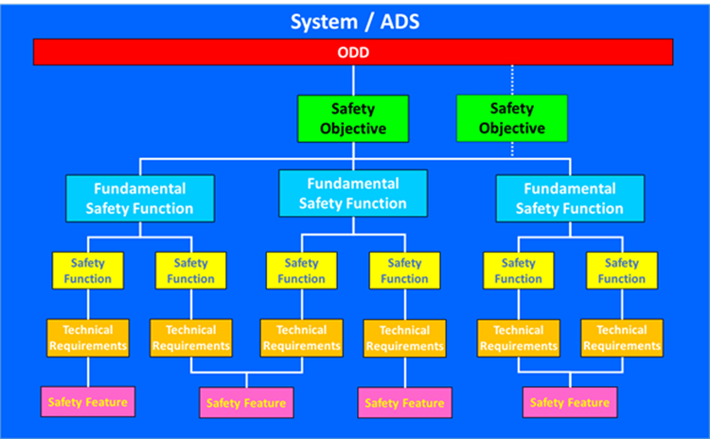
Definitions

Slide 6
Definitions
Safety function : A specific purpose that must be accomplished for safety for a vehicle or activity to prevent or to mitigate consequences of normal operation, operational disturbance and accident/emergency conditions.
Fundamental safety function : A specific safety function of the whole ADS.
Safety feature : is an item designed to perform a safety function for design conditions or that has a safety function for design conditions (I.e., designed not to perform a safety function, but in some design condition it performs also a safety function). It includes the collection of equipment that provides services such as cooling, lubrication and energy supply required by the protection system and the safety actuation systems.

Slide 7
System / ADS
Motorway (all weather/light conditions, in EU)
Safety Objective: not to cause accidents that are foreseeable and preventable
Safety Objective
Automated Lane Keeping System
Automated Lane Change System
Fundamental Safety Function
Keep the lane
OEDR
Safety Function
Safety Function
Safety Function
Safety Function
Technical Requirements
Technical Requirements
Technical Requirements
Technical Requirements
Technical Requirements
Technical Requirements
Safety Feature: HDW and SFTW to perform the safety function
Safety Feature
Safety Feature
Safety Feature
Notes:
From ISO26262:
(not FUNCTION nor FEATURE are defined)
"design feature such as a hardware part"
Hardware part = "a portion of a hardware component at the first level of hierarchical decomposition"
Component="non-system level element that is logically or technically separable and is comprised by more than one hardware part or in more than one software units"
System = "set of components or sub-systems that relates at least a sensor, a controller and an actuator with one another"

Slide 8
Comments
Safety does not modify the design process, but represents and additional design objective.
Safety is related to all the conditions of the vehicle and all the implemented systems.
Vehicle “System / ADS”
A vehicle can be designed either to be an ADS or to host an ADS
From the design, it is known the difference between System – subsystem – component – item;
Considering the above, an “ADS” can be considered as the whole system and all the specific ADSs as subsystems (eg., ALKS 60 km/h, ALKS 130 km/h, …) performing a fundamental safety function.
“Fundamental safety functions vs Safety functions”
Every system has its own functions.
If an ADS is considered as “ a whole system” of the vehicle, then the specific ADSs can be defined as “Fundamental safety functions”. The related functions will be defined as “Safety functions”.

Slide 9
Comments
Functions vs Safety functions”
According to the “Fundamental safety principle”, stated above, an ADS is a Safety system. All its functions must satisfy safety principles and objectives.
Indeed it is more appropriate to state that an ADS has “safety” functions.
On the other hand, other systems of a vehicle (e.g., the side glass control) do not need to satisfy safety requirements. In this case the system will have to perform functions through the application of the related technical requirements without any demonstration of the safety (i.e., the achievement of proper operating conditions, prevention of accidents and mitigation of accident consequences, resulting in protection of vehicle occupants and other road users from undue risks).

Slide 10
Comments
Safety feature vs ODD
Safety feature can also be defined as an item designed to perform a safety function for design conditions or that has a safety function for design conditions. It includes the collection of equipment that provides services such as cooling, lubrication and energy supply required by the protection system and the safety actuation systems.
To state that a feature has its own ODD is not the proper view of the issue:
It can be mixed with the ADS ODD, i.e., same definition for different application;
According to the above definition, a feature is an item that can perform or that can have a safety function;
Hence, it sounds more appropriate to state that a feature will satisfy specific technical requirements (i.e., measurable quantities).
On the other hand, ODD can contain indefinite parameters that through the functional analysis and the technical requirements are translated in measurable quantities.

Slide 11
Can an ADS “unnecessary disturb the normal flow of traffic?”

Slide 13
No reference to the need to avoid unnecessarily disrupting the normal flow of traffic
Notes:
All the above can be considered «safety objectives» to be satisfied

Slide 14
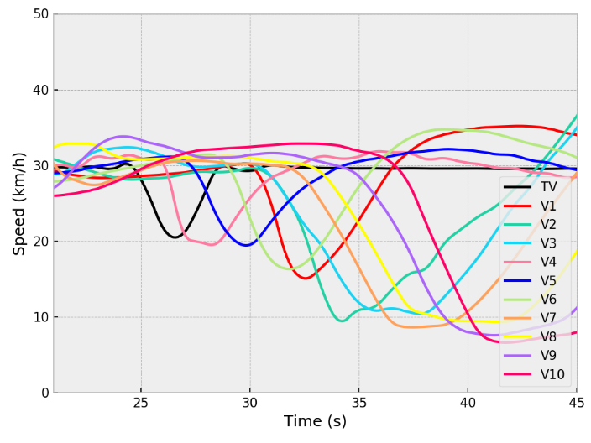
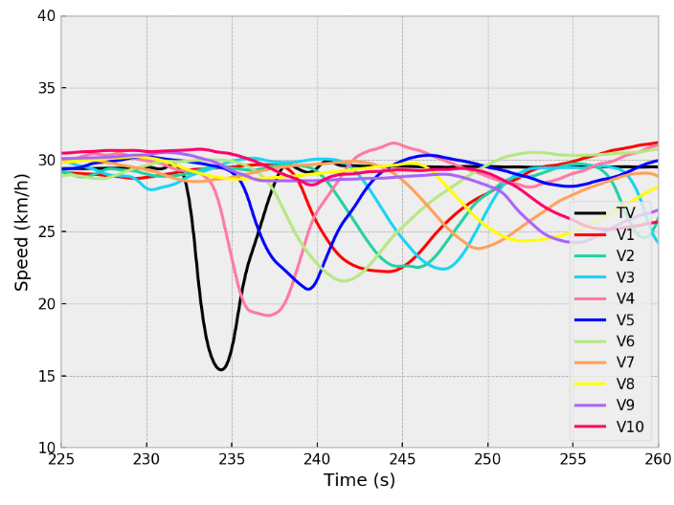
String stability
In FRAV-06-09 JRC already introduced the concept of string stability and suggested to introduce a related requirement (e.g. ensure string stability)
ACC with short time headway
ACC with long time headway
The perturbation is absorbed upstrem
The perturbation is amplified upstrem

Slide 15
Other example: Proposal for Amendment to ALKS Regulation 157 for increasing the max speed to 130 km/h
Requirements. The activated system shall:
  comply with traffic rules
  not cause any collisions reasonably foreseeable and
  preventable
  adapt the speed to adjust the distance to a vehicle in
  front in the same lane to be equal or greater than the
  minimum following distance.

Slide 16
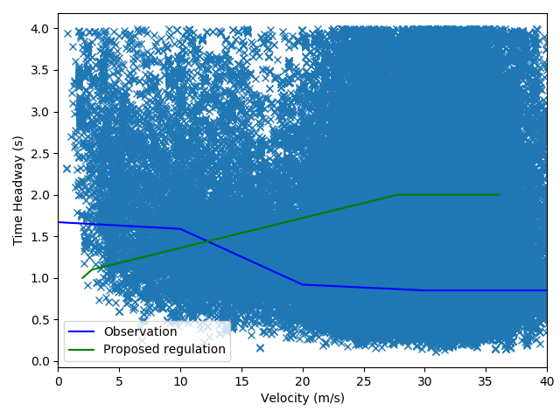
Comparison with traffic data
Proposal R157 amendment
Modal time headway from highD
Source: highD dataset (https://www.highd-dataset.com/details)

Slide 17
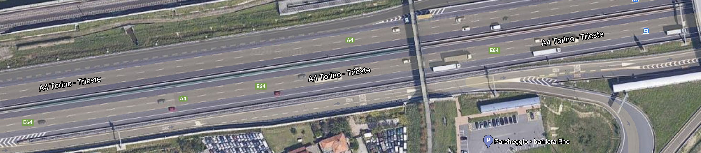
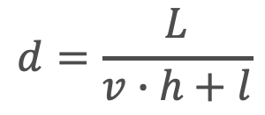
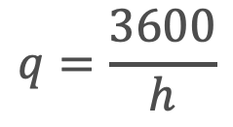
Impact on traffic flow
$$q=\frac{3600}{h}$$
$$d=\frac{L}{v∙h+l}$$
q = traffic flow [veh/h] | d = traffic density [veh/km] | h = time headway [s] | v = vehicle speed [m/s] | l = vehicle length [m] | L = road stretch length [m]

Slide 18
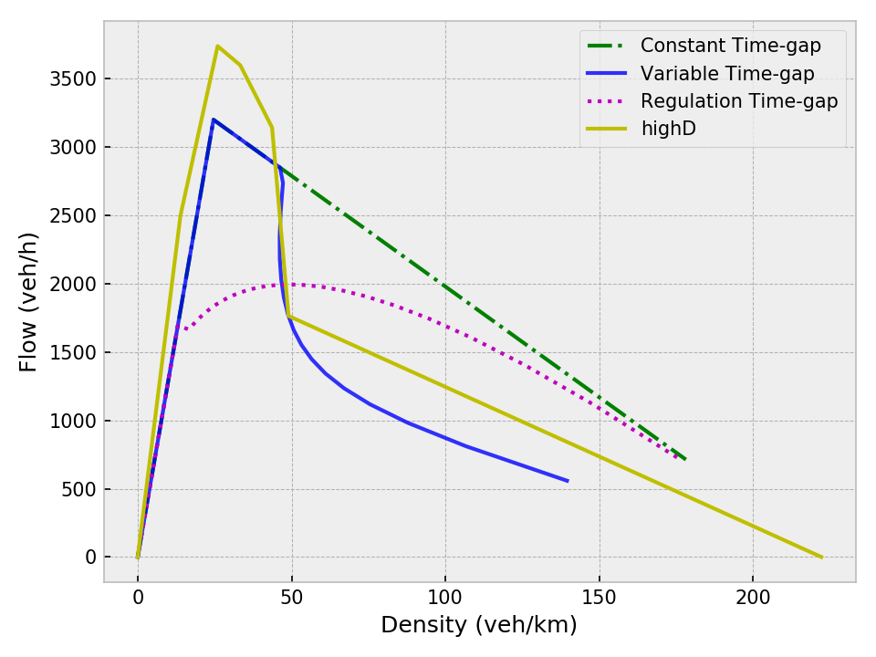
Effect of operational requirements. Example
Traffic fundamental diagram
Future ALKS
Human driver from highD
Commercial ACC

Slide 19
JRC recommendation
Take into account traffic-related requirements (e.g. ensure vehicles’ string stability)
Focus on performance rather than behavioural/operational requirements
Set performance levels in a transparent way so that both impact on safety and impact on traffic can be assessed
Use basic traffic theory to make simple considerations on potential traffic impacts (e.g. impact on motorway capacity)

Slide 20

Thank you
© European Union 2020
Unless otherwise noted the reuse of this presentation is authorised under the CC BY 4.0 license. For any use or reproduction of elements that are not owned by the EU, permission may need to be sought directly from the respective right holders.
Slide xx: element concerned, source: e.g. Fotolia.com; Slide xx: element concerned, source: e.g. iStock.com
Notes:
Update/add/delete parts of the copy right notice where appropriate.
More information: https://myintracomm.ec.europa.eu/corp/intellectual-property/Documents/2019_Reuse-guidelines%28CC-BY%29.pdf

