Slide 1


219
VETC(China) experience with the Golden instruments
Nov 2020
PMP Webconference

Slide 2
JRC golden instruments test at VETC
Light duty vehicle
Correlation test between labs with golden instruments and vehicle
CS/ET comparison
Heavy duty engines
Comparison between CVS/ET and tailpipe/CS SPN measurements.
SPN emission behavior from different stage

Slide 3
PMP-HDE test at VETC
Test content
7 heavy-duty engines (China3/5/6)
WHTC-C, WHTC-H, WHSC,NRSC, ETC, ESC
Emission Level | Engine ID | ATS | Crankcase | Retrofit DPF | Regeneration
China3 | 1# | w/o | × | √ | ×
 | 2# |  | √ | √ | √（passive)
China5 | 3# | DOC+DPF | × | × | ×
 | 4# | DOC+SCR | × | × | ×
China6 | 5# | DOC+DPF+SCR+ASC | × | × | ×
 | 6# |  | √ | × | √（active)
 | 7# |  | √ | × | √（active)

Slide 4
Instrument and setup
Constant Volume Sampling system (CVS)
- APC with ET and 23 nm CPC (CVS23)
- 10nm CPC externally (CVS10) provided by JRC
Tailpipe (TP)
  APC with CS and 23nm (TP23) /10 nm CPCs (TP10) provided by JRC

Slide 5
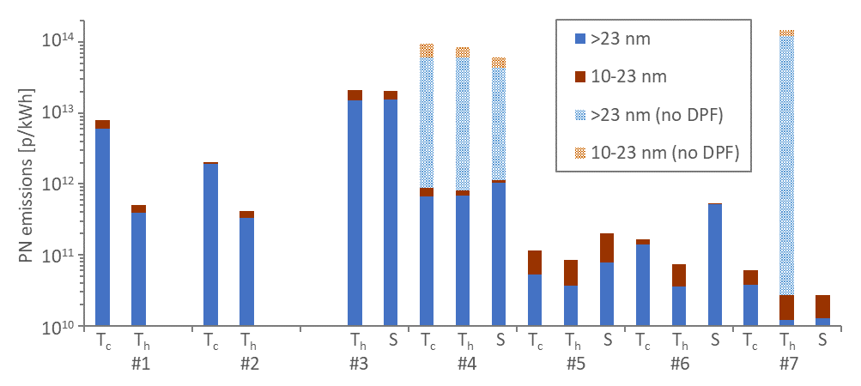
Emission level
DPF have high filtration efficiency for both SPN23 and SPN10
SPN10 of the 3 tested China 6 engines can meet current limit (6×10¹¹ p/kWh)
China 6 engines

Slide 6
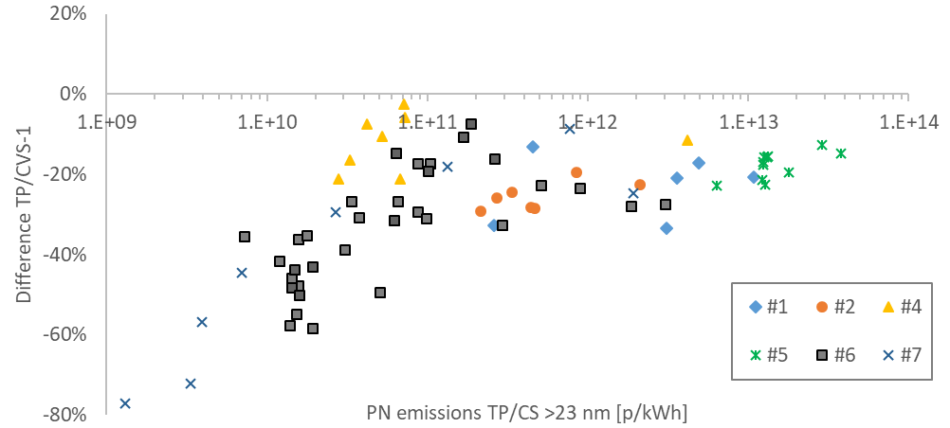
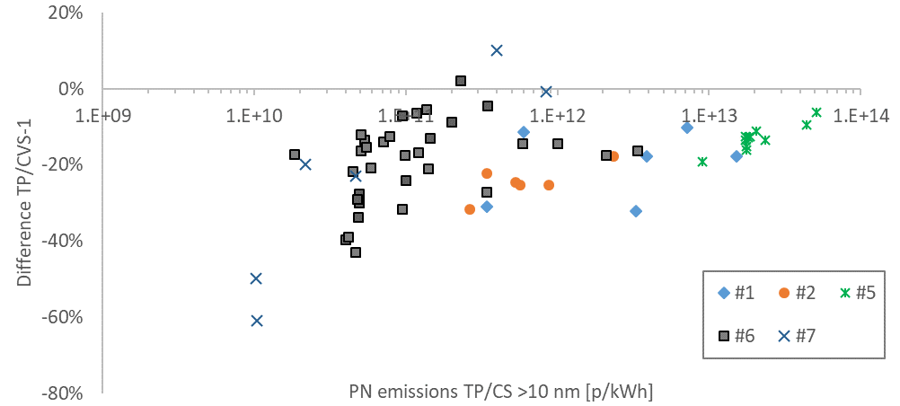
TP(CS) vs CVS(ET)
SPN measured at TP(CS) were generally lower than CVS(ET)
The gaps (TP vs CVS) of SPN23 were higher than SPN10
Growth of particles after dilution
Volatile remove efficiency CS and ET
Background level in CVS

Slide 7
Crankcase emissions
Crankcase emission impacts greatly on particle emission.

Slide 8
Crankcase emissions
Time alliance is a big challenge for TP testing when introducing crankcase emission to the tailpipe measurement.
Especially on high load/ speed.

Slide 9
Next step
Detailed test work will be carried out on more China6 engines
SPN10 emission level → Necessity to interduce SPN10 in HDV regulation
(DPF efficiency, DPF regeneration, SPN10-NH3 slip
Tailpipe test procedure and correlation to CVS
Coordinate with Light duty SPN requirements

Slide 10
Acknowledgement
Dr. Barouch.GIECHASKIEL
Dr. Tero.LAHDE
Dr. Giorgio.MARTINI
Dr. Hua.Lu Karlsson
Thank you！
sheng.su@vetc.org.cn

