Slide 1


Direct Vision
N3G – Industry Proposals
VRU-Proxi
18 November, 2020
Acea working group truck safety
VRU-Proxi-16-07

Slide 2
Direct Vision – N3 Differentiation
A division of the direct vision requirement between vehicles that are more likely to run in cities (Level A) and vehicles that very seldomly or never enter a city (Level B) is proposed
  Different thresholds should apply for the different vehicle groups
  Proposal based on a few basic vehicle characteristics and leverage on a similar division done in the EU CO2 Regulations
N3G vehicles are handled in this proposal

Slide 3
What is N3G – heavy off-road truck?
An off-road vehicle is per definition one that qualifies into (sub)category G according to Annex I of Regulation (EU) 2018/858 and paragraph 2.8 of UN ECE Consolidated Resolution on the Construction of Vehicles (R.E.3)
  Underlying need is to ensure off-road driving capacities and obstacle avoidance
N3G vehicles – off-road classified heavy trucks – are exempted from, or have less strict requirements in, a number of regulations
  E.g. FUP (R93), RUP (R58), Noise (R51), Brakes (R13), Lights (R48), External Projections (R61)
  Underlying reason is that the needs for off-road driving capacities and obstacle avoidance hinder some equipment to be mounted and makes some functions inappropriate
  When derived from an N3, many of those requirements are still fulfilled by the N3G vehicle
N.B. A construction vehicle is not per definition an off-road vehicle –
most tipper and mixer trucks sold do not qualify into the N3G definition

Slide 4
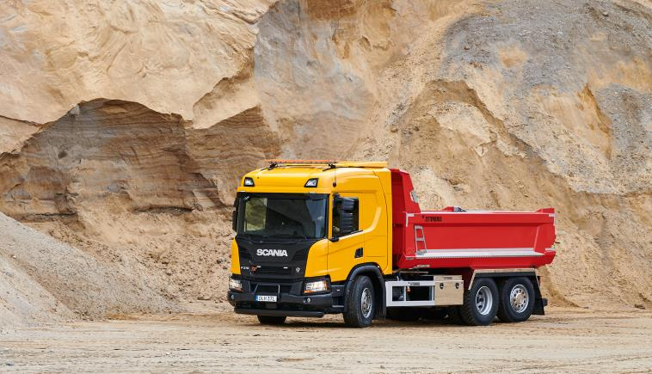
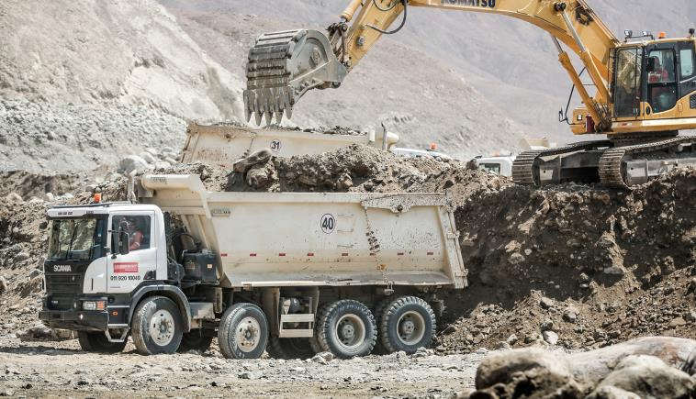
N3G ≠ construction vehicle
A construction vehicle is not per definition an off-road vehicle – most tipper and mixer trucks sold do not qualify into the N3G definition
  Machinery on wheels:
  Small fleet and low mileage
N3 construction vehicle
N.B. relatively low chassis/cab height
N3G construction vehicle
N.B. relatively high chassis/cab height

Slide 5
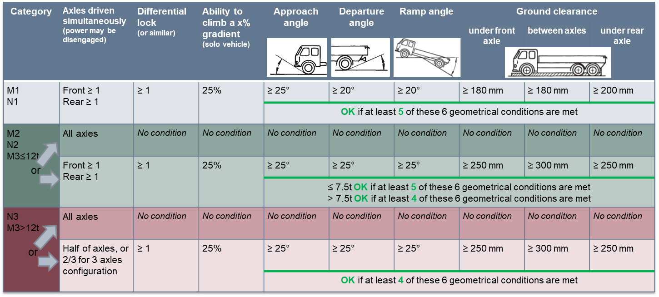
N3G – Regulation (EU) 2018/858 (and R.E.3)

Slide 6
N3G – not possible to “phase out”
N3G operation in relevant operations and locations, non exhaustive
  Forestry in Scandinavia and South Africa
  Open pit mining in Australia and Malaysia
  Underground mining in South Africa and Sweden
  Reclaiming land from the sea in the Netherlands
  Road construction in Siberia during flooding in the spring
  Defence operation all over the world
  Construction sites all over the world
  City construction and waste handling to a low extent, in particular UK

Slide 7
Direct vision – performance Analysis
Achieving a high direct vision performance, according to the volumetric method, requires the chassis/cab height to be low, since direct vision performance is built up from a combination of:
  Chassis/cab height (driver’s position height)
  Cab design specificities (i-panel, doors, windows, driver’s longitudinal position…)
…in which parameter 1, chassis/cab height, has the predominant influence
  the higher chassis/cab height, the lower the direct vision performance
Parameter 1 is a customer choice based on their operational needs
Parameter 2 can be influenced by the OEM by considerable redesigns of the cab and/or additional medium-heavy development work

Slide 8
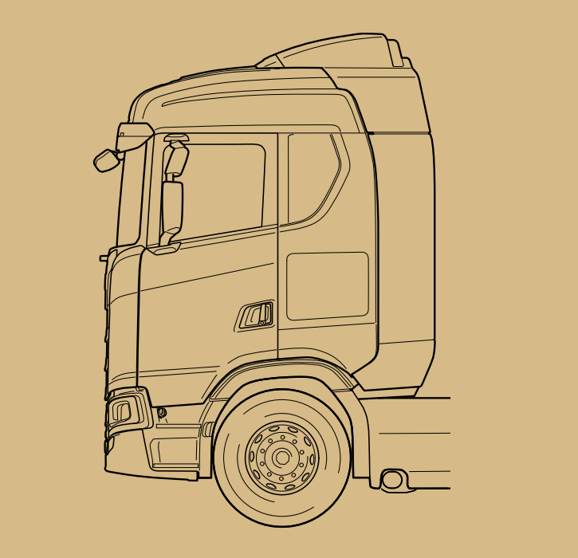
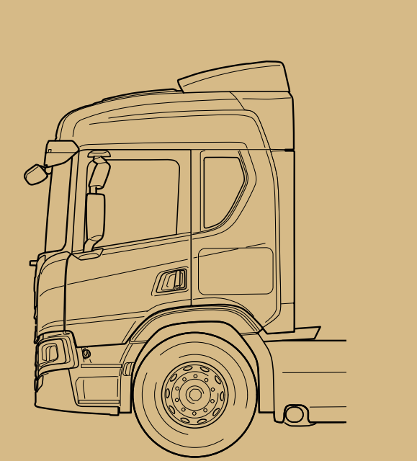
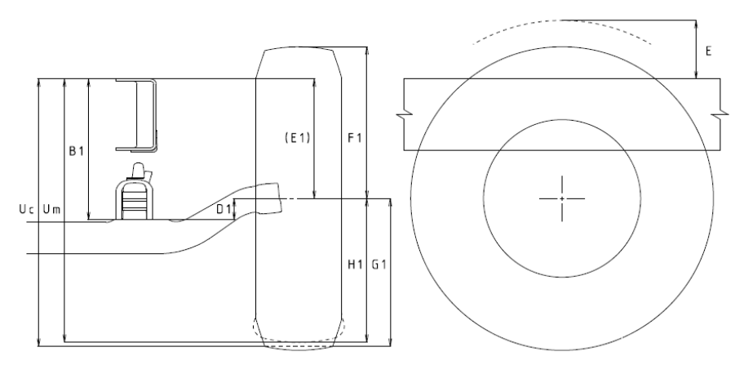
Direct vision – Chassis/cab height Analysis
The most predominantly influencing parameter (1) is the sum of
    Chassis height, i.e. size of axle drop, height of suspension and wheel size
    Cab floor height over the chassis
a)
b)
3
2
1
2b
2a
1
a) Chassis height: wheel size (1), axle drop (2) and suspension height (3)
b) Cab floor height over the chassis (2a, 2b) for two different cabs with same chassis height (1)

Slide 9
Direct vision – Chassis/cab height Analysis
The most predominantly influencing parameter (1) is the sum of
    Chassis height, i.e. size of axle drop, height of suspension and wheel size
    Cab floor height over the chassis
  For long haulage, the highest chassis heights (a) are rarely needed, while the highest cab floor heights (b) are both needed and desirable
  For off-road trucks (N3G), the highest cabs (b) are rarely needed, while high chassis heights (a) including large wheels are operational prerequisites
  Exemptions among N3G are AWD-trucks and a small portion of non-AWD

Slide 10
Chassis/cab height Long haul versus N3G
Given the different basic needs between (non-AWD) N3G and long haulage vehicles, the following analysis apply
  For long haulage applications with flat floor cabs and normal-high chassis, the highest cab floor heights are at approximately X mm *
  For non-AWD N3G applications with normal high cabs, with their higher chassis, the highest cab floor heights are found at approximately X-100 mm **
  A difference of ~100 mm in cab floor height at this level indicates a difference in direct vision volume of approximately 1 m³, provided everything else is kept constant
  This is valid in general, but differs slightly between manufacturers and designs and “the tail” of specifications may require further consideration
* N.B. vehicles not limited to 4,00 m total height can have higher total floor height
** N.B. higher cabs are also used in N3G to some content; “the tail”

Slide 11
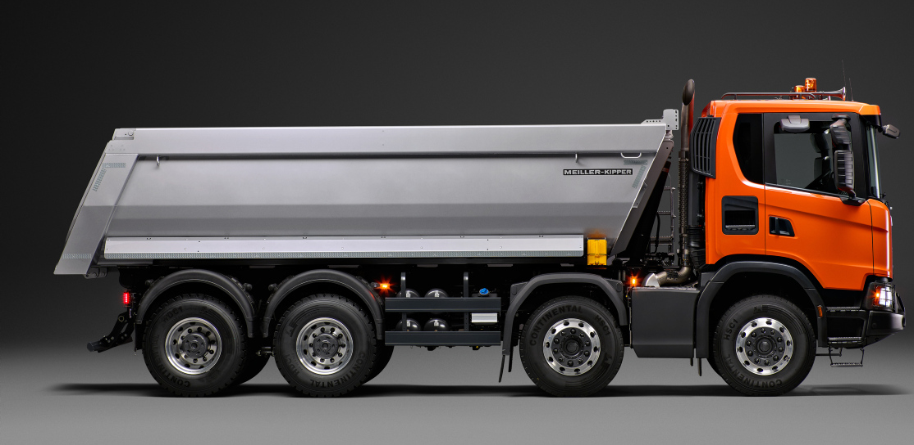
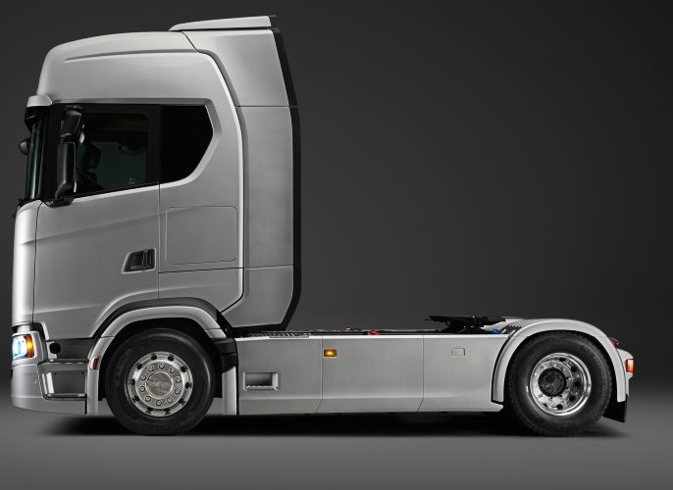
Long haul versus N3G – General rule
N3G (left) has higher chassis height than Long haul tractors (right)
The higher cabs that are normally used in Long haul however most often result in a higher total cab floor height, as indicated above

Slide 12
N3G summary and proposals
  The following three proposals are possible:
Introduce a third level B+ group, with a limit value 1 m³ above level B group threshold for non-AWD N3G vehicles, AWD vehicles in level B group
  Technology neutral: same cab improvements as long haulage (Level B group) guaranteed
N3G vehicles qualified through the attack angle (≥25°) – level B group
  Provide clarity but is not future proof due to potential FUP requirement
N3G vehicles qualified through front ground clearance (≥250 mm) – level B group
  Provide clarity and is future proof to FUP requirement

