Slide 1
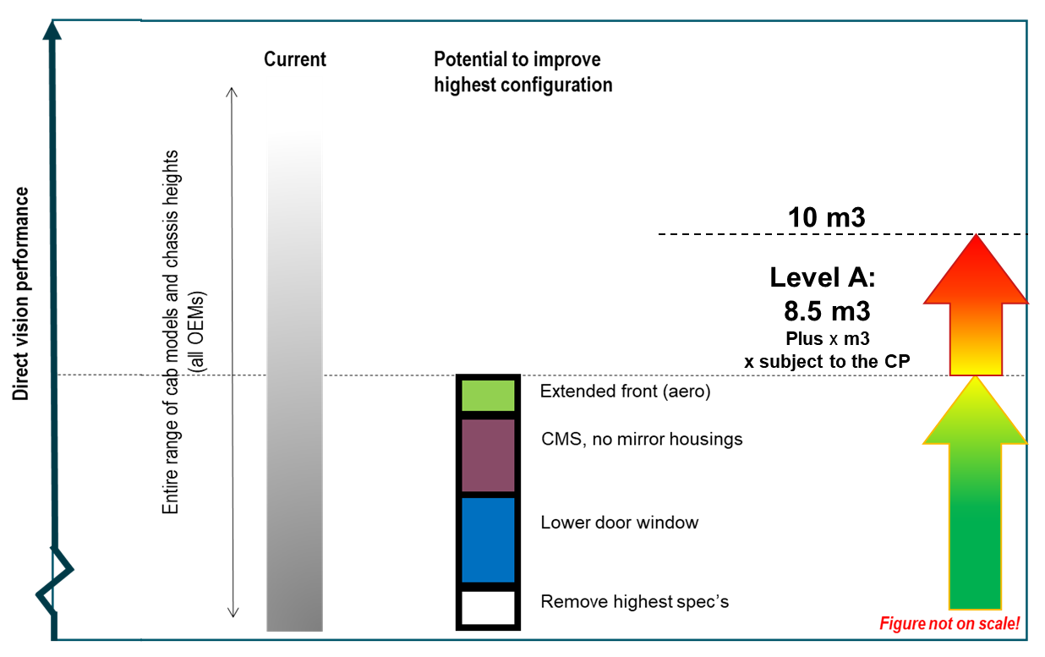
Potential Measures to Improve Direct Vision
Category A for urban requirements
VRU-Proxi-16-08
Further improvement of Direct Vision will trigger more
Unbalanced economical consequences for some OEMs, like ban from market of some cab platforms before their planned end-of-life.
Substantial CO2 reduction as key requirement for the next years not achievable
Delete Blind Spots to the greatest possible extent 2026/29
Wide scale use of CMS
Lower door-window
Extended front, and combination of that
Accompanied by portfolio adjustment (sales stop) of highest specs on all OEMs cab platforms currently planned for 2026/2029 with all related consequences for economy.
~ 5 m³ (Starting level at current worst cases) VARY FOR MANUFACTURERS
UN ECE Task Force Direct Vision; 18th November 2020

Slide 2
Potential Measures to Improve Direct Vision
How to move on
Industry have deepest knowledge of vehicle architecture
Establishment of EG-VRU-PROXI DV task force very helpful
Still necessary steps to take concerning thresholds
UN ECE Task Force Direct Vision; 18th November 2020

