Slide 1
AEBS HDV IWG
Industry input for the kick-off meeting of November 9, 2020

Slide 2
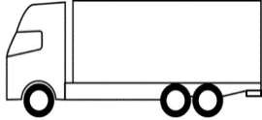
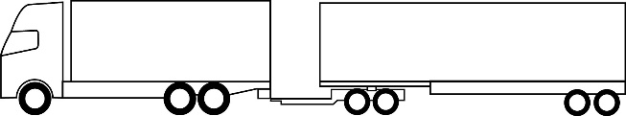
Generals
  With regard to pedestrians and cyclists, industry efforts are currently put on “VRU-Proxi”.
    A new work item related to VRU / low speed creates a new burden with regard to resources, as well as risks to get contradictory requirements.
    Raises the question of whether VRU proxi has tackled the right priority with regard to VRU. The group needs accident statistics to support the need to regulate city driving / C2P / C2B, and to fix relevant priorities.
  Industry is open to consider feasibility of solutions for roadworks/service vehicles.
  More stringent requirements may lead to:
    Even earlier warning / braking
    More potential false warnings / braking
    Drivers mistrusting the system
    Higher risks of rear-end collisions (added to the lack of forward visibility when behind an HDV)
  Industry will support the adaption of current R131 to the new state-of-the-art, which may include some reasonable carry-over of new concepts from UN R152.
  R131 currently specifies AEBS for vehicles primarily used under monotonous highway driving conditions.
  Including city driving means developing a new system, e.g. with regard to the control strategy and sensors.
  HDV manufacturers have low experience on city-AEBS, unlike passenger car manufacturers.
    With regard to LPB vs LPS, there is a world of difference between for example a solo tractor and a multi-trailer combination. How will this be accounted for?
8t
60t

Slide 3
Industry recommendation
  Focus on updating UN R131 with state-of-the-art and with most interesting concepts from UN R152:
    E.g. stationary objects, clarification of range of parameters where performance is expected, system robustness (while taking care to avoid the multiplication of tests)
    Keep the focus on vehicles “primarily used under monotonous highway driving conditions”
  Consider technical feasibility to improve detection of stationary roadworks / service vehicles
  Exclude city driving / C2P / C2B from the scope, at least until the items above are cleared and relevant accidentology data given

