Slide 1
TFSR-15-06
LEDr Light Sources
Equivalence Report for C5W LEDr
In support of document TFSR-15-05
P. Plathner
5 January 2021

Slide 2
Checklist for Equivalence of Parameters C5W LEDr (12V)
Parameters Check
3.1. Parameters with the same values
3.1.1. Cap ⎫
3.1.2. Maximum lamp outline dimensions ⎫
3.1.3. Electrical connector n/a
3.1.4. Test voltage ⎫
3.1.5. Objective luminous flux ⎫
3.1.6. Colour of emitted light ⎫
3.1.7. Light centre length ⎫
3.1.8. Distortion free zone ⎫
3.2. Parameters with similar values
3.2.1. Normalized luminous intensity distribution see page 3 ⎫
3.2.2. Size and position of the light-emitting-area see page 4 ⎫
3.2.3. Homogeneity of the light-emitting-area see page 4 ⎫
3.2.4. Contrast of the light emitting area n/a
3.3. Parameters with different values
3.3.1. Electrical power consumption 2.0 W max (HE) / 2.5 W min ⎫
3.3.2. Dependency of the luminous flux on the applied voltage (range) ⎫
3.3.3. Dependency of the luminous flux on elevated ambient temperatures ⎫
3.3.4. Cap temperature 75°C max, see page 5 ⎫
3.3.5. The spectral content n/a
3.4. Additional parameters
3.4.1. Thermal run-up behaviour ⎫
3.4.2.1 PWM operation to stabilize the applied voltage ⎫
3.4.2.2 PWM operation to dim light sources n/a
3.4.3 Polarity ⎫
Requirements regarding failure detection
4.1 Failure detection 150 mA min ⎫
4.2 Failure behaviour below 10 mA (12V) ⎫

Slide 3
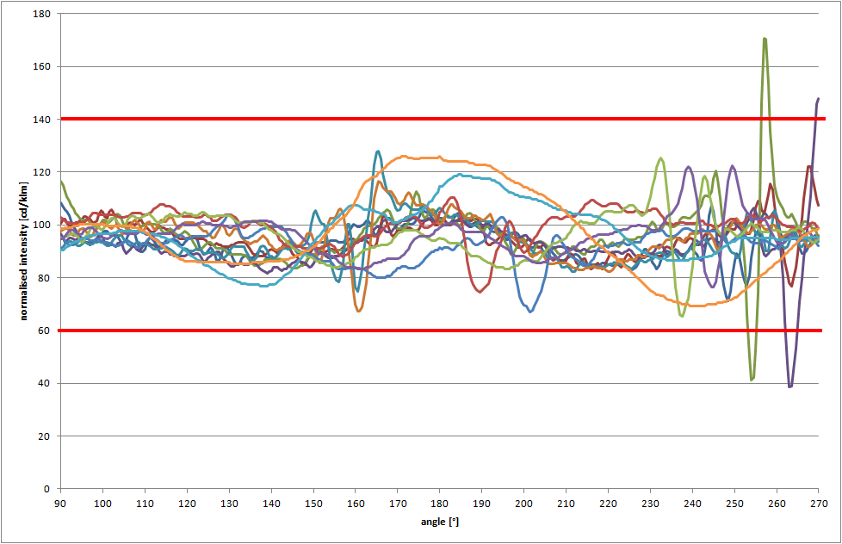
Normalised Intensity Distribution
C5W (incandescent lamp)
C0

Slide 4
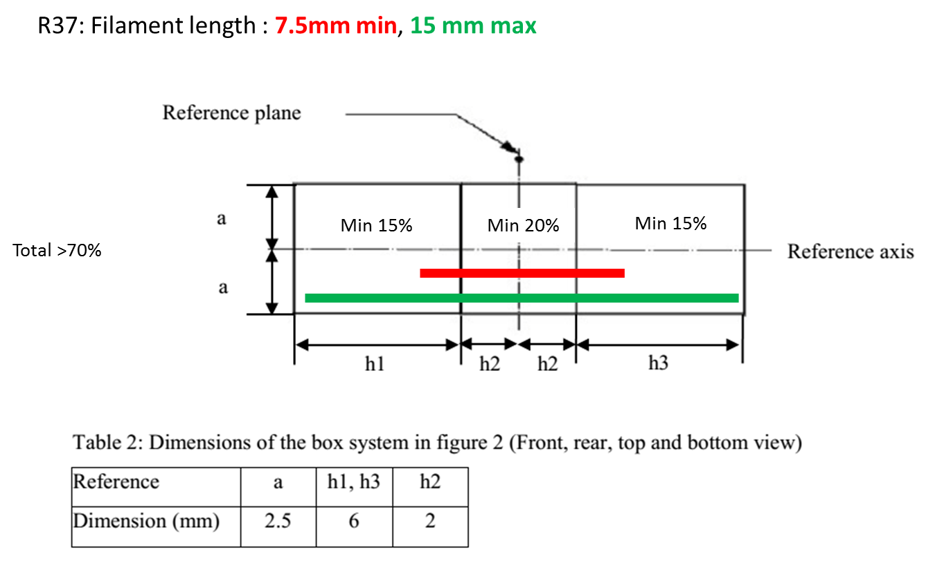
Size, Position and Homogeneity of the Light-Emitting-Area C5W

Slide 5
Cap temperature (incandescent lamp)
MP1
MP2
MP1: Free burning 85°C
MP2: Free burning 75°C

