Slide 1
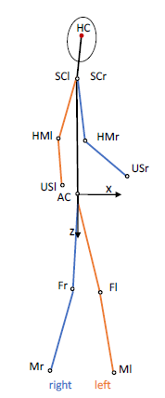
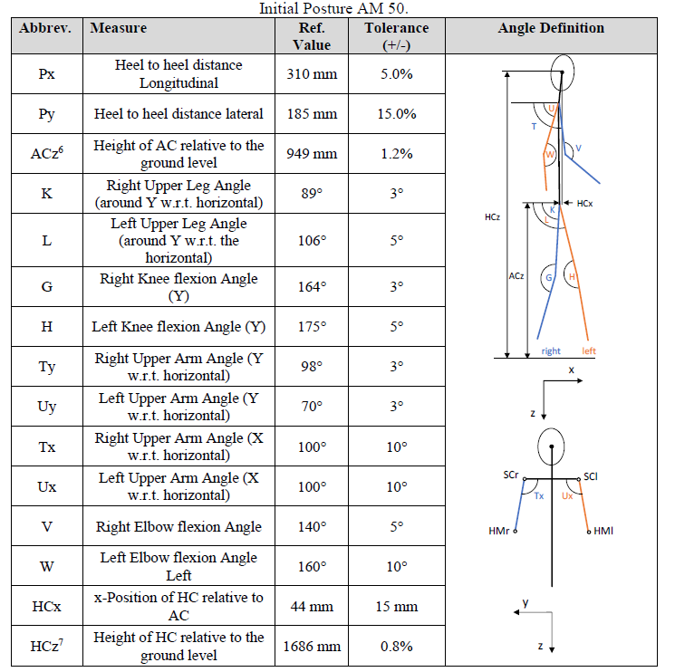
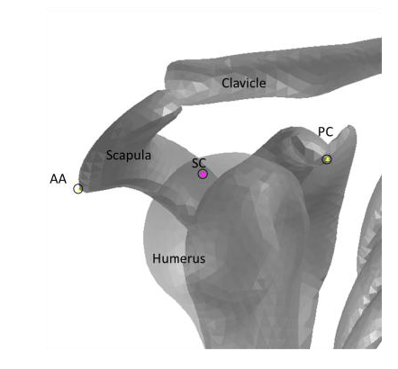
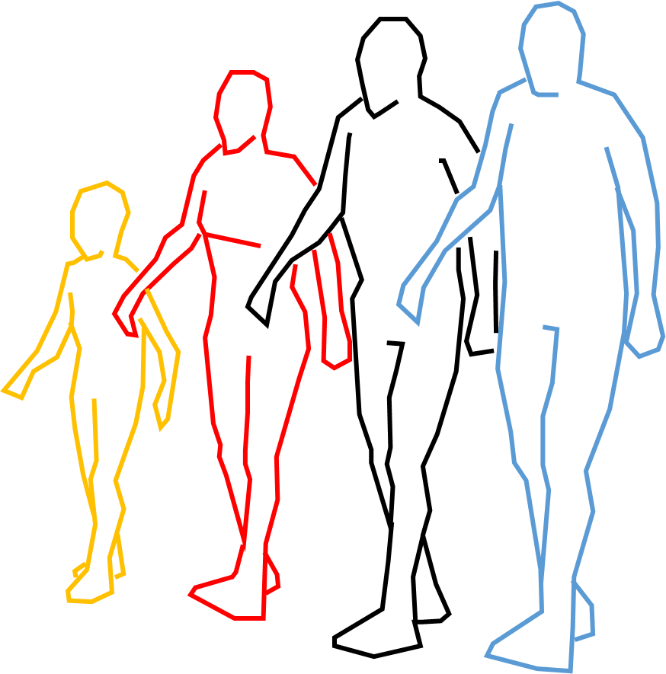
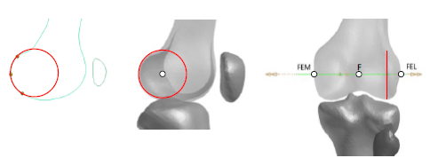
Reminder of IWG-DPPS-7-08
HBM positioning
in Euro NCAP Tech. Bulletin 024
1. Anatomic landmarks used to define measure points on the skeleton:
2. For each HBM:
Definition of reference values for all measure points (under use of tolerances).
“based on the recommendations of the international society of biomechanics (ISB)“
[TB024, p33]
“The joint angles of the legs are based on SAE J2782 and the arm posture is based on a natural posture.” [TB024, p7]
OICA confirms using the TB 024 HBM positioning and proposes to introduce it in amended GTR9/UN R127.

Slide 2
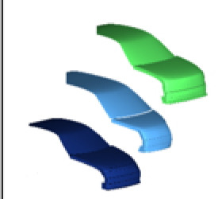
Follow-up HIT numerical simulation
Transfer TB 024 in GTR9- preliminary discussion
IWG-DPPS-9-10.r1
OICA (VDA Expert Group “PG Simulation” ) is currently working to simplify TB024 in order to transfer the in GTR9-DPPS amendment.
Certification of human body models (HBM):
  HBMs fulfill positioning requirements at beginning of simulation t₀
  OEM runs simulations on Generic Vehicles (GV)*: 2 velocities, 3 car shapes
  Requirements for contact time and position of head and pelvis vs. the GVs
  Simulations must fulfill quality requirements
GV : discussion on administration of the models ongoing

