Slide 1
AEBS HDV –
French Railway crossing accidents
21th December 2020

Slide 2
Context
Objective : investigate railway crossing accidents to assess the potential of the AEB in these situations
Database: BEA-TT (Bureau d’Enquêtes sur les Accidents de Transport Terrestre)
  31 accidents at railway crossing which have been investigated in depth
    2 accidents involved pedestrian without any road vehicle
    1 accident is due to infrastructure default
    → 28 accidents have been considered
  These accidents occurred between 2004 and 2019

Slide 3
Railway crossing accident analysis
Vehicle categories
HV (Heavy Vehicle) | 11
LV (Light Vehicle) | 8
SC (Special Convoy) | 5
BU (Bus) | 4
Total | 28
Categories of involved vehicles:
Fatalities and injured people :
Railway crossing type:
Barrier position (24 accidents at railway crossing with barrier) :
Attempt to circumvent the barrier:
Nombre total de victimes
Injured people in vehicles | 74
Killed people in vehicles | 33
Injured people in trains | 178
Killed people in trains | 3
Railway crossing type
With barrier | 24
Without barrier | 4
Barrier closed when vehcile was arriving ?
Yes | 7
No | 17
Circumvention attempt ? |  | Type de véh.
Yes | 4 | 4 LV
No (barrier impact) | 3 | 1 HV, 1 BU, 1 LV

Slide 4
Railway crossing accident analysis
Main accidents scenarios:
  Vehicle maneuvering at Railway Crossing (RC) : 5 accidents (1 SP et 4 HV)
  Trailer stuck at RC: 4 accidents (4 SP)
  Vehicle stuck at RC because of dense traffic : 2 accidents (1 BU et 1 PL)
Conclusion :
  Many accidents occurred while barrier was opened when the vehicle was arriving
  Some scenarios are identified as redundant (trailer stuck, vehicle maneuvering at the RC, etc.)
  For more than half of all accidents with closed barrier when vehicle was approaching, there were attempts to circumvent the barrier (either for intentional reason like during a chase or for unintentional reason like driver fault)
  Considering an AEBS capable of detecting closed RC barrier only 3 accidents could have been avoided. The one involving the HV is due to ice on the road and unlikely avoidable with a such system.
  → An adequate AEB could have avoided 2 railway crossing accidents involving for the first a LV (4 killed people) and the second a bus(18 injured and 6 killed people)

Slide 5
Railway crossing accident analysis
Potential of the AEBS:
  Regarding the accident sample (28 accidents), the AEBS could have :
    avoided 7 % of all accidents at railway crossing
    decrease of -30% the people killed in the vehicle
    decrease of -28% the killed people (in vehicles and trains)
    decrease of -26% the injured and killed people in the vehicles
    decrease of -10% the killed and injured people (in vehicles and trains)

Slide 6
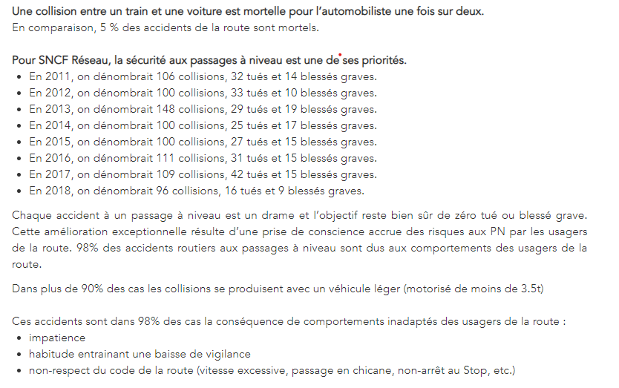
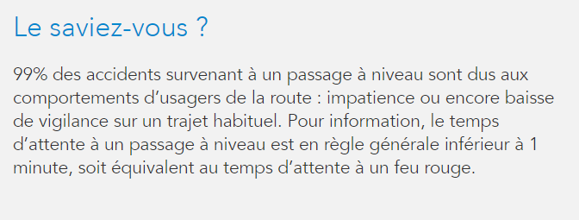
SNCF information

