Slide 1
AEBS HDV –
French Railway crossing accidents
26th January 2021

Slide 2
Railway crossing accident analysis
Main accidents scenarios:
  Vehicle maneuvering at Railway Crossing (RC) : 5 accidents (1 SP et 4 HV)
  Trailer stuck at RC: 4 accidents (4 SP)
  Vehicle stuck at RC because of dense traffic : 2 accidents (1 BU et 1 PL)
Conclusion :
  Many accidents occurred while barrier was opened when the vehicle was arriving
  Some scenarios are identified as redundant (trailer stuck, vehicle maneuvering at the RC, etc.)
  For more than half of all accidents with closed barrier when vehicle was approaching, there were attempts to circumvent the barrier (either for intentional reason like during a chase or for unintentional reason like driver fault)
  Considering an AEBS capable of detecting closed RC barrier only 3 accidents could have been avoided. The one involving the HV is due to ice on the road and unlikely avoidable with a such system.
  → An adequate AEB could have avoided 2 railway crossing accidents involving for the first a LV (4 killed people) and the second a bus (18 injured and 6 killed people)

Slide 3
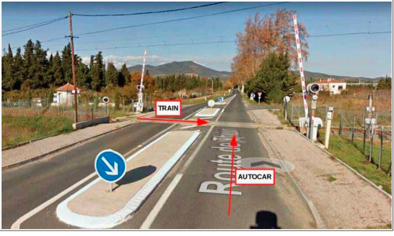
Railway crossing accident analysis
One Bus accident which is AEBS relevant !
Accident information:
  14th December 2017
  Extra-urban road located in the south of France
  Railway crossing with half barrier
  BUS within M3 vehicle category
  The BUS driver was responsible

Slide 4
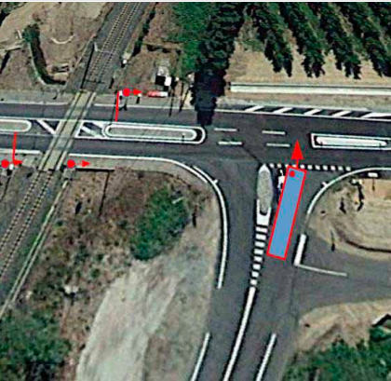
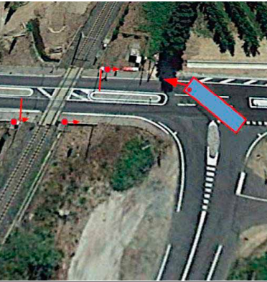
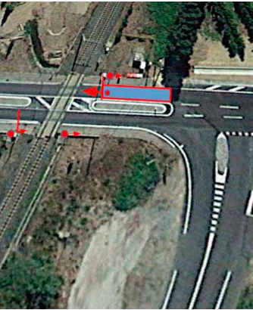
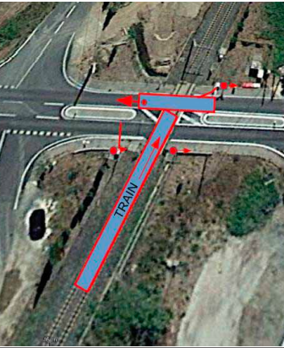

Railway crossing accident analysis
Bus trajectory:
Vehicle speed ≈ 10 km/h
Barrier closed
Train speed ≈ 80 km/h
Impact

Slide 5
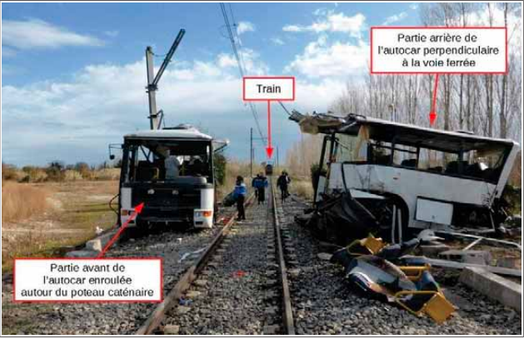
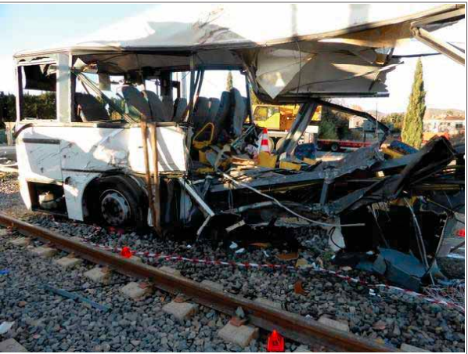
Railway crossing accident analysis
Consequences:
17 children & 1 adult seriously injured and 6 children killed on their way to school

Slide 6
Railway crossing accident analysis
Conclusion:
  Number of HDV-AEBS relevant accidents is not representative
  Number of HDV-AEBS relevant lives that could have been saved is much more representative

