Slide 1
IWG AEBS HDV
Accident Analysis
Daniel Sander (BASt / Germany)

Slide 2
Content
General accident situation for HDV
German Insurers Data
Lower Saxony Statistic
German In-Depth Accident Study (GIDAS)
Impact of AEBS on the development of rear-end collisions on German motorways
Conclusion

Slide 3
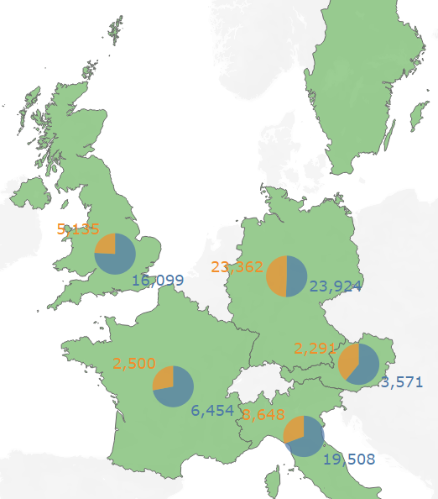

General accident situation for HDV [5]
Nearly 114,000 commercial vehicle drivers involved in accidents with personal injuries (Sum 2016-2018)
Development of the figures relatively constant for reviewed period
Commercial vehicle > 3.5 t
Semi-trailer tractor

Slide 4
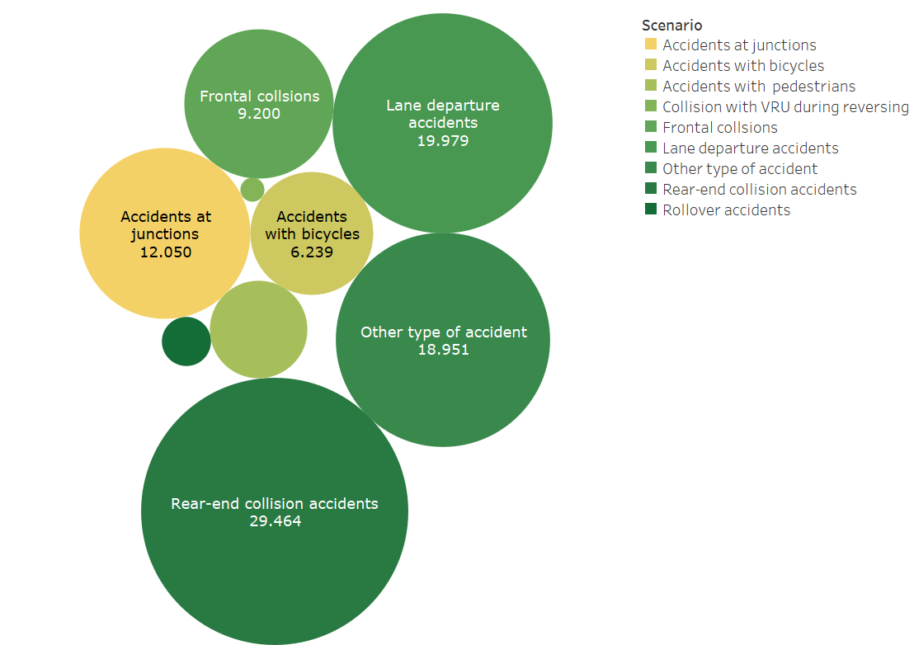
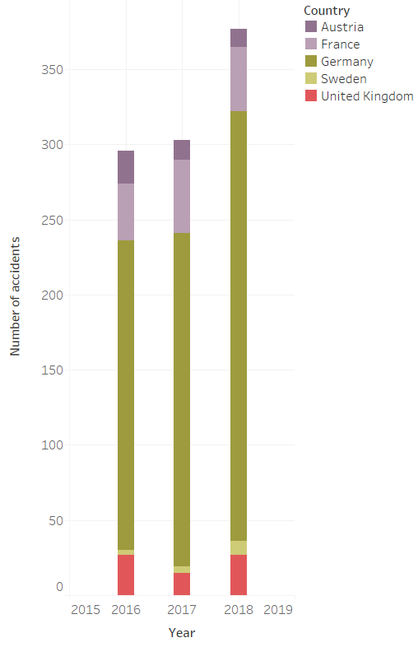
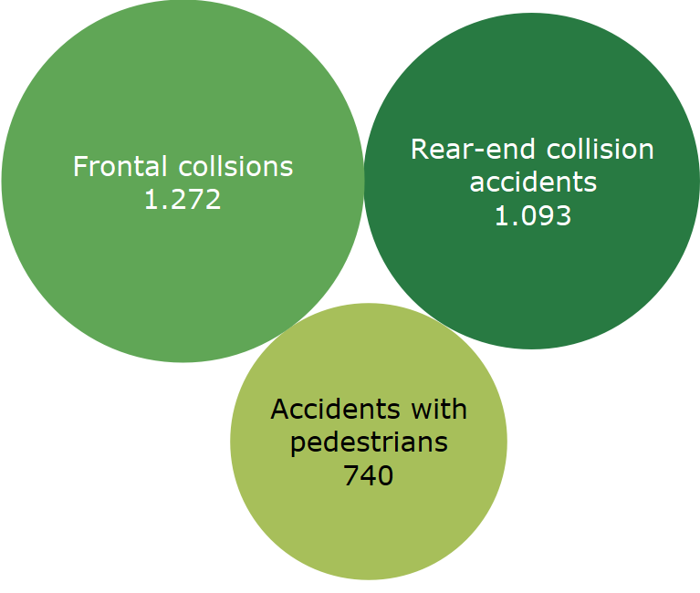
General accident situation for HDV [5]
Most frequent accident scenarios with fatalities
Accidents per Scenario

Slide 5
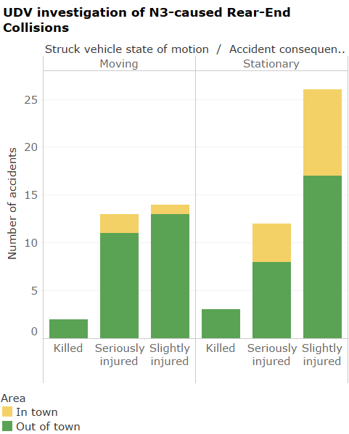
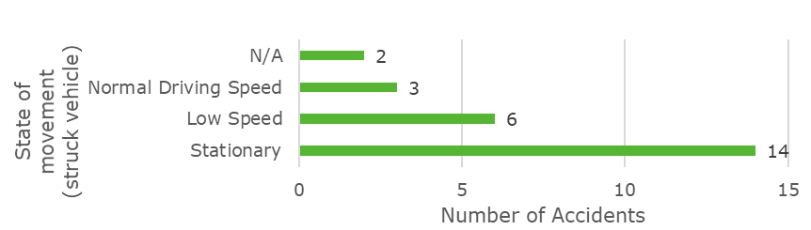
German Insurers Data [4]
70 accidents with the knowledge concerning the state of motion of the struck vehicle
6 out of 29 moving struck vehicles had a velocity
< 10 km/h
Avoidance of 41 (stationary) + 6 (low speed) accidents not addressed by UN R 131
Additional in-depth investigation of N3-caused Rear-End collisions in Brandenburg 2016 shows quite similar results:

Slide 6
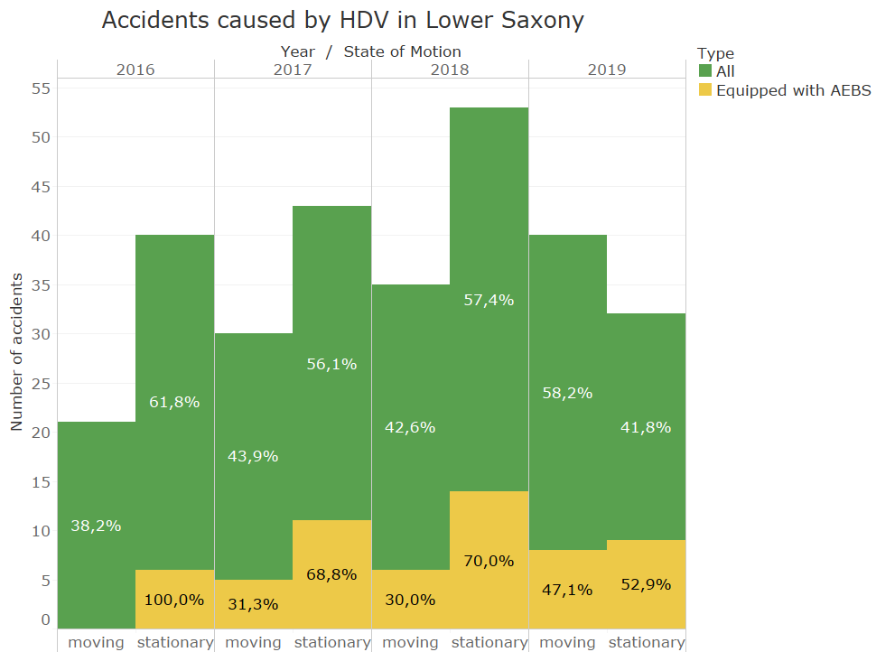
Lower Saxony summary [1-3]
Huge portion of stationary struck vehicles (54% in average)
Accidents with stationary Safety/Service or broken down vehicles are an issue (6 accidents in 2017, 5 in 2019)

Slide 7
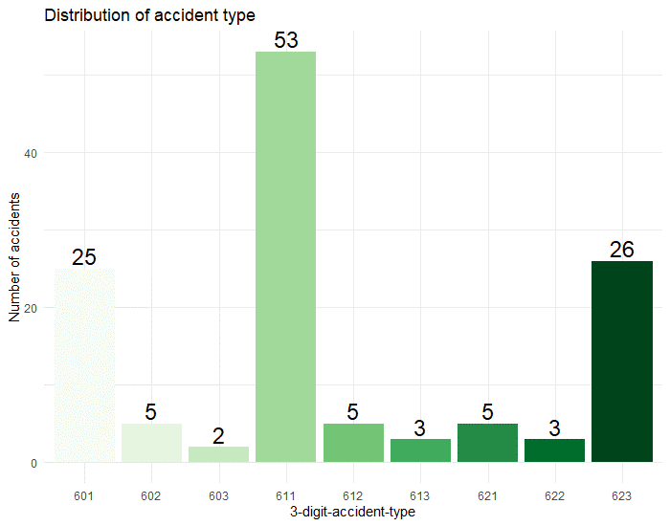

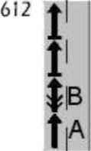
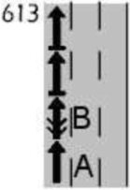
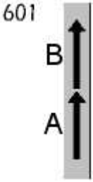
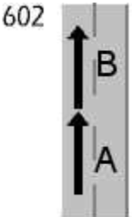

German In-Depth Accident Study (GIDAS)
Most accidents (n=60) in traffic jam situations (611-613)
Notable amount of accidents due to traffic light situations (623) and following scenarios (601, 602)

Slide 8
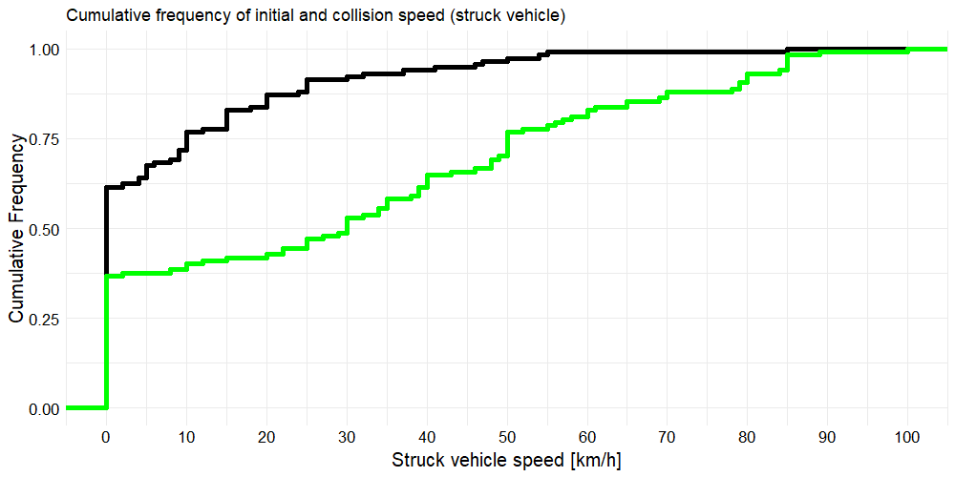
German In-Depth Accident Study (GIDAS)
Collision speed v_{c}
Initial speed v₀

Slide 9
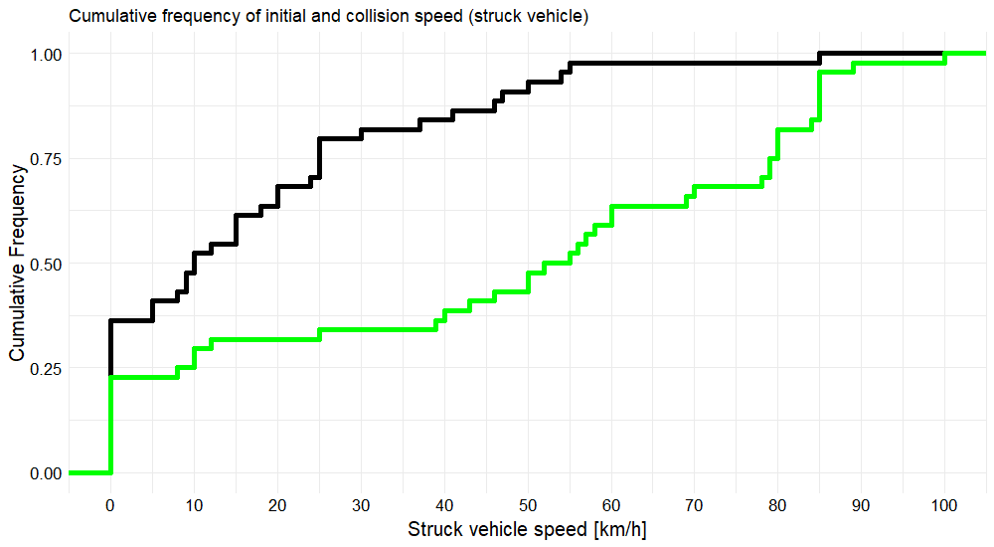
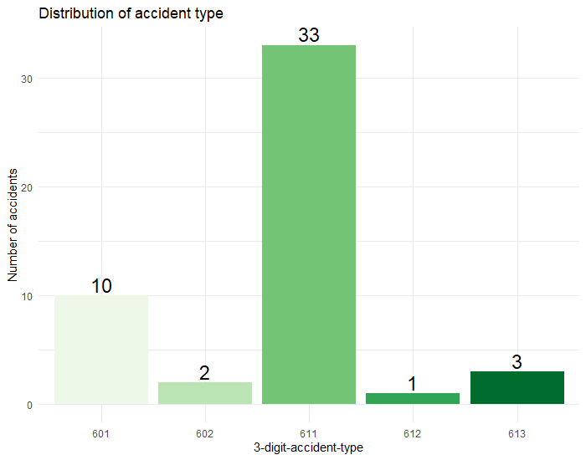
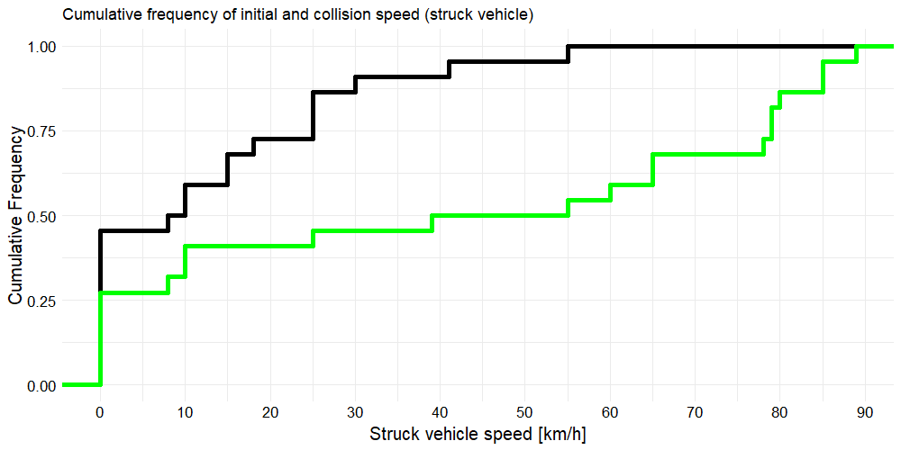
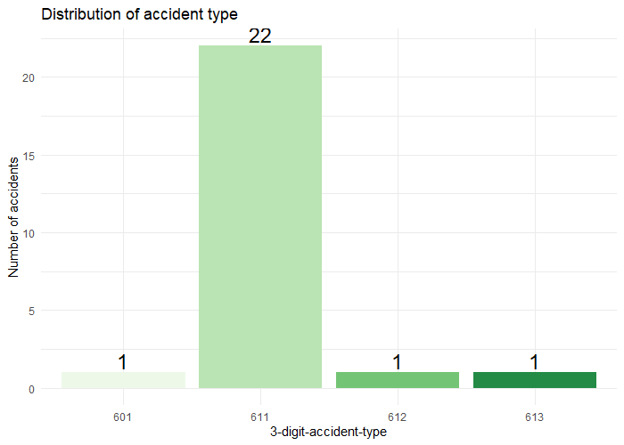
German In-Depth Accident Study (GIDAS)
Collision speed v_{c}
Motorways
Initial speed v₀
→ 22 out of 25 cases with killed or seriously injured (KSI) car occupants happened on motorways
KSI

Slide 10
Impact of AEBS on the development of rear-end collisions on German motorways
Comparison period (CP)
Analysis period (AP)
Stufe 1:
Neufahr-
zeuge
2010
2011
2012
2013
2014
2015
2016
2017
2018
 |  | Scenario
 |  | Rear-End | Other
Vehicle age | New | AG | CG I
 | Old | CG II | CG III
Odds ratios used to determine total effect of AEBS
Total effect has been determined from individual changes within each group from CP to AP
Total effect 37% (significant); also reduction in injury severity
AG: Analysis group CG: Control group I-III

Slide 11
Conclusions
Rear-End accidents caused by HDV are still a problem
(> 1000 fatalities in Sweden, UK, France, Austria and Germany in 2016-2018)
A huge portion of struck vehicles remains stationary or is driving with low speed (< 10 km/h)
Notable amount of accidents with maintenance or broken down vehicles
Accidents with Killed or seriously injured car occupants most frequent on Motorways

Slide 12
Sources
[1] E. Petersen, C. Scholze und R. Böhnke, „Notbremsassistenzsysteme im Lkw - Eine Analyse niedersächsischer Autobahnunfälle des Jahres 2017 und Einfluss aktueller Systeme“, Zeitschrift für Verkehrssicherheit, Jg. 2018, Nr. 5, S. 336–344, 2018.
[2] E. Petersen, C. Scholze und C. Falke, „Notbremsassistenzsysteme im Lkw - eine Analyse niedersächsischer Autobahnunfälle in den Jahren 2015 bis 2019 und der Einfluss aktueller Systeme“, Zeitschrift für Verkehrssicherheit, Jg. 2020, Nr. 66, S. 245–256, 2020.
[3] E. Petersen, N. Simon und U. Krupitzer, „Lkw-Unfaelle mit schweren Personenschaeden auf niedersaechsischen Autobahnen und deren Relevanz sowie Vermeidbarkeit durch aktuelle Notbrems-Assistenzsysteme“, Zeitschrift für Verkehrssicherheit, Jg. 2016, Nr. 5, S. 273–279, 2016.
[4] T. Trabert, I. Shevchenko, G. Müller und A. Malczyk, In-depth Analyse schwerer Unfälle mit schweren Lkw. Berlin: Gesamtverband der Deutschen Versicherungswirtschaft e.V., Unfallforschung der Versicherer, 2018.
[5] EU-Accident data for commercial vehicles. Provided by Euro NCAP Truck working group

Slide 13
Thank you for listening!
Sander, Daniel
Section F1 – Active Vehicle Safety and Driver Assistance Systems
Federal Highway Research Institute (BASt) Brüderstraße 53
51427 Bergisch Gladbach
Telefon +49 (0)2204 43 5112
sander@bast.de
www.bast.de

