Slide 1
Temperature effects on tyre/road noise– presentations from the STEER project
IWGMU-09-02
Presented by the chair of IWG MU
9th meeting, 23 February 2021

Slide 2

The STEER project (STrenghtening the Effect of quieter tyres on European Roads):
CEDR Call 2018 Noise and Nuisance, A: Quieter tyres, Tyre Labelling System and Pavements
Partners:
- Grolimund & Partner AG (CH) (Coordinator)
BRRC (BE)
VTI (SE)
SINTEF (NO)
Nokian Tyres plc (FIN)
Time frame: Dec.2019-Nov.2021
Budget: 316 000 EUR
Investigation limited to C1 tyres

Slide 3
Project structure:
WP1: Coordination and project management
WP2: Identification and discussion of the problem
WP3: Solving the reproducibility issues of tyre labels
WP4: Improving the representativity of tyre labels for the noise emission on actual European roads
WP5: Impact analysis and scenarios
WP6: Conclusions, recommendations and dissemination

Slide 4
Deliverables per February 2021:
Task 2.1 Report on the background information and existing data (SINTEF) (approved by CEDR)
Task 2.2 Report of the a priori uncertainty analysis of the tyre labelling procedure (BRRC) (approved)
Task 3.1 Temperature effects on tyre/road noise measurements (VTI) (Draft - not yet approved)
Task 4.3.1 Report on the representativity of the ISO test track compared to common European roads (BRRC, SINTEF, VTI) (Draft – not yet approved)
Task 5.5 Constraints/impediments for tyre manufacturers to produce quieter tyres (Nokian) (Draft – not yet approved)

Slide 5
T3.1: Temperature effects on tyre/road noise measurements – Review of methods:
Existing temperature correction procedures in relevant standards and regulations are reviewed and the latest information about the noise-temperature relations is explored and commented:
- UN ECE and EU regulations (117, EC 661/2009 and EC 1222/2009)
- ISO/TS 13471-1:2017 (CPX)
- ISO/DTS 13471-2:2020 (Pass-by, expected to be published in 2021)
- OBSI method and AASHTO TP76-13
- SAE J57

Slide 6
Temperature to be used –pros and cons:
Tyre temp: Most relevant temperature influencing the noise-temperature relationship. However, variability of temperature within the tyre, difficult to measure, and not stable in time. May be accessible in the future with sensors within the tyre, transmitting temperature data.
Road surface temp: Already in regulations, however correction procedure is based on investigations more than 20 years ago. Road surface temperature is influenced by variables such as cloudiness/sunshine, solar radiation, position of temperature measurement device, etc. Literature shows that for a certain air temperature, the road temperature can vary from 11-17°C. Road surface temperature can be measured by IR-sensor or sensors within the road surface.
Air temperature: There is much more data available for air temperature vs noise than for road surface temperature vs noise. Studies so far have indicated that tyre temperature is more influenced by air than by road surface temperature. If tyre temperature is acknowledged as the optimal for temperature correction, one would prefer air temperature (until relevant and stable tyre temperatures can be used). Or maybe a weighted mix of air and surface temperatures would be better (but this requires more studies to find the best mix and the appropriate coefficients).

Slide 7
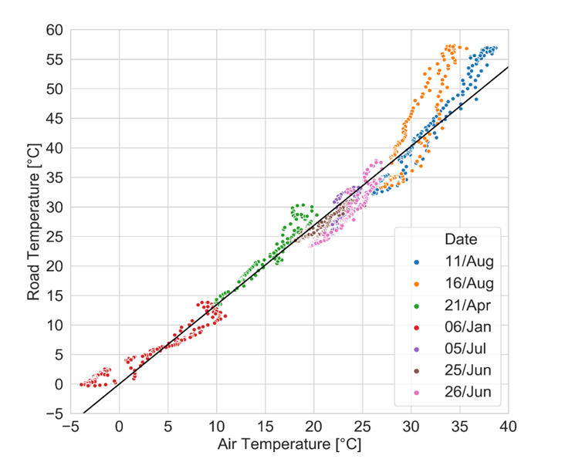
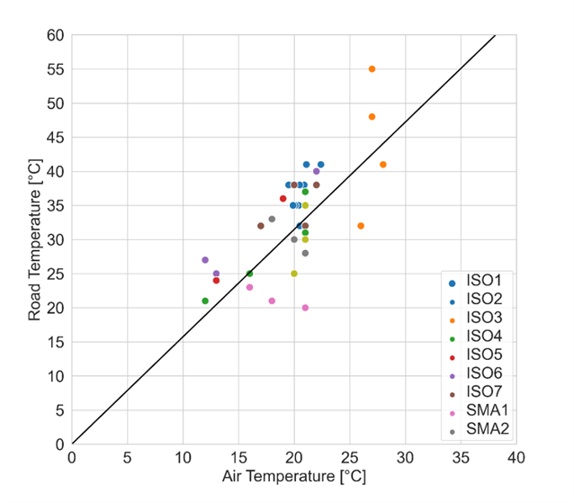
Air temperature: Most stable and easiest to measure. Often used in standards. Can be influenced by the position of the measuring device. Recommendation to measure 1.2-1.5 m above the ground, to reduce influence of radiation. Correlation with road surface temperature has been investigated in several projects:
Japan (ref. Nissan/Shirahashi, 2020): The Netherlands (ref. M+P, 2005):

Slide 8
Conversion between temperature coefficients based on air and road temperatures:
From GRPB-73-17 (not in the STEER report)
Conversion factors when converting from air to road surface temperature:

Slide 9
Discussion of potential non-linearity in temperature corrections based on road temperatures:
The relations between noise and air temperature are assumed to be linear. This is because
there is no firm evidence of a non-linear behaviour that has been published. It has so far
been considered that this the same for road temperature, since published data suggesting
non-linearity are not known.
However, if it accepted that the relationship between air and road temperatures is
non-linear (due to the extra warm-up of dark ISO surfaces in intensive sunshine), if
conversion is made from air to road temperature corrections, there will be a
corresponding non-linearity in the correction based on road temperatures.
A "knee" temperature at 30 °C is proposed (see next slide)

Slide 10
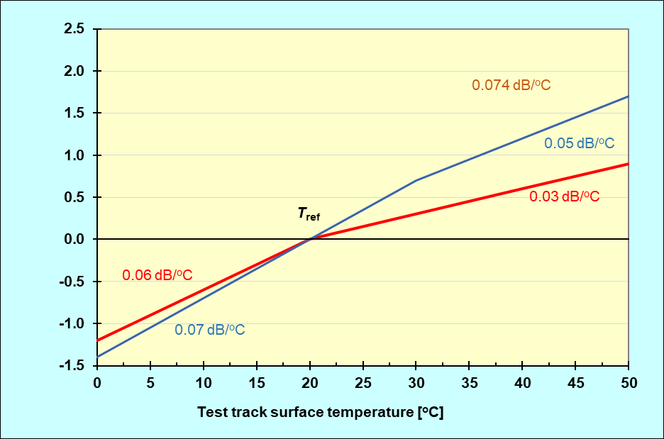
Proposal from STEER, for temperature correction(R117):
Air temperature: As proposed in ISO/DTS 13471-2:
C1/C2 tyres: -0.10 dB/°C, C3 tyres: -0.06 dB/°C (dense surfaces).
If road surface temperature is used (for political reasons):
C1/C2 tyres:
-0.07 dB/°C < 30°C
-0.05 dB/°C > 30°C
C3 tyres:
-0.04 dB/°C < 30°C
-0.03 dB/°C > 30°C

Slide 11
Conclusions:
The amount of available data is far from satisfactory, However, by using the recommendation, measurement uncertainty will be reduced. It is estimated that the standard error of 0.1 dB and a maximum error of 0.75 dB (at the highest temperatures) if the adjustments of allowed range is applied. The correction shall be based on air temperatures.
Both air and road temperature shall be limited to +5 to 40°C. The upper limit for road surface temperature can for example be met by making the ISO surface light grey instead of black (examples given from asphalts in Tokyo) or by reversing "heating" devices, as found on northern European ISO test tracks
To stabilize tyre temperatures, the following warm-up periods for tyres are proposed:
C1 tyres: 40 min, C2 tyres: 1 hour, C3 tyres: 2 hours

