Slide 1
R100-3 48V Issue
Risk for AC 48V Motor Generators
12.02.2021

Slide 2
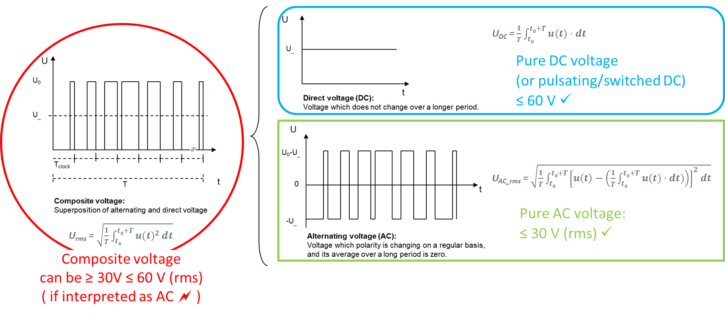
R100-3 Issue Risk for AC 48V Motor Generators
Management Summary
Topic
  The 03 series of amendments to UN Regulation no. R100 “Electric Vehicles Safety” was recently established and is applicable from 2023 for new approvals and from 2025 for all vehicles. It is mandatory for vehicle approval in the European Union.
  For 48V systems a new “special voltage condition” is included in this amendment: In case certain voltage thresholds are exceeded an isolation resistance test (not new) after exposure to water (new) has to be passed successfully.
  Compared to the 02 series of R100 the new “specific voltage condition” is more severe “… ≤ 30 V AC (rms) or and ≤ 60 V DC.” moreover the “water test” is newly introduced.
Issue
  Already with R100-02 there is a risk for
  mis-interpreted in a way that 48V air
  cooled Motor Generators can´t meet it.
  (But the isolation resistance test (w/o water) can be passed)
  The new “specific voltage condition” increases the risk of
  mis-interpretation. In this case the new “water isolation resistance
  test applies”.
  Air cooled 48V Motor Generators are expected not to pass this test,
  which will be mandatory in Europe
Approach
  Amend paragraph 2.42 by additional a footnote regarding the (correct) interpretation of composite voltages:
  “Note 2: For pulsating DC voltages (alternating voltages without change of polarity) the DC 60V threshold have to be applied.”

Slide 3
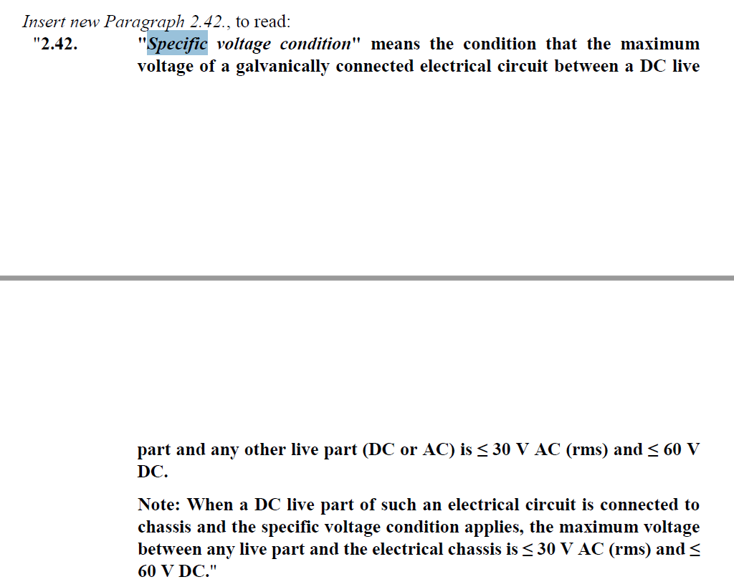
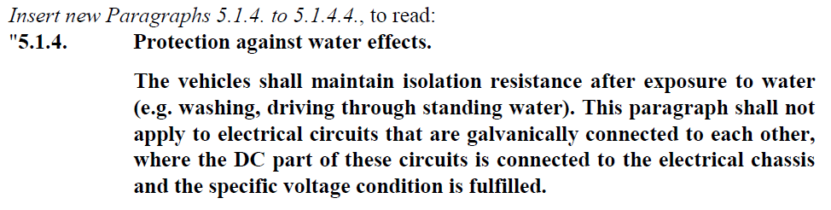
R100-3 Issue Risk for AC 48V Motor Generators
Summary
References
Current version of the introduction of the “specific voltage condition” in ECE-TRANS-WP.29-GRSP-2020-06e, chapter 2.42 can be a risk for especially 48V air cooled components like e.g. 48V motor generators which are sold from various suppliers and are in series since years with different OEMs.
Although this was not intended (according to discussions with experts from e.g. OICA), the currently proposed text of paragraph 2.42 48V air cooled components can be interpreted in a way that it do not fulfil the “specific voltage condition” even if it is connected to chassis ground. The reason is, that it is not clear if the voltages between “a DC life part and an AC life part” have to be interpreted as a composite voltage or ‘pure’ AC voltage. Especially the use case, which is possible according to the current text of paragraph 2.42 has not been considered and evaluated sufficiently: “AC condition between a DC life part and an AC life part” (e.g. the B+ bolt of a 48V motor generator to a phase of the same device). If the voltage is a composite/mixed signal, it is > 30V AC (rms) and the “specific voltage condition” is not fulfilled.
If the “special voltage condition” is not fulfilled the new “water isolation resistance
test” applies. Air cooled 48V Motor Generators are expected not to pass this test.
Already with the old (R100-2), less stronger specification there have been a remaining (actually occurred) risk, that the specification can be mis-interpreted in a way, that 48V air cooled Motor Generators can´t meet it. But the isolation resistance test (w/o water) can be passed.
CLEPA proposes to add a 2nd footnote to paragraph 2.42 regarding the (correct) interpretation of composite voltages, to avoid any mis-interpretation.

Slide 4
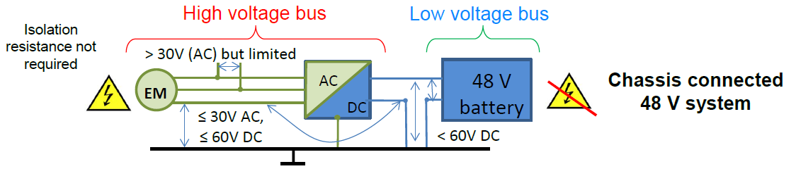
R100-3 Issue Risk for AC 48V Motor Generators
Concern / CLEPA Evaluation
The following figure is based on document “EVS-08-06e_48V_Integration_in_GTR_20_EVS.pdf” from
48 V System – Integration in GTR EVS, Input for OICA / GTR EVS-Meeting, OICA proposal version 2-2, May 25th 2015;
see also “EVS-06-24e_OICA-proposal_Amendment_to_GTR_EVS.pdf” from 6th EVS-gtr meeting Seoul, Nov. 2014).
Voltage B *
Voltage A *
* Voltage B between a DC life part (e.g. B+ bolt of an 48V Motor Generator (MG)) and an AC live part (e.g. phase of an 48V MG) has been not considered so far in the referenced document (see above). Voltages A and B can be evaluated as composite/mixed voltage and would in that case be > 30V AC (rms), which would be in conflict with the “special voltage condition” in ECE-TRANS-WP.29-GRSP-2020-06e, paragraph 2.4.

Slide 5
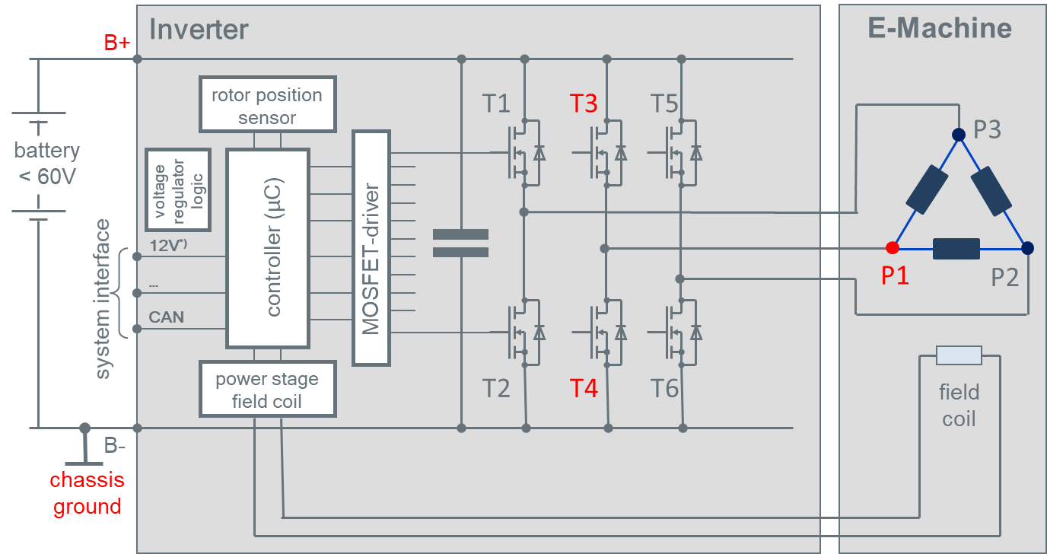
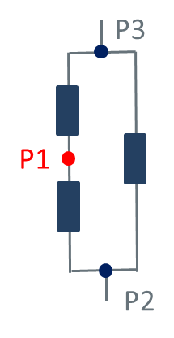
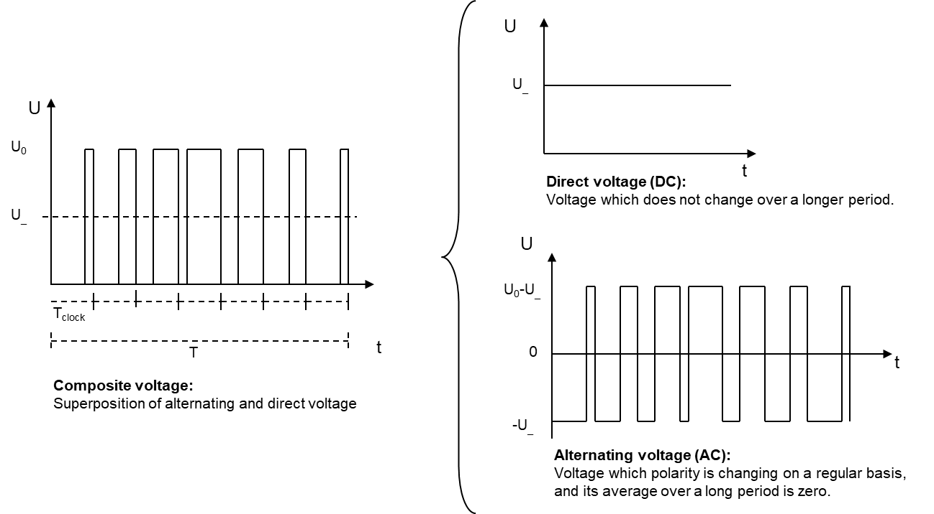
R100-3 Issue Risk for AC 48V Motor Generators
Detailed Explanation of Voltages A / B
Explanation of Voltages A / B using a 3 phase example looking at one representative point P1. This valid also for other phase numbers.
Voltage B
Voltage B
Voltage B
Voltage A
Voltage A
Voltage A
T3 open, T4 closed
P1 is connected directly to ground
Voltage A = Ground
Voltage B = B+
T3 closed, T4 open
P1 is connected directly to B+
Voltage A = B+
Voltage B = Ground
T3 open, T4 open
Parallel circuit
Ground ≤ U_{P3-P2} ≤ B+
Voltage A/B _{max} = U_{P3-P2}
if symmetric Voltage A/B _{max} = 0.5 * U_{P3-P2}
Voltages A and B are pulsating / switched DC voltages with U₀ ≤ B+ ≤ 60V
t

Slide 6
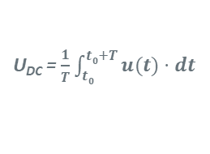
R100-3 Issue Risk for AC 48V Motor Generators
Composite, AC & DC Voltages in 48V Systems
Key issue: Interpretation of the “red signal”:
  Composite AC would be a problem
  Pure AC with DC offset evaluated separately (blue/green) OR pulsating (switched) DC with DC threshold
U_{DC} = $\frac{1}{T}\int_{t0}^{t0+T}{u(t)⋅ⅆt}$
≤ 60 V
U_{AC_rms} = $\sqrt{\frac{1}{T}\int_{t0}^{t0+T}{{\left[u\left(t\right)−\left(\frac{1}{T}\int_{t0}^{t0+T}{u(t)⋅ⅆt)}\right)\right]}^{2}ⅆt}}$
≤ 30 V (rms)
U_{rms} = $\sqrt{\frac{1}{T}\int_{t0}^{t0+T}{{u(t)}^{2}ⅆt}}$
can be ≥ 30V ≤ 60 V (rms)

Slide 7
R100-3 Issue Risk for AC 48V Motor Generators
CLEPA proposal
Approach:
AC is interpreted as a pure AC “alternating around ground w/o DC offset” according to scientific understanding of AC. There have to be added a 2nd note in paragraph 2.42 to make this crystal clear. To be noted the feedback from Japan, to delete the first sentence originally proposed by CLEPA : AC „Voltage AC (rms)“ is an AC without DC offset, which means its average over a very long time is zero (no composite signal).
Amend paragraph 2.42 to add a new footnote 2, as follows:
  "Specific voltage condition" means the condition that the maximum voltage of a galvanically connected electrical circuit between a DC live part and any other live part (DC or AC) is ≤ 30 V AC (rms) and ≤ 60 V DC.
  Note 1: When a DC live part of such an electrical circuit is connected to chassis and the specific voltage condition applies, the maximum voltage between any live part and the electrical chassis is ≤ 30 V AC (rms) and ≤ 60 V DC.“
  Note 2: For pulsating DC voltages (alternating voltages without change of polarity) the DC 60V threshold have to be applied.

Slide 8
R100-3 Issue Risk for AC 48V Motor Generators
Overview of Activities
CLEPA discussed this problem and its proposal with relevant experts of the EVS IWG.
Experts from OICA considered that components like BRM are not subject to the “special voltage condition”. CLEPA believes a risk for mis-interpretation still remains.
In the absence of support from Contracting Parties, a possible solution could be to reflect this doubt in the technical report of of GTR20. CLEPA believes this will not create regulatory certainty in relation with R100 and its application in Europe.
Interest expressed by the European Commission during the 20th EVS IWG meeting, where it was agreed to continue discussion at 21st EVS IWG and in the meantime CLEPA to submit an informal document to next GRSP session, subject to withdrawal in case of rejection by the 21st EVS IWG.

