Slide 1
Development of Guidelines for Improvement of Vehicle Safety Regarding Infant-Carrying Vehicles
Presentation material for
53rd session of GRSP &
104th session of GRSG
Notes:
・ Japan had formulated the guideline to improve the vehicle safety regarding Infant-Carrying Vehicles last March.
Here, I like to share the information in respect to this guideline.
・日本は今年の3月に、幼児専用車に関する車両安全性を向上させるためのガイドラインを策定したので、情報展開をさせて頂きます。

Slide 2
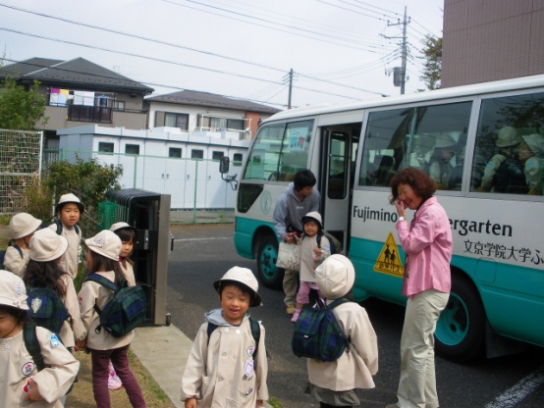
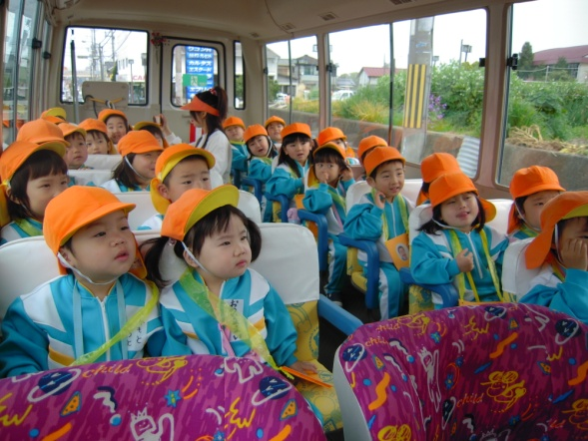
1. General Description of Infant-Carrying Vehicles
(1) What is an infant-carrying vehicle?
Motor vehicle that transports infants (of ages 3 to 6) between home and preschool/kindergarten
(2) Status of use of infant-carrying vehicles
An infant-carrying vehicle carries 10 to 50 infants and 1 or 2 adults (preschool/kindergarten teachers, etc.) in addition to the driver.
Transports infants from home to preschool/kindergarten and from preschool/kindergarten to home.
Operated in early morning and early evening (hours with a relatively heavy traffic).
Operated in the vicinity of the preschool/kindergarten.
Operated at low speeds (motorways are not used).
Infant passengers may sit with personal items on (school bag, water bottle, etc.).
(3) Number of infant-carrying vehicles owned
Number of infant-carrying vehicles owned in Japan: 17,800 (as of March 2009)
Notes:
・ Now, I like to start the explanation of this guideline as outlines.
・ Infant-carrying vehicles in Japan are the vehicle used to transport infants at the ages of 3 years to 6 years old between home and preschool/kindergarten.
・ And this Infant-carrying vehicles are running at the time of commuting rush hour with heavy traffic. It is the time to go to offices in the morning or to go home in the evening.
・ At the present time, we have 17,800 Infant-carrying vehicles owned in Japan.
・まずは、ガイドラインの概要について説明をさせて頂きます。
・日本で使用される幼児専用車は、３才から６才ぐらいの幼児を自宅と幼稚園まで間を送迎するために使用されている自動車です。
・また、幼児専用車は、比較的交通量の多い朝の通勤時間と夕方の帰宅時間に運行しています。
・現在、日本でおける幼児専用車の保有台数は、17,800台となっております。

Slide 3
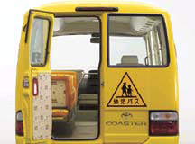
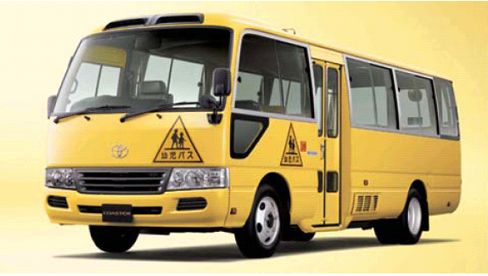
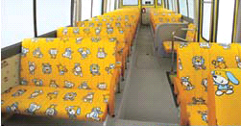

2. Standards Applicable to Infant-Carrying Vehicles
◆ Seat size requirement (*1)
◆ Prohibition of installation of
folding seats
◆ Exemption from the seat belt installation requirement (*2)
◆ Emergency exit size, etc.
◆ Mandatory gangway
installation
◆ Gangway size requirement
◆ Prohibition of installation of
areas for standing passengers
◆Mandatory platform installation
Bus for infants
◆Requirement on platform size, etc.
◆Indication on the vehicle
(*1) Seat size: Depth 230 mm or more & 270 mm or less
(*2) Reasons for the exemption include:
* Infants not able to fasten/unfasten their own belts; difficult to exit in emergency situations.
* Infant body build depends on age; difficult to designate a specific configuration of the belt.
* Passengers accompanying infants (preschool/kindergarten teachers, etc.) would have to assist them with fastening/unfastening of belts, if installed.
Notes:
・ This slide shows the safety standards applied to Infant-carrying vehicles in Japan up to now.
・ Infant-carrying vehicles have the indication of carrying infants on the surface of their bodies, in order to call for the attention of other drivers.
・ We have the Platform Installation requirement which specifies the requirement on the position and dimension, and also requests the Emergency Exit installation requirement.
・ Also, as the cabin requirement, we have the requirement on its seat size, gangway size , but we require the seatbelt installation as only an option.
・ The reasons to exempt the seatbelt installation form the requirement are;
・ it is not easy for infants to fasten/unfasten their own belts, therefore it would be difficult for them to exit in emergency situations.
・ It is very difficult to designate the specific configuration of the belt, because infants body builds are varied depending on their ages.
・ And, the installation of seatbelts will create works for adult passengers accompanying infants to assist them with fastening/unfastening. Therefore, the Infant-carrying vehicle with large capacity requires the many hours for this kind of assisting works, and there will be many other issues.
・このスライドでは、これまでの日本における幼児専用車に適用している安全基準をとりまとめてあります。
・車体表面には、他の運転者に注意を喚起することを目的として、幼児専用車であることを表示しています。
・乗降口の設置要件では、その位置や寸法要件があり、また、非常口の設置要件も求めております。
・また、客室内の要件としては、座席の座面寸法や通路寸法要件がありますが、座席ベルトの装備は任意としています。
・座席ベルトの装備要件を除外している理由としては、
・ 幼児自らが座席ベルトの脱着をおこなうことができず、緊急時の脱出が困難であること。
・ 幼児の体格は年齢によって様々であり、一定の座席ベルトの設定が困難であること。
・ そして、大人の同乗者がベルト脱着の補助作業が発生し、多くの定員をもつ幼児専用車では補助作業に多くの時間が必要となること等、多くの課題があります。

Slide 4
3. History of Discussions on Safety Measures, Etc.
Mothers of infants, etc. requested that the installation of seat belts be mandatory for the infant-carrying vehicles.
Discussion started after grasping the current status of accidents and the infant behaviors in collisions:
2009: Current status of accidents involving infant-carrying vehicles grasped;
A survey on accidents involving infant-carrying vehicles in other countries conducted at the 46th session of GRSP (Informal document No. GRSP-46-41, Dec. 2009);
2010: Investigation on safety of infant-carrying vehicles (collision experiments) conducted;
2011: A hearing survey to stakeholders conducted and the direction of the measures discussed;
2012: WG on Infant-Carrying Vehicles established, and specific safety measures discussed (a total of 4 meetings held);
March 2013: The Guidelines developed.
The members of the WG consist of academic experts, research institutes, automakers, auto parts makers, etc., and it is also attended, as observers, by preschools/kindergartens using infant-carrying vehicles.
Notes:
・ Next, this slide is about the past development of the safety measures.
・ In Japan, person riding on the rear seat of passenger vehicles and likes have to wear seatbelt since the year of 2008 as mandatory regulations.
・ Because of this regulations and the raising of public awareness to wear seatbelts among the vehicle users, now we have many requests that seatbelts should be installed for even the infant-carrying vehicles.
・ From this, we have decided to study the safe riding for infants including the necessity of seatbelts installation for infant-carrying vehicles.
・ Since 2009, we tried to grasp the actual accident status involving Infant-carrying vehicles and the behaviors of infant bodies on collision. On the basis of the results of those studies, we set up the working group specializing on infant-carrying vehicle and started to discuss the specifications of the safety measures in details, since 2012.
・次に安全対策の検討経緯です。
・日本では2008年より、乗用車等の後部座席に乗車する際には、座席ベルトの着用が義務付けされました。
・それにより、自動車ユーザーのベルト装着に対する意識が向上し、幼児専用車についても座席ベルトを装備するべきとの要望が高まってきました。
・このことから、幼児専用車の座席ベルト装備の必要性を含め、幼児の安全な乗車について、検討を行うこととなりました。
・2009年より、幼児専用車の事故実態の把握や衝突時の幼児の挙動の把握をおこなった上で、2012年より幼児専用車ワーキンググループを設置し、具体的な安全対策の仕様を検討しました。

Slide 5
4. Current Status of Accidents Involving Infant-Carrying Vehicles (1/2)
Using data on traffic accident statistics recorded during 6 years from 2003 to 2008, vehicle-to-vehicle accidents, single vehicle accidents and person-to-vehicle accidents involving buses/microbuses and minivans, etc. registered as infant-carrying vehicles that were carrying passengers age 6 and younger were analyzed.
◆ Collision Areas on Infant-Carrying Vehicles
Front
Right front corner
Left front corner
Right side
Left side
Rear
Right rear corner
Left rear corner
No. of vehicles
involved in
accidents
393
229
206
125
176
109
46
39
(29.7%)
(17.3%)
(15.6%)
(9.4%)
(13.3%)
(8.2%)
(3.5%)
(2.9%)
◆ Injured Body Parts of Injured Infants
200
No. of casualties (persons)
180
160
1
140
120
Death
100
Severe injury
80
142
143
157
Minor injury
60
40
1
1
1
20
38
6
5
4
26
37
0
Head
Face
Neck
Chest
Abdomen
Back
Hip
Arms
Legs
Others
Notes:
・ Next, I like to explain briefly about the actual accidents status involving infant-carrying accidents.
・ For the analysis of accidents involving infant-carrying vehicles, we used the Japan Traffic Accidents General Database in the period of 6 years from 2003 to 2008. And we have analyzed vehicle-to-vehicle accidents, single vehicle accidents and person-to-vehicle accidents as the subjects in relation to the passengers of 6 years old, or younger.
・ 30% of the vehicle to be collided in accidents involving infant-carrying vehicles are at front. Following frontal collision, collision at right-front corner and then at left-front corner. As you see, those two are still counted as the frontal collision. As the results, about 60% of accidents are collided at the front end of vehicles.
・ At the infant-carrying vehicle accidents, most injuries of injured infants were minor. The injured body parts of injured infants were in head, face and neck injuries accounted for about 80% of total.
・次に幼児専用車の事故実態について、簡単にご説明させて頂きます。
・事故の分析は、2003年～2008年の６年間の交通事故統計データを用い、車両相互事故、車両単独事故および人対車両事故を対象として、幼児専用車の乗員のうち６歳以下の乗員について分析を行いました。
・幼児専用車の事故における衝突部位は、前面が最も多く約30%を占めています。次いで、右前角、左前角と車両の前方を衝突する事故が全体の約６割以上を占めていることがわかった。
・幼児専用車の事故において、負傷した幼児の傷害は、ほとんどが軽傷ではあるものの、その傷害部位は、頭部、顔部および頚部で全体の約80%を占めています。

Slide 6
4. Current Status of Accidents Involving Infant-Carrying Vehicles (2/2)
◆ Vehicle Structures Causing Injuries to Infants
400
1
No. of casualties (persons)
350
300
250
200
Death
372
2
Severe injury
150
Minor injury
100
161
50
1
0
13
12
Door, window,
ceiling, pillar
Seat
Other interior
parts
Exterior parts
+ others
Results:
Among the collision areas on infant-carrying vehicles, the frontal area (including the left and right front corners) accounted for the most, at about 60%.
As for the injured body parts, the “head”, “face” and “neck” accounted for 70-80% of all the body parts; and the “seat” accounted for the majority of the vehicle structures causing such injuries.
Notes:
・ Here, we have found that the vehicle parts to cause two-third of injuries of injured infants were seats.
・ As the results of analyzing the accidents status involving infant-carrying vehicles, there are very few accidents with this vehicle resulting in fatalities and serious injuries.
・ Therefore, as we have identified the damages to have injuries on face, neck or head by the seat in front which is the vehicle parts to cause the damages, we decided to present the safety measures on those subjects as priority.
・また、負傷した幼児への加害部位は、2/3を座席が占めておりました。
・ 幼児専用車の事故実態を分析した結果、幼児専用車の死亡・重傷事故が少ないこともわかりました。
・したがって、今回の検討の対象を、前方座席が加害部位となって、頭部、顔部、頚部を受傷する事故とし、優先的に安全対策を示すこととしました。

Slide 7
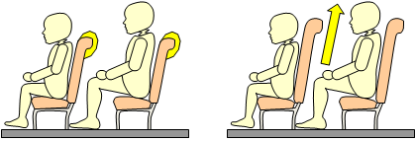
5. Guidelines on Safety Measures
◆ Events that need early improvement of safety
Events in which the head, face, and/or neck is injured by the seat in front (minor injuries)
◆ The Guidelines request that motor vehicle manufacturers develop vehicles, by March 2015, in which the following safety measures are implemented with the accidents involving infant-carrying vehicles taken into account:
  Shock-absorbing material to be added to the rear of the seatback;
  Seatback height to be increased by about 100 mm
  (height from the seating surface to the top of the seatback to be about 470-490 mm).
  Note: Installation of seat belts not to be required until those suitable for infant seats in infant-carrying vehicles are developed.
Addition of shock-absorbing material to the rear of the seatback
Change of the seatback height
(About 470-490 mm)
Notes:
・ As the results of studies;
・ This is a part of seating requirement for bus described in UN R80. We will add the shock-absorbing materials to the rear of the seatback which comply with a certain shock absorbing performance. We used the performance requirements for shock-absorbing materials as a reference.
・ Also, the height of seatback should be around 470mm to 490mm. This is the effective height to mitigate a damage to 6 years old infants without loosing the visibility if infants from adults passenger accompanying infants.
・ About these measures, we request auto vehicle manufacturers to develop infant seats as soon as possible or at least done by March, 2013.
・ The motor vehicle manufacturers, etc., shall be develop seat belts suitable to the installing onto infants seats. But until then, we do not require the installation of seatbelts for infant-carrying vehicle.
・検討の結果、
・協定規則第80号に定めるバスの座席の要件の一部である、座席後面の衝撃吸収性能要件を参考として、座席後面に一定の衝撃吸収性能要件を満たす緩衝材を追加する。
・また、シートバックの高さについては、大人の同乗者からの視認性を低下させないで、６歳児でも被害軽減効果が有効となるように、シートバックの高さを470mm～490mm程度とする。
・これらの対策について、自動車製作者等に対し、幼児用座席の開発に早期に取り組み、2015年３月までに車両開発を行うことを要請します。
・なお、座席ベルトは、幼児専用車に装備される幼児用座席に適した座席ベルトが開発されるまで、装備を求めておりません。

Slide 8
6. Concept and Purpose of the Guidelines
The Guidelines, while giving consideration to the current usages of infant-carrying vehicles, show the direction in which the motor vehicle manufacturers, etc. should develop their infant-carrying vehicles to improve their safety.
Since no seat belts suitable for infant seats installed in infant-carrying vehicles currently exist, the Guidelines will facilitate development of such seat belts suitable for the infant seats (the motor vehicle manufacturers, etc. shall aim to develop them in the next 3-5 years).
Notes:
・ This guideline aims to point out the direction for automobile manufacturers to improve the safety at the time of developing this type of vehicles. And also, the development should be done with due consideration to the ways of actual uses of infant-carrying vehicles.
・ And now, there are no seatbelts suitable to the seat for infant of the infant-carrying vehicle. Therefore, formulating this guideline, we like to prompt the development of seatbelts suitable for infant-seating, now.
・本ガイドラインの目的としては、幼児専用車の使用実態も考慮しつつ、自動車製作者等が幼児専用車を開発するときの安全性向上のための方向性を示すものです。
・そして、現在、幼児専用車に装備される幼児用座席に適した座席ベルトが存在しないことから、ガイドラインの策定を機に、今後、幼児用座席に適した座席ベルトが開発されることを促すものです。

Slide 9
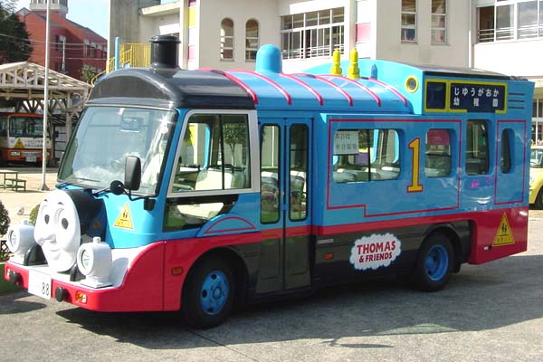
Thank you for your attention.
Attachments:
  → Guidelines for Improvement of Vehicle Safety Regarding Infant-Carrying Vehicles
Notes:
・ Please confirm the contents of this guideline with GRSG-104-●● of informal documents.
・ Also, we will inform this information at GRSP on May.
・ Thank you for your attentions.

