Slide 1
TF ADAS
Scope and objectives
Industry views
TF-ADAS-01
2021-02-18

Slide 2
Content
How to synch the “2 parallel work streams” on ADAS ?
Considerations about regulatory scope:
    R79 Analysis - Common vs specific requirements
    Scope of R79 vs future ADAS Regulation
Road map for the development of new ADAS Regulation
(and subsequent R79 amendments)

Slide 3
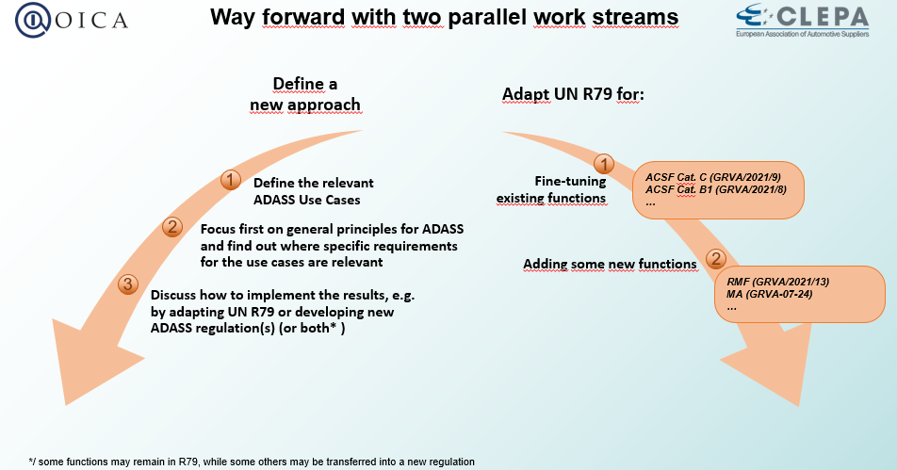
How to synch the “2 parallel work streams” on ADAS ?
Reminder from GRVA-08-23
Industry views:
The TF ADAS should primarily deal with the “new regulation” for ADAS
Industry is keen to deliver “short term” amendments to R79 independently from the “new ADAS regulation”
(e.g. RMF should amended in R79 ASAP, while clearly part of the scope of the “new regulation”).
These different “short term” R79 amendments may be worked within or in-parallel-with the TF ADAS, whatever the most efficient

Slide 4
R79 Analysis - Common vs specific requirements (current status)
Current R79
On-going
Test
Annex 8
Annex 8
Annex 8
Annex 8
Performance requirements
Aysmax
B1 needed
LC timing Sensor range…
Requirements to avoid negative side effects
< 5km/h
< 10km/h
within lane;
offset <0,75m
Longitudinal requirements
Longitudinal requirements
EMC, no deterioration of basic steering, overridable with <50N, Annex 6
HMI
Acoustic
Remote: RCM ~ RCP
Specific
Specific
Specific
RCM ~ACSF-A
Deliberate action, indicate status
Indicate interventions/when operational, Indicate failures
a, b
c
a(i) a(ii) a(iii), b
A
(incl RCP)
B1
C
CSF
ESF
RCM
ACSF
[RMF]

Slide 5
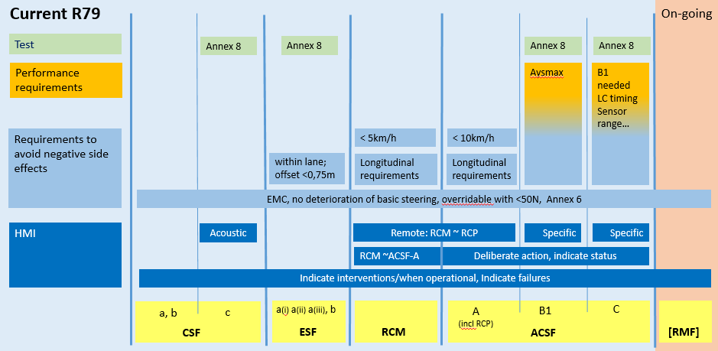
Scope of R79 vs future ADAS Regulation
ADAS regulation may only cover ADAS with both “lateral and longitudinal control”
The scope proposals here are addressing the main R79 limitations:
Longitudinal control does not fit in R79
A number of Use Cases are restricted / prohibited by R79 (i.e. definitions and ADAS scope in R79 are not general enough)
UN R79
ADAS Reg.
UN R79
ADAS Reg.
“Missing use cases” and “adjustments needed” could probably be handled under the current approach (i.e. be kept in R79)
ADAS regulation may as well cover continuous lateral control (which would then address more of the restricted / prohibited UCs by R79)

Slide 6
Road map for the development of new ADAS Regulation
(and subsequent R79 amendments)
This slide is not about short term amendments needed in R79 (e.g. RMF or RCP HMI…)
Identify new use cases
Definition of ADAS
Need for a new Taxonomy of ADAS functions ?
Freeze scope of the ADAS new Reg.
Freeze split of requirements between “General” and “specific”
Freeze split of requirements between R79 and ADAS Reg.
Define ADAS General requirements
Define Specific requirements in ADAS Reg.
(To avoid negative effects and/or to define minimum performance)
Prepare Amendment to R79
(e.g. to transfer requirements from R79 to ADAS reg.)

