Slide 1

11th Session
Status Review and Session Orientation
Document FRAV-11-03
Web Conference
30 March 2021

Slide 2
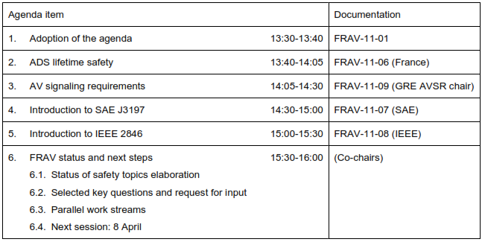
Agenda item 1
Adoption of the agenda

Slide 3
Agenda items 2-5
FRAV Stakeholder Presentations
ADS lifetime safety
  Presentation from France (FRAV-11-06)
AV signaling requirements
  Presentation for the chair of GRE AVSR task force
Introduction to SAE J3197
  Presentation from SAE on ADS data loggers
Introduction to IEEE 2846
  Presentation from IEEE on Assumptions for Models in Safety-Related AV Behavior Scope

Slide 4
Agenda items 6
FRAV Status and Next Steps
Status of safety topics elaboration
  Synthesis of stakeholder comments on FRAV-09-08
Key questions raised by comments
  What are the functions required to operate vehicle in traffic (DDT)?
  Who are the “users” across the different levels of automation and ADS configurations?
  Who are the “road users” ADS would interact with?
  EDR/DSSAD IWG request: FRAV views on DSSAD requirements for ADS
Parallel work streams to prepare written responses for May session
Prepare input for discussion on 8 April to provide basis for drafting responses

