Slide 1
France 11/02/2021
Vehicle configuration’s evolution and ADS safety along lifetime
Consideration about potential impact on safety requirements and evaluation process of ADS
Notes:
1

Slide 2
ADS safety requirements should be met in any [authorized] vehicle configuration
The fact that “ADS should maintain a safe operational state”. (Ensure safety throughout the useful life of the ADS, such as safety-critical updates, responses to obsolescence, end of production, etc.) is one of the five main aspects of ADS performance listed by FRAV.
According to VMAD, the validation for the system safety should take into account the “overall vehicle design into which the ADS is being integrated”.
2
Notes:
2
2
2

Slide 3
Vehicle configuration will evolve during lifetime
due to the use of the vehicle,
  Ex: load variation: vehicle unloaded, loaded, overloaded
because some parts wear out and their performance changes with wear,
  Ex: tyre breaking distance
because they can be replaced by parts different from those used to homologate the vehicle,
  Ex: retreaded tyres for trucks
because their repair will induce a different adjustment from that carried out in the factory,
  Ex: cameras, detection sensors,
because the traffic rules require it.
  Ex: winter tyre fitment.
3
Notes:
3
3
3

Slide 4
ADS safety can be impacted by the evolution of the vehicle configuration
The Vehicle Manufacturer is responsible for the ADS’s response strategy to these configuration changes to ensure safety.
But how should these configuration changes be taken into account by the approval process ?
Should they be part of the ODD ?
Should they be managed by the vehicle owner/driver if not detected by the ADS itself ? And then how should the vehicle owner/driver be informed of that ?
4
Notes:
4
4
4

Slide 5
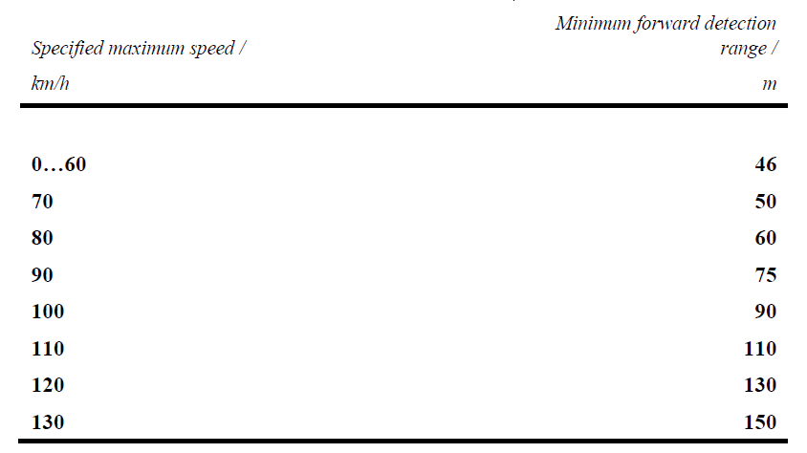
Example of interference between ADS safety requirements and vehicle configuration:
R157 amendment for « highway chauffeur ».
Braking demand threshold in case of « imminent collision » : 5 m/s²
Detection table for speed above 60 km/h
µ = 0,5
seems to be the minimum adhesion level required to ensure adequate reaction time even at 130 km/h.
Lower µ levels can be reached in operation depending on the road conditions (dry, wet, snow, ice...), the type of tires fitted on the vehicle, their level of wear...
5
Notes:
5
5
5

Slide 6
This observation raises two questions
How will the system cope with different grip conditions depending on the road and the vehicle’s tire fitment during the vehicle’s lifetime?
  What are the consequences for the vehicle user/owner if the solutions are not standard?
How will the system comply with local traffic rules in winter (mandatory special equipment on specific roads & countries) without recognizing its tires?
  Who is liable in case of accident? The vehicle manufacturer or the vehicle owner?
GRVA work should take these questions into considerations when proposing regulatory framework
  (however GRAV may not be responsible to address these questions)
6
Notes:
6
6
6

Slide 7
Thank you for your attention.
Pierre Bazzucchi
Pierre.bazzucchi@developpement-durable.gouv.fr
7
Notes:
7
7
7

