Slide 1

Electric Vehicle (EV) Reference Guide
Draft 1 Summary & Discussion
Next Steps
Agenda item 5a,b,c
7th Electric Vehicles and the Environment (EVE) Informal Working Group (IWG) meeting
October 17 – 18, 2013
Beijing, China

Slide 2
Outline
Agenda item 5.a): EV Reference Guide Development
  Background
    Electric Vehicles and the Environment IWG
    Summary of EVE activities to date, meetings
    EV Reference Guide development
      Vehicle attributes, Guide outline, Questionnaire, Prioritization discussion points
  Current Status of the Guide: Draft 1 summary and review
    Review of submitted comments
    Discussion questions
Agenda item 5.b): Discuss next steps in roadmap
  Guide development
  Future meetings, other tasks
Agenda item 5.c): Discuss potential extension of EVE mandate
Agenda item 5.a): EV Reference Guide Development

Slide 3
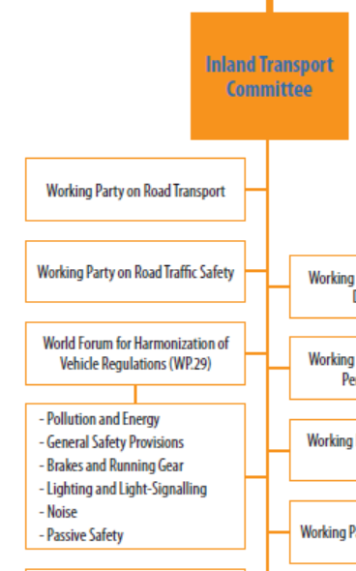
Electric Vehicles and the Environment IWG
Established in 2012
Chair: US EPA, Co-Chair: China, Japan, Secretary: EC
Objectives:
  Exchange information on current and future regulatory requirements for EVs in different markets,
  Identify and seek to minimize the differences between regulatory requirements, with a view toward facilitating the development of vehicles to comply with such requirements,
GRPE
EVE IWG
Agenda item 5.a): EV Reference Guide Development

Slide 4
Summary of EVE activities to date
6 informal working group meetings since 2012
Specific EVE meeting objectives:
  Develop a priority list of topics to address the most timely and significant considerations before the EVE informal working group.
  Understand and document the current consideration of EVs under the work of other established informal working groups: EVS, WLTP, HDH, EFV and VPSD.
  Establish a mechanism for sharing ongoing research and information sharing on topics related to EVs and the environment.
  Develop a reference guide for regulatory activities already established or being considered by contracting parties.
Agenda item 5.a): EV Reference Guide Development

Slide 5
Summary of EVE meetings
EVE Session #2 – Baltimore (13-14.9.2012)
  Finalized TOR, initial discussions to develop an EV reference guide.
EVE Session #3 – Conference Call (27.11.2012)
  Proposed a format for the reference guide and questionnaire.
EVE Session #4 – Geneva (14.1.2013)
  Confirmed the format for the reference guide and questionnaire, initiated information gathering.
  Concurrence from GRPE on progress report and terms of reference
EVE Session #5 – Tokyo (11-12.4.2013)
  Completed information gathering, discussion of completed questionnaires by contracting parties and summary presentation.
EVE Session #6 – Geneva (3.6.2013)
  Sought input from CPs and other IWGs on list of priority issues to inform reference guide recommendations and guide potential future research/testing
  All stakeholders invited to submit further literature/data.
Agenda item 5.a): EV Reference Guide Development

Slide 6
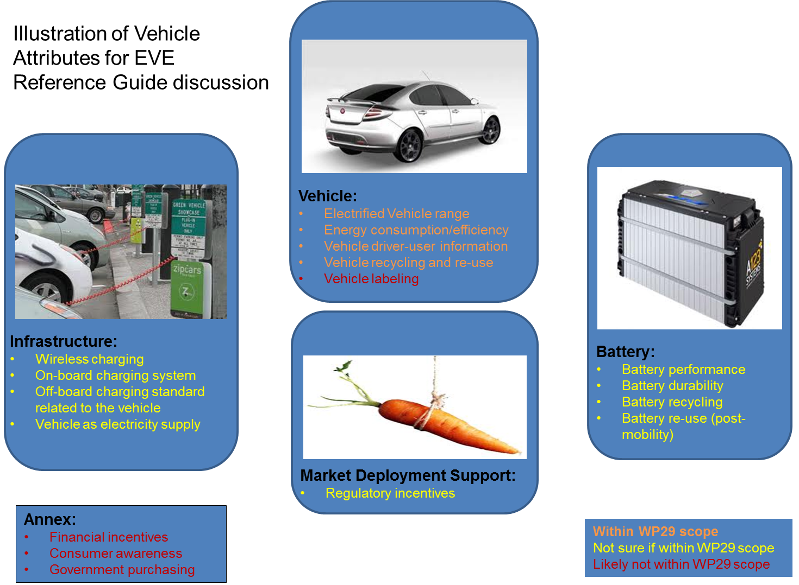
EV Reference Guide Development- Vehicle attributes
EVE-3 meeting (conference call, Nov 2012), Guide format proposed
EVE-4 meeting (Geneva, January 2013), Guide format approved
Agenda item 5.a): EV Reference Guide Development

Slide 7
EV Reference Guide Development- Guide Outline
EVE-3 meeting (conference call, Nov 2012), Guide format proposed
EVE-4 meeting (Geneva, January 2013), Guide format approved
Agenda item 5.a): EV Reference Guide Development

Slide 8
EV Reference Guide Development- Questionnaire
EVE-3 meeting (conference call, Nov 2012), Questionnaire format proposed
EVE-4 meeting (Geneva, January 2014), Questionnaire format approved
EVE-5 meeting (Tokyo, April 2013), Questionnaire results discussed
Agenda item 5.a): EV Reference Guide Development

Slide 9
EV Reference Guide Development- Prioritization discussion points
EVE-6 meeting (Geneva, June 2013), priority issues list approved
Agenda item 5.a): EV Reference Guide Development

Slide 10
EV Reference Guide Development- Prioritization discussion points
EVE-6 meeting (Geneva, June 2013), priority issues list approved
Agenda item 5.a): EV Reference Guide Development

Slide 11
EV Reference Guide Development- Prioritization discussion points
EVE-6 meeting (Geneva, June 2013), priority issues list approved
Agenda item 5.a): EV Reference Guide Development

Slide 12
Current Status of the Guide: Draft 1 summary and review
Prepared by FEV, Inc. – contractor hired by US EPA
Document has 6 sections:
  Introduction
    Overview of EVE IWG, Purpose of Guide, Outline of Guide
  Reference Guide Design & Methodology
    Guide organization, scope, rationale
  Summary of Findings
    EV attributes discussed in groups: vehicle, battery, infrastructure, market deployment
  Conclusions
    High and low activity, Gaps and implications of analysis
  Next steps
    Potential areas for future work, gtr recommendations
  Annex
    Other EV attributes (i.e. financial incentives, etc.)
Agenda item 5.a): EV Reference Guide Development

Slide 13
Current Status of the Guide: Draft 1 summary and review
Summary of Findings: Vehicle Attributes
Figure 7 : Vehicle attributes, global snapshot
Agenda item 5.a): EV Reference Guide Development

Slide 14
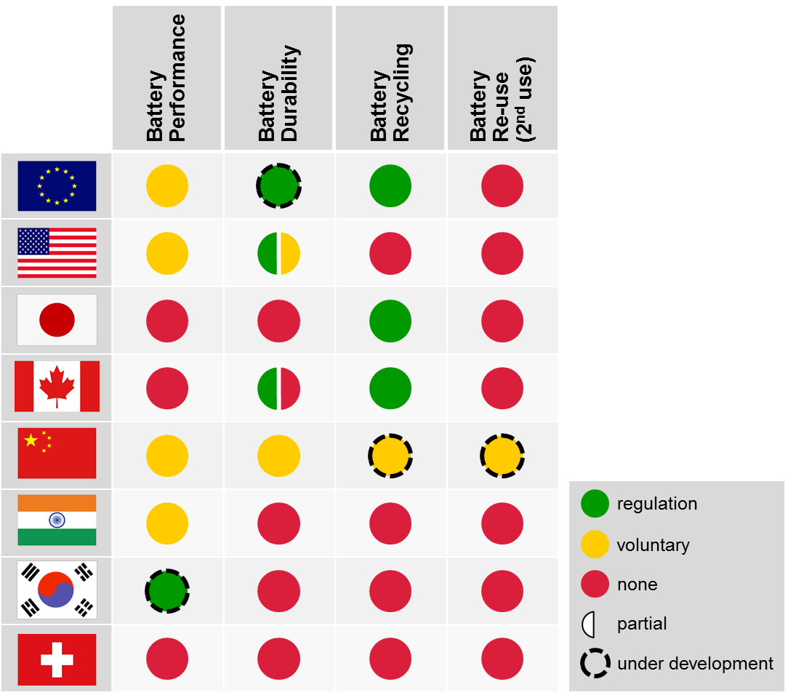
Current Status of the Guide: Draft 1 summary and review
Summary of Findings: Battery Attributes
Figure 13 : Battery attributes, global snapshot
Agenda item 5.a): EV Reference Guide Development

Slide 15
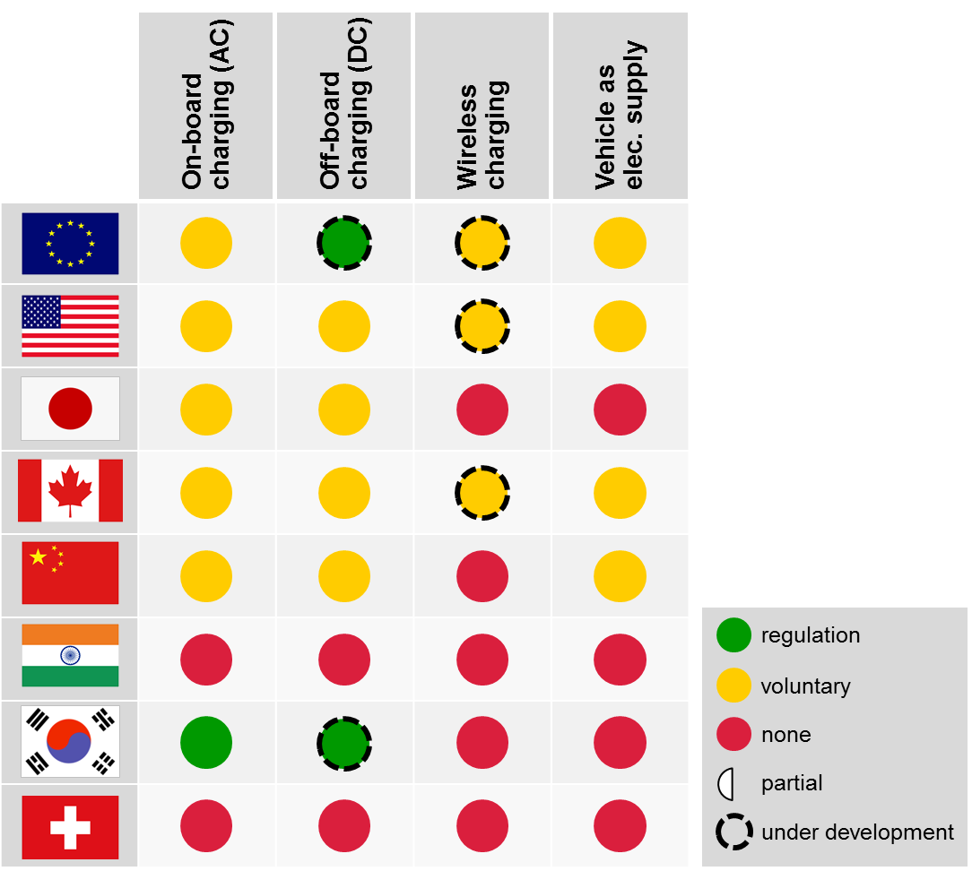
Current Status of the Guide: Draft 1 summary and review
Summary of Findings: Infrastructure Attributes
Figure 19 : Infrastructure attributes, global snapshot
Agenda item 5.a): EV Reference Guide Development

Slide 16
Current Status of the Guide: Draft 1 summary and review
Summary of Findings: Market deployment Attributes
Figure 25 : Market deployment attributes, global snapshot
Agenda item 5.a): EV Reference Guide Development

Slide 17
Current Status of the Guide: Draft 1 summary and review
Conclusions: High activity areas
Figure 27 : Activity chart, Overall
Figure 28 :
Activity chart, Vehicle attributes
Agenda item 5.a): EV Reference Guide Development

Slide 18
Current Status of the Guide: Draft 1 summary and review
Conclusions: High activity areas
Figure 29 : Activity chart, Infrastructure attributes
Figure 30 : Activity chart, Market deployment attributes
Agenda item 5.a): EV Reference Guide Development

Slide 19
Current Status of the Guide: Draft 1 summary and review
Conclusions: Low activity areas
Figure 31 : Activity chart, Battery attributes
Agenda item 5.a): EV Reference Guide Development

Slide 20
Current Status of the Guide: Draft 1 summary and review
Conclusions: Gaps and Implications of the Analysis
Vehicle attributes
  Energy efficiency and range are critical input parameters to other key events- there is a lack of global uniformity in regards to drive cycle and test procedures for determination of key vehicle performance criteria.
    This disconnect was identified by the UNECE and is the subject of Phase 1 of a GTR being developed under the framework of WLTP working group.
  A gap still exists in accounting for the use of accessories, in particular air conditioning, cabin heating, and vehicle exterior lighting.
  General lack of provisions corresponding to advanced thermal management systems such as heat pumps or infra-red heating.
  Active battery management systems employed by different OEMs / battery pack manufacturers as well as driver selectable operating modes (sport, eco etc. ) are also aspects that are generally not yet addressed.
  Vehicle labeling, while widely practiced globally (high activity), overwhelmingly excludes electrified vehicles (US is the exception), representing another significant gap.
Agenda item 5.a): EV Reference Guide Development

Slide 21
Current Status of the Guide: Draft 1 summary and review
Conclusions: Gaps and Implications of the Analysis
Battery attributes
  Battery performance determination is largely non-standard, with a mix of voluntary standards (USABC, SAE, ISO, IEC) and some country-specific ones existing or in development (China, South Korea).
  Battery recycling by virtue of its widely differing requirements globally can be considered to be gapped as well. There are also a number of countries that simply do not have any requirements in place pertaining to battery recycling.
  Battery re-use post mobility represents a wide gap that will be challenging to govern given the highly variable nature of battery wear and inherent differences in chemistry, construction, and power management.
Agenda item 5.a): EV Reference Guide Development

Slide 22
Current Status of the Guide: Draft 1 summary and review
Conclusions: Gaps and Implications of the Analysis
Minimal gaps Infrastructure and Market deployment attributes
Infrastructure attributes
  The gap here is one that is temporary and continuing to close with time.
    A roadmap of ISO/IEC standards governs the systems and communication protocols and there is a generally well harmonized set of standards that govern the connectors.
Market deployment attributes
  There are no gaps that exist in the context of regulatory incentives.
Agenda item 5.a): EV Reference Guide Development

Slide 23
Current Status of the Guide: Draft 1 summary and review
Next steps: Vehicle range & efficiency testing
  It is recommended that testing procedures for EVs include cold ambient temperature testing with cabin heating in operation and testing at elevated ambient temperatures with air conditioning in operation.
    Phase 2 of the GTR being pursued by the WLTP working group aims to address low temperature ambient conditions; if this recommendation goes beyond the scope of WLTP, a separate GTR could be considered.
  It is recommended that information on battery durability, which will be part of the WLTP GTR and subsequently adopted into EC law (2015/2016), be leveraged to develop correction factors that can be used to project range and energy efficiency over the operating lifecycle of the corresponding electric vehicles that receive these batteries.
Agenda item 5.a): EV Reference Guide Development

Slide 24
Current Status of the Guide: Draft 1 summary and review
Next steps: Vehicle labeling (outside WP.29 scope)
  It is recommended that an effort to harmonize vehicle labeling world-wide be considered. Two phases of adoption are proposed:
    Phase 1 – Adoption of a world-wide label that lists the following critical attributes:
    Phase 2 – Phase 1 but with the following amendments: WLTC test procedure, Summer and Winter sets of values
    Future phase - include deterioriation factors
Agenda item 5.a): EV Reference Guide Development

Slide 25
Current Status of the Guide: Draft 1 summary and review
Next steps: Battery performance
  it is recommended that uniform propulsion battery test procedure be pursued through a GTR.
    This would be in line with current plans to pursue a battery durability standard via WLTP GTR and would more fully complete the definition of requirements for propulsion batteries.
    It is recommended that currently available international standards be used as references in this work, in particular ISO 12405-1 and 12405-2 which are the most elaborate of the standards that have been released to-date.
Agenda item 5.a): EV Reference Guide Development

Slide 26
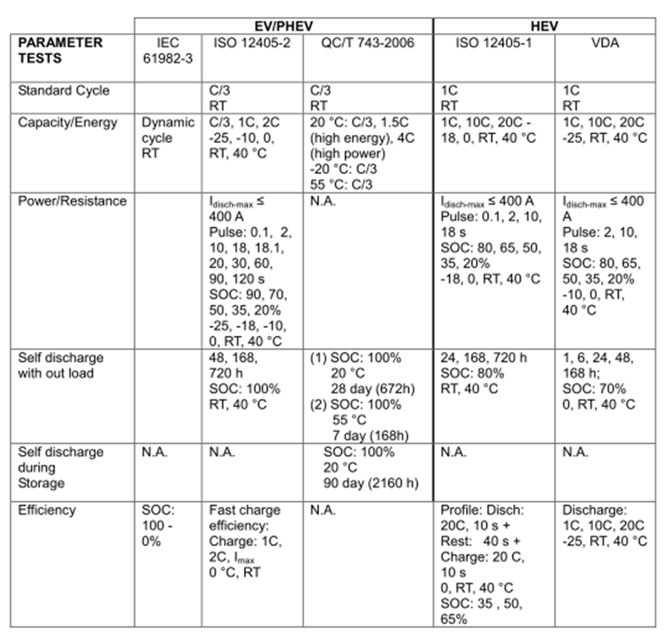
Current Status of the Guide: Draft 1 summary and review
Next steps: Battery performance
Figure 33 : Overview of major battery performance standards.
Agenda item 5.a): EV Reference Guide Development

Slide 27
Current Status of the Guide: Draft 1 summary and review
Next steps: Battery recycling and reuse (outside WP.29 scope)
  It is recommended is that resources be allocated to evaluate the value of developing manufacturing-for-recyclability battery requirements.
    Global battery recycling requirements are largely non-existent, but given the diversity of global recycling practices and attitudes, pursuit of a GTR is not recommended at this time.
  A study to look at issues surrounding battery reuse post-mobility (i.e. durability behavior of batteries at to understand battery characteristics below the mobility-feasible threshold)
    The challenge here is in ensuring consistent performance from used battery packs that have been subjected to a variety of duty cycles and driving behaviors during their mobility life. A GTR is not recommended at this time.
    The findings of such a study could then be considered in developing requirements for re-use.
Agenda item 5.a): EV Reference Guide Development

Slide 28
Review of submitted comments:
Agenda item 5.a): EV Reference Guide Development

Slide 29
Discussion Questions:
Under Next Steps, should recommendations be defined as “overall future work” and “for future work under GRPE/WP.29” ?
Additional recommendations?
Agenda item 5.a): EV Reference Guide Development

Slide 30
Agenda item 5b-
Next steps in EVE IWG roadmap: Guide development
Comments on the Guide can be submitted to Erin.Marchington@ec.gc.ca until October 25, 2013
The Guide will be revised (draft 2) and submitted as an informal document to GRPE by Dec.1, 2013 for discussion and comments at the Jan 2014 GRPE
EVE #8 – Geneva, 2:30-5:30 p.m., January 7, 2014 GRPE- accept comments on Guide
  EVE #9 – To be decided, February 2014- revise Guide based on GRPE comments and finalize (draft 3)
The Guide will be revised (draft 3) and submitted as an formal document to GRPE by March 1, 2013 for anticipated approval at the June 2014 GRPE
EVE #10 – Geneva, June 2014 GRPE- wrap-up meeting
Seek final approval of the Guide at Nov. 2014 WP.29 following GRPE concurrence
Agenda item 5.b): Next steps in EVE IWG roadmap

Slide 31
Agenda item 5b-
Next steps in EVE IWG roadmap: Future meetings, other tasks
Agenda item 5.b): Next steps in EVE IWG roadmap

Slide 32
Agenda item 5c- Discuss potential extension of EVE mandate
Current EVE mandate until November 2014
Guide will be approved at the WP.29 session in November 2014
Work effectively completed upon submission of the Guide to the GRPE on March 1, 2014 for formal approval at the June 2014 GRPE session
The last EVE meeting (EVE-10) is currently scheduled for June 2014 in Geneva
Consider:
Guide recommendations, potential for gtr development
Upcoming GRPE sessions: Jan 2014, June 2014
Upcoming WP.29 sessions: Nov 2013, March 2014, June 2014, Nov 2014
Proposed Process:
Informally discuss option to extend mandate at GRPE in January 2014
If agreed by EVE at GRPE, EVE mandate extension proposal could be submitted concurrent with reference guide at GRPE session of June 2014
The GRPE Chair would then report to WP.29 about the GRPE agreement to extend the mandate concurrent with submission of report in November 2014
Agenda item 5.c): Potential extension of EVE mandate

