Slide 1

Submitted by the experts from Japan
UNR157-05-03
5^{h} SIG on R157
10,11 May 2021
Japanese proposal of
minimum following distance for ALKS
National Traffic Safety and Environment Laboratory

Slide 2

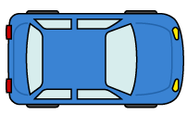
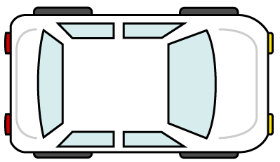
ADS vehicle has to avoid a collision with the forward vehicle as well as a vehicle which is driven by a human driver even when the forward vehicle suddenly stops. A sudden stop of the forward vehicle includes the case that the forward vehicle stops abnormally by the effect other than the braking device (for example, a rear end collision).
(Note: Current minimum following distance requirement in R157 was decided based on the concept above.)
Therefore, Japan considers that the minimum following distance of ALKS should be decided based on the capability of braking distance.
An example of an abnormal sudden stop of the forward vehicle

Slide 3
Japan proposes to apply the values which are based on braking distance researched by Korea (ACSF-22-09r1) to the minimum following distance in the speed range above 60km/h.
No change is needed below 60 km/h, because the values are almost equal to or greater than the value based on braking distance.
Notwithstanding the above requirement, the requirement can be deemed to be satisfied if the TS admit that the ADS is capable of avoiding collision in case of a sudden stop (i.e. velocity decreased suddenly to 0km/h) of the leading vehicle.

Slide 4
Appendix
Extracts from ACSF-22-09r1

