Slide 1
Lane change requirement concept
Submitted by the experts from Japan
UNR157-05-04
5^{h} SIG on R157
10,11 May 2021
MLIT, Japan

Slide 2
Lane change requirement concept
 | Regular lane change (Especially passing slow vehicles) | Emergency lane change (MRM, emergency evasive manoeuvre)
Situation | Lane change in order to continue normal driving (i.e. passing slow vehicles, merging, departing) These types of lane change are not necessarily essential. | Situations that are safer by changing lane than by keeping lane. (risk mitigation, collision avoidance)
Required safety level | As safe as lane keeping (safe → safe) | Avoid collision or mitigate damage because the situation is already in danger (not safe → safer than before)
Requirement | Do not cause accident Should detect the vehicles in the target lane Should detect “next next” lane and more | Should avoid collision or minimise damage
Technical difficulty | High | Low
Priority | Low (not necessary with speed extension) | High (necessary with speed extension)
Way forward | Discuss this requirement in later stage. (Since the various environment and movement of vehicles have to be considered by scenario based testing, this issue should be discussed in FRAV and VMAD first. Avoiding divergence with FRAV/VMAD is also important aspect.) | Discuss this requirement first. The requirement of RMF can be applicable. Discussing step by step (from lower level to high level) can make the process easier.

Slide 3
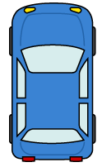
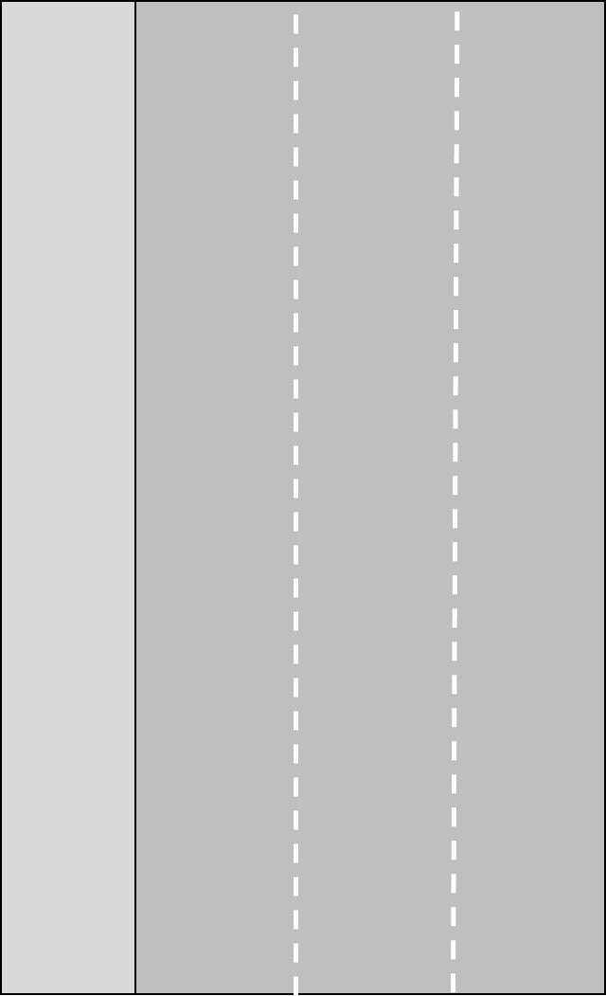

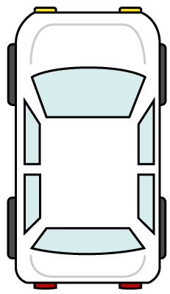

静止車両
① ② ③
① ② ③
Detect vehicle which go to lane 2
Ego vehicle
shoulder
Other vehicles
Detect vehicle which go to lane 2
Detect shoulder condition
Detect vehicle on lane 2
shoulder
Regular lane change
Emergency lane change
(MRM, Emergency evasive manoeuvre)
Image of detection area

