Slide 1


UNR157-05-10
OICA/CLEPA Input
to the
Special interest group on UN-R 157
with regard to
Different types of lane crossing manoeuvres

Slide 2

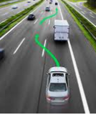
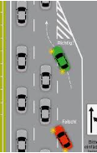
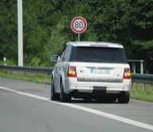
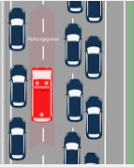
ALKS types of manoeuvres leading the vehicle to cross lane markings
A
B
C
D
E
F
G
Category | Regular Lane Change |  | MRM Lane Change | Manoeuvre crossing lane markings | Evasive Steering crossing lane markings during an Emergency Manoeuvre
Subcategory | Regular lane change („optional“) | Regular lane change („required“) |  |  | Emergency Lane Change | Emergency evasive manoeuvre crossing lane markings
Examples
Description | Operation can in principle be continued in the current lane, lane change is performed to e.g. maintain cruise speed, follow traffic rules | Operation cannot be continued in the current lane | Lane Change that is performed during an MRM MRM lane change across regular traffic lanes (a1) MRM lane change to a lane intended for slower traffic (a2) MRM lane change to a lane intended for faster traffic (b) MRM lane change to the hard shoulder | Examples: Forming an acess corridor for emergency vehicles Moving the vehicle off the road as far as possible during an MRM | A maneuver aimed at avoiding a collision with an obstacle, by creating a lateral offset. ALKS vehicle will continue operation in the adjacent lane. | A maneuver aimed at avoiding a collision with an obstacle, by creating a lateral offset. ALKS vehicle will continue operation in the original lane.
1
2
Access corridor
MRM to narrow
hard shoulder
3

Slide 3
1
2
3
Lane Change
(=operation in an adjacent lane of travel)
Critical Situation
for Regular Lane Change
General provisions for lane change
What is a critical situation?
Critical Situation
for MRM Lane Change
Braking
Emergency Maneuver
Identical as for
[MRM]
lane change
1
Evasive Maneuver crossing the lane marking up to [30]cm
Evasive Maneuver
(=return to the original lane of travel)
General provisions for an evasive maneuver crossing lane markings
2
Evasive Maneuver crossing the lane marking up to [half the vehicle‘s width]cm
What is a critical situation?
3
Evasive Maneuver crossing the lane marking more than [half the vehicle‘s width]cm
Regular maneuver crossing lane markings?? See next slides

Slide 4
ALKS types of manoeuvres leading the vehicle to cross lane markings
Evasive steering without crossing lane markings
Evasive steering with up to [30cm] crossing of lane markings
Evasive steering with up to [half the vehicle‘s width] crossing of lane markings
Evasive steering with more than [half the vehicle‘s width] crossing of lane markings
Is criticality really relevant?
Regular Lane Change
How far the vehicle enters the adjacent lane influences the required freespace.
As the ALKS does not return to its original lane, the criticality assessment shall be the same as that for a lane change.

Slide 5
ALKS types of manoeuvres leading the vehicle to cross lane markings
Can the situation be addressed by a regular/MRM lane change?
System capable of performing regular lane changes?
Detected early enough?
Enough free space in the adjacent lane?
No.
Yes.
Why not?
Regular/MRM Lane Change
System not capable of performing regular lane changes
There is not enough freespace in the adjacent lane
Time is too short/Criticality is too high
Is there enough space for an evasive maneuver?
No.
Yes.
Brake
Evasive Maneuver possible

