Slide 1
Alternative assessment of ALKS performance
UNR157-05-12
Response to OICA’s comments
Assessment of additional scenarios
Criticality-based scenario classification
K. Mattas, B. Ciuffo, S. Vass, C. Galassi

Slide 2
OICA’s comments (UNR157-04-10) to EC proposed text (UNR157-03-06)
1. Possible adverse affect on the surrounding vehicles' traffic flow
  The proposed conditions don’t take false reaction avoidance sufficiently into account
  When braking earlier, it is natural, that more collisions could be avoided, but this could be detrimental to many other aspects of road safety, (e.g. rear end collision by a following vehicle)
  When ALKS vehicles are forced to brake too strongly too early, this will likely disrupt traffic flow
EC reply
  The proposed approach is a performance model used only to define whether a certain scenario would be preventable or not for an attentive human driver. It does not introduce any operational requirement to the ALKS. It is based on tactical safety approach adopted by experienced drivers
  The model assumes that driver is able to anticipate the risk by mild decelerations before reaching a safety critical situation. The comment on braking too strong too soon does not seem to hold.
  Is industry suggesting that ALKS vehicles will not be able to be at least as safe as a competent human driver?

Slide 3
OICA’s comments (UNR157-04-10) to EC proposed text (UNR157-03-06)
2. Design constraints (not technology neutral)
  In order to meet the required performance, the underlying approach would likely need to be implemented into the system software when assessing the criticality of a situation
  So instead of setting a performance expectation, the approach is so detailed, that it would likely be a technical requirement on implementation
EC reply
  Is industry suggesting that ALKS vehicles will not be able to be as safe as a competent human driver without using an approximation of her/his driving logic?
  Is it possible that a shorter reaction time and a continuous monitoring by the ALKS would not be sufficient to have in place something better than the driver model proposed by the EC?
  The model is set to be a performance model and there is no requirement to implement such a high-level control logic. For this reason also this comment does not seem to hold
Notes:
Her/his

Slide 4
OICA’s comments (UNR157-04-10) to EC proposed text (UNR157-03-06)
3. Possible Intel patent conflicts
  The proposed approach could require the use (see 2.) of certain potentially protected IP, as some aspects of the RSS are protected by international patents (WO2018115963, WO2019180506, WO2020035728, WO2020245654)
EC reply
  Even in the case that the comment would hold true for the RSS, since the EC is not suggesting to use the RSS as performance model and the proposed approach is included in the legislation as a set of equations on which there cannot be protected IP, even in the case that an OEM would use the equation as part of the high-level vehicle controller there would be no issue. For this reason also this comment does not seem to hold
Notes:
Her/his

Slide 5
OICA’s comments (UNR157-04-10) to EC proposed text (UNR157-03-06)
Industry considers the proposed concept not mature enough to replace the recently introduced provisions for ALKS.
The discussion should first be finalized within FRAV/VMAD, then a comparison between the new approach and what is established for ALKS shall be made and if necessary the new approach can be used to provide guidance within ALKS on how to assess the performance of the system.
EC reply
  Since the model in the amendment proposal has the same scope as that used in the current R157 (define the performance of an attentive and competent human driver) we don’t believe that the discussion should be necessarily finalized in FRAV
  A thorough assessment of the model has been performed including comparison with the performance models used in R157 and other models (i.e. RSS).
Notes:
Her/his

Slide 6
Insights to the EC performance model proposal (FSM)
Given the questions raised by Industry the following slides will:
  Compare the results of the EC performance model with RSS and the two performance models currently in R157 for the cut-in scenario
  Make the same comparison for cut-out and car-following scenarios
  Show that by using the «membership» of the Fuzzy model it is possible to classify scenarios on the basis of their criticality
At the end of the presentation additional background slides are provided with more information about the model
Notes:
Her/his

Slide 7
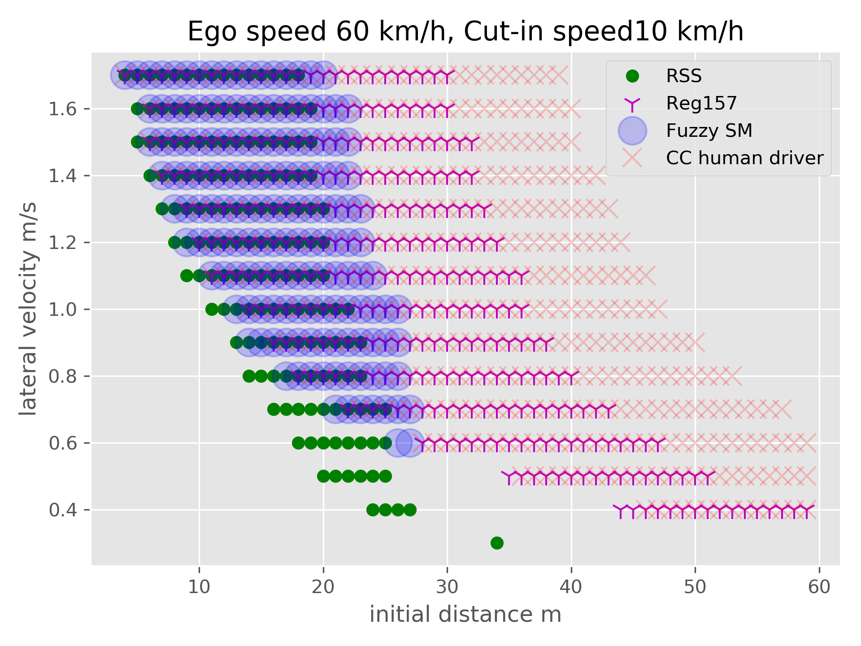
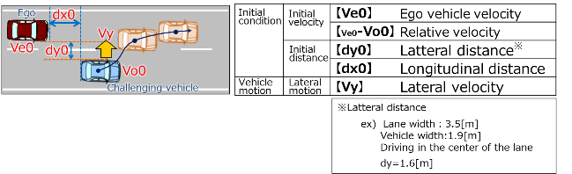
Unpreventable cut-in scenarios
Simulation framework proposed by Japan for the CC model
Same values for the common parameters of FSM, RSS and CC.
The Reg157 model uses its own parameters

Slide 8
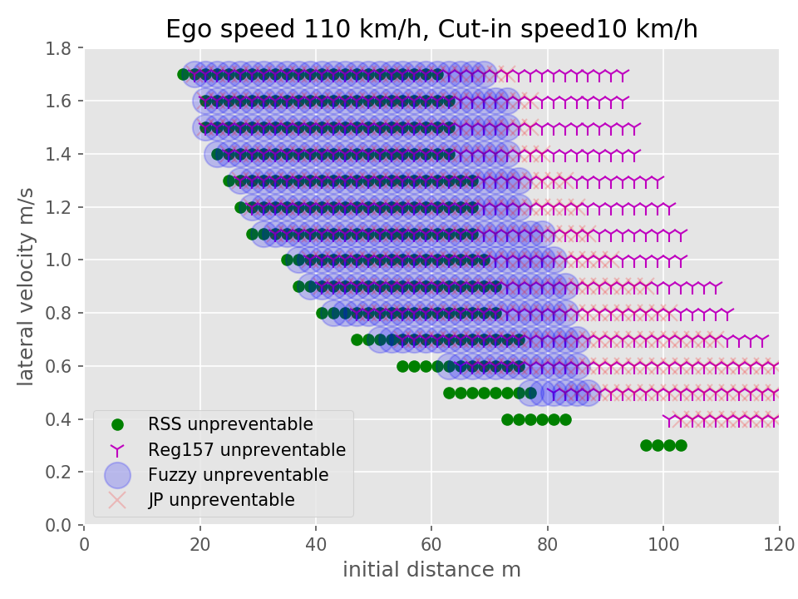
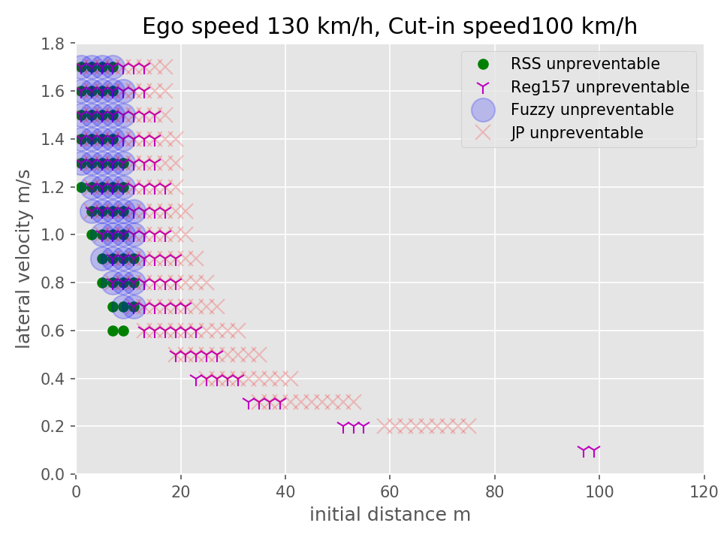
Unpreventable cut-in scenarios

Slide 9
Cut in scenario classification
The FSM is a satisfactory compromise among the different approaches proposed so far to identify unpreventable cut-in scenarios.
What about the preventable ones?
  Is it possible to classify them on the basis of their criticality to allow their fair random selection?
Two possible approaches:
  TTC
  FSM

Slide 10
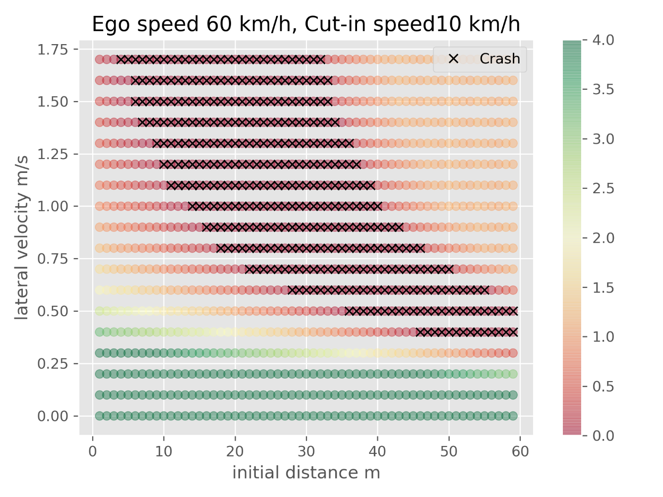
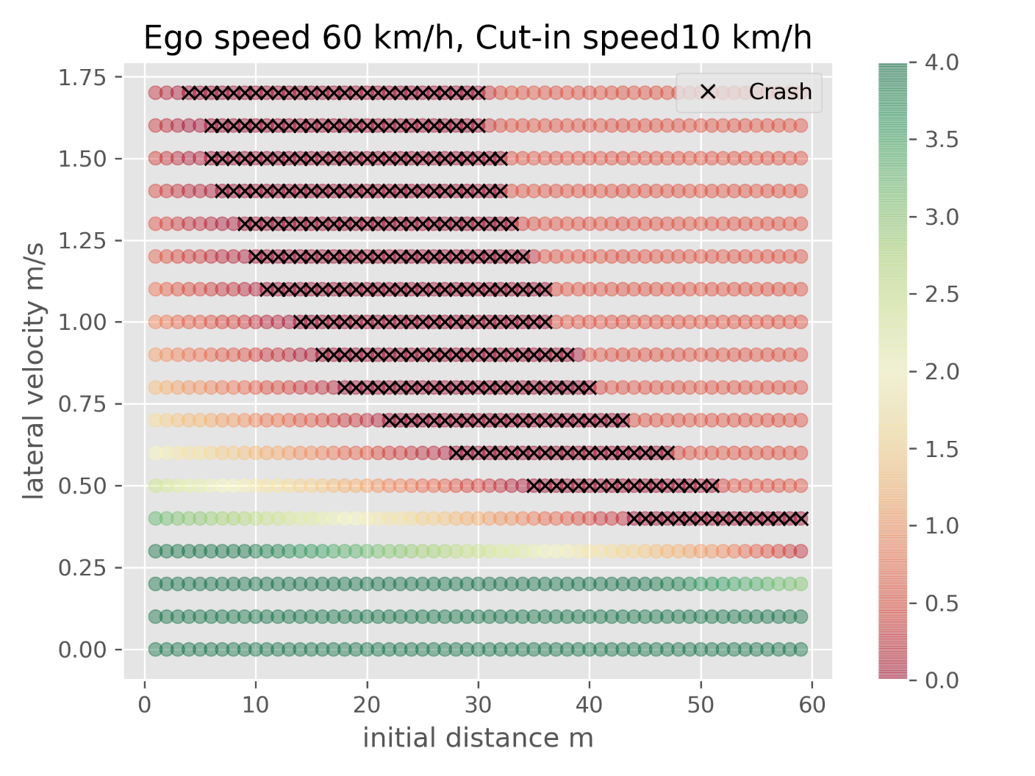
Cut in scenario, minimum TTC
CC human driver model
Reg 157 model

Slide 11
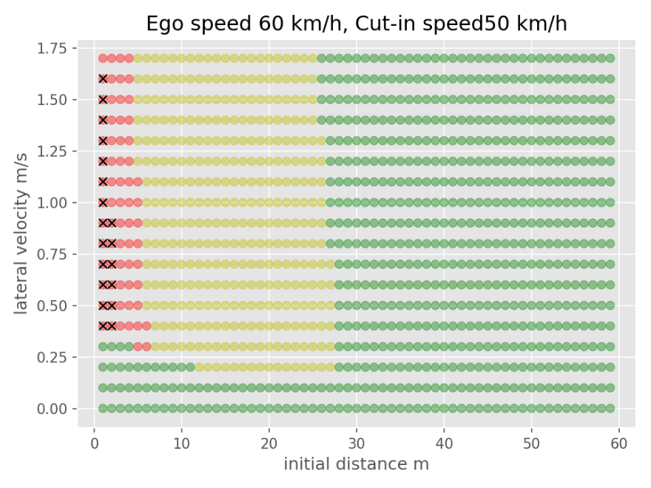
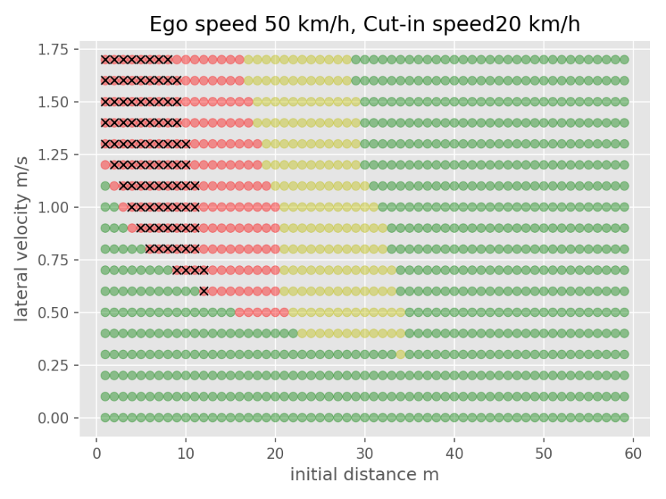
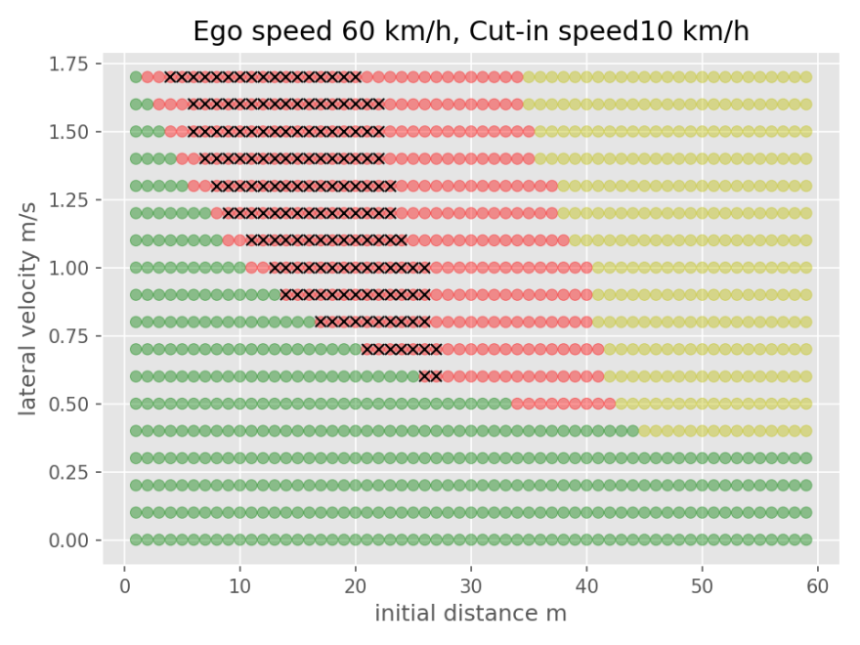
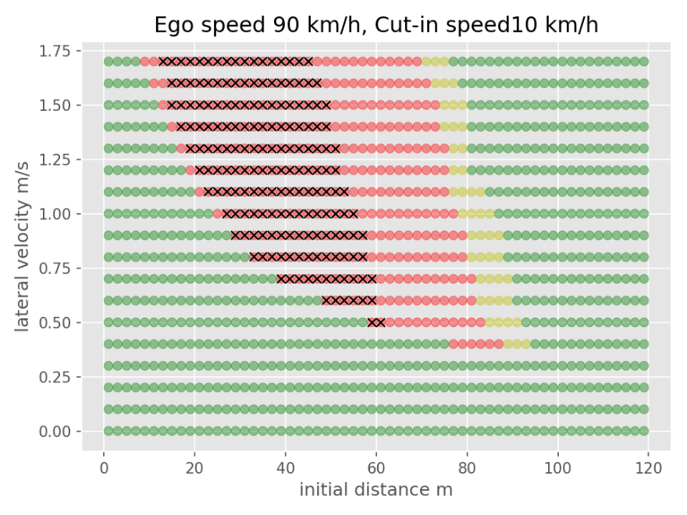
Cut in scenario, using Fuzzy SSMs examples
Green: Easy
Not a big challenge for the ADS
Yellow: Medium
More interesting than easy cases
Red: Hard
Most of the scenarios in test track should be hard cases, as they represent the most important challenge to the control

Slide 12
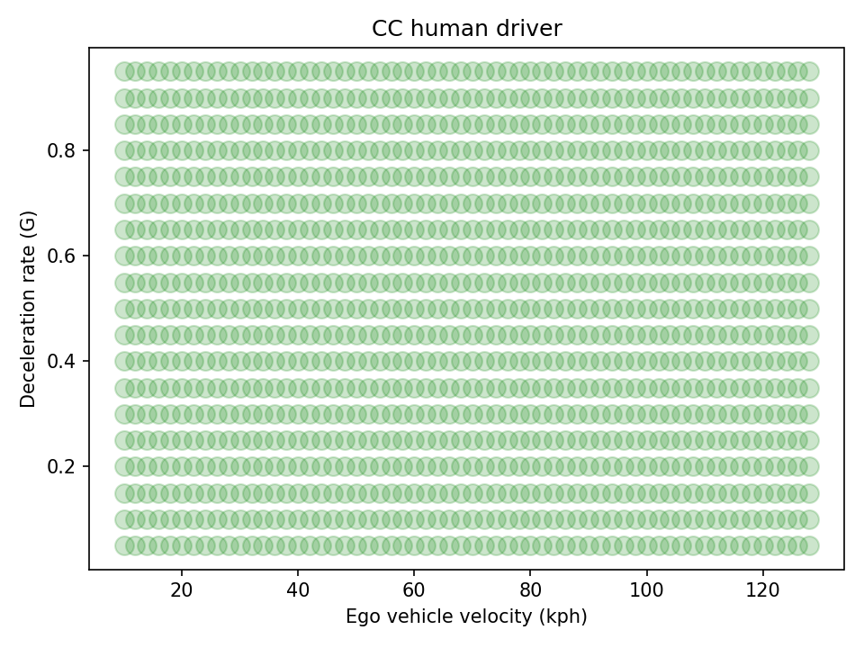
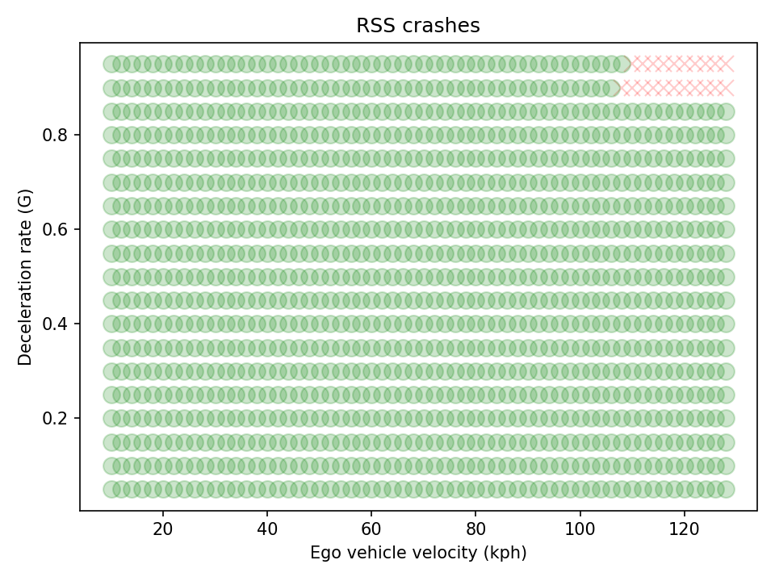
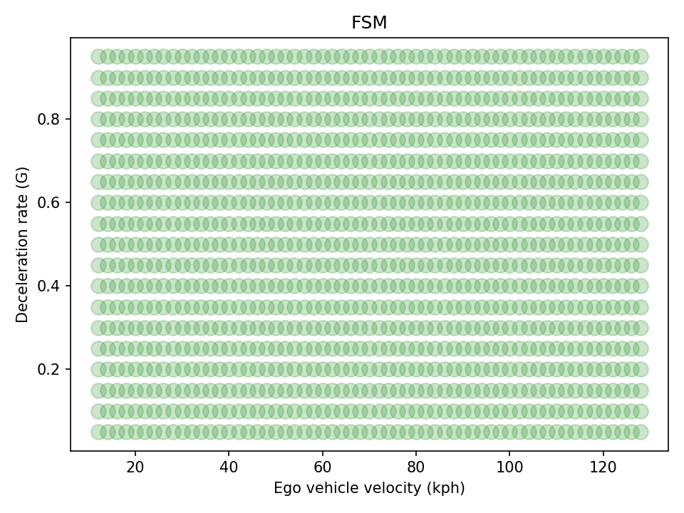
Car-following scenarios
CC -> no collisions
RSS -> collisions at high speed
FSM -> no collisions

Slide 13
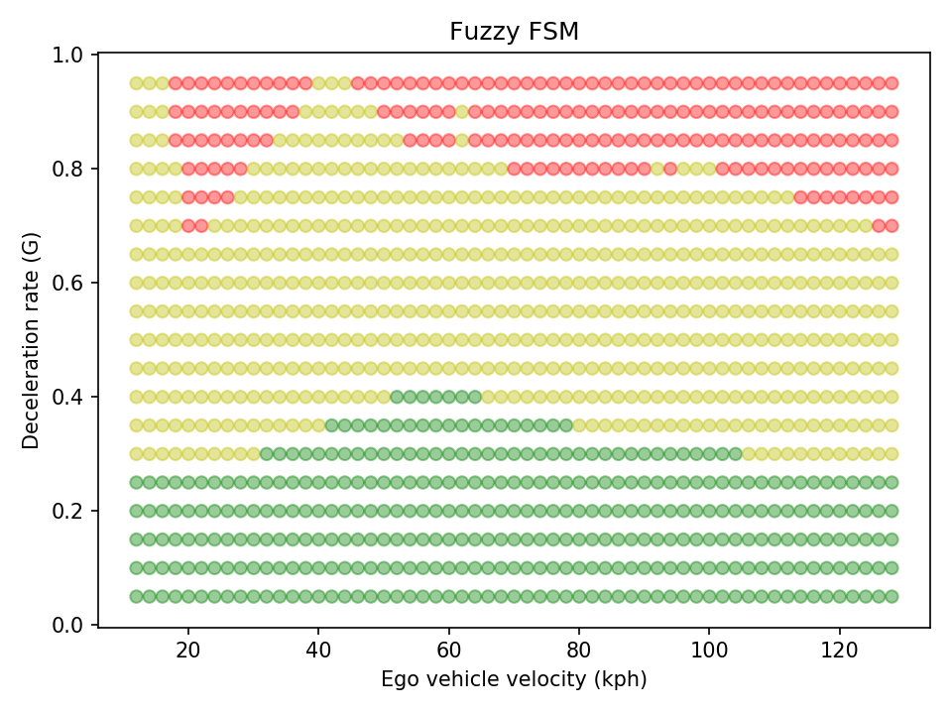
Classification of car-following scenarios
In this case the criticality of the scenario is affected by the steady state distance used for the driver
The initial distance is set to have PFS = 0 in the model.

Slide 14
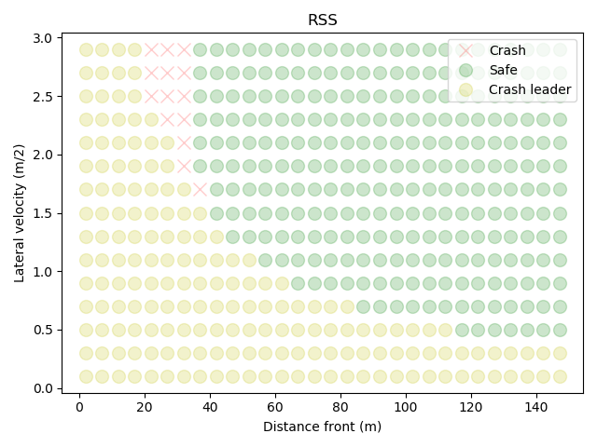
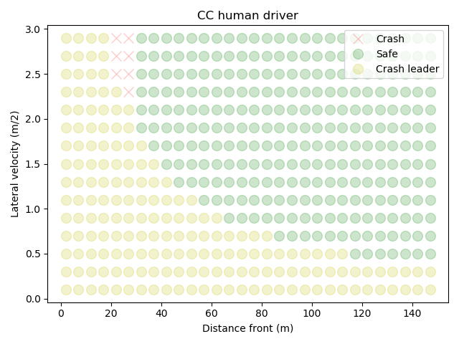
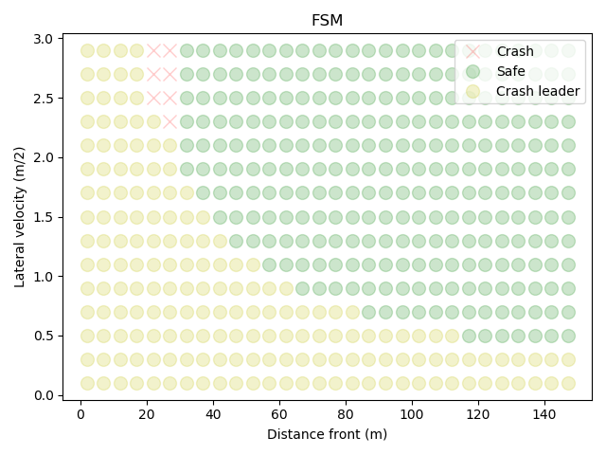
Cut-out scenarios results
At higher speeds a few collisions for all models.
Pictures for ego vehicle speed of 110 km/h

Slide 15
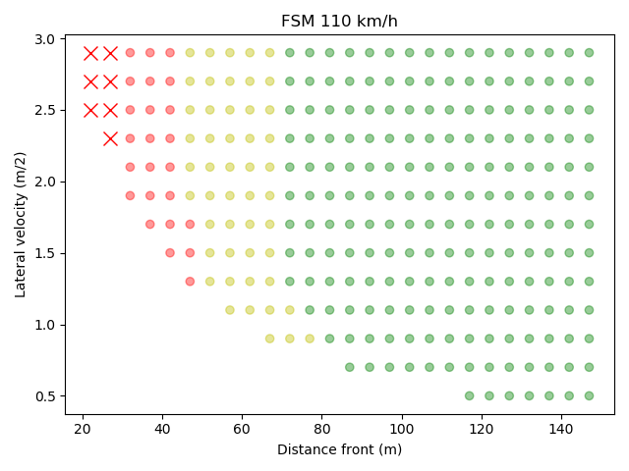
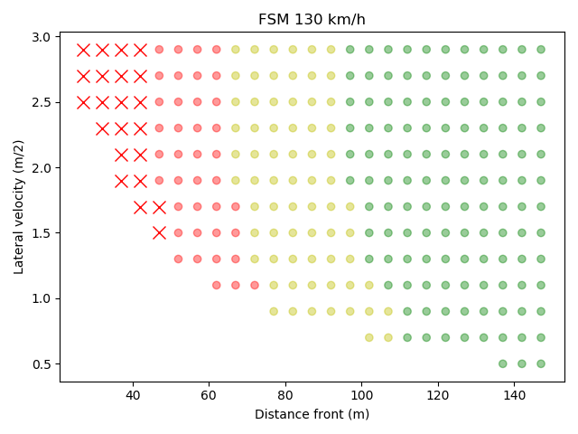
Classification for cut out scenarios

Slide 16
Conclusions
Criticisms to the performance model proposed by the EC raised by industry do not seem to hold
The proposed approach shows better performances than what included in current text and a good compromise wr other SoA models like the RSS
The proposed model allows a simple classification of the criticality of a prevetable scenario that can help in the parameter selection for track-tests
The proposed model shows similar results to the current models regarding car-following (no unpreventable cases) and cut-out (a few unpreventable cases for high-speed scenarios)

Slide 17
Background information
Section 1. The Fuzzy surrogate Model

Slide 18
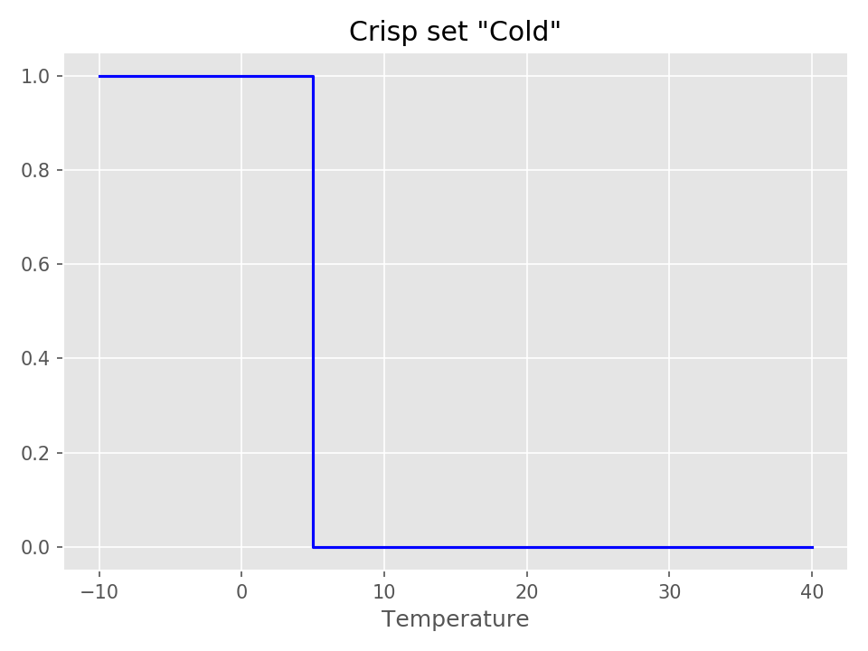
What is Fuzzy Logic? Crisp sets
Classical set is a collection of distinct objects. Any element is either in a set or not.
We can describe a set by its characteristic function. It takes the value 1 for elements that are in the set and the value 0 for elements that are not in the set
The sets are ‘Crisp’

Slide 19
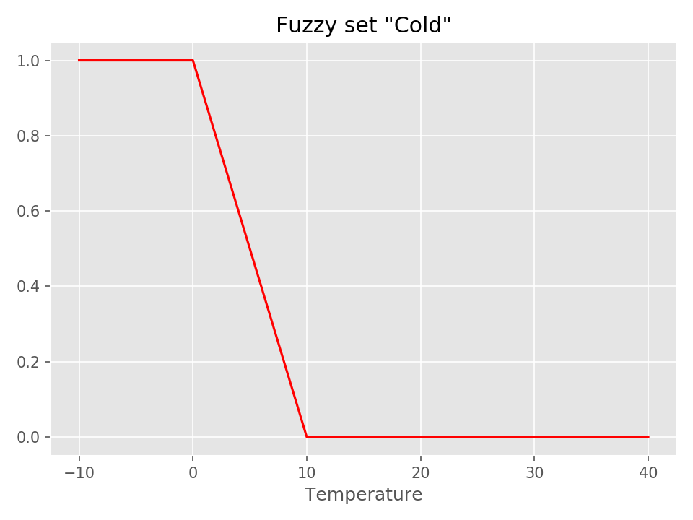
What is Fuzzy Logic? Fuzzy sets
Characteristic functions of Fuzzy sets can take all values from 0 to 1
This can be helpful in many cases to better describe a situation
Based on those we can create fuzzy rules

Slide 20


Why Fuzzy logic
Two vehicles with known speeds. What is a safe distance?
Safe
Unsafe

Slide 21
Why Fuzzy logic
Two vehicles with known speeds. What is a safe distance?
Safe
Do nothing
Unsafe
Decelerate hard

Slide 22
Why Fuzzy logic
Two vehicles with known speeds. What is a safe distance?
Safe
Do nothing
Unsafe
Decelerate hard

Slide 23
Why Fuzzy logic
Two vehicles with known speeds. What is a safe distance?
Safe
Unsafe
Safe
Fuzzy
Unsafe

Slide 24
Why Fuzzy logic
Two vehicles with known speeds. What is a safe distance?
Safe
Unsafe
Safe
Fuzzy
Unsafe
The more unsafe, the harder the vehicle must decelerate

Slide 25
Car following scenarios
Three models are compared
Regulation Appendix 3 model
RSS model
Fuzzy logic model

Slide 26
Longitudinal safe distance according to Fuzzy SSMs
Two different definitions of unsafe:
If the leader vehicle decelerates, the follower vehicle cannot avoid an accident (Vienna Convention on Road Traffic)
If nothing changes, there will be a collision in x sec (TTC)
We calculated the Proactive Fuzzy SSM (PFS) and the Critical Fuzzy SSM (CFS)

Slide 27


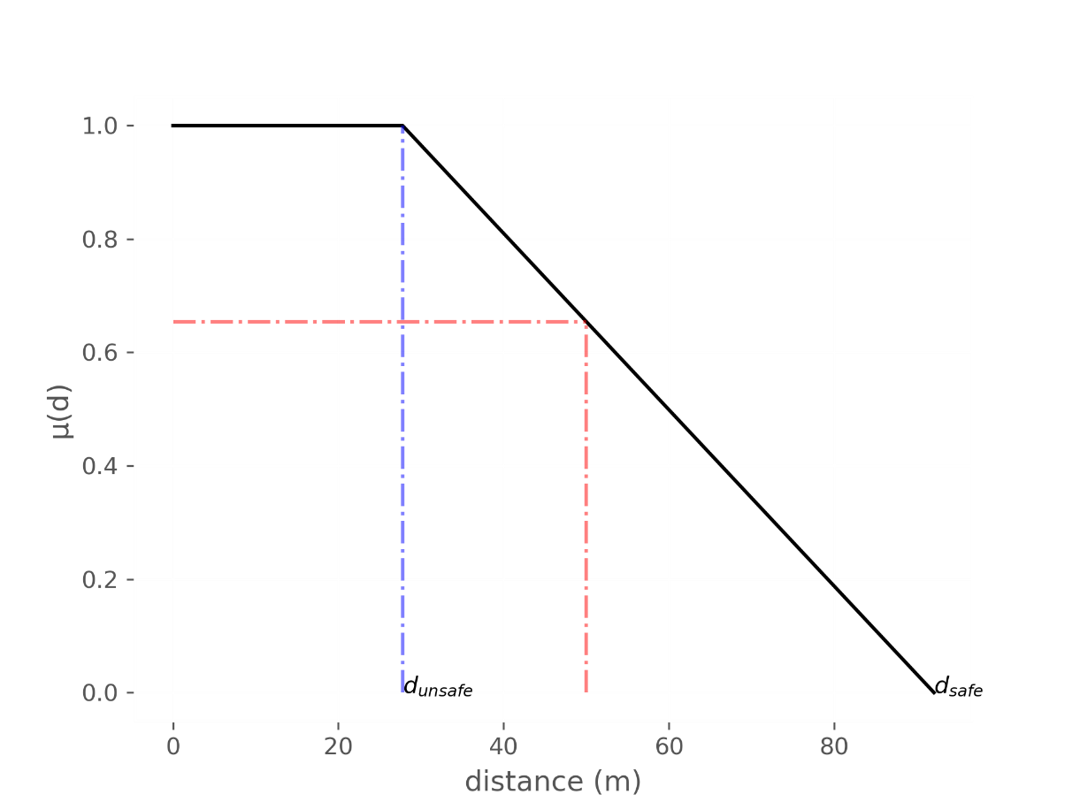
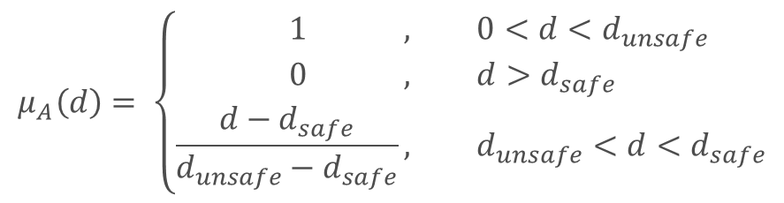
Longitudinal safe distance according to Fuzzy SSMs
Maximum
Unsafe
distance
Minimum
Safe
distance
$$μ_{Α}\left(d\right)= \left\{\begin{aligned}1 , &0<d<d_{unsafe} \\ 0 , &d>d_{safe} \\ \frac{d−d_{safe}}{d_{unsafe}−d_{safe}}, &d_{unsafe}<d<d_{safe}\end{aligned}\right.$$

Slide 28
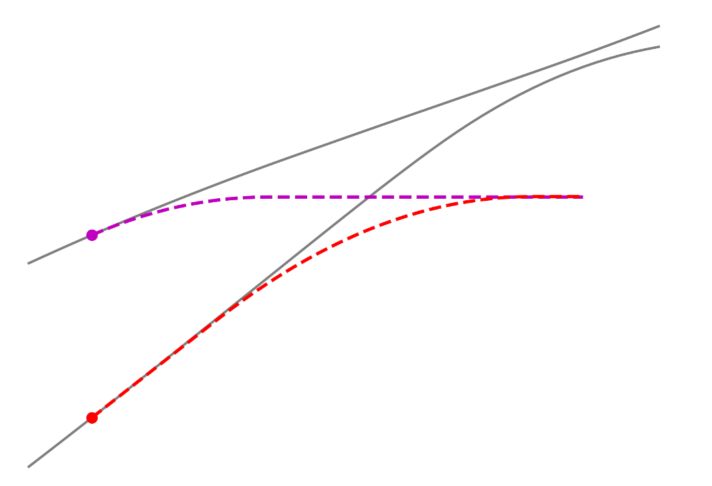
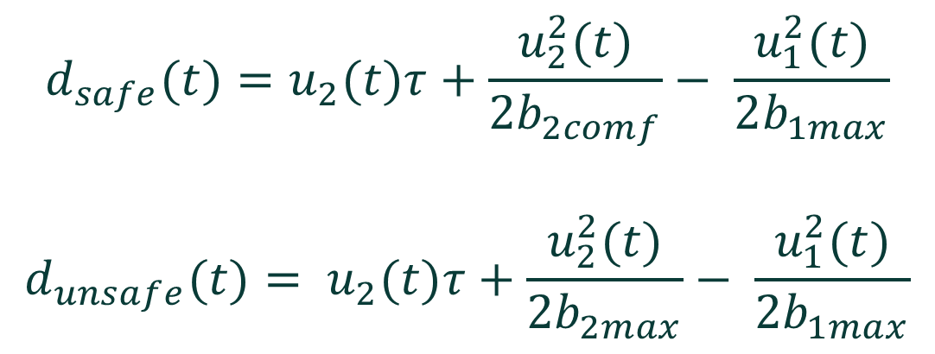
Longitudinal safe distance according to Fuzzy SSMs
PFS: If the leader vehicle decelerates, the follower vehicle cannot avoid an accident
$$d_{safe}(t)=u_{2}(t)τ+\frac{u_{2}^{2}(t)}{2b_{2comf}}− \frac{u_{1}^{2}(t)}{2b_{1max}}$$
$$d_{unsafe}(t)= u_{2}(t)τ+\frac{u_{2}^{2}(t)}{2b_{2max}}− \frac{u_{1}^{2}(t)}{2b_{1max}}$$

Slide 29
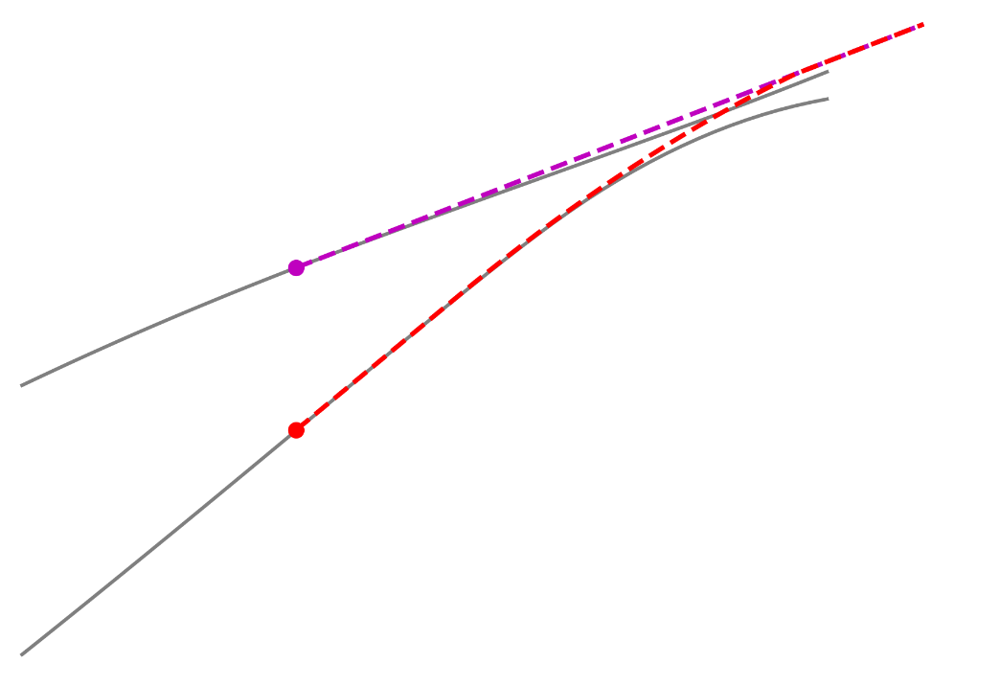
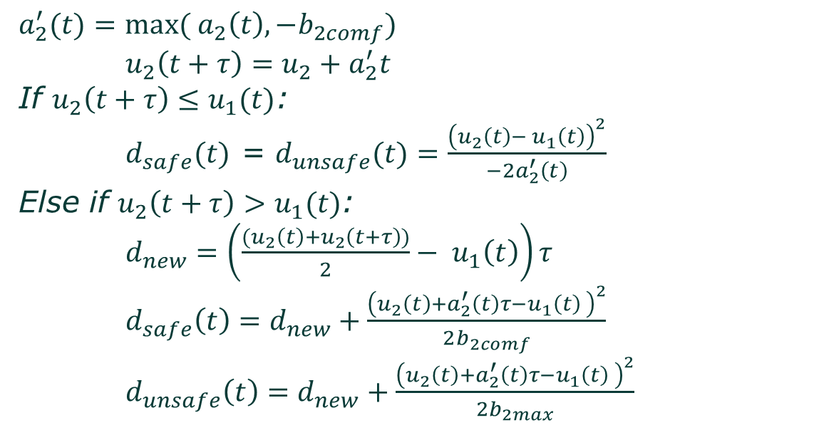
Longitudinal safe distance according to Fuzzy SSMs
CFS: If nothing changes, there will be a collision
$a_{2}^{′}(t)=max( a_{2}\left(t\right), {−b}_{2comf})$
$u_{2}\left(t+τ\right)=u_{2}+a_{2}^{′}t$
If $u_{2}\left(t+τ\right)≤u_{1}(t)$:
$d_{safe}(t)$ = $d_{unsafe}(t)=\frac{{\left(u_{2}\left(t\right)− u_{1}\left(t\right)\right)}^{2}}{−2a_{2}^{′}\left(t\right)}$
Else if $u_{2}\left(t+τ\right)>u_{1}(t)$:
$d_{new}=\left(\frac{{(u}_{2}\left(t\right)+u_{2}\left(t+τ\right))}{2}− u_{1}\left(t\right)\right)τ$
$d_{safe}\left(t\right)=d_{new}+\frac{{\left(u_{2}\left(t\right)+a_{2}^{′}\left(t\right)τ−u_{1}\left(t\right) \right)}^{2}}{2b_{2comf}}$
$d_{unsafe}\left(t\right)=d_{new}+\frac{{\left(u_{2}\left(t\right)+a_{2}^{′}\left(t\right)τ−u_{1}\left(t\right) \right)}^{2}}{2b_{2max}}$

Slide 30
Capacity for calm proactive reaction
The deceleration is relative to the values of PFS and CFS
PFS value of 1 induces full comfortable deceleration (e.g. 3 m/s²)
CFS value of 1 induces full deceleration (e.g. 6 m/s²)
PFS value of 0.2 induces 20% of comfortable deceleration (e.g. 0.6 m/s²)
The suggested model has the ability to apply a calm deceleration proactively, to avoid getting into a more serious (and possibly unavoidable) conflict

Slide 31
Background information
Section 2. Cut-in scenario: additional results

Slide 32
Range of concrete scenario assessed
Ego vehicle longitudinal speed 10 – 130 kph
Cutting-in vehicle longitudinal speed 10 – 120 kph
Cutting-in vehicle lateral speed 10 – 120 kph
Initial longitudinal distance 1 – 60 m (1 – 120 for high speeds)

Slide 33
Parameters used in the simulations
Reaction time:
  Reg157 -> 0.35 sec
  CC human driver, FSM, RSS -> 0.75 sec
Maximum deceleration (ego-vehicle)
  CC human driver, RSS -> 0.774 G
  Reg157, FSM -> 6 m/s²
Maximum jerk (ego-vehicle, absolute)
  CC human driver, RSS, FSM -> 12.65 m/s³

Slide 34
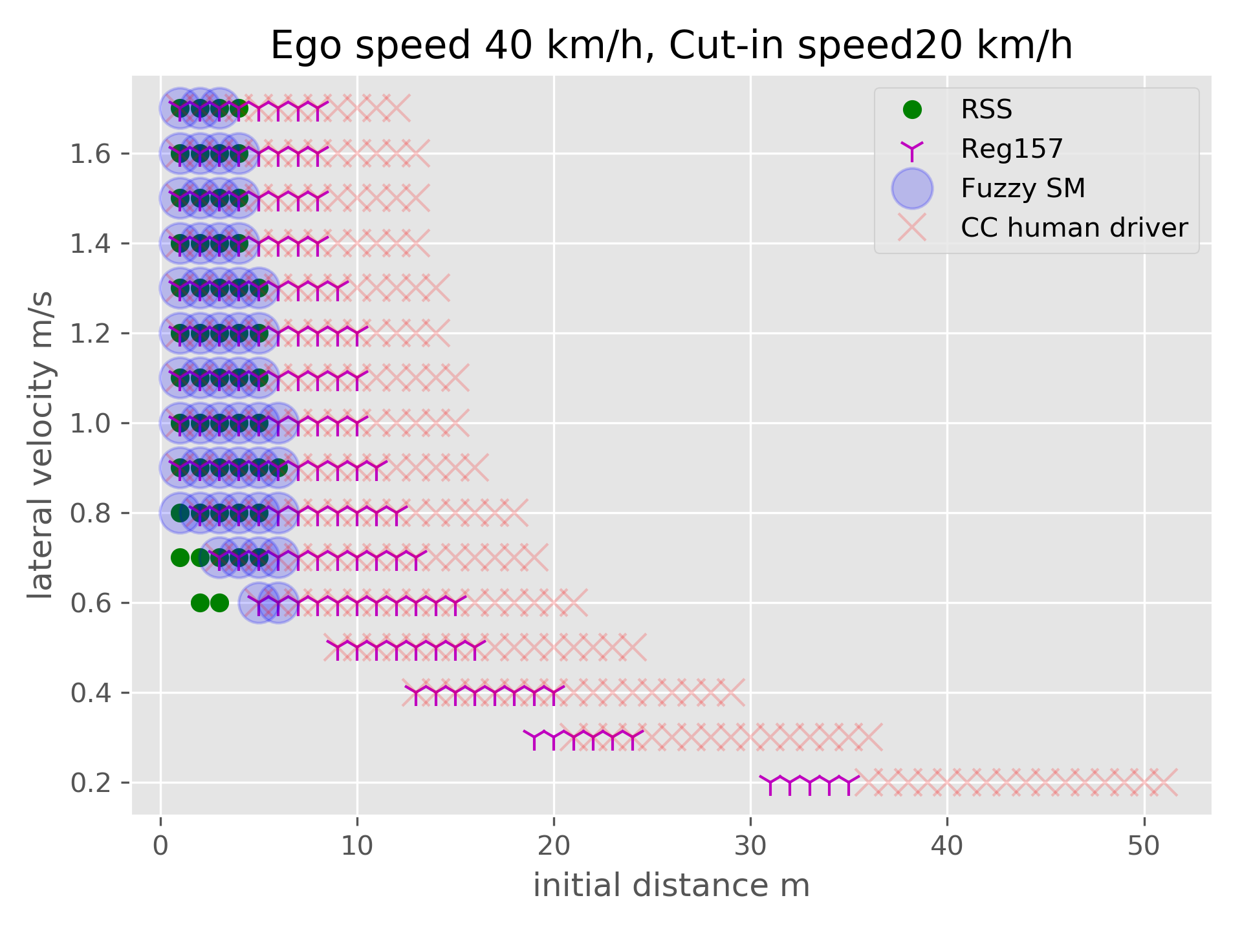

Cut in Unpreventable

Slide 35
Background information
Section 3. Criticality based classification of preventable scenarios

Slide 36
Criticality-based classification using Fuzzy SMs
In each simulation, PFS and CFS (see background information) are calculated for each simulation step. They take values for 0 to 1, with:
PFS = 1, the situation is “proactively unsafe”, the ego vehicle would not avoid an accident in case of a hard deceleration of the preceding vehicle
CFS = 1, the situation is “critically unsafe”, there is a severe conflict, and a very hard deceleration is required
By the maximum value of each scenario we classify in:
Easy: PFS <=0.85, Medium: PFS>0.85 and CFS <0.9, Hard: CFS=>0.9

Slide 37
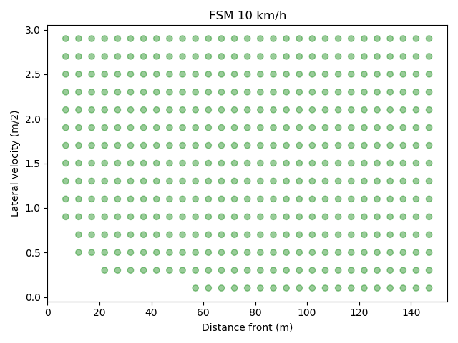
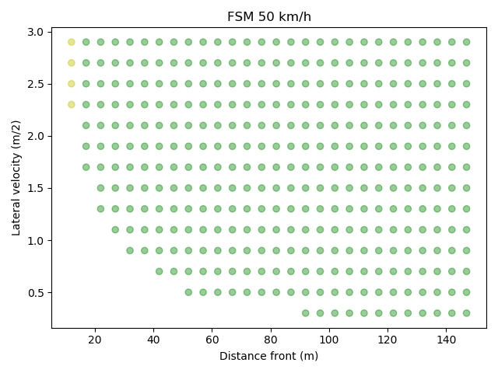
Classification for cut out scenarios

Slide 38
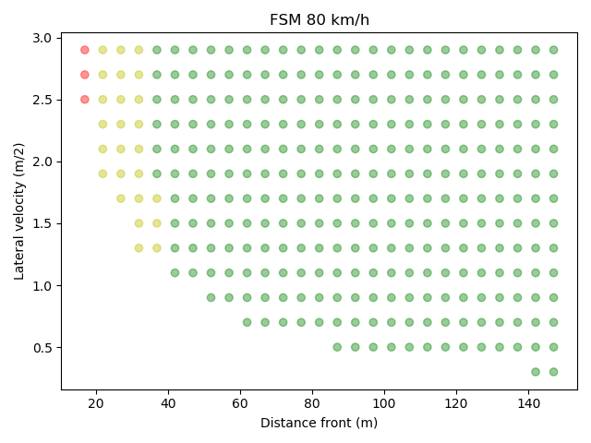
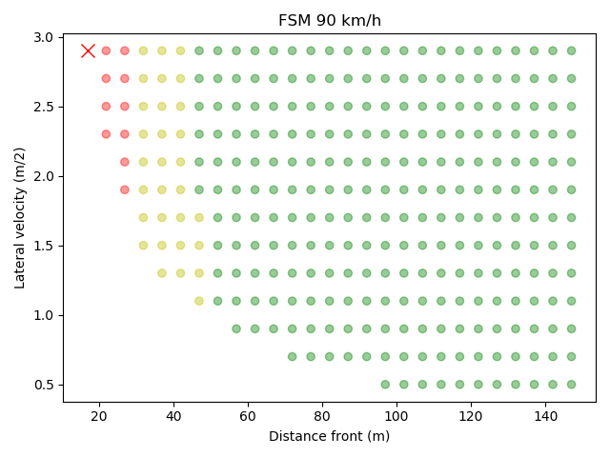
Classification for cut out scenarios

Slide 39
Background information
Section 4. Car-following and cut-out

Slide 40
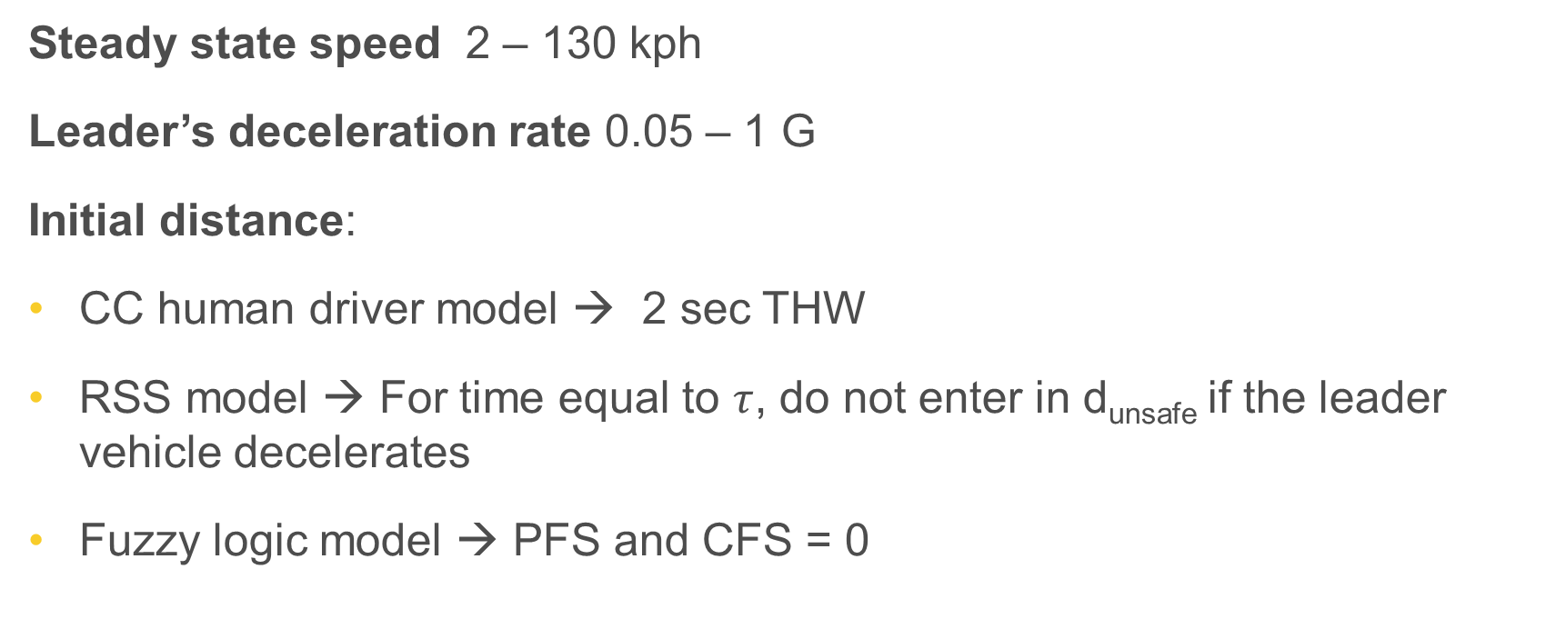
Car following scenarios
Steady state speed 2 – 130 kph
Leader’s deceleration rate 0.05 – 1 G
Initial distance:
CC human driver model → 2 sec THW
RSS model → For time equal to $τ$, do not enter in d_{unsafe} if the leader vehicle decelerates
Fuzzy logic model → PFS and CFS = 0

Slide 41
Car following scenarios simulated
Reaction time starts when:
CC human driver model → Leader vehicles deceleration harder than 5 m/s²
RSS model → Ego vehicle enters d_{unsafe} (could be avoided with calm deceleration)
Fuzzy logic model → PFS or CFS > 0

Slide 42
Parameters used in the simulations
Reaction time:
  CC human driver, FSM, RSS -> 0.75 sec
Maximum deceleration (ego-vehicle)
  CC human driver, RSS -> 0.774 G
  FSM -> 6 m/s²
Maximum jerk (ego-vehicle, absolute)
  CC human driver, RSS, FSM -> 12.65 m/s³

Slide 43
Cut out scenarios
Three models are compared
CC human driver model
RSS model
Fuzzy logic model

Slide 44
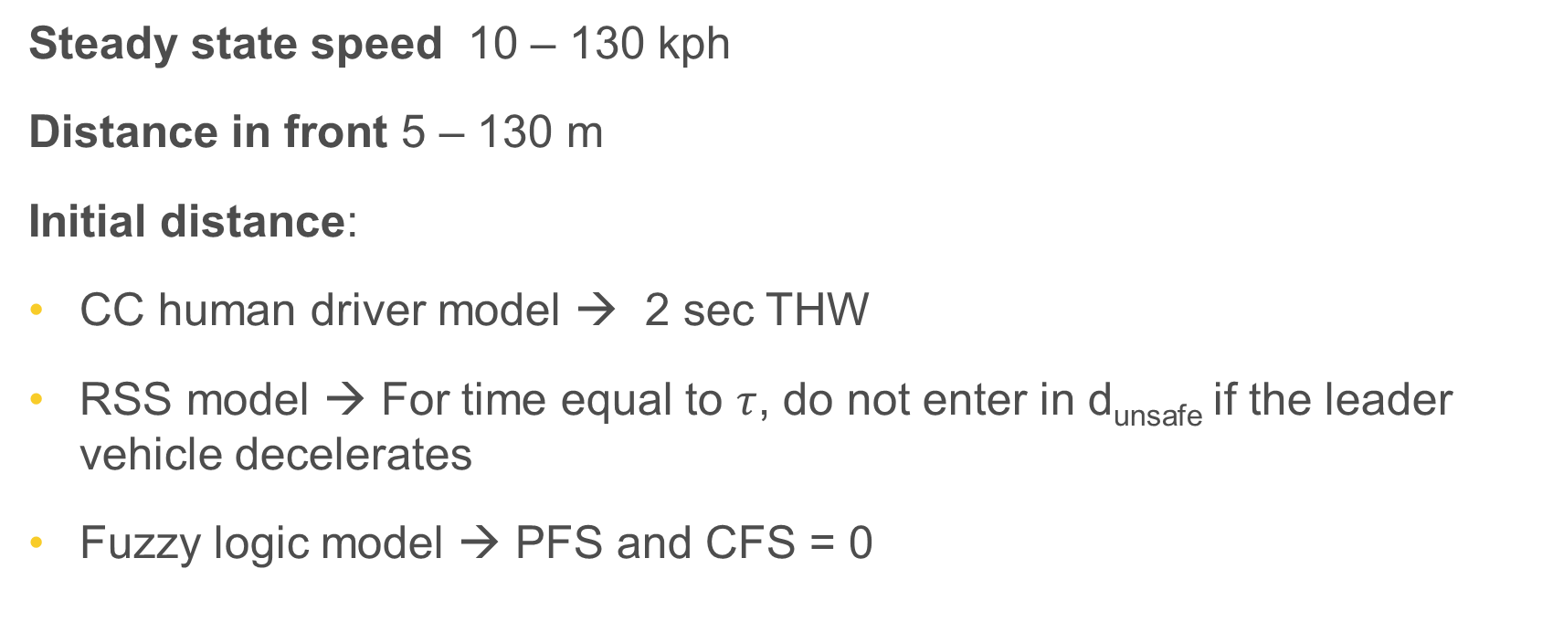
Cut out scenarios simulated
Steady state speed 10 – 130 kph
Distance in front 5 – 130 m
Initial distance:
CC human driver model → 2 sec THW
RSS model → For time equal to $τ$, do not enter in d_{unsafe} if the leader vehicle decelerates
Fuzzy logic model → PFS and CFS = 0

Slide 45
Cut out scenarios simulated
Reaction time starts when:
Leader vehicle has moved more than 0.375 m (wondering zone) or has crashed and
RSS model → Ego vehicle enters d_{unsafe} (could be avoided with calm deceleration)
Fuzzy logic model → PFS or CFS > 0

Slide 46
Parameters used in the simulations
Reaction time:
  CC human driver, FSM, RSS -> 0.75 sec
Maximum deceleration (ego-vehicle)
  CC human driver, RSS -> 0.774 G
  FSM -> 6 m/s²
Maximum jerk (ego-vehicle, absolute)
  CC human driver, RSS, FSM -> 12.65 m/s³

Slide 47
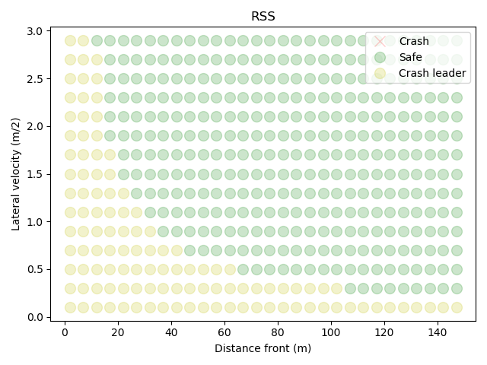
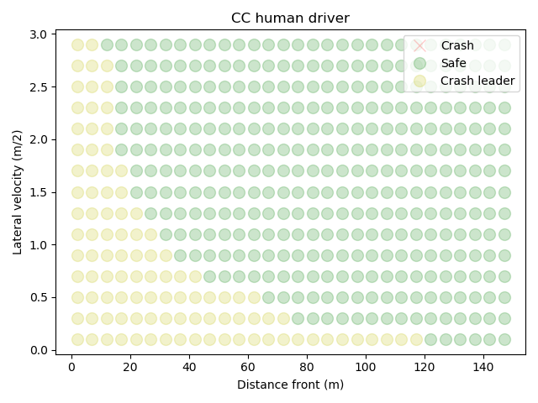
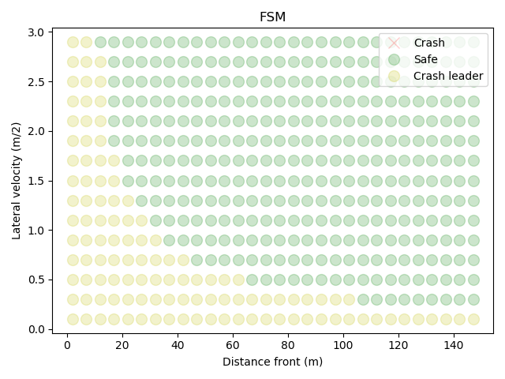
Cut-out scenarios results
For low speeds the ego vehicle avoids the
collision with the stopped vehicle for any model
Pictures for ego vehicle speed of 60 km/h

Slide 48

Thank you
© European Union 2020
Unless otherwise noted the reuse of this presentation is authorised under the CC BY 4.0 license. For any use or reproduction of elements that are not owned by the EU, permission may need to be sought directly from the respective right holders.
Slide xx: element concerned, source: e.g. Fotolia.com; Slide xx: element concerned, source: e.g. iStock.com
Notes:
Update/add/delete parts of the copy right notice where appropriate.
More information: https://myintracomm.ec.europa.eu/corp/intellectual-property/Documents/2019_Reuse-guidelines%28CC-BY%29.pdf

