Slide 1
Submitted by the Republic of Korea
UNR157-05-13
Minimum Following Distance for ALKS
UN R157 5th SIG on 10&11 May 2021
MYUNGSU LEE
Korea Automobile Testing & Research Institute

Slide 2
The Korean Comment to Minimum Following Distance discussion
In 22nd ACSF IWG(ACSF-22-09r1, April 2019), a formula that considered the margin distance based on the braking distance of the state of art vehicles acquired on the wet road was proposed, but there was an comment from ACSF member that the Minimum Following Distance proposed was too long in the middle and high speed range
Therefore, in 23rd ACSF IWG(ACSF-23-07, July 2019), a renew formula that combines and the general time gap of European road traffic law with the braking distance was proposed
In conclusion, the proposal that the time gap gradually increase to 2.0 s seems to be reasonable
Present speed of the ALKS vehicle |  | ACSF-22-09r1(KOREA) (UNR157-05-03) |  | ACSF-23-07(KOREA) |  | GRVA-2020-32(Germany)
 |  | Minimum time gap | Minimum following distance | Minimum time gap | Minimum following distance | Minimum time gap | Minimum following distance
(km/h) | (m/s) | (s) | (m) | (s) | (m) | (s) | (m)
7.2 | 2.0 | - | 2.0 | - | 2.0 | 1.0 | 2.0
10 | 2.78 | - | 3.2 | - | 2.0 | 1.1 | 3.1
20 | 5.56 | - | 5.6 | - | 3.6 | 1.2 | 6.7
30 | 8.33 | - | 9.2 | - | 7.2 | 1.3 | 10.8
40 | 11.11 | - | 14.1 | - | 12.1 | 1.4 | 15.6
50 | 13.89 | - | 20.3 | - | 18.3 | 1.5 | 20.8
60 | 16.67 | - | 27.6 | - | 25.6 | 1.6 | 26.7
70 | 19.44 | 1.9 | 36.3 | 1.8 | 34.3 | 1.7 | 33.1
80 | 22.22 | 2.1 | 46.1 | 2.0 | 44.1 | 1.8 | 40.0
90 | 25.00 | 2.3 | 57.2 | 2.0 | 50.0 | 1.9 | 47.5
100 | 27.78 | 2.5 | 69.5 | 2.0 | 55.6 | 2.0 | 55.6
110 | 30.56 | 2.7 | 83.1 | 2.0 | 61.1 | 2.0 | 61.1
120 | 33.33 | 2.9 | 97.9 | 2.0 | 66.7 | 2.0 | 66.7
130 | 36.11 | 3.2 | 113.9 | 2.0 | 72.2 | 2.0 | 72.2
MFD from current regulation
(0~60km/h → 2.0~26.7m)

Slide 3
The comparison of 3 doc. plots
MFD from current regulation
(0~60km/h → 2.0~26.7m)
Distance[m]
speed[km/h]

Slide 4
Appendix

Slide 5
Submitted by the Republic of Korea
Informal Document - ACSF-23-07
Minimum Following Distance to the front
ACSF IWG 23rd session on July 2019, Brussels
Korea Automobile Testing & Research Institute

Slide 6
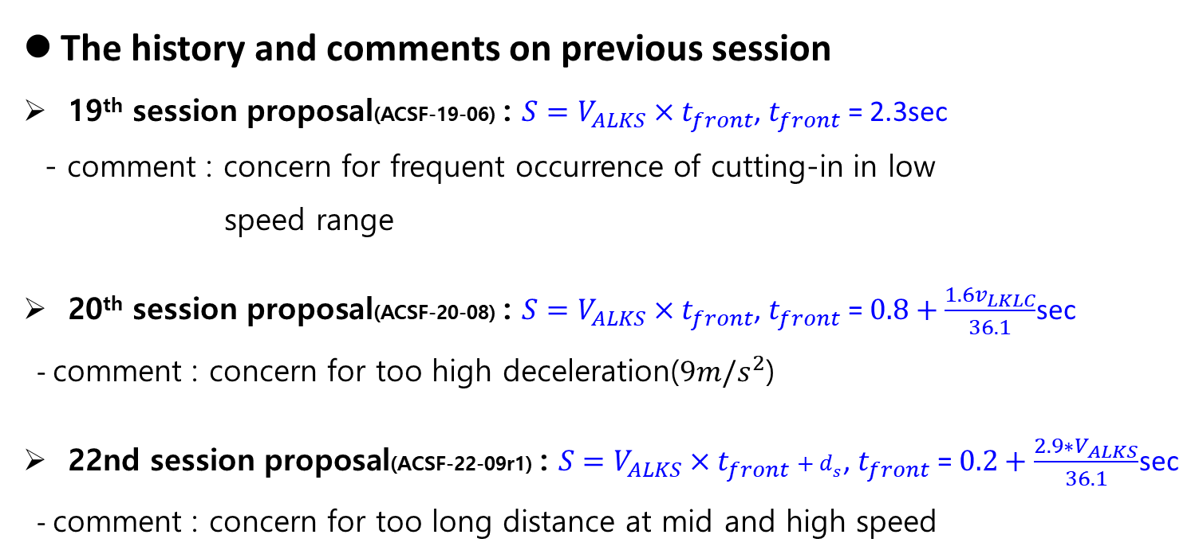
Comment Histroy
The history and comments on previous session
19th session proposal(ACSF-19-06) : $S=V_{ALKS}×t_{front}$, $t_{front}$ = 2.3sec
- comment : concern for frequent occurrence of cutting-in in low
speed range
20th session proposal(ACSF-20-08) : $S=V_{ALKS}×t_{front}$, $t_{front}$ =$0.8+\frac{1.6v_{LKLC}}{36.1}$sec
- comment : concern for too high deceleration($9m/s^{2}$)
22nd session proposal(ACSF-22-09r1) : $S=V_{ALKS}×t_{front}{+ d}_{s}$, $t_{front}$ = $0.2+\frac{2.9∗V_{ALKS}}{36.1}$sec
- comment : concern for too long distance at mid and high speed

Slide 7
Plot for the respective formula

Slide 8
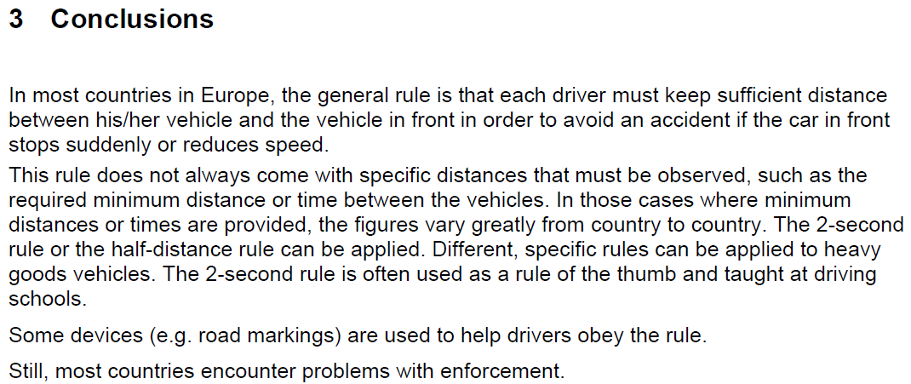
Safe distance between vehicles April 2010
Source : Conference of European Directors of Roads

Slide 9
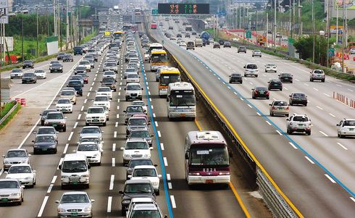
Consideration of full range speed for next step (ALKS for high speed)
Road speed limits are used in most countries to set the max./min. speed at which road vehicles can legally travel on particular stretches of road. But, the speed range under min. speed is depending on particular situation(e.g. traffic Jam) and can be allowed
Road max. limit speed (e.g. 130km/h)
General driving range
Time gap = 1.8~2 sec
ALKS for high speed
Road min. limit speed (e.g. 60km/h)
particular driving range
Time gap < 1.8 sec
(e.g. traffic jam)
ALKS for low speed
ALKS for low speed

Slide 10
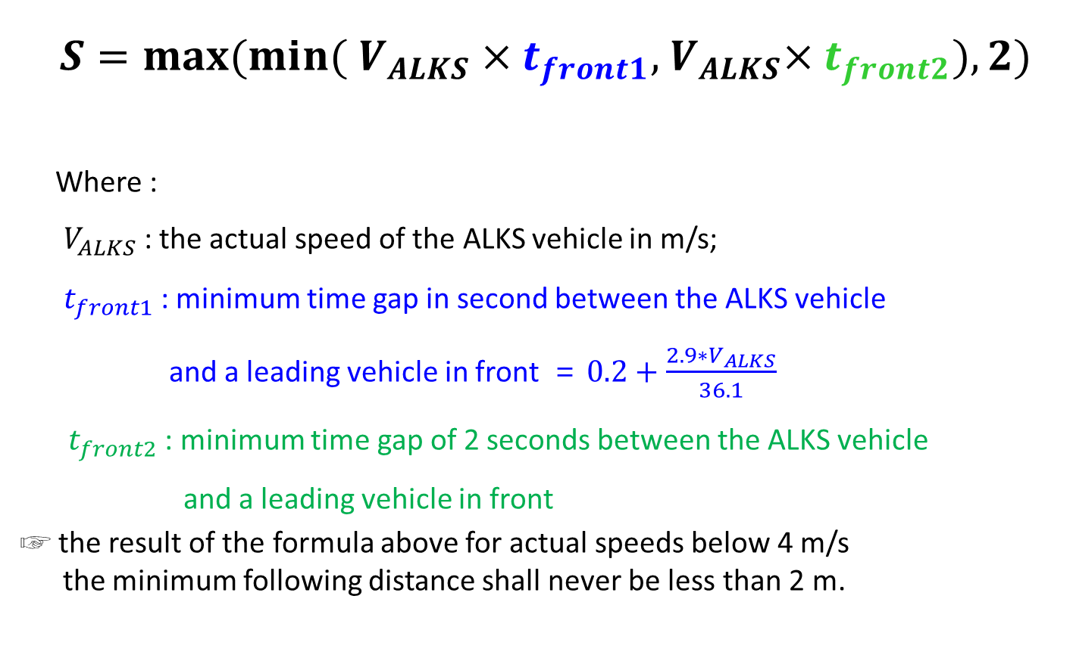
New Formula for Minimum Following Distance
$$S={max⁡(min⁡( V}_{ALKS}×t_{front1},{ V}_{ALKS}×t_{front2}), 2)$$
Where :
$V_{ALKS}$ : the actual speed of the ALKS vehicle in m/s;
$t_{front1}$ : minimum time gap in second between the ALKS vehicle
and a leading vehicle in front = $0.2+\frac{2.9∗V_{ALKS}}{36.1}$
${ t}_{front2}$ : minimum time gap of 2 seconds between the ALKS vehicle
and a leading vehicle in front
☞ the result of the formula above for actual speeds below 4 m/s
the minimum following distance shall never be less than 2 m.
Low speed application
High speed application

Slide 11
Plot for G/OICA vs. ROK

Slide 12
Appendix-1

Slide 13
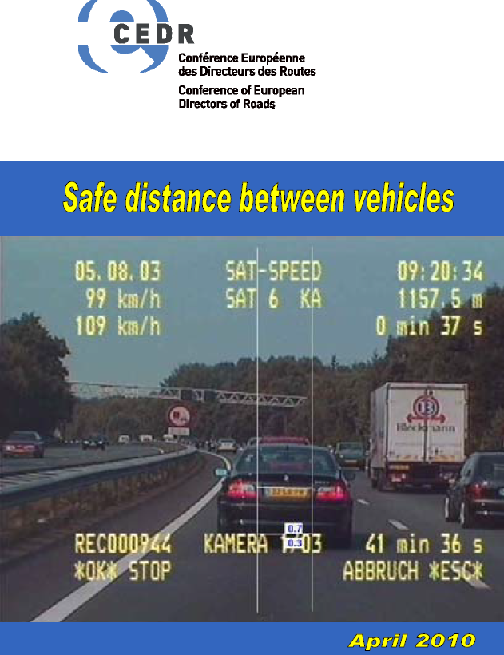

Slide 14
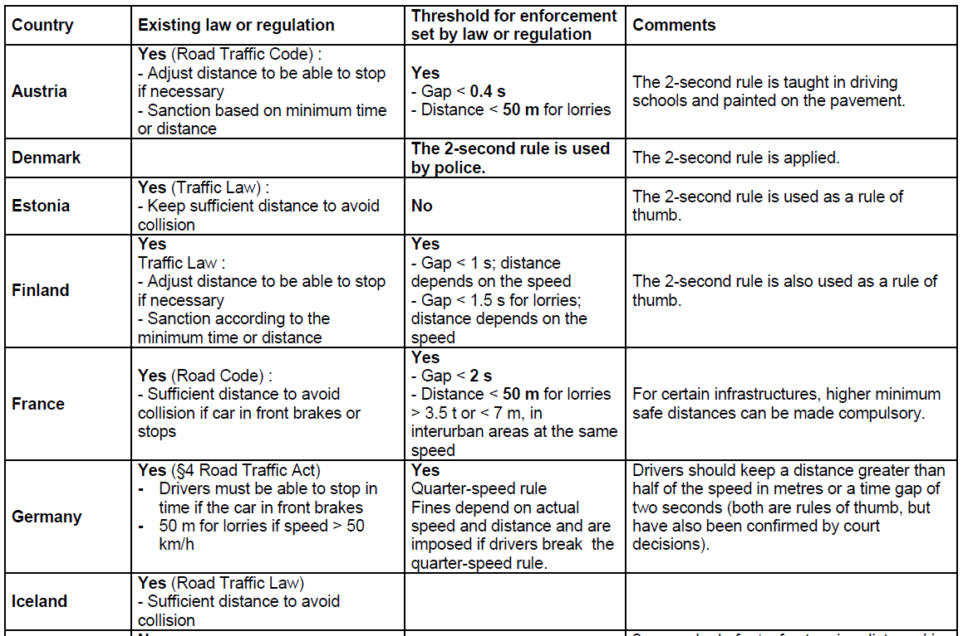

Slide 15
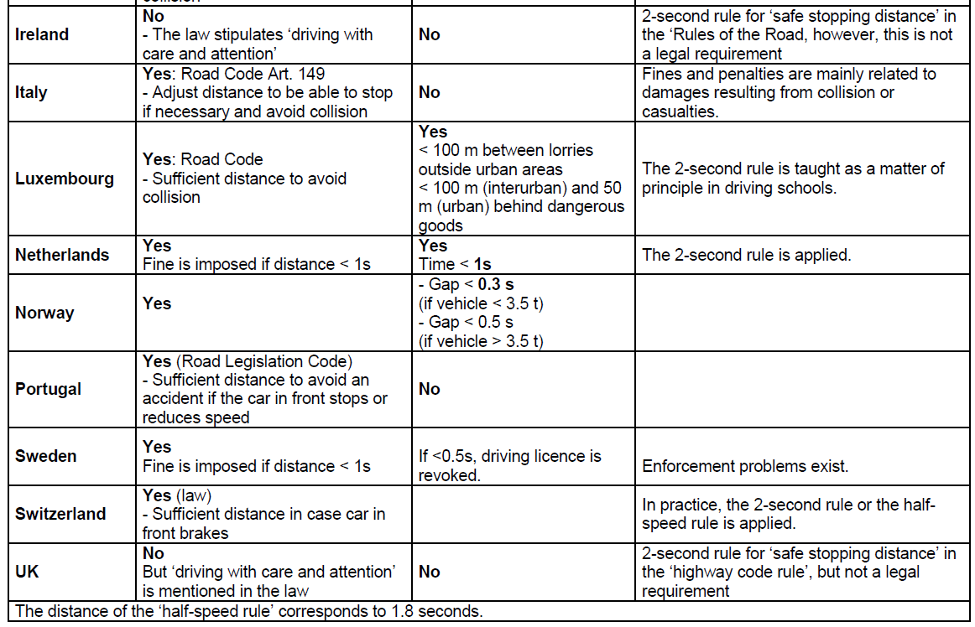

Slide 16
Plot for G/OICA vs. ROK vs. braking dist.

