Slide 1
New regulation proposal of Close-proximity field of driver’s awareness for vehicle moving off from standstill.
JAPAN.
VRU-Proxi-17-08

Slide 2
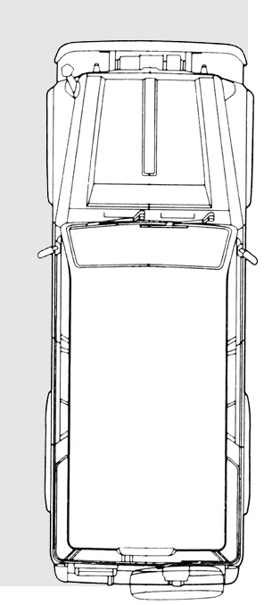
Proposal
New regulation for Close-proximity field of driver’s awareness for vehicle moving off from standstill.
To propose vehicle close-proximity field of driver’s awareness in order to prevent accidents when the vehicle moving off.
* Japan think 1st priority is increasing driver’s awareness.
Scope: M1, N1

Slide 3
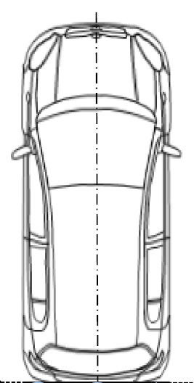
Proposal (continued)
Φ0.3m×1.0m pole
0.3m
Field of driver’s front and lateral side close-proximity awareness
Center of side mirror (UN-R46 class III)
0.3m
Any part of pole to be seen.
Means of driver’s front close-proximity awareness
- Direct vision from adjusted driver’s ocular point.
- Indirect vision (cameras, mirrors without periscope)
- Detection
* When the class III mirror mounted in front of entire vehicle, field of vision is limited to the front side only.

Slide 4
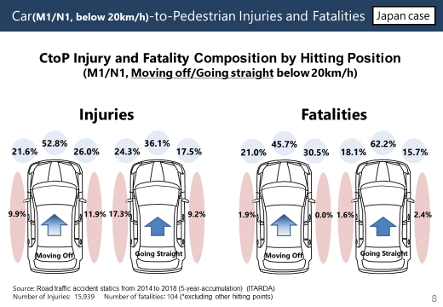
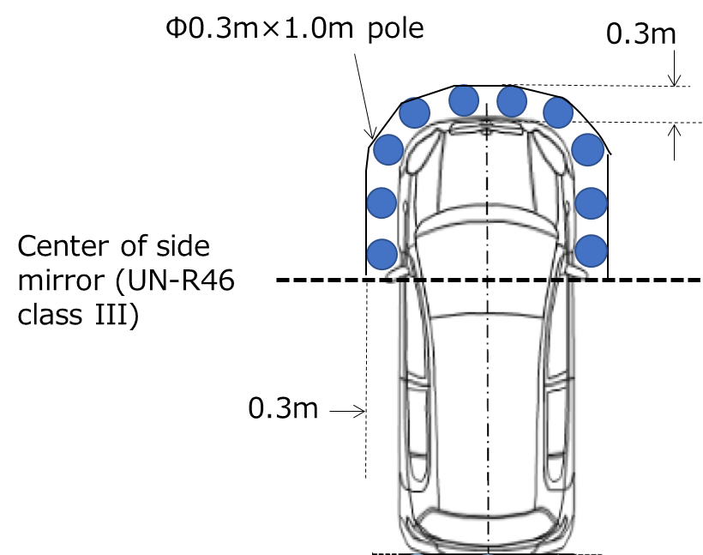
Proposal (continued)
Justifications for the proposal
Accident data about pedestrian contact is existing not only vehicle front but also front lateral side.
Now, no vision requirements for vehicle front side proximity. Therefore, minimum safety level shall be required. Including reversing, close-proximity vision all around vehicle can be satisfied by this proposal.
Safety requirements shall be technology neutral.
Improvement of front side close-proximity vision provides increase of driver’s awareness not only standstill but also turning left or right.
Proposal
Accidentology (VRU-Proxi-13-09), Osaka Japan (Feb. 2020)

Slide 5
Basic concept for regulation drafting
Common structure with reversing regulation (R-158).
Part I only for mirror
  Static test of mirrors covered by other regulations.
Part II Installation
  Technology neutral approach applied.
  Add new requirements for each means.
    Field of driver’s close-proximity awareness.
    Direct vision from adjusted driver’s ocular point.
    Requirements for camera and detection system.
    Test method for detection.
  Field of driver’s front close-proximity awareness to be satisfied by the combination of means for driver’s front close-proximity awareness.

Slide 6
Proposal (continued)
Direct vision
Any part of pole to be seen from adjusted driver’s ocular point.
・Methods of driver’s ocular point adjustment
・Based on Back Angle *same as R125
・Based on driver’s stretching (passenger’s side and front side)
・Based on driver looks out of the side window

Slide 7
Proposal (continued)
Direct vision
Any part of pole to be seen from adjusted driver’s ocular point.
Methods of driver’s ocular point adjustment
(1) Based on back angle *Same as R125
(2) Based on driver’s stretching (passenger’s side and front side)
Back angle [°] | Adjustment distance [mm] |  | Back angle [°] | Adjustment distance [mm]
 | Forward/ rearward | Upward/ downward |  | Forward/ rearward | Upward/ downward
5 | −186 | 28 | 23 | −18 | 5
6 | −177 | 27 | 24 | −9 | 3
7 | −167 | 27 | 25 | 0 | 0
8 | −157 | 27 | 26 | 9 | −3
9 | −147 | 26 | 27 | 17 | −5
10 | −137 | 25 | 28 | 26 | −8
11 | −128 | 24 | 29 | 34 | −11
12 | −118 | 23 | 30 | 43 | −14
13 | −109 | 22 | 31 | 51 | −18
14 | −99 | 21 | 32 | 59 | −21
15 | −90 | 20 | 33 | 67 | −24
16 | −81 | 18 | 34 | 76 | −28
17 | −72 | 17 | 35 | 84 | −32
18 | −62 | 15 | 36 | 92 | −35
19 | −53 | 13 | 37 | 100 | −39
20 | −44 | 11 | 38 | 108 | −43
21 | −35 | 9 | 39 | 115 | −48
22 | −26 | 7 | 40 | 123 | −52
 | Adjustment distance [mm]
 | Forward/rearward | Lateral | Upward/ downward
Upward stretching | 0 | −10 | 40
Forward stretching | −140 | −15 | 10
Lateral stretching | 30 | −110 | 15
(3) Based on driver looks out of the side window (driver’s side)
 | Adjustment distance [mm]
 | Forward/rearward | Lateral | Upward/ downward
Looks out of side window | [XX] | [YY] | [ZZ]
To be defined by on-going study

Slide 8
Proposal (continued)
Indirect vision
Any part of pole to be seen in the camera image or mirror surface.
Detection
Φ0.3m×1.0m pole
0.3m
Detection needs 0.2m distance from vehicle.
Center of side mirror (UN-R46 class III)
Pole to be detected in the 0.1m range (rest of filed of vision).
0.3m

Slide 9
Proposal (continued)
Combination of several means for awareness
Close-proximity field of awareness shall be fully covered by the single or the combination of means for driver’s awareness.
Example
Detection system
Front close-proximity mirror
Camera
Direct vision
Direct vision
Direct vision
Camera

Slide 10
Proposal (continued)
On-off conditions of the Close-proximity camera system or detection system
Direct vision or mirrors always provide vision.
On the other hand, electrical system can not always active due to power or other static purposes.
Therefore, driver’s on-demand activation allowed.
15.2.3. Close-proximity front and lateral side view camera system and detection system requirements
15.2.3.1. Close-proximity front and lateral side view camera system and detection system shall be activated easily by the driver’s operations when the gear in the out of parking range.
15.2.3.2. Close-proximity camera system or detection system that can not cover all field of means for driver awareness at the same time shall be easily show area of the driver’s interest by the driver’s operations.
For the camera system
16.3. Deactivation
The front and lateral side view image may change the camera view by the driver’s operation or automatically without the driver’s operations.

Slide 11
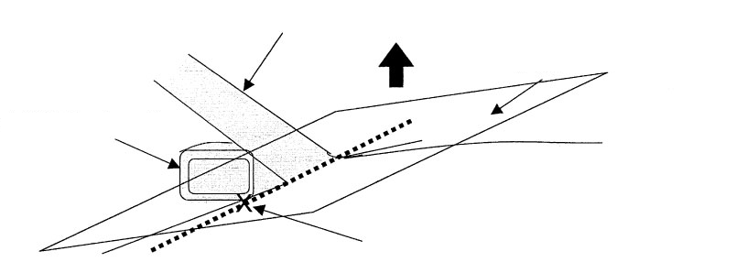
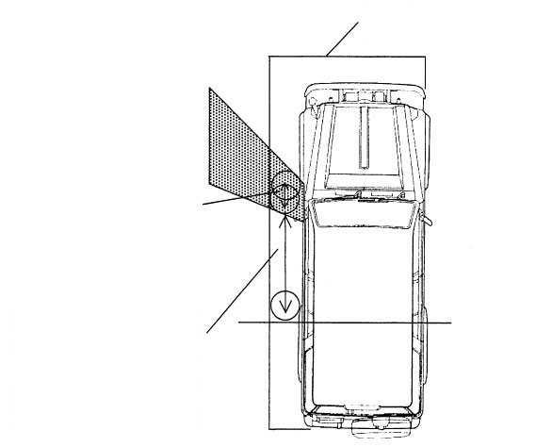
Proposal (continued)
Exemption by blind area caused by A-pillar and side-mirror mount
Blind area created by A-pillar
Plane parallel to the vehicle centre line and passing through point a
Range of field of vision
Blind area created by exterior rear-view mirror
Distance between the centre of a cylinder in contact with the front edge of the blind area and the centre of a cylinder in contact with its rear edge: X (m)
Lowermost point of the side glazing's transparent area where the ground surface can be viewed through the side glazing when the left side of the vehicle is checked from the reference eye-point centre (point a)
Front edge of the rear wheel
Distance between the rear edge of a cylinder in contact with the rear edge of the blind area and the front edge of the rear wheel: L (m)
The range of the blind area created by the A-pillar or exterior rear-view mirror in paragraph 15.2.4.10. shall be an area that meets the following formula. In this case, if there are more than one blind area, each blind area shall meet the conditions of the formulae.
X ≤ 0.292∙L − 0.203
Where:
X [m]: is the limit of the excluded area, i.e. the distance between the centre of a cylinder in contact with the front edge of the blind area and the centre of a cylinder in contact with its rear edge.
L [m]: is located inside the blind area created by the A-pillar or exterior rear-view mirror. Distance between the rear edge of a cylinder in contact with the rear edge of the blind area and the front edge of the rear wheel.

Slide 12
Thank you for your attentions.

