Slide 1
Summary of the development of the UNECE Direct vision Standard for Heavy Goods vehicles
Dr Steve Summerskill, Dr Russell Marshall, Iain Knight
VRU-Proxi-17-12

Slide 2
Objectives
Recent proposals for limit values based on the same meeting discussions have come up with different interpretations – TF chairs presentation at last VRU proxi ended up with several versions as a consequence:
Industry has a clear request from VRU proxi to quantify the impact of each different proposal on the table in terms of which vehicles can be improved to meet the standard and which will require complete redesign/be eliminated from the market
CPs will ultimately have to make a choice on proposals/limit values balancing extent of safety gain against economic effects
Critical that all stakeholders share a common understanding of how the limits are defined, what they are and what they might mean in terms of what VRUs are visible in different circumstances
Aim of this document is to provide a single reference that can be used to understand the relationship between VRU distance and volume and the extent to which different proposals ‘eliminate blind spots’ free from commentary on what level of ambition the regulation should have

Slide 3
Why and how the London direct vision standard was defined

Slide 4
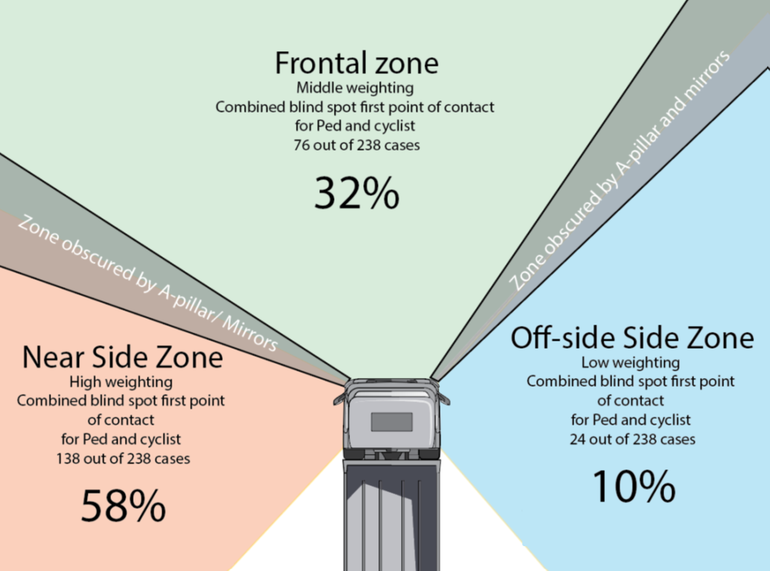
Why and how the London direct vision standard was defined
Accident data analysis supporting the requirement for a DVS
An accident data analysis (UK STATS 19 database) was performed in the project that defined the TfL version of the DVS¹
This highlighted that a disproportionate number of accidents were occurring between HGVs and VRUs in London
This highlighted the key areas in close proximity to the vehicle cab in which different accident scenarios occur
  Causation data highlighted that the ability to see VRUs was a key issue
This analysis highlighted the near side zone (58%) was involved in the majority of collisions and collisions to front (38%) also being important to consider. The driver’s side involved 10% of collisions
For more detail on the accident data analysis see section 8 of the DVS project report¹
    UK/Japanese vehicle (Right hand drive). The percentage of collisions that result in a VRU
    being killed or seriously injured by vehicle side
¹SUMMERSKILL, S. ... et al., 2019. The definition, production and validation of the direct vision standard (DVS) for HGVS. Final Report for TfL review. Version 1.1. London: Transport for London. Report https://hdl.handle.net/2134/36622

Slide 5
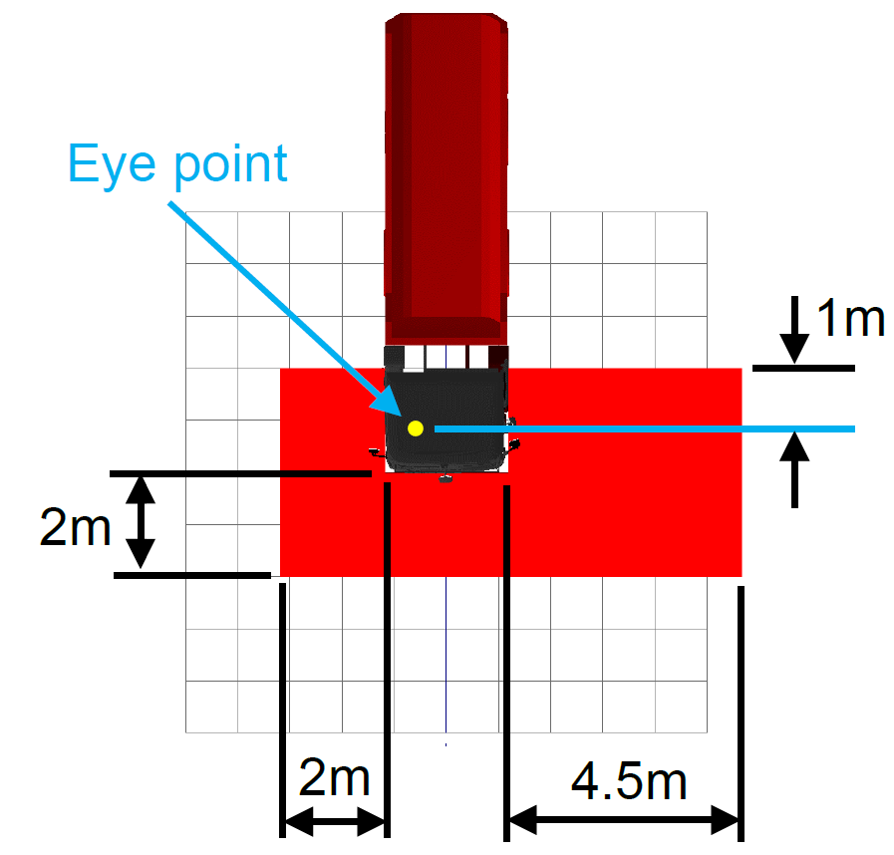
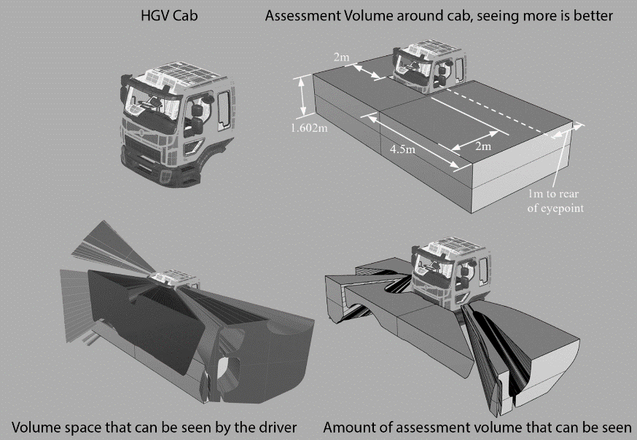
Why and how the London direct vision standard was defined
The volumetric method
The assessment method that has been defined in the London DVS, and adopted in the UNECE version involves the simple premise of constructing a volume of space around the vehicle which is defined by the area of greatest risk shown in the previous slide. The proportion of this volume that can be seen directly from a standardised set of eye points defines a score for the vehicle. The more that can be seen, the better of the vehicle.
A zone from the ground to 95th percentile Dutch male shoulder height (1.602m) has been defined around the vehicle as the risk area for close proximity collision. Most casualties relevant to direct vision will be within this area at the key moment before collision.
The plan view image of the assessment volume highlights that it replicates the areas covered by the Class V and Class VI mirrors, with an additional zone on the drivers side, the same distance away from the driver’s side as the zone to the front (2m).
Casualties could be positioned anywhere within this volume
The principle of volume is that making any volume within this zone visible in direct vision has a safety benefit and should be encouraged.
Hence Volume is proposed as the sole metric for measuring direct vision performance. It rewards all innovations that result in more direct vision in a safety critical zone close to the vehicle. It is accurate with high resolution.
Separately, a physical test method is under development to allow technical services to measure volume, or a very confidently related alternative, without the use of CAD. However, this should not be considered relevant to the setting of limit values at this stage and the digital approach is generally the preferred method as it is more time efficient. The digital method allows ratings for multiple cab heights to be produced quickly.
For more detail on the Volumetric method including the definition of the standardised eye point rig please the following
  UNECE WIKI of meeting records from the UNECE VRU Proxy Working Group. See meeting 6, first presentation from LDS https://wiki.unece.org/display/trans/VRU-Proxi+6th+session
  Section 9.4. Project report. SUMMERSKILL, S. ... et al., 2019. The definition, production and validation of the direct vision standard (DVS) for HGVS. Final Report for TfL review. Version 1.1. London: Transport for London. Report https://hdl.handle.net/2134/36622
  For more detail on the physical test method see the following presentation. UNECE WIKI of meeting records from the UNECE VRU Proxy Working Group. Meeting 15, presentation of testing results for the physical method. https://wiki.unece.org/download/attachments/109347936/VRU-Proxi-15-02%20Rev1%20%28LDS%29%20LDS%20Presentation%20-%20%20UNECE%20VRU%20PROXI%2014th%20meeting_DraftV2.pptx?api=v2
    UK/Japanese vehicle (Right hand drive). The plan view of the assessment volume showing the coverage matches the class V & VI mirrors on the passenger side and front. A 2m zone has been added to the driver’s side. This is mirrored for left hand drive vehicles
    How the Direct Vision Standard defines the volume of the assessment volume that is visible to the driver

Slide 6
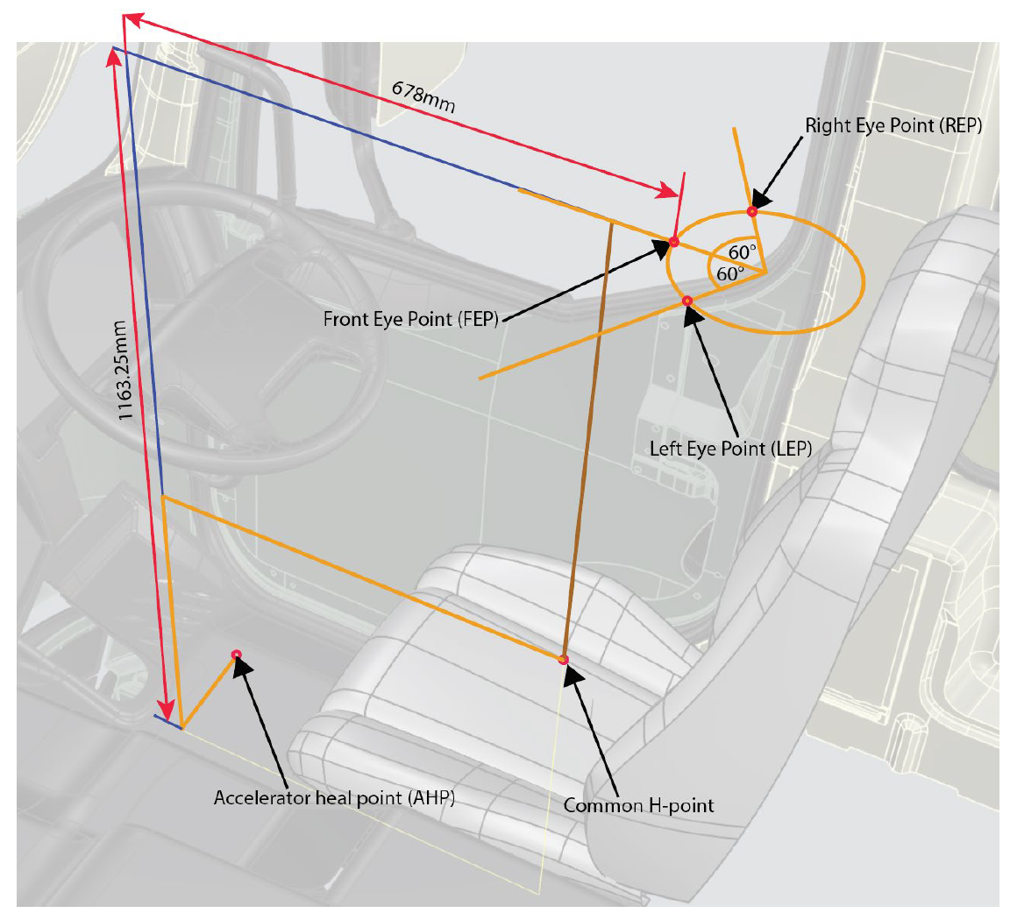
Why and how the London direct vision standard was defined
Standardised eye point
The DVS method uses a standardised eye point rig. See figure
This was defined in the TfL DVS project by the stakeholder group including 8 manufacturers
A standardised eye point was required due to the variability in the use of the seating reference point (SgRP) by manufacturers which had the potential to skew the results
The visible volumes through windows are created
Cab design
Assessment volume aligned to the cab
The visible volumes are intersected with the assessment volume
The volume of the assessment volume that is visible is the
performance metric
See Section 9.3.1 of the TfL DVS project report for more detail: Report link

Slide 7
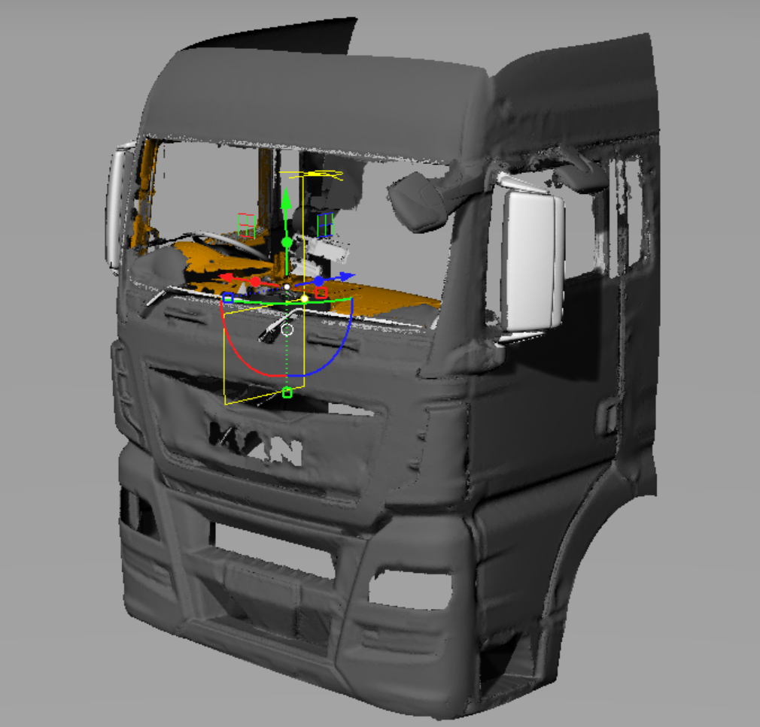
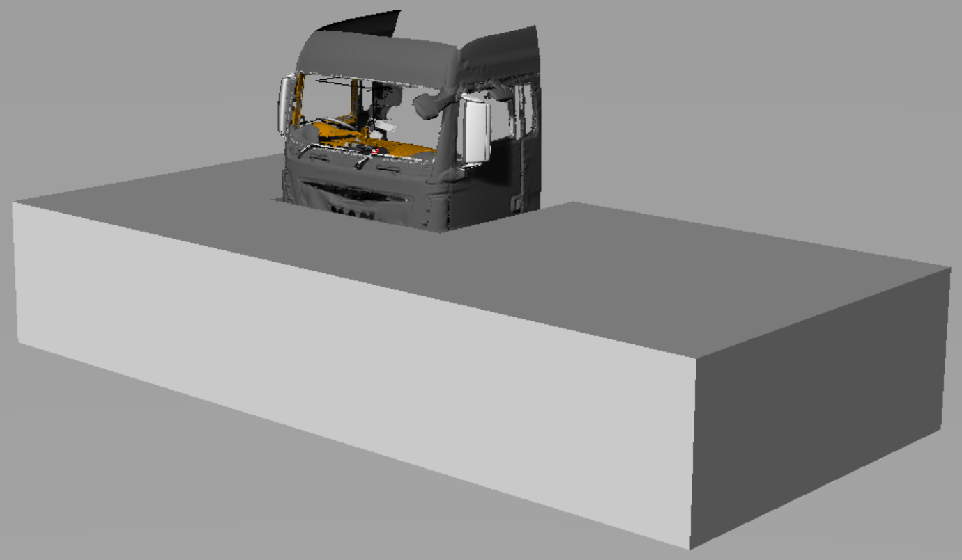
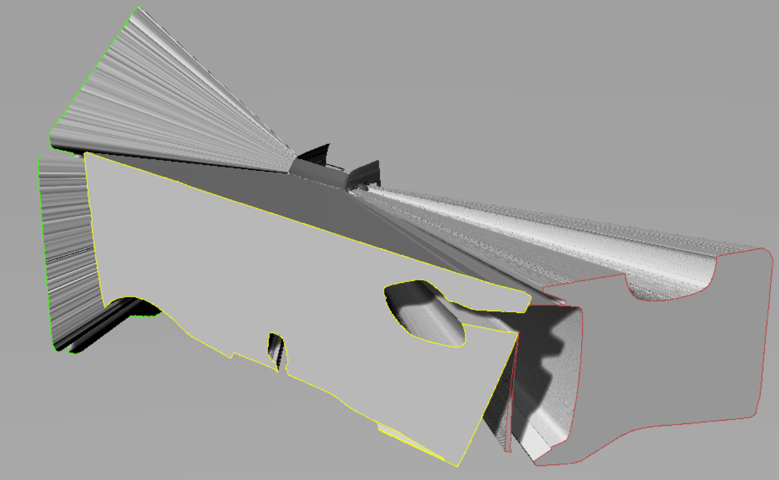
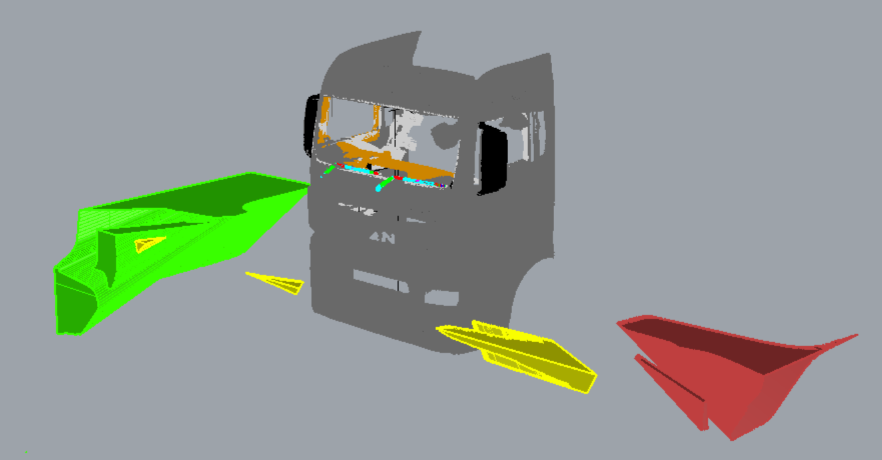
The volumetric method – Worked example results
The visible volumes through windows are created
Cab design
Assessment volume aligned to the cab
The simulated driver can see 2.4m³ or 4.65% of the assessment volume. In this example, the majority of this volume is seen to the driver’s side, which is associated with lower VRU casualty numbers
The visible volumes are intersected with the assessment volume
The volume of the assessment volume that is visible is the
performance metric

Slide 8
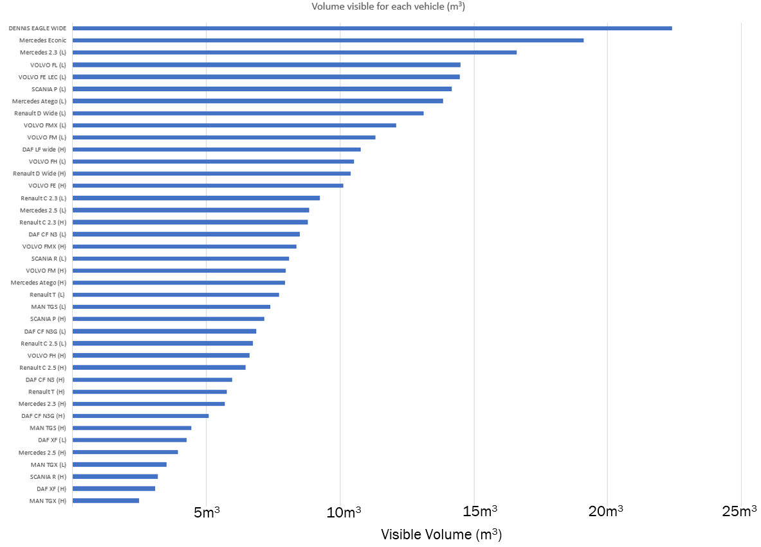
The volumetric method
The graph shows the range of volumetric performance in 52 examples of highest or lowest mounting positions across a range of make models
The size of the assessment volume varies by cab width, a 2.5m wide cab will have assessment volume of approx. 50m³
Note: In the London DVS cab designs were assessed at the maximum possible height (H) and minimum possible height (L) for that model. See graph. This was not weighted by sales or freight sector. So, 7 of 52 (13%) specifications assessed had volumes of less than 5m³ but this does not mean 13% of vehicles on the road have this level of visibility

Slide 9
How do we give context for the abstract volumetric score?
Using simulations of VRU distance, i.e. the distance away from the cab that a number of VRU simulations are located at whilst just allowing the head and neck to be visible.

Slide 10
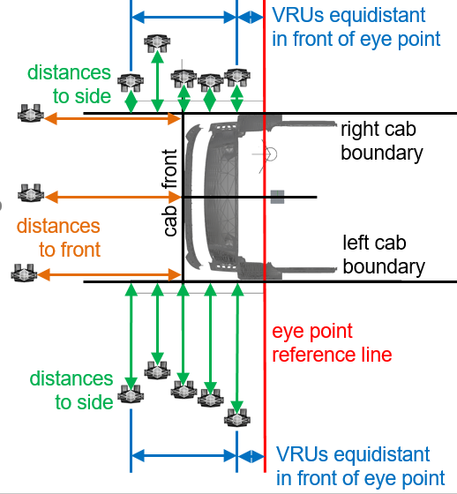
Why do we use VRU distance?
Considered in isolation, volumetric scores are abstract
A need was perceived for a simplified measure to help illustrate what the visible volumes related to in terms of something more visibly related to safety
Following a methodology originally applied in projects from 2011² and 2015³ a set of VRU simulations were created which allows VRU visibility to be assessed at 13 points around the vehicle.
The figure shows the arrangement of the VRUs around the cab.
² COOK, S., SUMMERSKILL, S., MARSHALL. R., ... et al., 2011. The development of improvements to drivers' direct and indirect vision from vehicles - phase 2. Report for Department for Transport DfT TTS Project Ref: S0906 / V8. Loughborough: Loughborough University and MIRA Ltd. See section 2.5 https://hdl.handle.net/2134/8873
³SUMMERSKILL, S. Marshall, R; Paterson, A; Reed, S (2015): Understanding direct and indirect driver vision in heavy goods vehicles. Report. https://hdl.handle.net/2134/21028

Slide 11
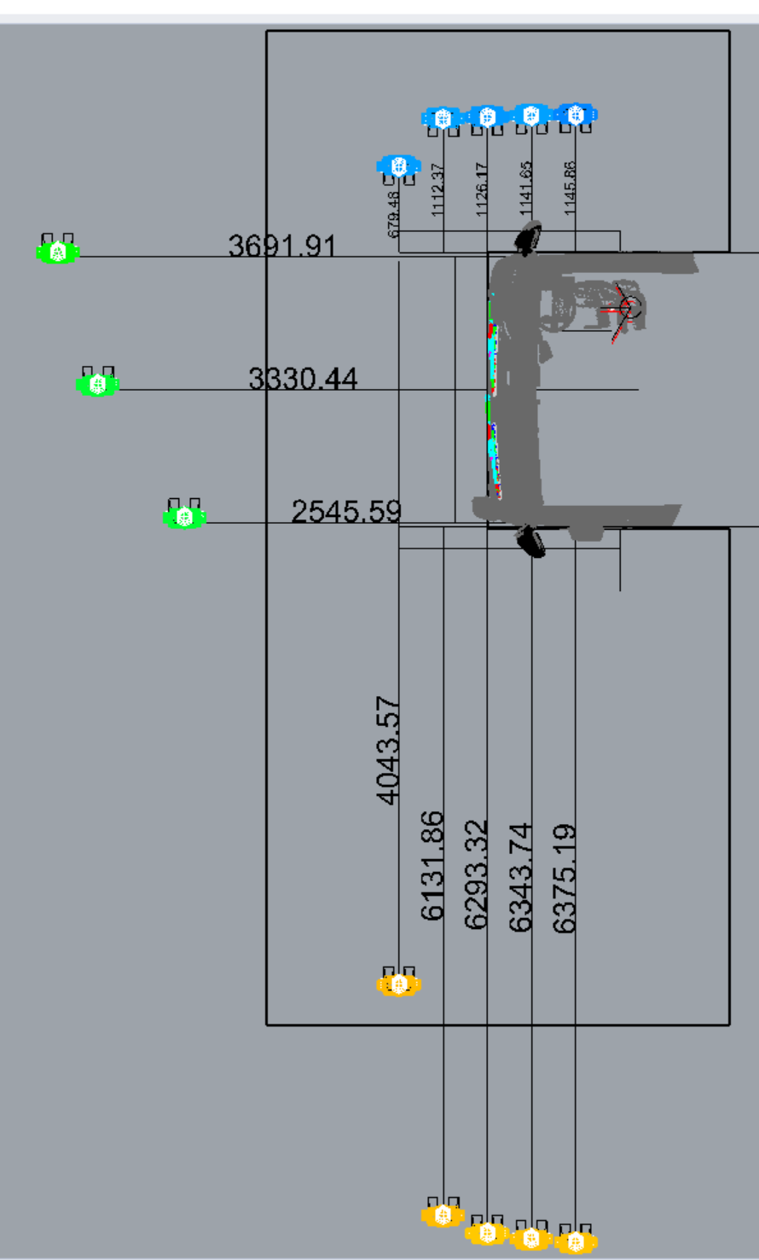
How are the VRU simulations defined and used
As per the diagram, an array of VRU simulations is arranged around the vehicle using a consistent method. Each VRU is then moved away from the side of the truck in one axis only
The portion of the VRU that must be visible was originally proposed as head and shoulders but head and neck is now agreed
This is followed by example results for the VRU distances
²COOK, S., SUMMERSKILL, S., MARSHALL. R., ... et al., 2011. The development of improvements to drivers' direct and indirect vision from vehicles - phase 2. Report for Department for Transport DfT TTS Project Ref: S0906 / V8. Loughborough: Loughborough University and MIRA Ltd. See section 2.5 https://hdl.handle.net/2134/8873
³SUMMERSKILL, S. Marshall, R; Paterson, A; Reed, S (2015): Understanding direct and indirect driver vision in heavy goods vehicles. Report. https://hdl.handle.net/2134/21028

Slide 12
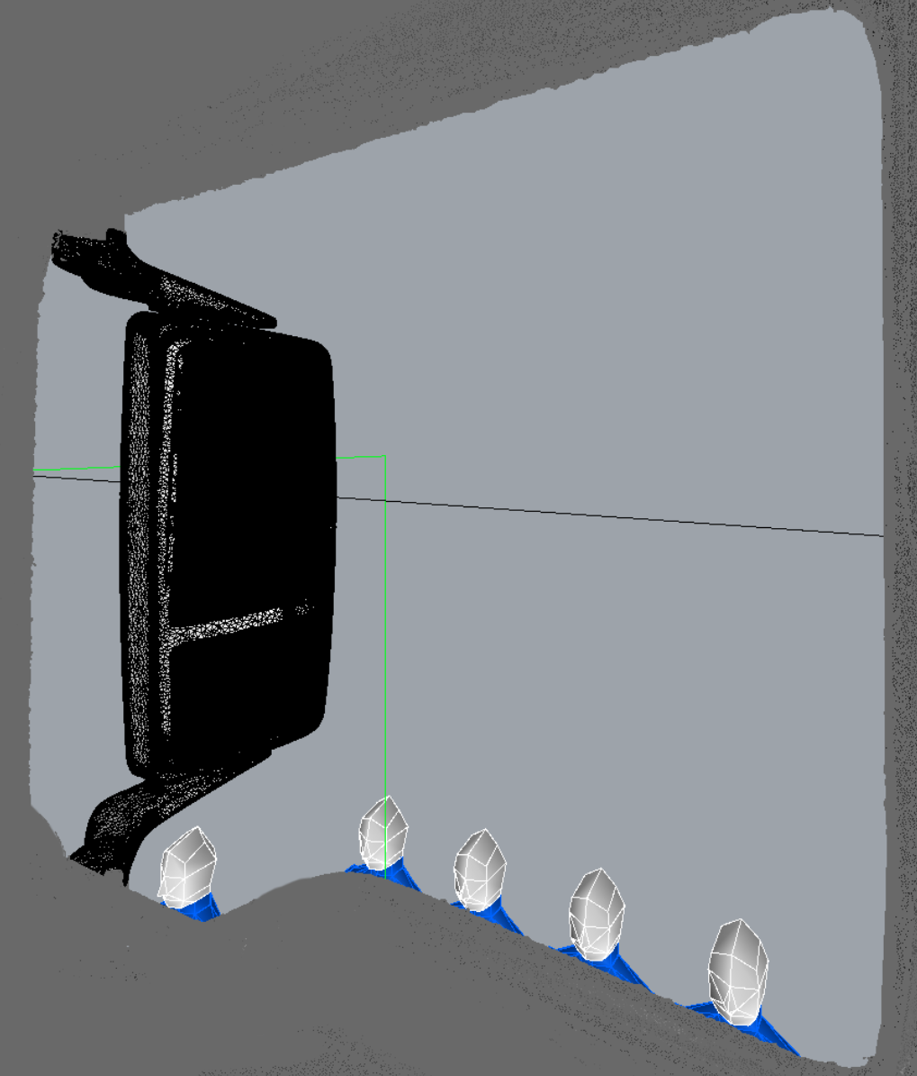
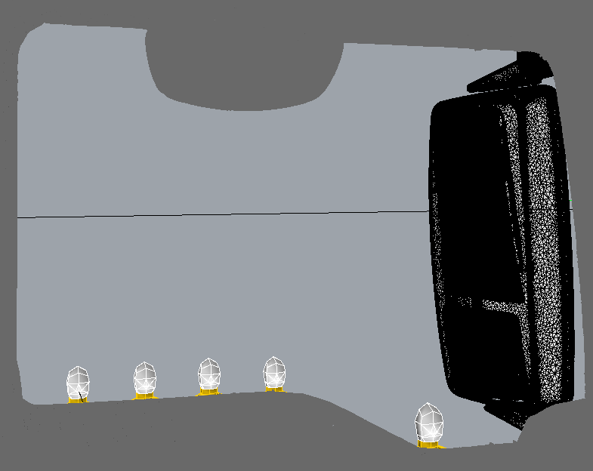
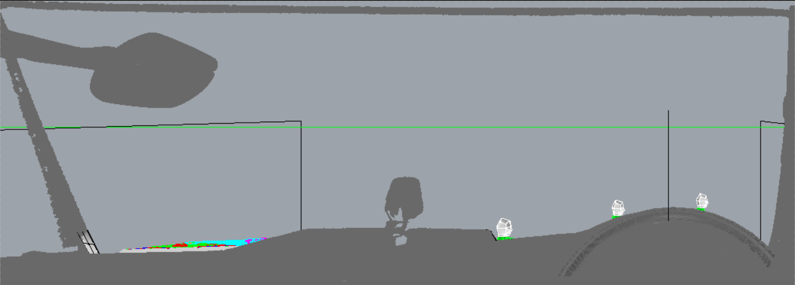
Example VRU distance result
The bottom images shows the placement of the VRU simulations to the front and sides of the vehicle for head and neck visibility from the simulated eyepoint.
Top right shows a plan view of VRU positions

Slide 13
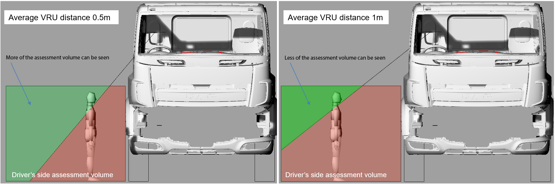
The use of VRU simulations (5th%ile Italian female)
There has been a consistent misunderstanding where it has been assumed that changing the average VRU distances changes the assessment volume
This is not the case. Changing the average VRU distance changes the amount of the assessment volume that must be seen in the DVS test

Slide 14
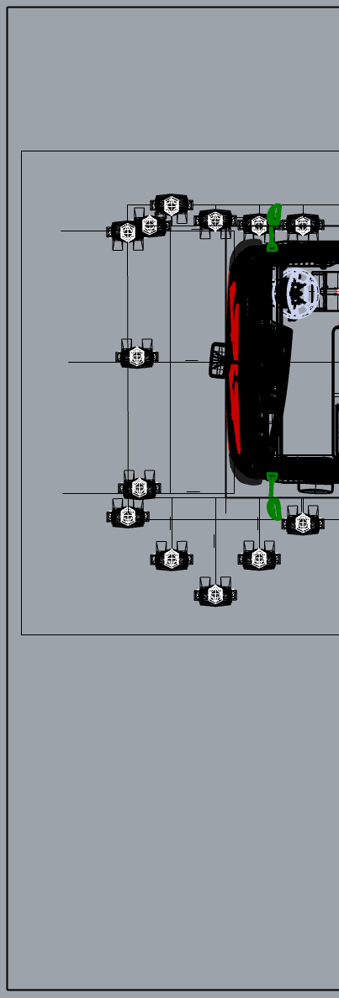
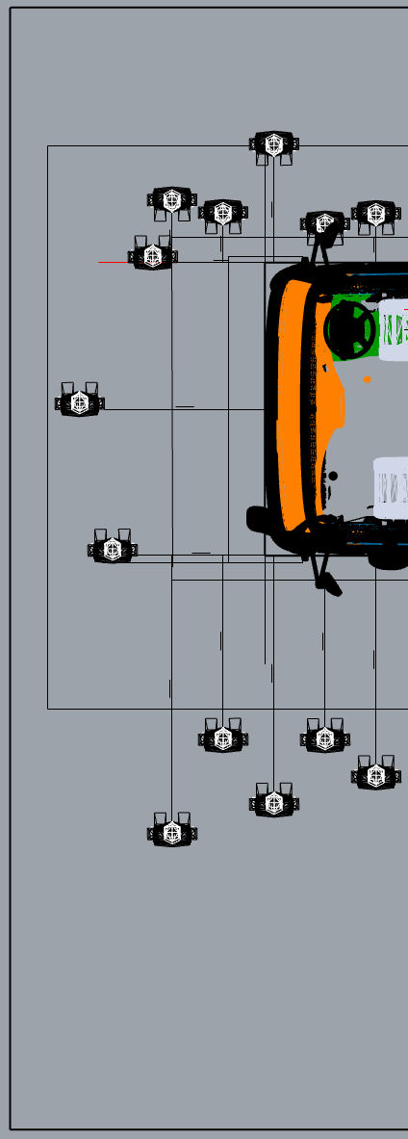
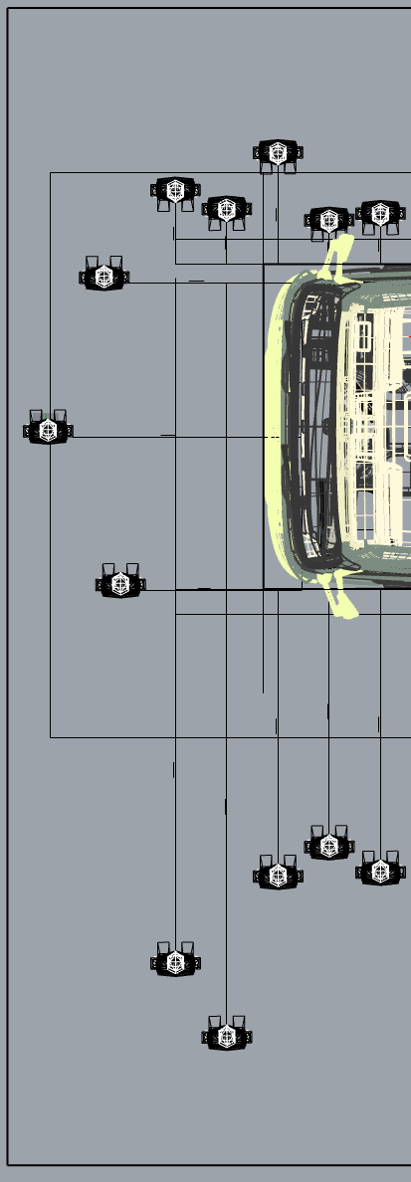
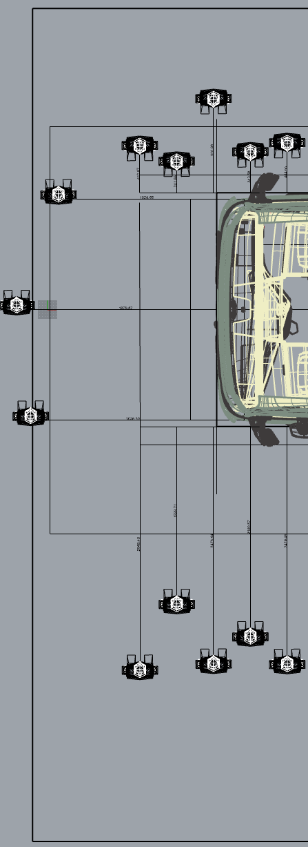
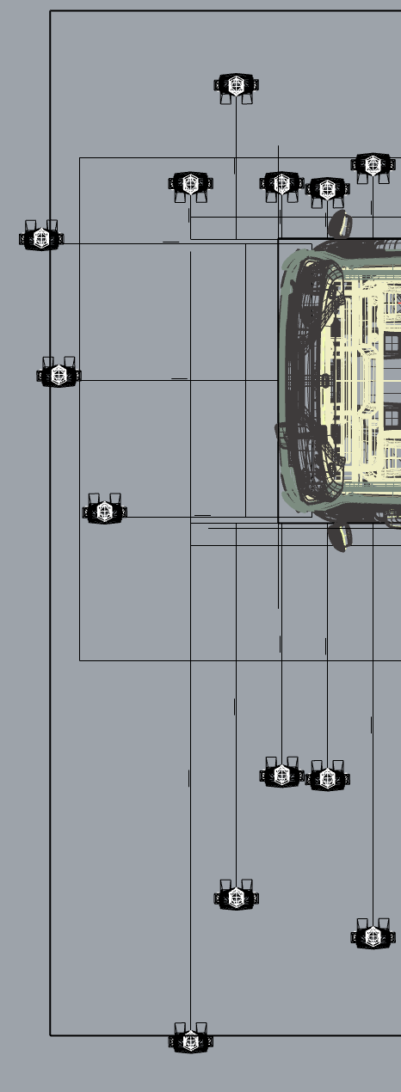
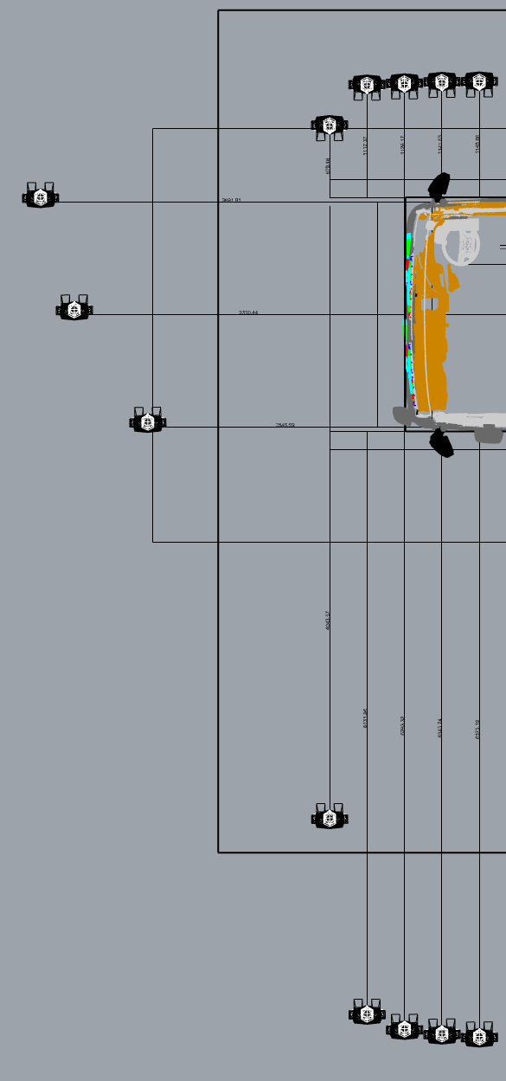
Example VRU distances for vehicles in the star boundary categories
(New version, Head & neck only visible) Tfl version
5 star
3 star
2 star
1 star
EMSR
ZERO Star
Note: average VRU distance to any one side (e.g. front) set at the mirror boundary does not guarantee elimination of blind spots between direct and indirect vision.
One VRU at the front may be invisible in both direct and indirect vision provided others are visible sufficiently far inside the mirror boundary for the average to be equal to 2m or less

Slide 15
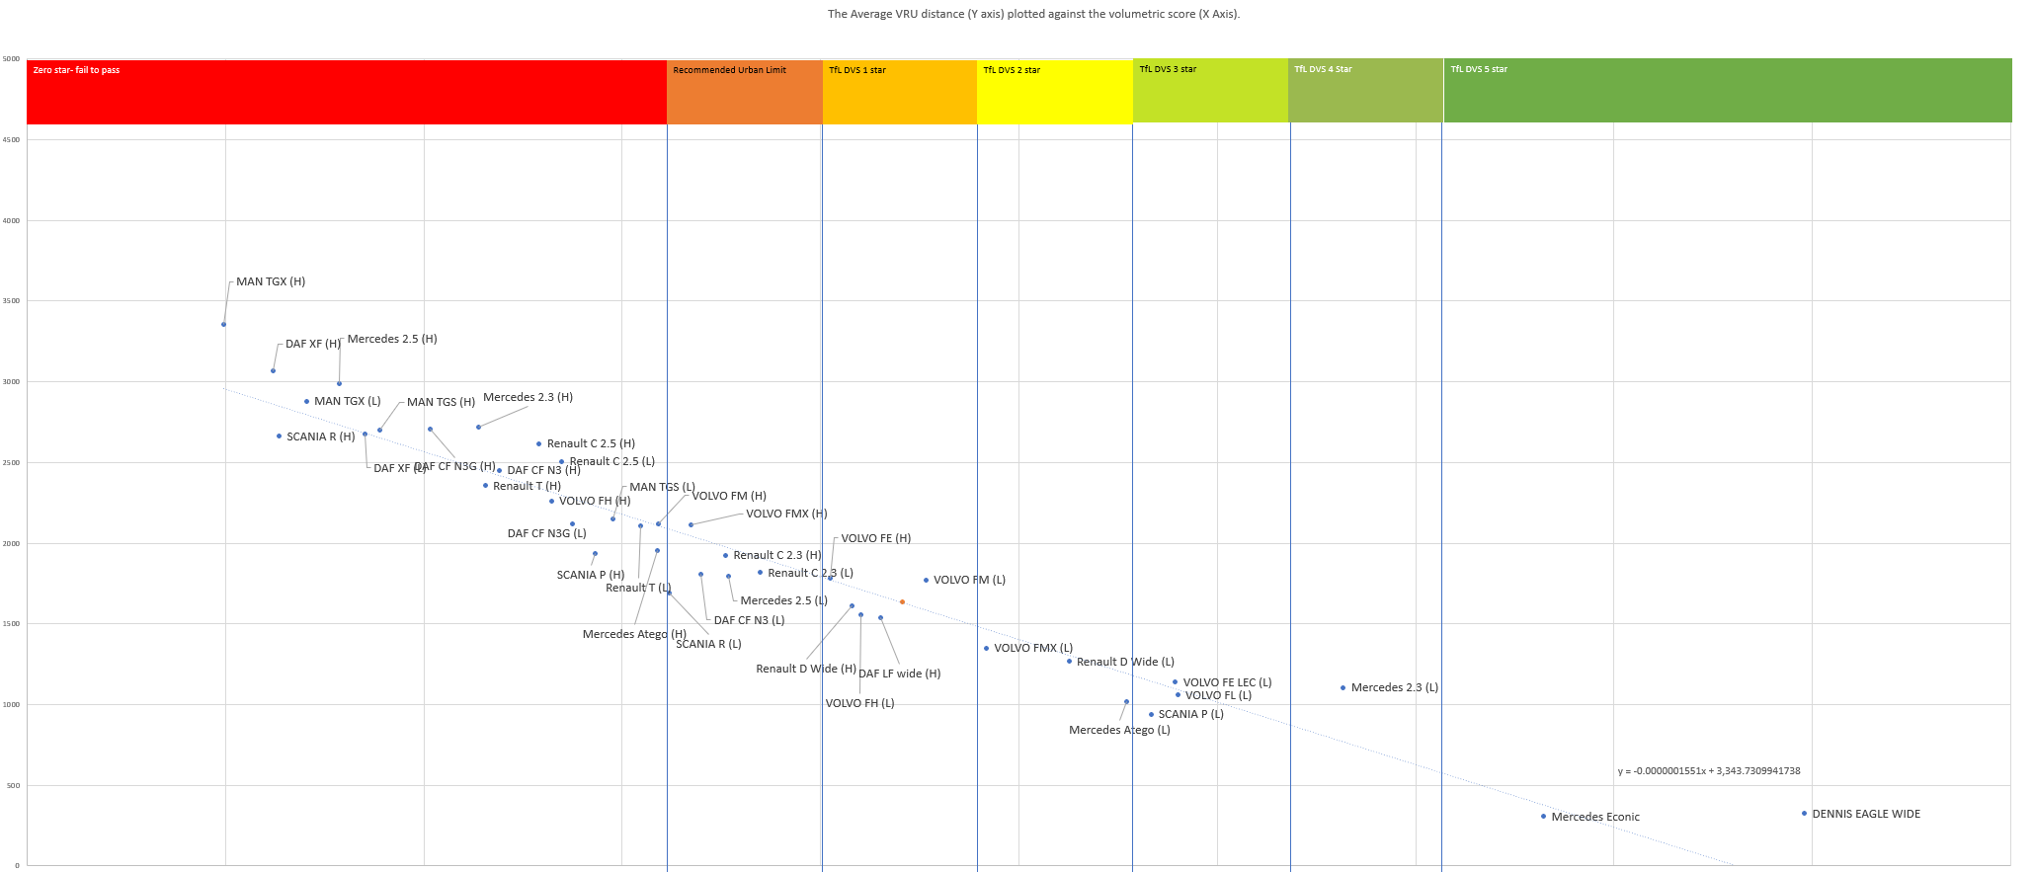
Plotting the Average VRU Distance against volume
When we plot the average VRU distance against volume we get a very strong correlation of 0.964 (where 1 is perfect)
5m³
10m³
15m³
20m³

Slide 16
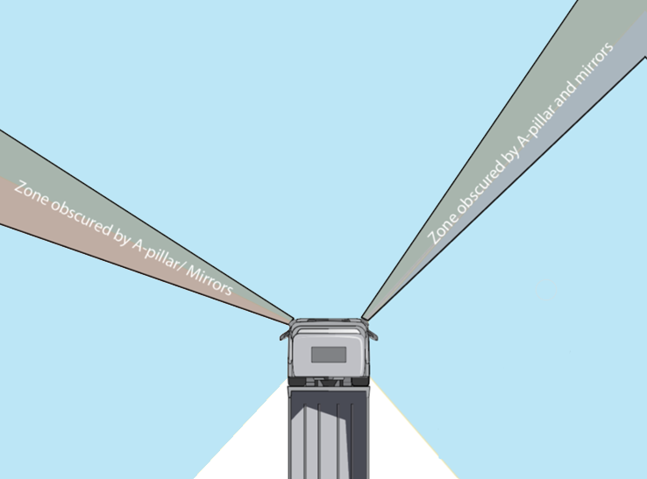
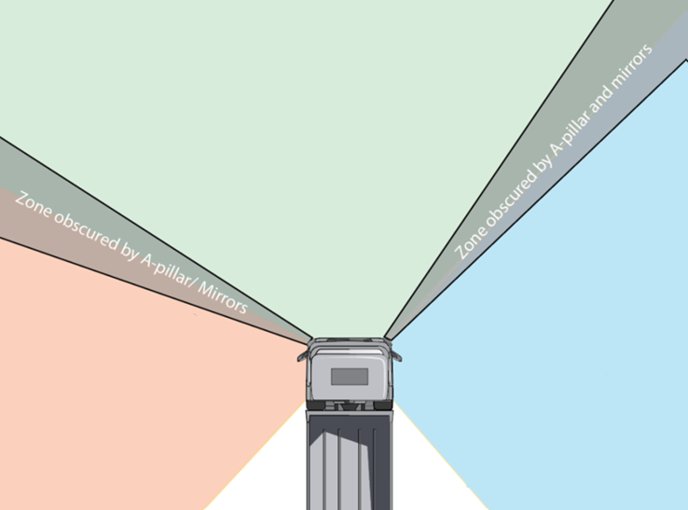
Combined or separated approach
The combined approach would allow the required visible volume to be gained from any side of the vehicle. e.g. a manufacturer may improve performance substantially to the driver and passenger sides by replacing mirrors with a camera system, but make no improvements to the front visibility as long as the total volume requirement is met.
The separated approach would require a minimum requirement to be met for each side individually. See right hand figure below
Combined approach
Separated approach
The minimum requirement of Xm³
Can be met by simply adding the performance for all sides
(left, front and right of the cab)
The vehicle must allow Bm³ or more to be seen to the front
The vehicle must allow Cm³ or more to be seen to the passenger side
The vehicle must allow Am³ or more to be seen to the passenger side

Slide 17
OVERVIEW OF Limit Proposals so FAR

Slide 18
common Principles
Volume of visible space
  The aim is to agree volumetric limits for either:
    An overall volumetric limit for a given vehicle category (combined)
    A volume limit for each side: Front, Driver, Passenger for each vehicle category (separate)
  Differentiation into vehicle categories has been proposed based on CO2 regulations (VECTO). The current category proposal is A = often used in urban areas, B = rarely used in urban areas, B+ = Off-Road
  Volumetric limits are established based on VRU distance as a visualisation tool.
VRU distance
  VRU distances are averaged for a given side
  For an overall volumetric limit the VRU distances for all three sides are averaged (an average of averages)
  Using correlation graphs of VRU distance to volume, the trendline allows any VRU distance to be converted into a volume (the spreadsheet has been circulated)
  All data now being considered is based on VRU distances using head and neck values

Slide 19
Problems
Decision to use the correlation line to convert VRU distance to volume makes conversion sensitive to the number and performance of vehicles in the sample. Sample size has been increased during analyses which changes the relationship
The decision to consider the ‘combined assessment zone’ and the ‘separated by side’ approach has complicated matters further. The distribution of total visible volume to front, passenger and drivers side varies by vehicle. Correlations to each side do not match perfectly with correlation of the whole zone
This was not initially fully understood, leading to some inconsistencies in presentation, particularly in terms of presenting a total visible volume to compare the ambition of proposals made according to ‘combined’ or ‘separated’ approach
Correlation graphs have been presented for specific purposes, not always with the whole samples. Thus using correlation equations from graphs in previous ppts can lead to differing results.
To resolve these problems a definitive spreadsheet calculation tool has been circulated and should be used for all conversions of VRU distance to volume for future WG discussions of candidate limit values. It is not intended to be used in the regulation itself or eventual type approvals
Detailed consideration of each proposal, as it was made at the time, is included in appendix slides and many values do not match the current spreadsheet for these reasons.

Slide 20
Proposals for Limit values (VRU distance) tabled since Osaka
VRU-Proxi | Proposer | Category | Zone | Average VRU Distance (m)
VRU-Proxi | Proposer | Category | Zone | All Sides | Passenger Side | Front | Drivers Side
13-Osaka | London DVS | All | Whole volume |  | 4.5 | 2.0 | 0.6
13-Osaka | UK Contracting Party | All | Whole volume | 1.6 | 2.5 | 1.7 | 0.6
13-Osaka | VRU Chair | All | Whole Volume | - | >2.5 | 1.7 | 0.6
13-Osaka | CP mirror zone -15% | All | Both | 2.042 | 3.825 | 1.7 | 0.6
13-Osaka | CP mirror zone -30% | All | Both | 1.717 | 3.150 | 1.4 | 0.6
15-Web | LDS | B | By side | 1.94 | 3 | 1.9 | 0.93
16-Web | ACEA | A | Whole Volume | 2.025 | Not controlled
16-Web | ACEA | B | Whole Volume | 2.412 | Not controlled
16-Web | ACEA | B+ | Whole Volume | 2.257 | Not controlled
16-Web | TF Hybrid | A | Both* | 1.98 | 3.135 | 1.897 | 0.918
16-Web | TF Hybrid | B | Both* | 2.211 | 3.5 | 2.08 | 1.053
16-Web | TF Hybrid | B+ | Both* | 2.093 | 3.315 | 1.99 | 0.976
* NB Task force compromise presented by volume only. VRU distances here relate only to the element for min limit in each direction not the larger total value

Slide 21
Converting the VRU distances to volume
The spreadsheet tool has two separate tabs for ‘combined’ and ‘separated’ approach
Proposals related to separated limits to each side must use the ‘separated’ tab to convert VRU distance to volume
Summing the volume to each side is not technically valid and should not be done
If, for comparison purposes, a total volume needs to be assigned to a proposal that applies separate limits to each side, then that comparison total should be calculated using the same VRU distances in the ‘combined’ tab. It should always be clearly labelled for comparison purposes only, it would not be applied in a final regulation and it will be a different number to the sum of the volumes to each side (in most cases)
Proposals for the combined approach should be made in the combined tab. It is not possible to calculate equivalent volumes to each side because many permutations would come to the same combined total volume.
The TF Compromise approach requires setting a total visible volume limit based on the combined approach. It then proposes additional limits to each side based on the separated approach. However, the VRU distances used to set the limits to each side in the separated approach should be lower than those used to set the total volume in the combined approach

Slide 22
Recent proposals converted to Volume Using Current (corrected) approach
VRU-Proxi | Proposer | Category | Zone | Volumetric limit (m³)
VRU-Proxi | Proposer | Category | Zone | Whole volume | Passenger Side | Front | Drivers Side
13-Osaka | London DVS |  | Whole volume | 6.30 | N/A
13-Osaka | UK Contracting Party |  | Both | 11.2 | 4.78 | 2.23 | 4.44
13-Osaka | CP Mirror zone -15% |  | Both | 8.39 | 1.89 | 2.23 | 4.44
13-Osaka | CP Mirror zone -30% |  | Both | 10.49 | 3.36 | 2.89 | 4.44
15-Web | LDS | B | By side |  | 3.69 | 1.79 | 2.74
16-Web | ACEA | A | Whole Volume | 8.5 | NA
16-Web | ACEA | B | Whole Volume | 6.0 | NA
16-Web | ACEA | B+ | Whole Volume | 7.0 | NA
16-Web | TF Hybrid | A | Min By Side | 8.8 | 3.4 | 1.8 | 2.8
16-Web | TF Hybrid | B | Min By Side | 7.3 | 2.6 | 1.4 | 2.1
16-Web | TF Hybrid | B+ | Min By Side | 8.1 | 3.0 | 1.6 | 2.5
16-Web | TF Hybrid | A | Higher total limit | >8.8 | NA
16-Web | TF Hybrid | B | Higher total limit | >7.3 | NA
16-Web | TF Hybrid | B+ | Higher total limit | >8.1 | NA
* Values in red are for comparison purposes only and would not be applied in a binding regulatory text

Slide 23
Appendix – details of proposals with values as they were at the time

Slide 24
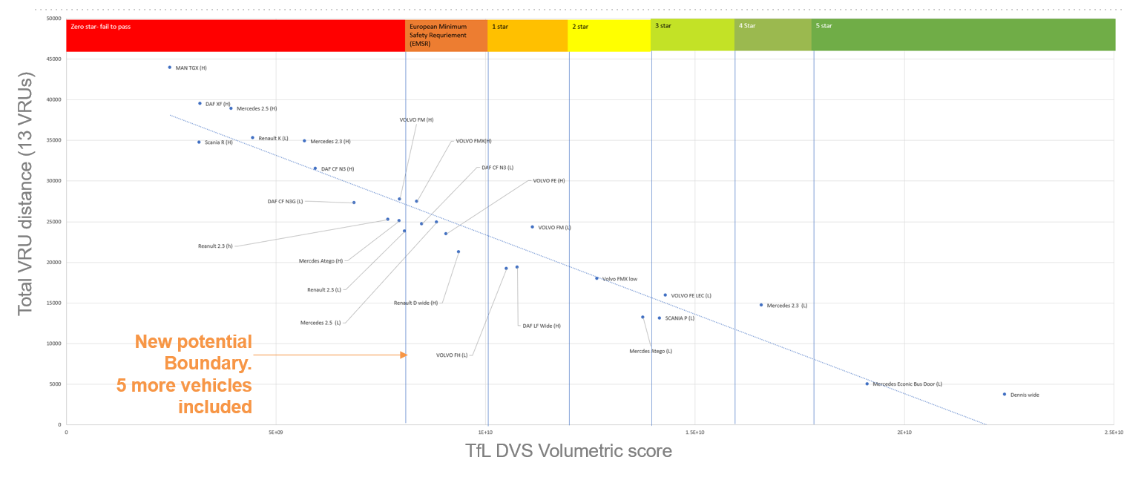
13th VRU PROXI - OSAKA
Prior to the Osaka meeting all discussions had used the methodology whereby volumetric limits were established by the performance of a real vehicle closest to the proposed VRU distance values
The approaches considered to this point were all ‘combined’
The proposal tabled, following the London DVS precedent was:
  VRU: Passenger = 4.5m, Driver = 0.6m, Front = 2m
  Volume = 8.08m³
Coincidentally this led to an almost perfect boundary width, one step below the London star rating scheme which was then termed the EMSR or European Minimum Safety Requirement
It should be noted that trend graphs at the time were not complete as not all of the vehicle sample had been processed at this time (n=27). Thus the trendline and resulting volumetric values were subject to change in later analyses

Slide 25
13th VRU PROXI - OSAKA
During the Osaka meeting the methodology changed. Rather than relying on a real vehicle, the trendline was explored to provide more flexibility in the VRU distances that could be proposed
In addition, it was acknowledged that the Front 2m limit and the passenger side 4.5m limit was very reliant on the synergy of direct and indirect vision
If the limit is set at 4.5m to the passenger side, then any VRU closer to the vehicle can only be seen via indirect vision and this puts all the reliance on close proximity visibility on indirect vision – this is not considered the best option for a direct vision standard
Further proposals were then considered that prioritised direct vision to a greater extent

Slide 26
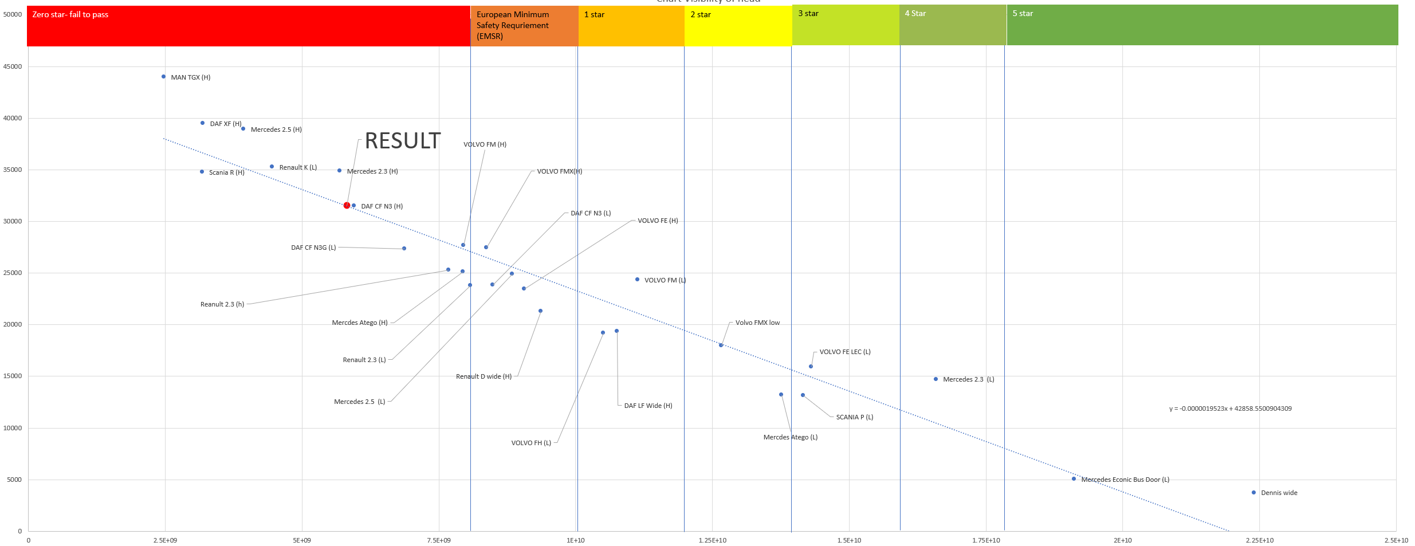
13th VRU PROXI - OSAKA
EMSR ‘equivalent’ using the trendline
  VRU: Passenger = 4.5m, Driver = 0.6m, Front = 2m
  Combined Volume = 5.82m³
The significant volumetric difference (~8m³ to ~6m³) is due to the vehicle that just passes the VRU thresholds being limited by front performance, it over performs to the sides
Note, in these investigations (done during the meeting) the graph used VRU distance as a total of all VRU distances, not an average of average – the impact of this is negligible, however scales may look different from more recent versions

Slide 27
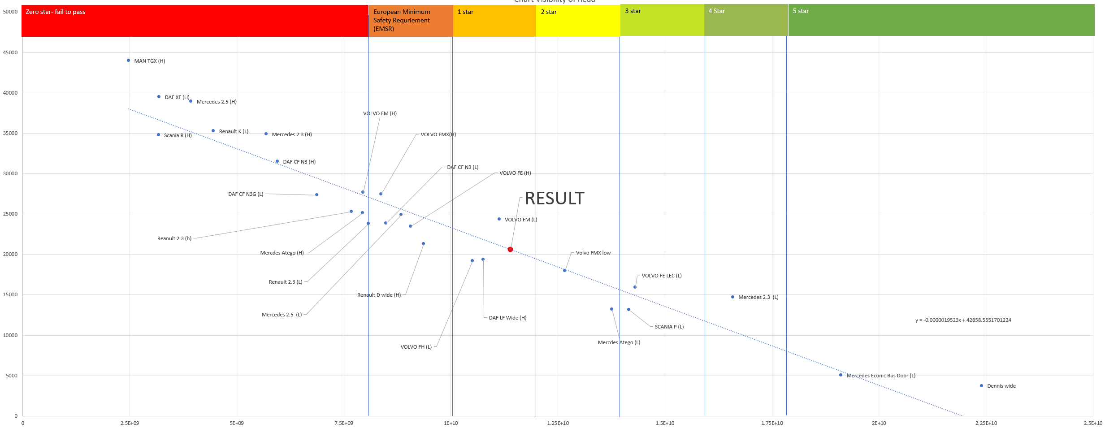
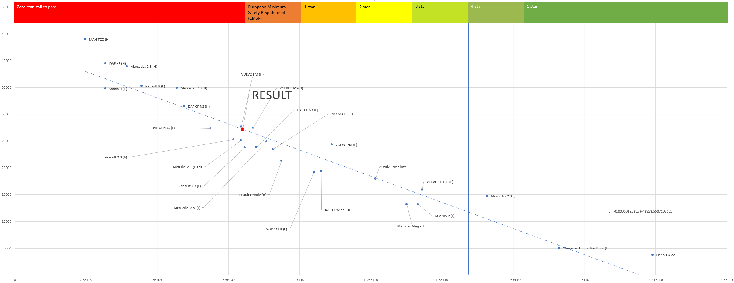
13th VRU PROXI - OSAKA
Reduced VRU distances
UK’s Contracting Party’s proposal
  VRU: Passenger = 2.5m, Driver = 0.6m, Front = 1.7m
  Combined Volume = 11.4m³
Chair’s proposal:
  VRU: Passenger = >2.5m, Driver = 0.6m, Front = 1.7m
  E.g. 15% reduction into mirror zone: Passenger = 3.825m
  Combined Volume = 8.01m³

Slide 28
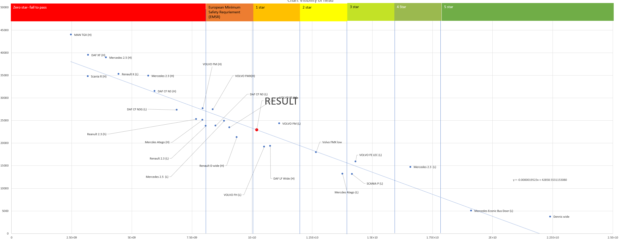
13th VRU PROXI - OSAKA
Reduced VRU distances
30% reduction into mirror zones:
  VRU: Passenger = >3.15m, Driver = 0.6m, Front = 1.4m
  Combined Volume = 10.2m³

Slide 29
14th VRU PROXI - WEB
The main developments at this meeting were:
  The inclusion of the full set of vehicles in the correlation graphs (n=40)
  The exploration of the separated approach in greater depth
  The introduction of the categorization of vehicles based on CO2 / VECTO regulation

Slide 30
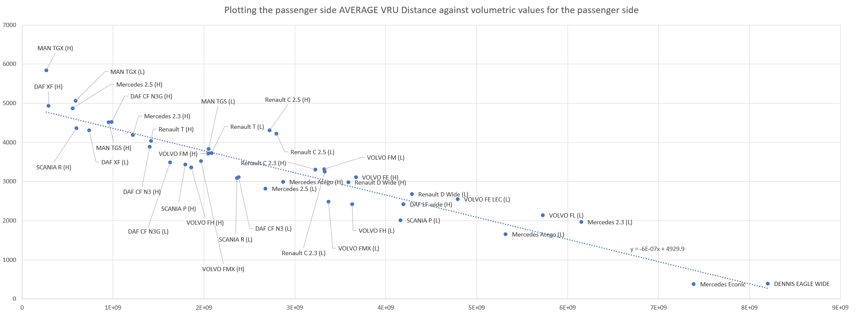
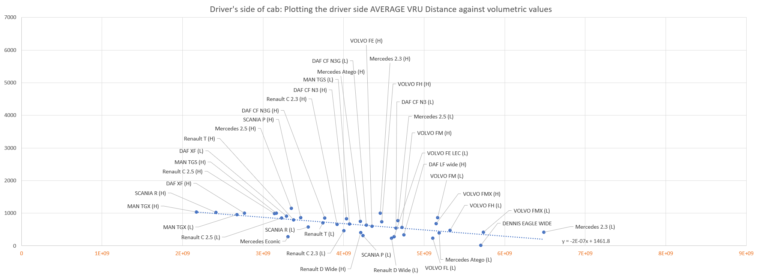
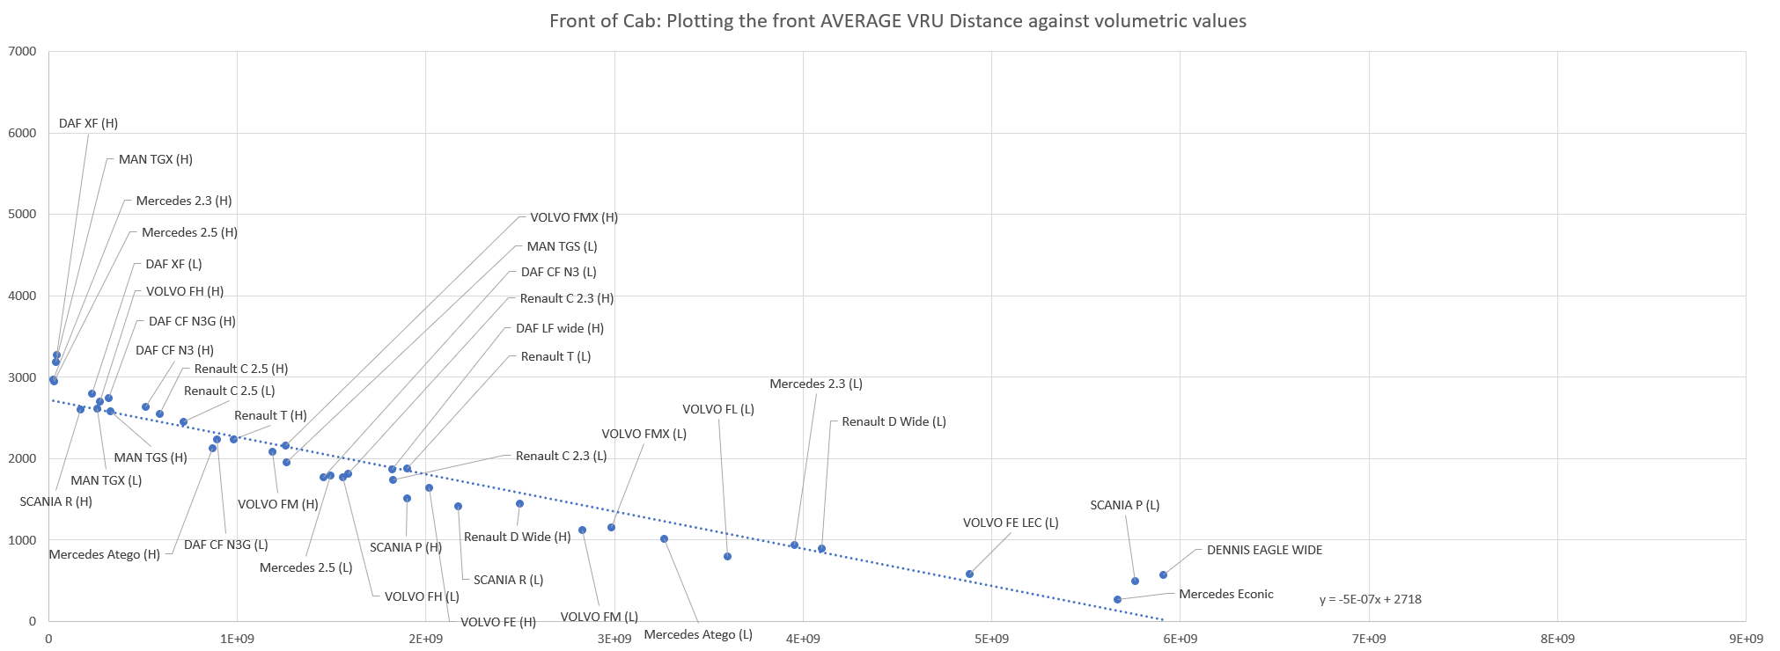
14th VRU PROXI - WEB
VRU distance proposals explored
Initial illustration of separated approach
  VRU: Passenger = 4.5m, Driver = 1.0m, Front = 2m
  Volume: Passenger = 0.72m³ , Driver = 2.25m³, Front = 1.44m³
UK Contracting Party
  VRU: Passenger = 2.5m, Driver = 0.6m, Front = 1.7m
  Volume: Reported as 10.4m³ overall*

Slide 31
14th VRU PROXI - WEB
VRU distance proposals explored
Chairs’ proposal - example 1 (15% reduction)
  VRU: Passenger = 3.825m, Driver = 0.6m, Front = 1.7m
  Volume: Reported as 8.19m³ overall*
30% reduction
  VRU: Passenger = 3.15m, Driver = 0.6m, Front = 1.4m
  Volume: Reported as 9.91m³ overall*
*Whilst these values were reported as combined values – this is incorrect and leads to misunderstanding. For a separated approach each side’s volume should be considered independently and not combined in this manner.

Slide 32
15th VRU PROXI - WEB
At this meeting the proposal for a differentiated approach had gained more broad agreement though the exact details were still being worked upon in the Working Group
The previous illustration values were represented:
  VRU: Passenger = 4.5m, Driver = 1.0m, Front = 2m
  Volume: Passenger = 0.72m³ , Driver = 2.25m³, Front = 1.44m³
UK Contracting Party with separated volumes:
  VRU: Passenger = 2.5m, Driver = 0.6m, Front = 1.7m
  Volume: Passenger = 4.26m³ , Driver = 4.54m³, Front = 2.2m³

Slide 33
15th VRU PROXI - WEB
With specific reference to the two emerging differentiation categories two proposals were made to initiate discussion:
UK Contracting Party – for Category A (urban):
  VRU: Passenger = 2.5m, Driver = 0.6m, Front = 1.7m
  Volume: Passenger = 4.26m³ , Driver = 4.54m³, Front = 2.2m³
  This was reported at 11m³ - though as previously noted this combined interpretation should not be used
LDS – for Category B (rural / inter-urban):
  VRU: Passenger = 3.0m, Driver = 0.93m, Front = 1.9m
  Volume: Passenger = 3.4m³ , Driver = 2.8m³, Front = 1.8m³
  This was reported at 8m³ - though as previously noted this combined interpretation should not be used

Slide 34
16th VRU PROXI - WEB
At this meeting the proposal for a differentiated approach had been developed further and three categories were now being proposed: A = largely urban, B = largely rural / inter-urban, B+ = construction
Various further proposals were considered:
ACEA Combined, Category A = 8.5m³
ACEA Combined, Category B = 6m³
ACEA Combined, Category B = 7m³ (defined as a fixed offset of 1m³ from Category B)

Slide 35
Created By Dr Steve Summerskill, Dr Russell Marshall and Iain Knight.

