Slide 1
Direct Vision proposal for a compromise
VRU Proxi 17 - 10th March 2021
VRU-Proxi-17-14

Slide 3
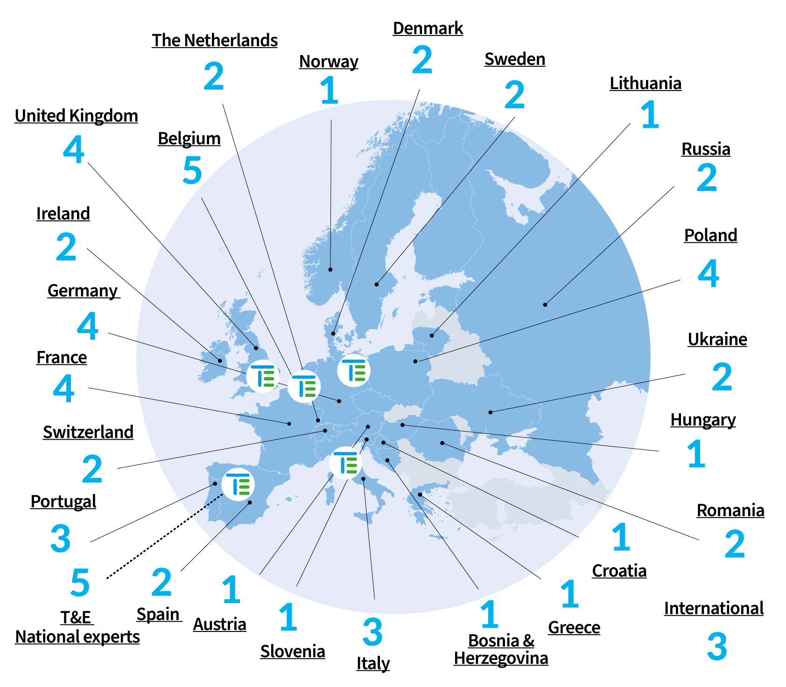
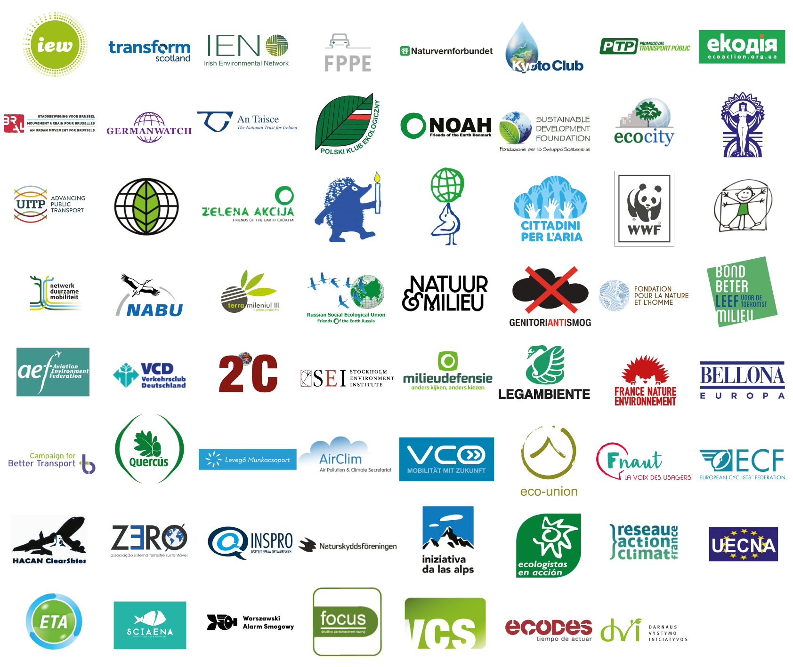
T&E:
26 Countries
61 Members
6 National offices

Slide 4

Background
T&E supported the assessment by Loughborough Design School from VRU Proxi 15: the ACEA proposal is insufficiently ambitious and doesn’t meet the General Safety Regulation requirement “to enhance the direct visibility of vulnerable road users … by reducing to the greatest possible extent the blind spots in front and to the side of the driver”. The letter sent from Berlin, Paris, London, C’hagen, Malmo and others to their national gov’s on Mon emphaises city support for this requirement
It’s important that direct vision addresses pedestrians killed to the front of trucks moving off from rest, as well as cyclists killed in nearside turns (i.e. frontal view is improved, not only the sides)
It is disappointing that industry can’t share evidence on the impact of different ambition levels, but we agree that the process must move on
We recognise some of the technical concerns of industry and make this compromise proposal in an attempt to break the current deadlock

Slide 5
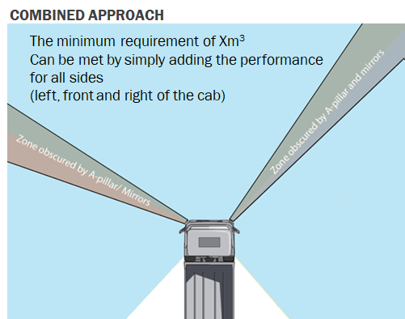
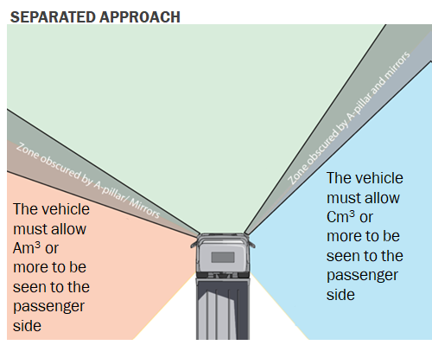
Combined or Separated Approach? A Hybrid
T&E concern: Combined approach may still permit low performance to the front
Industry concern: Separated approach excessively constrains design e.g. Mercedes Econic Low Entry cab fails (large structural pillar to the driver’s side)
Proposed solution: A hybrid involving meeting two minimum values:
  A minimum using the combined approach (i.e. the sum of the volume to the front and sides); AND
  A minimum to the front (set at level somewhat below what would be expected if total vision was evenly distributed around cab to allow flexibility)
  Minimises additional design constraint (the Econic will pass)
There is also an additional method change which would further reduce design constraints but would require significant work (approx 10-12 days?); see also ‘next steps’ slide

Slide 6
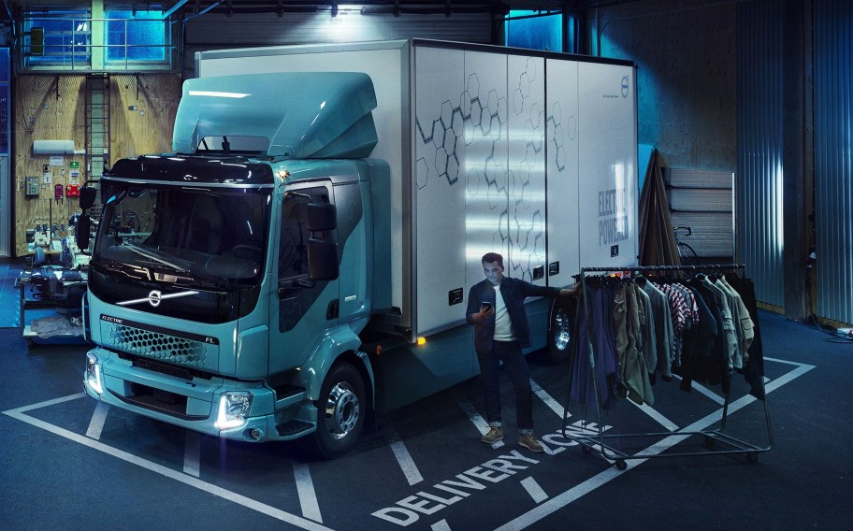
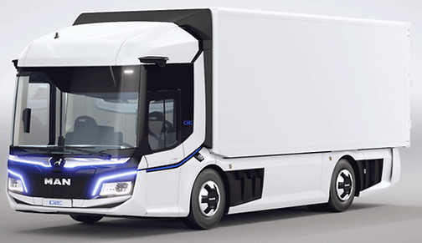
Category A: Vehicles that often enter urban areas
Most relevant collisions happen in urban areas. In the region of half involve Cat A trucks (based on approximation of GB data)
Excellent performance clearly feasible
London will require 14 m³ from 2024, and purchasing now is changing to meet this
Critical that high standards are maintained
Proposal:
  Combined volume minimum: 11.2 m³ (equivalent VRU distance passenger side 2.5, front 1.7, driver 0.6m)
  Front view minimum: 1.9 m³ (equivalent VRU distance 1.85m)

Slide 7
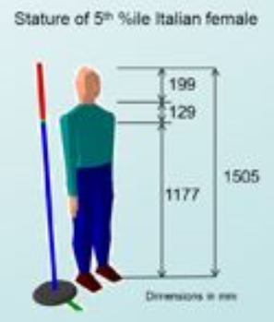
Blind Spot Definition for Categories B & B+
The London standard is based on seeing the head and shoulders. In earlier UNECE meetings, safety advocates reluctantly accepted a reduction to head and neck as a step towards truck-makers
We are prepared to consider a further reduction – but significant modelling is required
To work through the consequences of such a concession and translate it into min. volume levels, approx 11 – 15 days work by LDS would be required (see further ‘next steps’)
Without prejudice to that modelling work, our outline expectation would be a height reduction resulting in revised minima of [7 – 7.5 m³] combined, and [1 – 1.3 m³] to the front
For clarity, the downward revision of visible VRU height would only apply to B & B+ (& not A)
Risk for B & B+: continuing poor detection of VRUs, with adverse consequences for children/early teens
Table below: minima put forward by OEMs and advocates (in previous meetings)
Truck Category | ACEA/OICA (All 3 sides combined) M³ | Safety advocates (All 3 sides, with min. volume to the front unstated here) M³
A | 8.5 | 11.2
B+ | 7 | TBC
B | 6 | 8.2

Slide 8
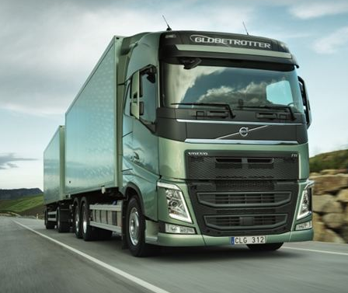
Category B: Vehicles that seldom enter urban areas
Industry perspective: Major technical / commercial issues in reducing blind spots in long haul trucks
T&E perspective: Seldom is not never: articulated trucks are involved in c.29% of relevant pedestrian fatalities in GB. A new, reasonable, balance must be struck between an industry which has become accustomed to using (and selling) high flat floor cabs for long haul and the clear danger such cabs present depending on their use profile.
Proposal: safety advocates would move further towards industry with a VRU height reduction (at the 2m mirror zone edge) leading to a revision in proposed minima:
  Front minimum: [X] m³
  Total combined minimum: [Y] m³ (TBC but most likely based on the volume achieved by vehicles somewhat better than those currently achieving X to the front)

Slide 9
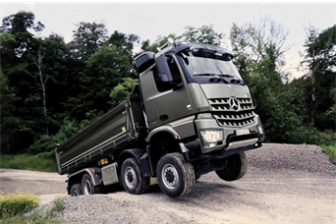
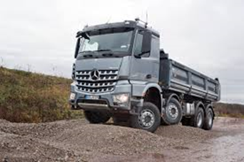
Category B+: Off-road vehicles not equipped with AWD
T&E concern: Clear evidence from GB & Germany that N3G do enter urban areas & are involved in relevant collisions. Construction variants an important vehicle type
Industry concern: Also captures vehicles (e.g. Scandinavian forestry, quarries) that never enter urban areas & need ground clearance & power
Proposal:
  Total combined minimum: Follow ACEA’s proposal for +1 m³ on Cat B volume = [X+1] m³ TBC
  Front minimum: [Y] m³ TBC - same as Category B
  Rationale for the same min. to the front as B: GB evidence suggests nearside turns are a substantially bigger problem for construction vehicles than moving off from rest. Cab standarisation likely to ensure [Y] m³ is in practice exceeded

Slide 10
Suggested next steps
The TF already reported a lack of a path to consensus, but this was without the benefit of the slides just presented due to time constraints at our side
We urge CPs to review the proposals and provide direction
Importantly:
The further proposed concession on VRU height, proposed for B and B+, would require 11 – 15 days work for LDS to propose new minima figures (i.e. for both the total for all 3 sides, and to the front)
A further method change could be considered regarding calculation of the minimum to the front, namely, instead of seeing only between the A pillars to seeing into a rectangular volume to the front. While this may facilitate the rounding of cabs (e.g. the A pillars move closer with more seen either side of them) it would require approx. 10 – 12 days of work at LDS
If there is support / appetite to scope these two significant method changes, it’s vital to note there is no funding model for further LDS work, and CPs are asked to advise on this issue
Finally:
We note that resolving direct vision without further delay is of benefit to industry (2026 EU legal date for application to new types)
  Consensus has been reached on the total combined view and differentiation into A, B and B+. To make a start on text, drafting on some elements could begin while modelling work is ongoing on others

Slide 11
Thank you
james.nix@transportenvironment.org

